Slide 1
Feature Importance

Slide 2
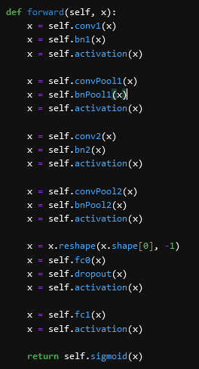
Network Architecture
2 Convolutional layers
2 Pooling layers (convolution with stride size == kernel size)
2 Fully Connected layers
Sigmoid output

Slide 3
Feature Importance
Several methods available, currently used two:
Grad-CAM
Extremely quick to calculate attributes
Very dependant on the network’s understanding of the feature maps
Shapley Value Sampling
Less dependant on the understanding on the network
Very slow to calculate, even through sampling

Slide 4
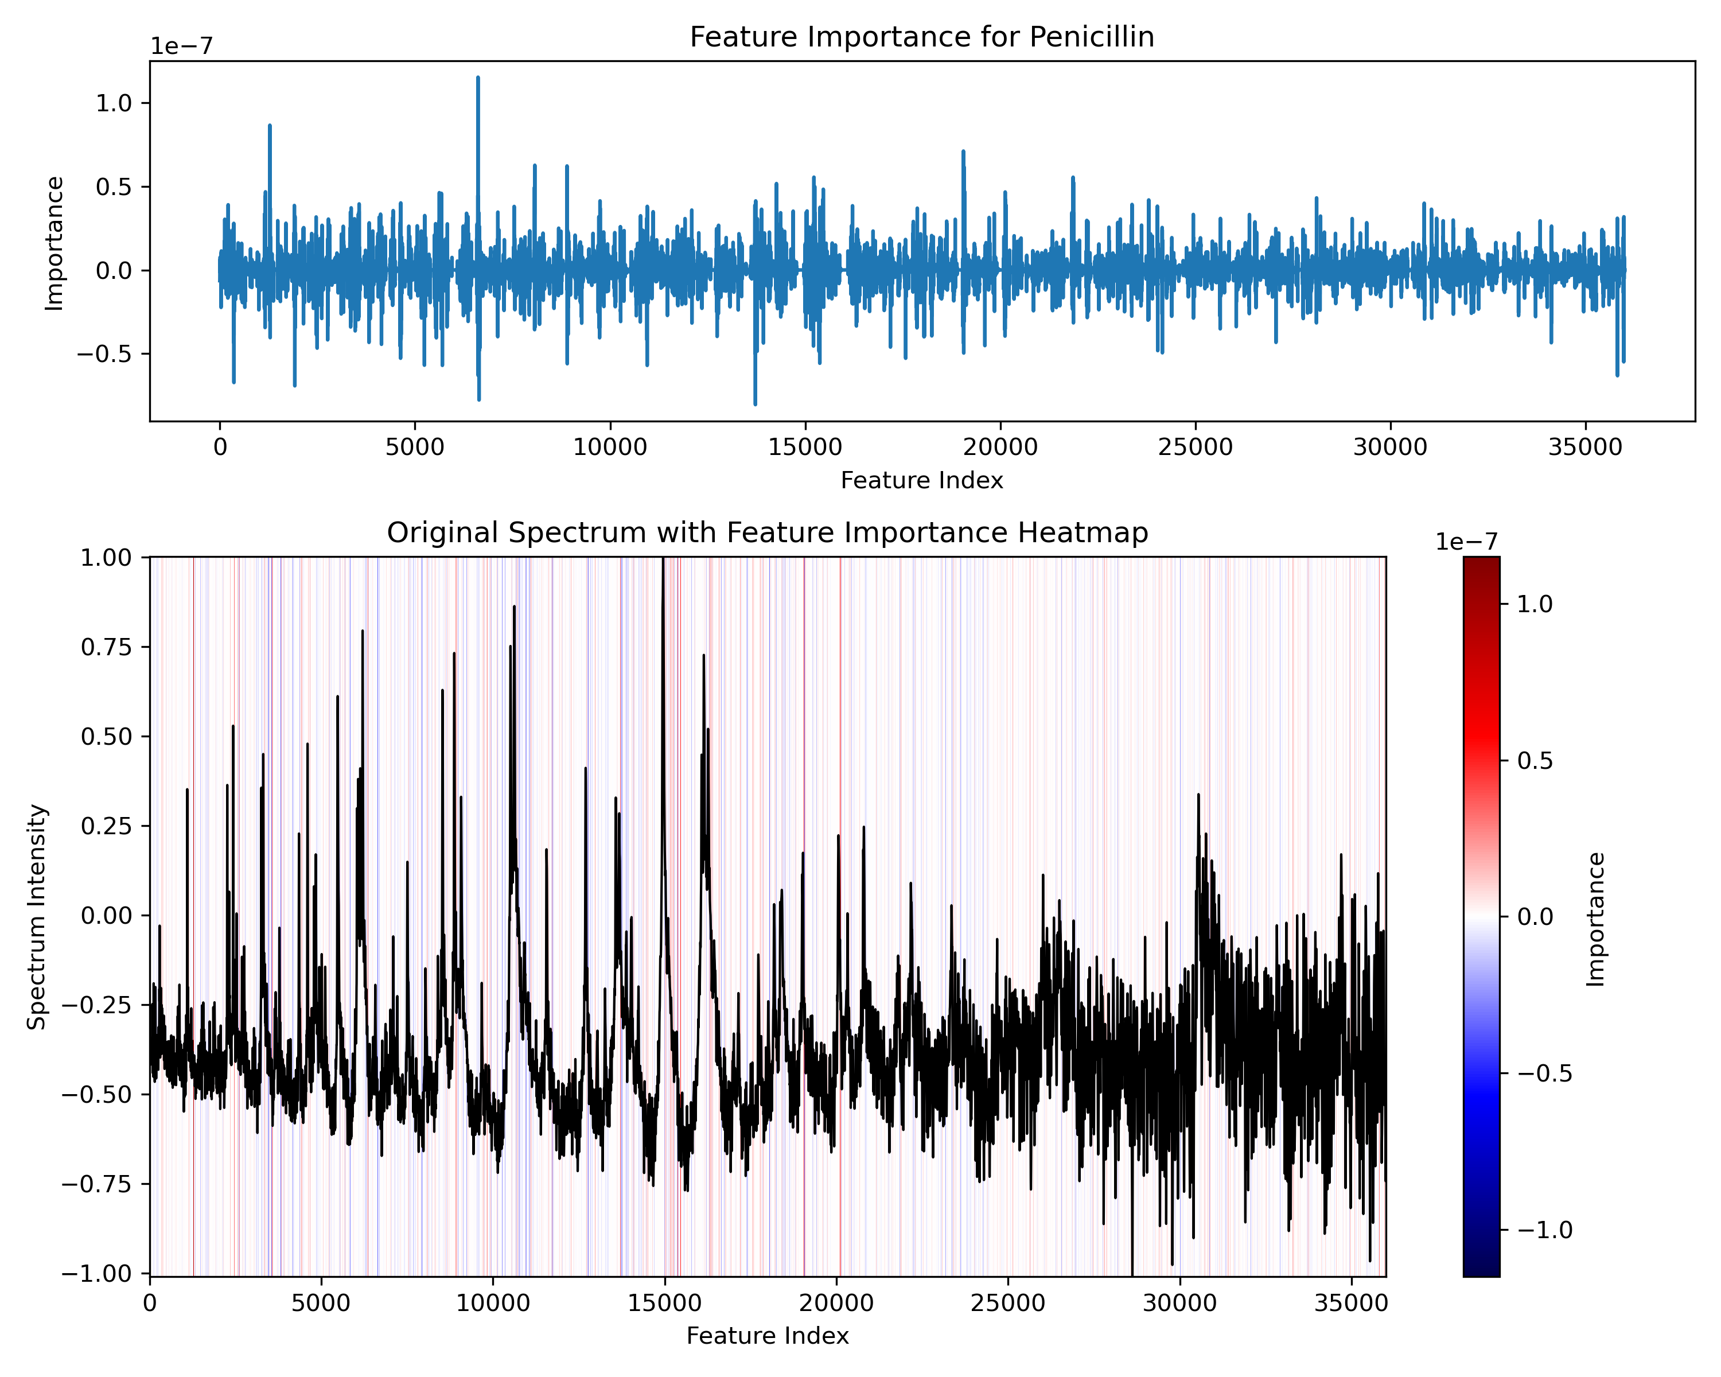
Grad-CAM

Slide 5
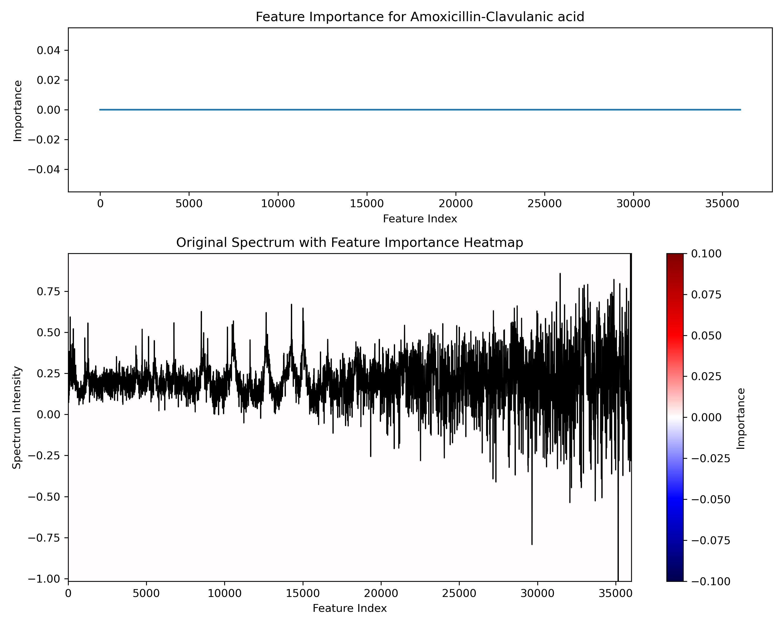
Grad-CAM

Slide 6
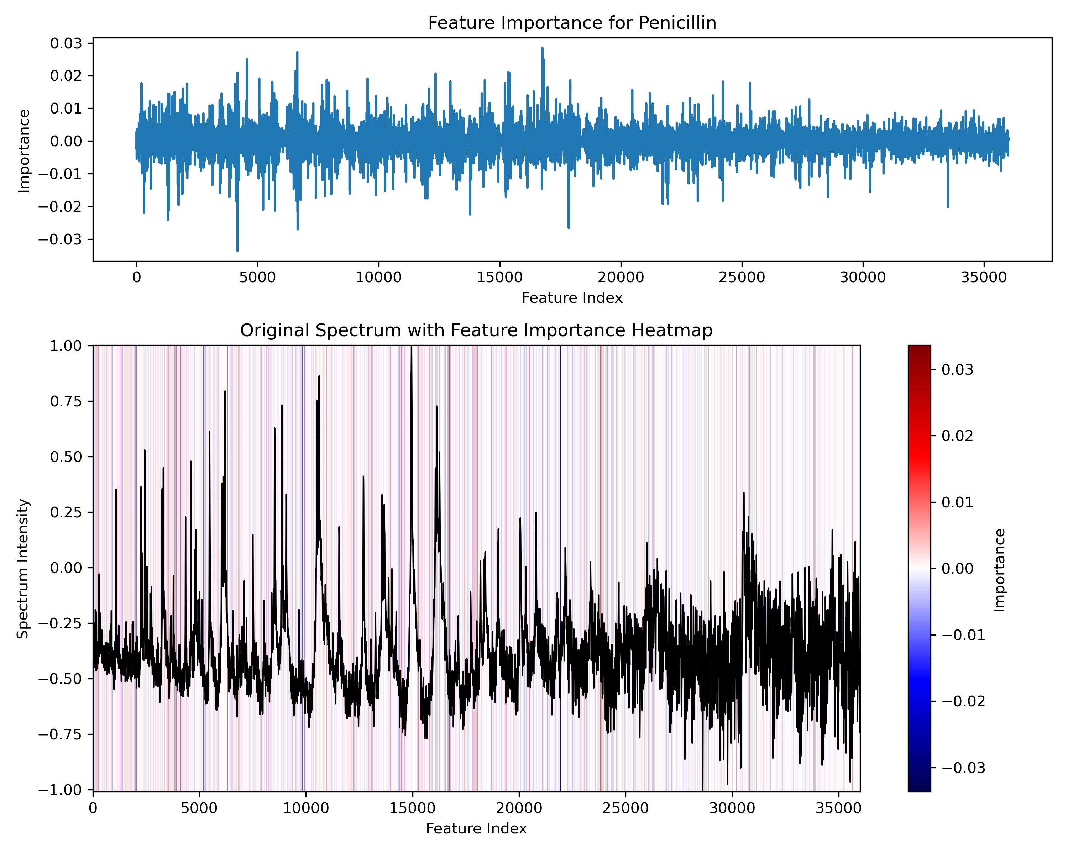
Shapley Value Sampling

Slide 7
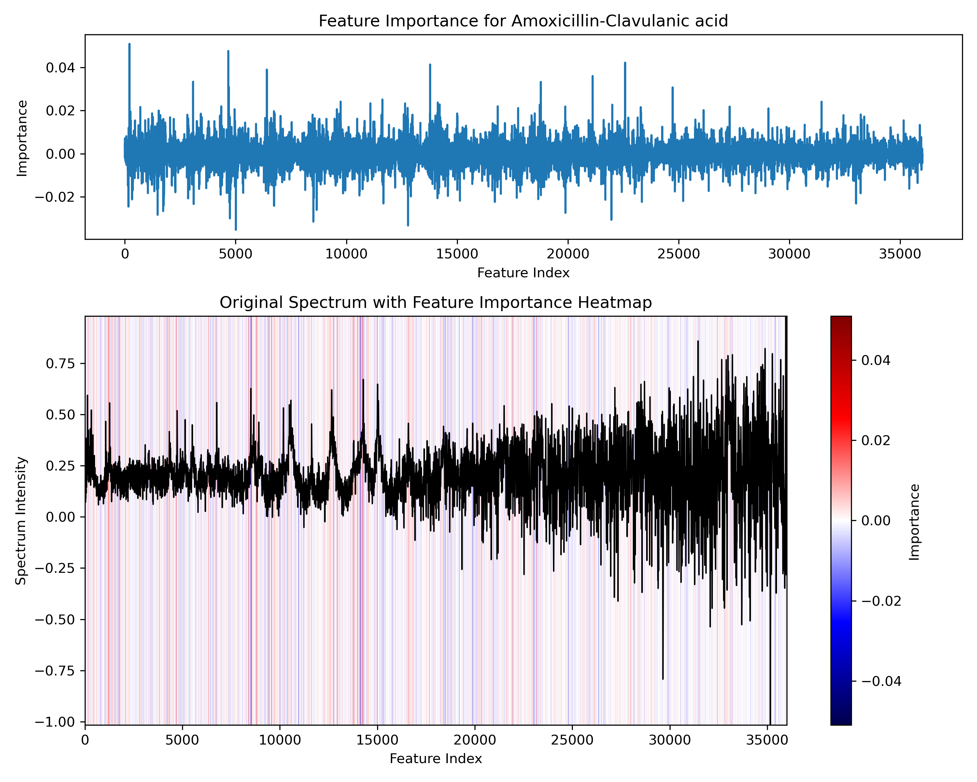
Shapley Value Sampling

Slide 8
Why doesn’t grad-CAM always work?
Network might not have a good understanding of the feature map for some resistances, leading to weak or non-existing gradient flow
Even though the network has a good understanding of the feature map, the activation function has a large impact on the mapping
ReLU is optimal for mapping class activations since it blocks negative values
ReLU does not work properly for this network, it leads to significantly poorer performance
ELU / SiLU activations lead to great performance, but sacrifices some clarity in the interpretation because they allow negative values to flow through the network

Slide 9
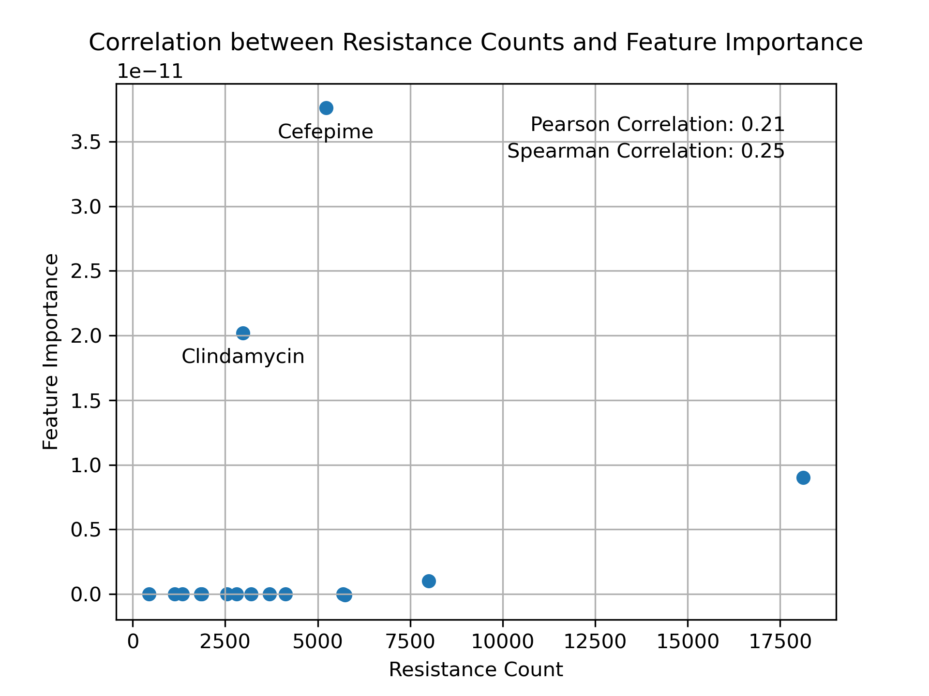
Importance of data (?)

Slide 10
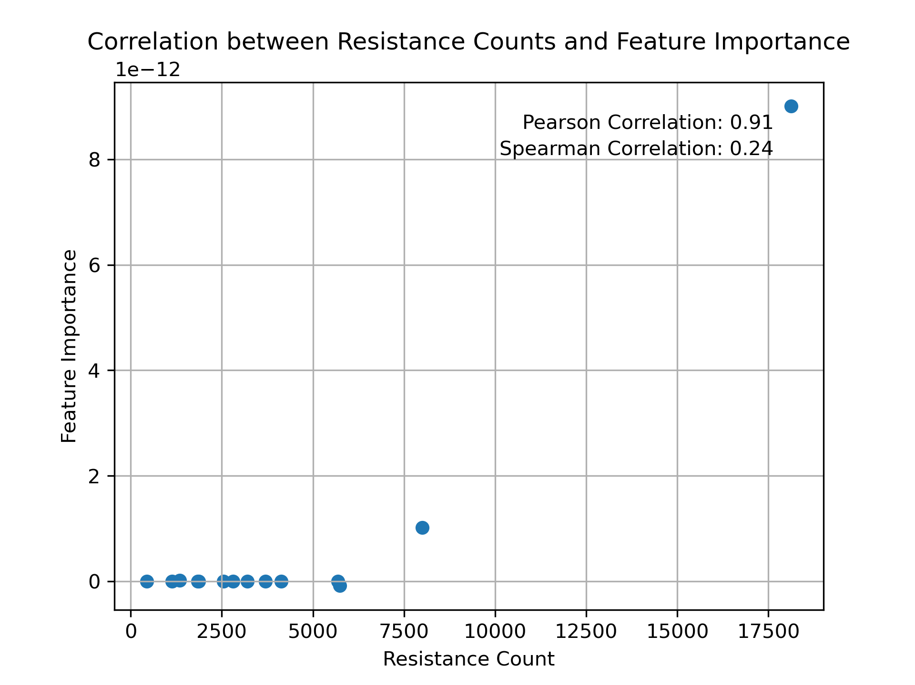
Importance of data (?)

