Slide 1

Genome-wide association study of human height
Rasmus Freund

Slide 2
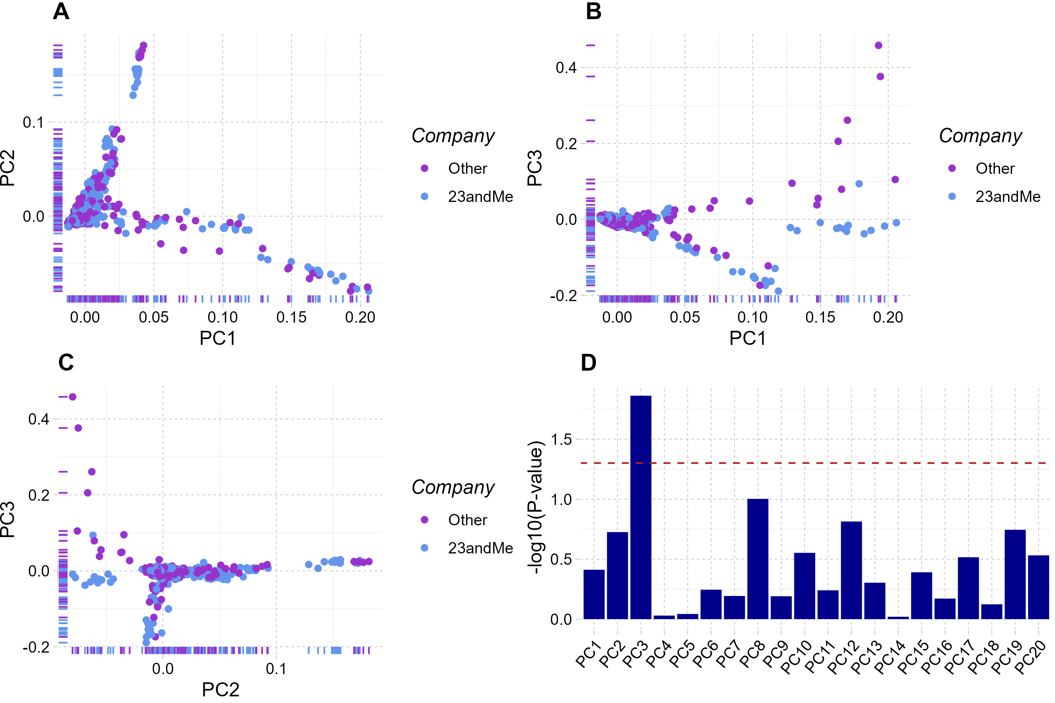
Company differences
Notes:
PCs were tested for significant differences between the group ”23andme” and ”other”, which denotes which company the sample originates from. Significant difference was detected in PC3 -> extreme examples were removed and PCs were recalculated.
F-statistics was calculated for all PCs to determine whether an ordinary t-test could be done, or a welsh-test had to be used

Slide 3
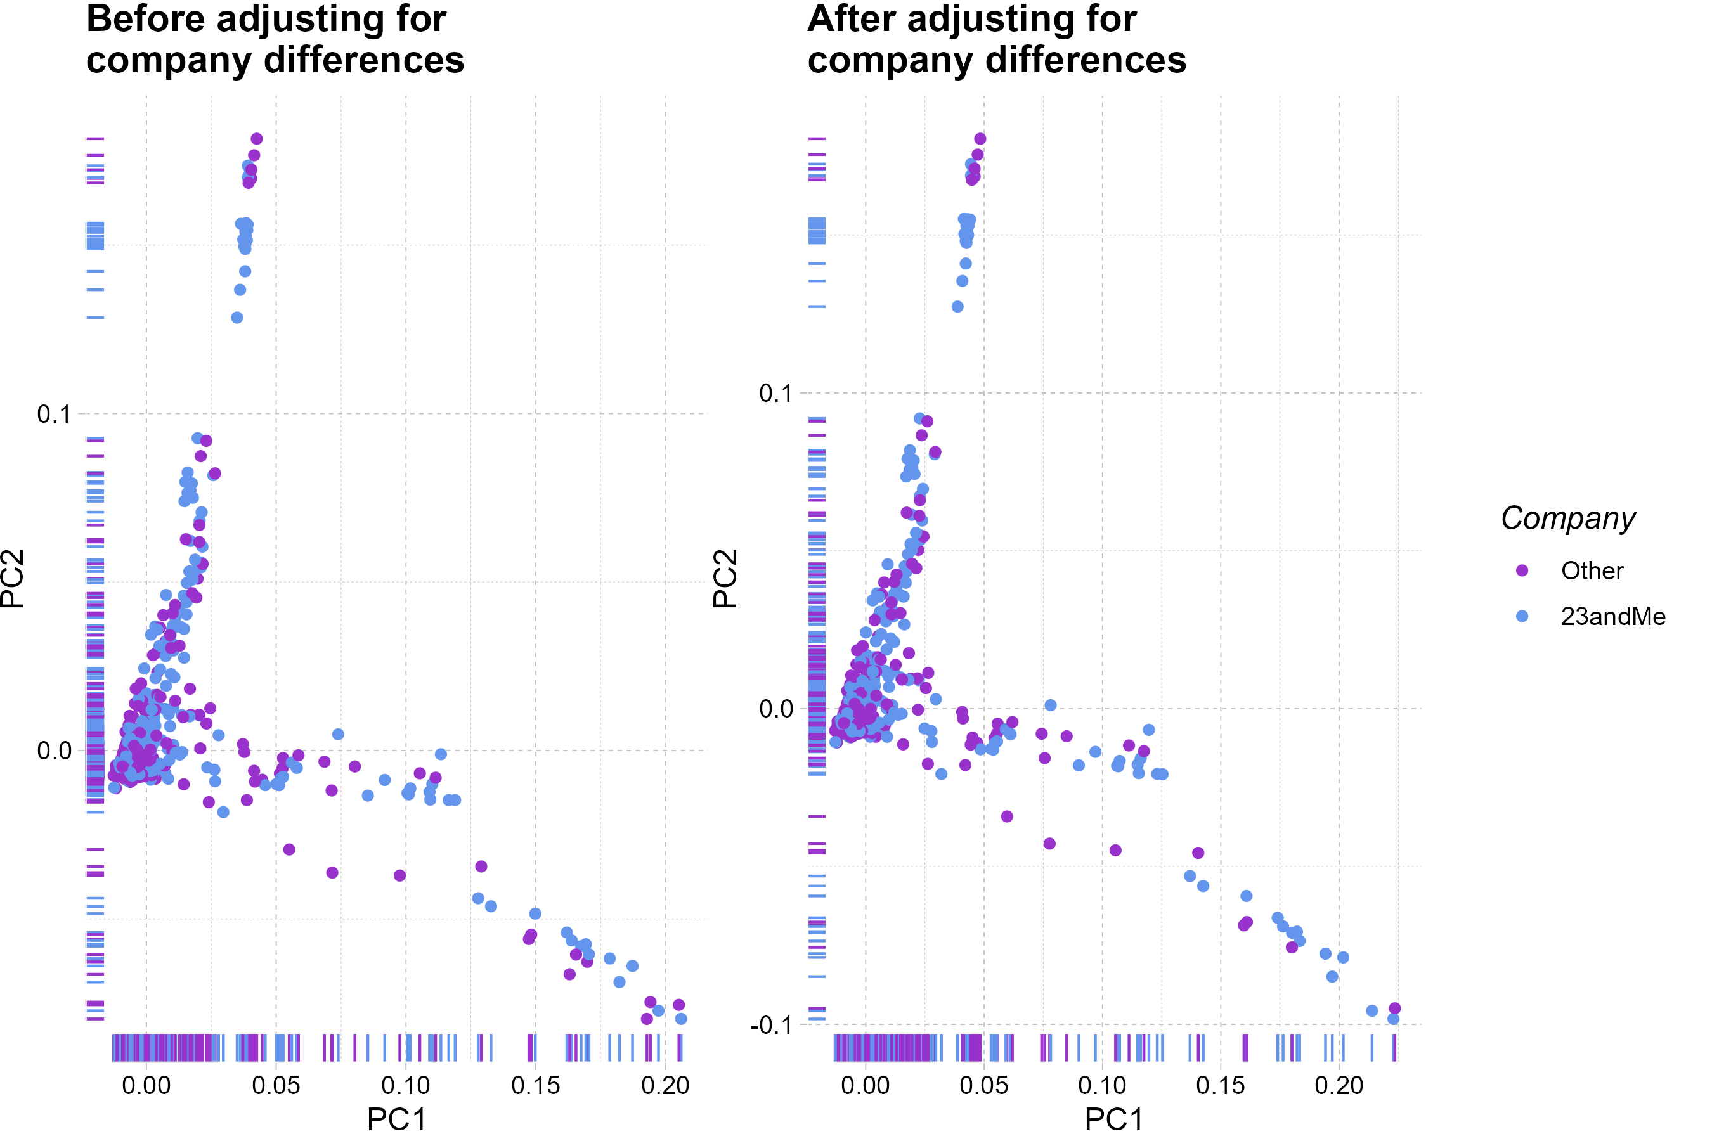
Company differences
Notes:
Comparison of before and after removing extreme PC3 values to determine if they had an effect of the overall distribution

Slide 4
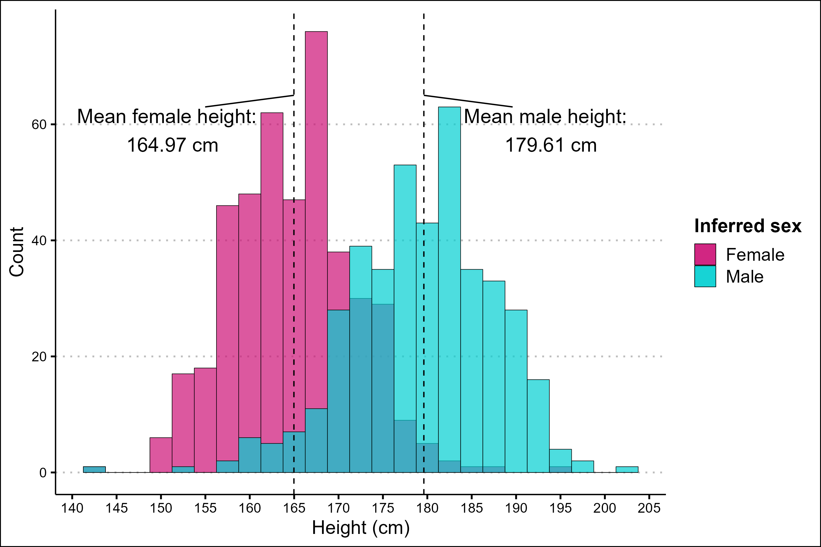
Distribution of height
Notes:
Height is self-reported, so I wanted to check if it follows the average population expectations – that is, men being taller than women on average

Slide 5
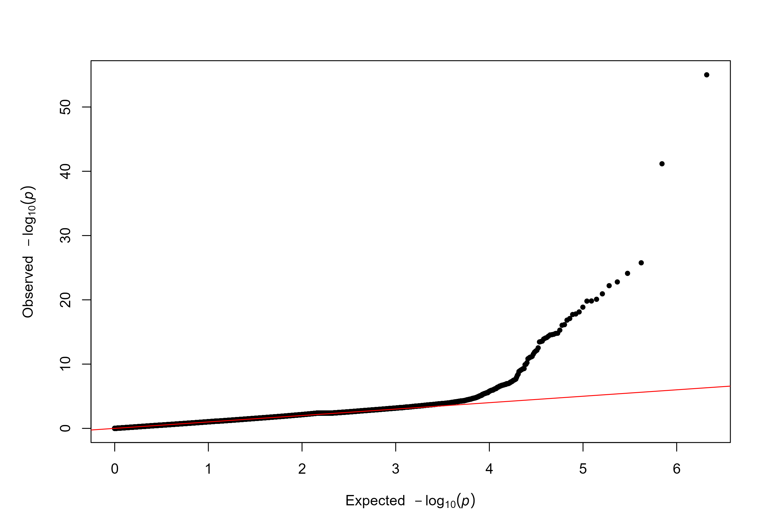
QQ-plot
Notes:
QQ-plot prior to correcting for PCs – inflated statistics for the upper quantile

Slide 6
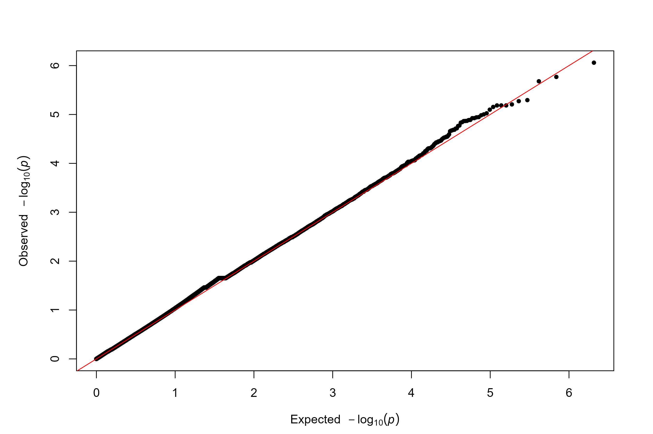
QQ-plot
Notes:
QQ-plot after correcting for PCs – p-values are no longer inflated at any point of the graph

Slide 7
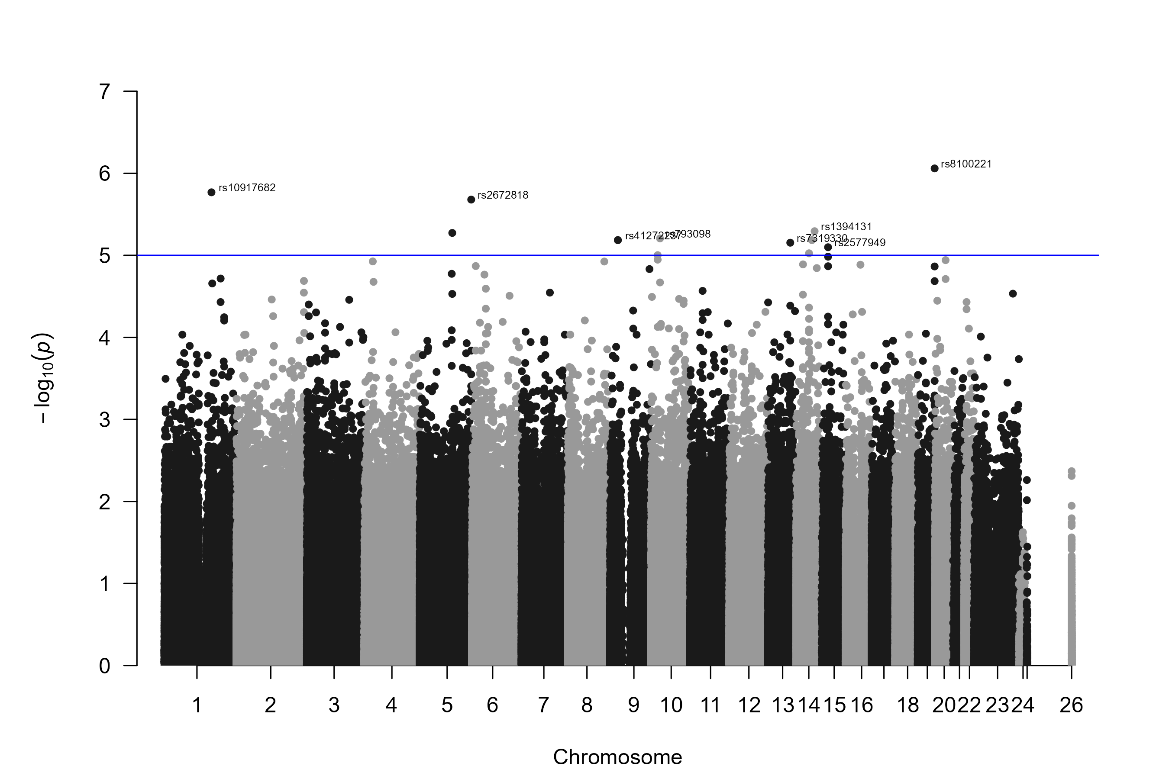
Genome-wide significance
Notes:
Manhattan plot shows no GWS SNPs. rs2577949 was identified in another study to be significant for height. Plotted blue line is “suggestive” data points.

