Slide 1
Productivity with ReSharper
Rasmus Kromann-Larsen

Slide 2
This talk
Introduction to ReSharper
A whirlwind tour
Don’t expect to learn all the shortcuts today
Getting started

Slide 3
Disclaimer
Not associated with JetBrains
Productivity
Keyboard-centric development
ReSharper is just the tool I use
Alternatives: CodeRush (and VS2010)

Slide 4
ReSharper - What?
Productivity add-in for Visual Studio
Made by JetBrains
Not free (but trial)
Addictive
Current version: 5 (VS2005 – 2010)
This talk: 4.5 (VS2005 – 2008)

Slide 5
ReSharper - Why?
Writing code
Less pointy-clicky, more action
Reduce mechanical steps
Work with code at a structural level
Powerful chaining
Laptops
Navigation / Exploration
Code style alignment
Friendly FxCop / StyleCop

Slide 6
ReSharper - Why?
C# / VB.NET
Statically typed - ripe for tooling
Fairly verbose
Readability / Maintainability
Refactoring
Longer names

Slide 7

...show me the ninja moves!
Talk is cheap...

Slide 8
Disadvantages
Performance
Visual studio start-up
Solution-wide analysis
External tool dependency

Slide 9
First Steps
Context actions [Alt+Enter]
Then
Generate code [Alt+Insert]
Refactor this! [Ctrl+Shift+R]
One shortcut a day / week

Slide 10
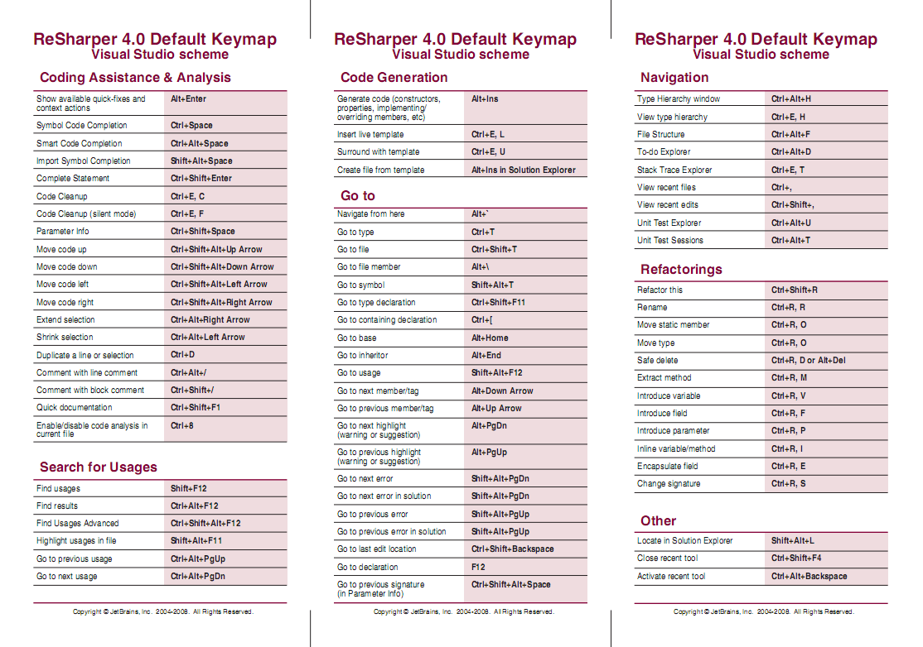
Cheat sheets

Slide 11
Collaboration
Pair programming
Benefits from keyboard-centric development
Code dojos

Slide 12
Keyboard Jedi
Made by Roy Osherove
Presentations
Mouseless mode
Doesn’t work on 64-bit Windows
James Kovacs fix (Link)

Slide 13
Other features
Live templates
Settings sharing
Solution-wide analysis
Test runner

Slide 14
Questions
Blog: www.rasmuskl.dk
Mail: rasmus@kromann-larsen.dk
Twitter: @rasmuskl

