Slide 1
Practical SOLID in C#

Slide 2
Introduction
Rasmus Kromann-Larsen
Systems Engineer at Systematic, Aarhus
ANUG
Blog: http://www.rasmuskl.dk
Mail: rasmus@kromann-larsen.dk
Twitter: rasmuskl

Slide 3
Agenda
Intro / Motivation
SOLID Principles
Examples
Real-Life Example

Slide 4
Feature Cost

Slide 5
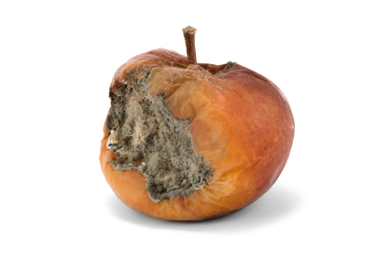
Software decay?
Fragility
Breaks in unrelated places
Rigidity
Ripple effects
Hard to understand
Re-bugging

Slide 6
Why does software decay?
External sources
Changing requirements
Deadlines
Internal sources
Technical debt
Multiple developers
Broken windows
Long lifespan

Slide 7
What do we want?
Maintainable code
Flexible code
Readable code
Not directly visible, hard to sell!

Slide 8
SOLID
Single Responsibility Principle
Open Closed Principle
Liskov Substitution Principle
Interface Segregation Principle
Dependency Inversion Principle

Slide 9
SOLID
What?
Object-oriented design principles
Dependency management
Robert C. Martin in 1995
Why?
Awareness
Terminology

Slide 10
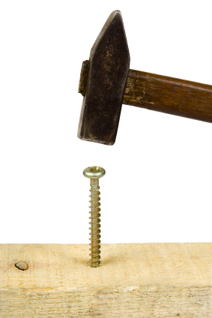
What won’t SOLID do for you?
Be a silver bullet
Replace common sense
Right tool for the job
Guidelines, not laws

Slide 11
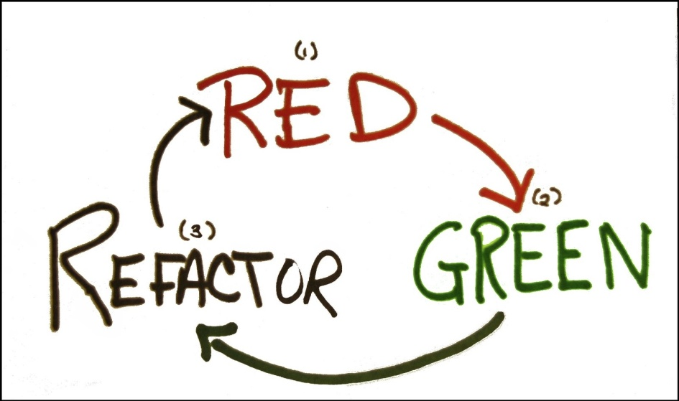
SOLID and TDD
My path to SOLID
Steep learning curves
Synergy

Slide 12
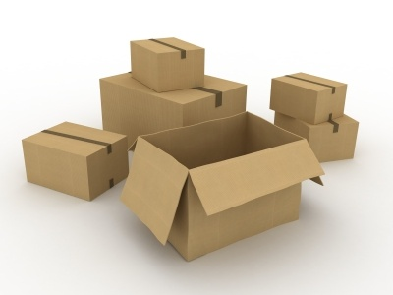
Open Closed Principle
Software entities should be open for extension, but closed for modification.
What?
Don’t touch existing code

Slide 13
Open Closed Principle
Why?
Don’t break existing code!
Requires decoupling
Scales well over time
How?
Seams

Slide 14
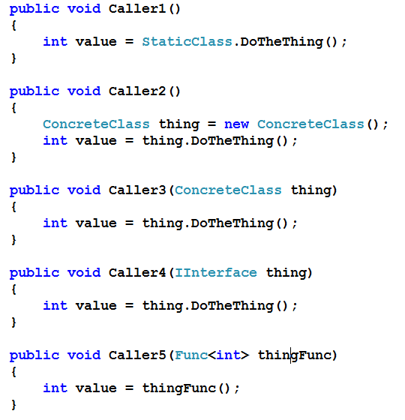
Flexibility

Slide 15
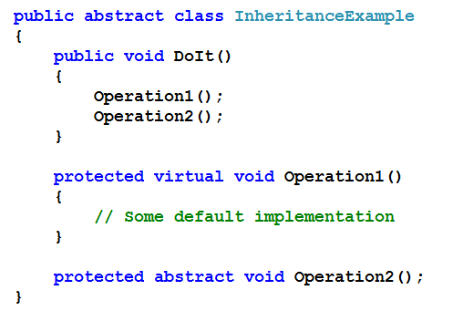
Seams - Inheritance

Slide 16
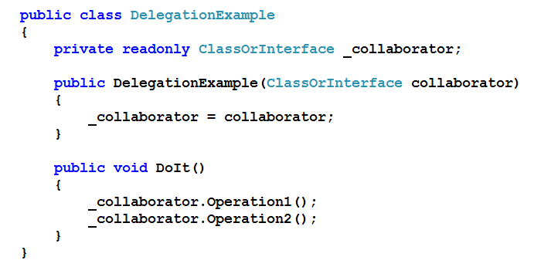
Seams - Composition

Slide 17
Open Closed Principle
Warning signs
Open/duplicated conditionals
Downcasts
“Popular” classes
Pragmatic approach?
Modify for extension

Slide 18
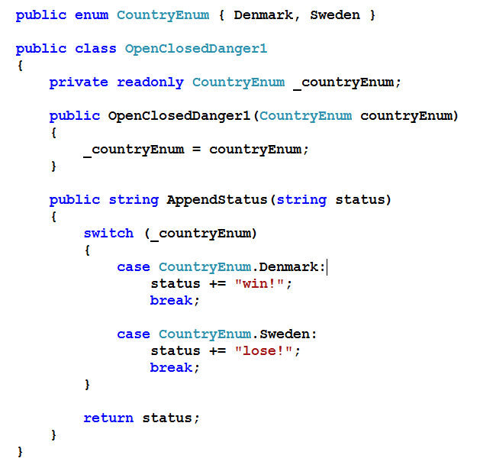
OCP

Slide 19
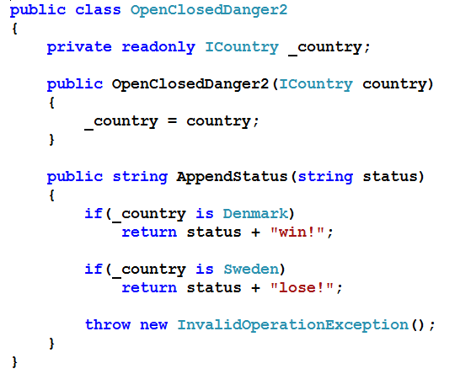
OCP

Slide 20
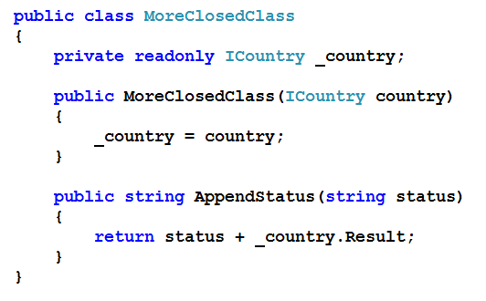
OCP

Slide 21

Single Responsibility Principle
A class should only have one reason to change.
What?
Favor small classes
Focus change impact

Slide 22
Single Responsibility Principle
Why?
Cohesion
Gravity
Naming
Reuse in the small
How?
Seperate concerns

Slide 23
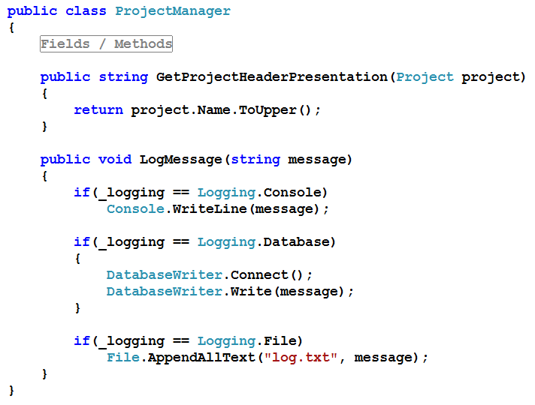
SRP

Slide 24
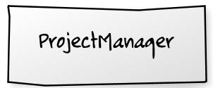
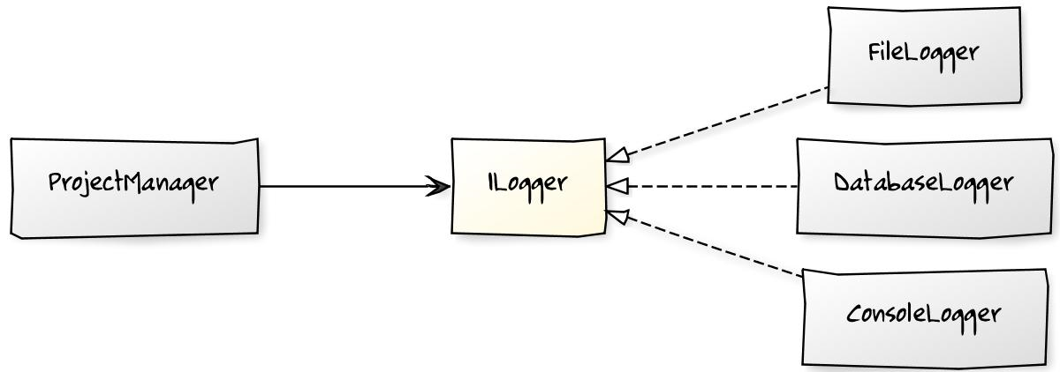

Slide 25
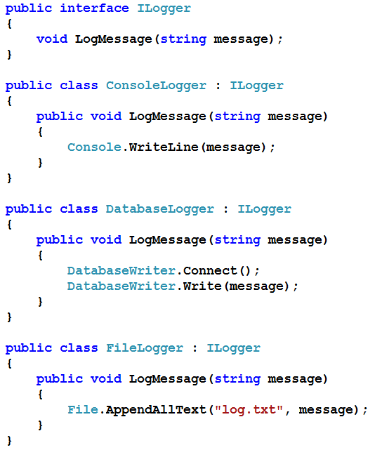
SRP

Slide 26
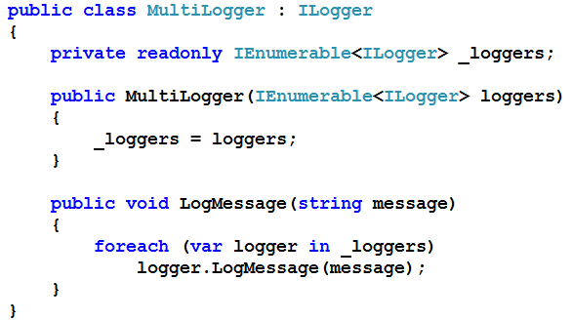
SRP / OCP - Extending

Slide 27
Single Responsibility Principle
Warning signs
Big Classes
Low cohesion
Pragmatic approach?
Separate as needed
Especially to reduce duplication

Slide 28
Composition vs Inheritance
Favor composition
Coupling
SRP helps inheritance

Slide 29
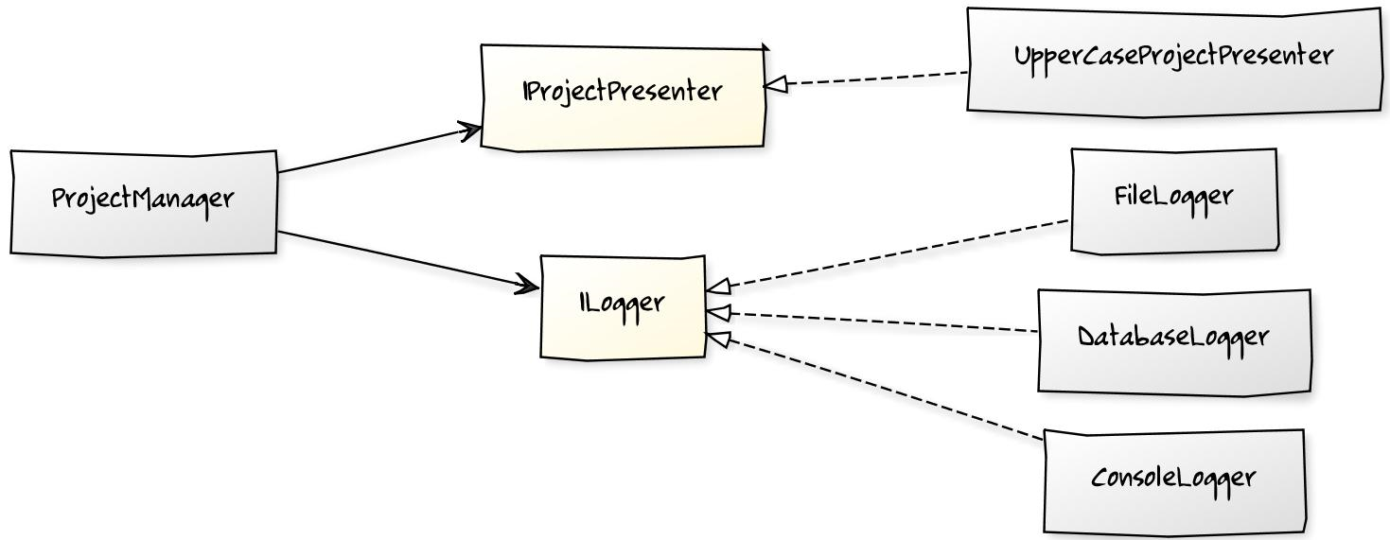
Composition

Slide 30
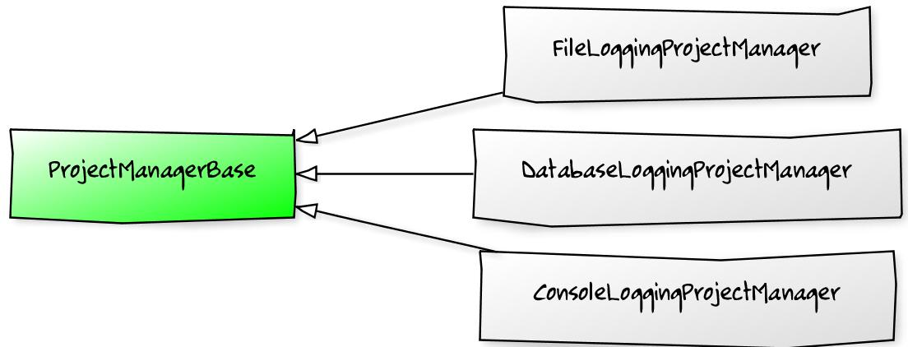
Inheritance

Slide 31
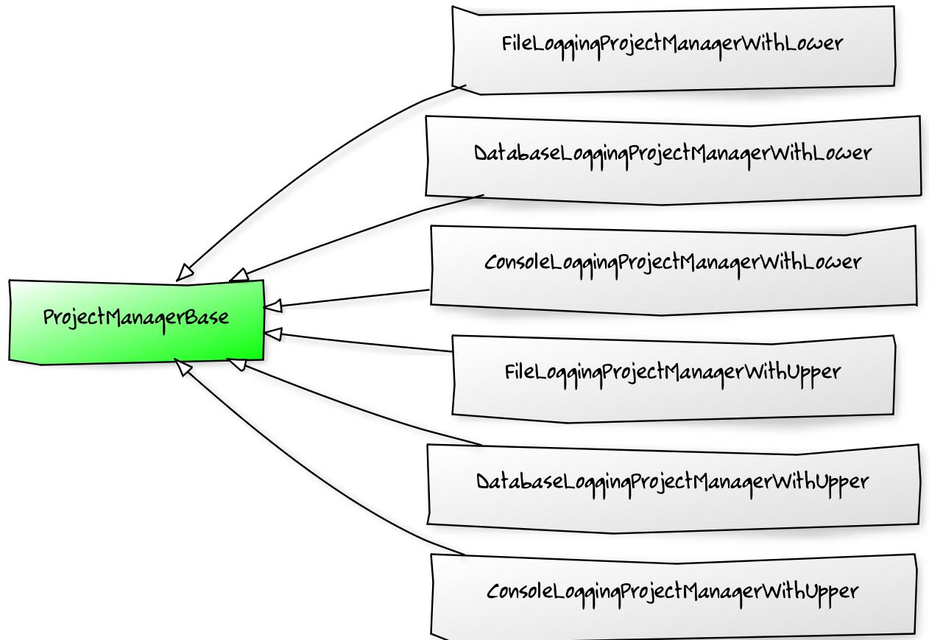
Inheritance

Slide 32

Liskov Substitution Principle
Functions that use pointers or references to base classes should be able to use derived classes without knowing it.
What?
Respect contracts

Slide 33
Liskov Substitution Principle
Why?
Enable OCP
Avoid surprises
Contracts simplify code
How?
Design by Contract
Encapsulating collections

Slide 34

Design By Contract
Preconditions
Types, Parameters
Postconditions
Return values
Invariants
No duplicates

Slide 35
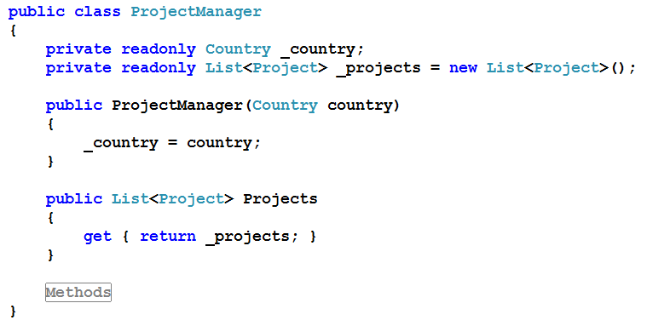
LSP

Slide 36
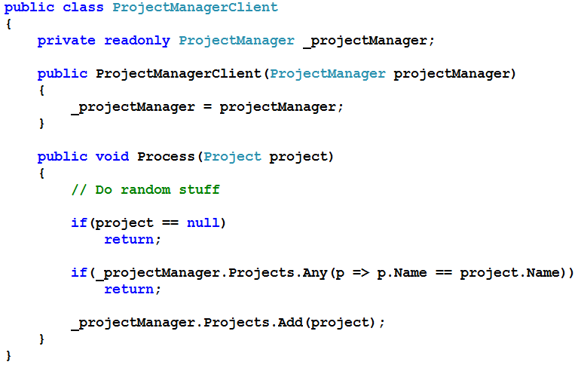
LSP - Client

Slide 37
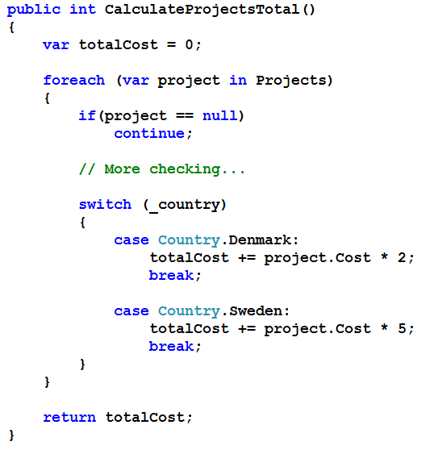
LSP - Internal

Slide 38
Dependency Inversion Principle
A. High level modules should not depend upon low level modules. Both should depend upon abstractions.
B. Abstractions should not depend upon details. Details should depend upon abstractions.
What?
Depend on abstractions

Slide 39
Dependency Inversion Principle
Why?
Decoupling
Stability
How?
Break dependencies

Slide 40
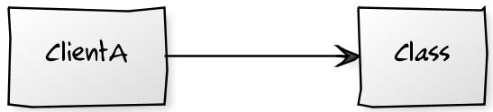
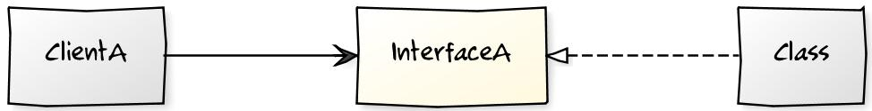
Dependency Inversion Principle

Slide 41
Dependency Injection
Visible Dependencies
Who knows concrete classes?
Factories
IOC Containers
Reflection Conventions

Slide 42
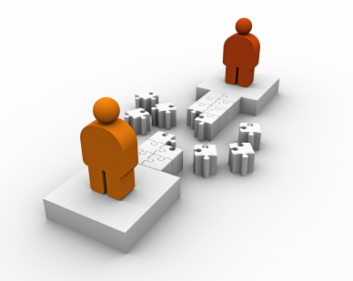
Interface Segregation Principle
Clients should not be forced to depend on interfaces they do not need.
What?
Keep interfaces cohesive
Leverage multiple interfaces

Slide 43
Interface Segregation Principle
Why?
Cohesion
Easier to create implementations
Towards roles
Refactoring
How?
Minimize interfaces

Slide 44
ISP

Slide 45
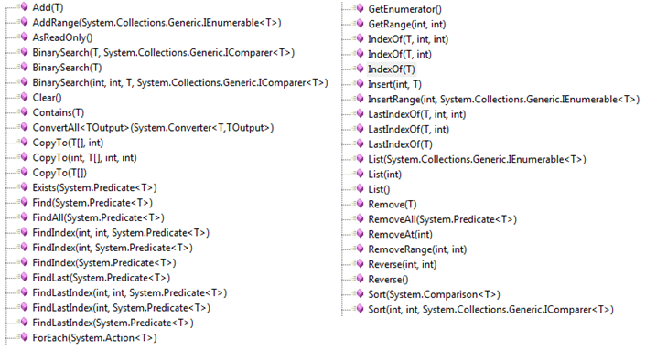
Interface Segregation Principle

Slide 46
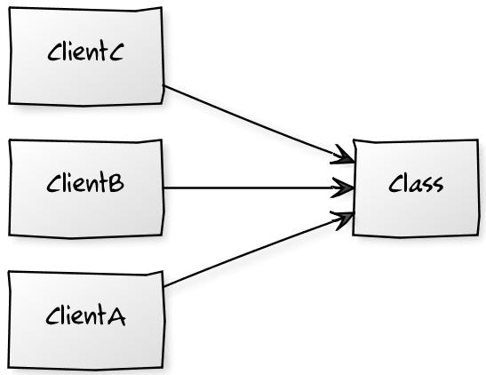
ISP Refactoring

Slide 47
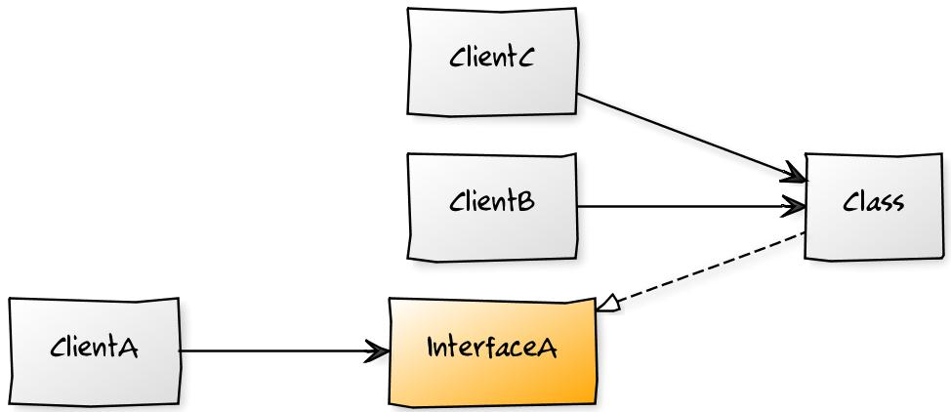
ISP Refactoring (ISP/DIP)

Slide 48
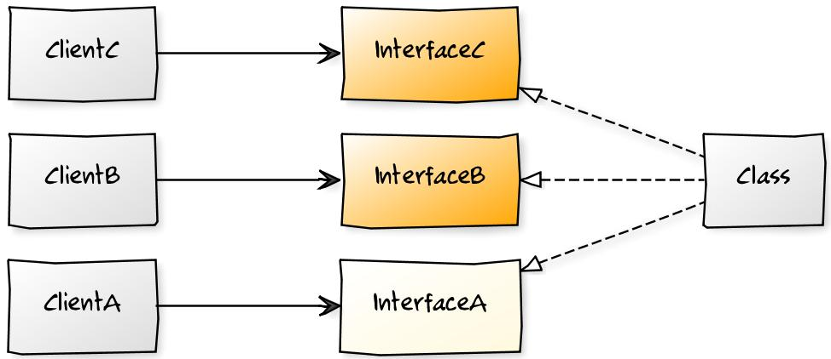
ISP Refactoring (ISP/DIP)

Slide 49
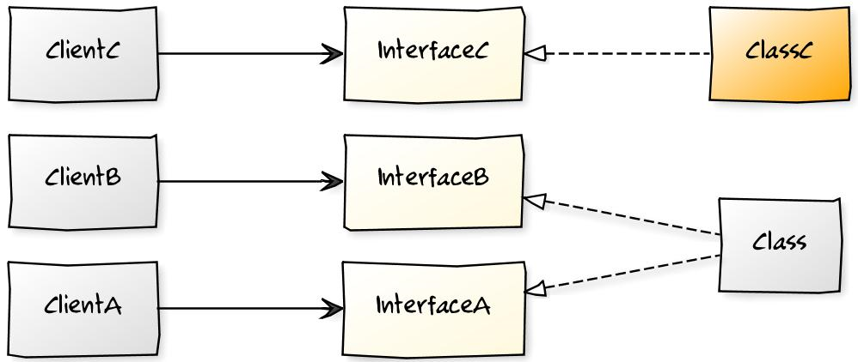
ISP Refactoring (SRP)

Slide 50
”Real Life” Example

Slide 51
Server 1
Asynchronous MSMQ
Server 2
Domain
Domain

Slide 52
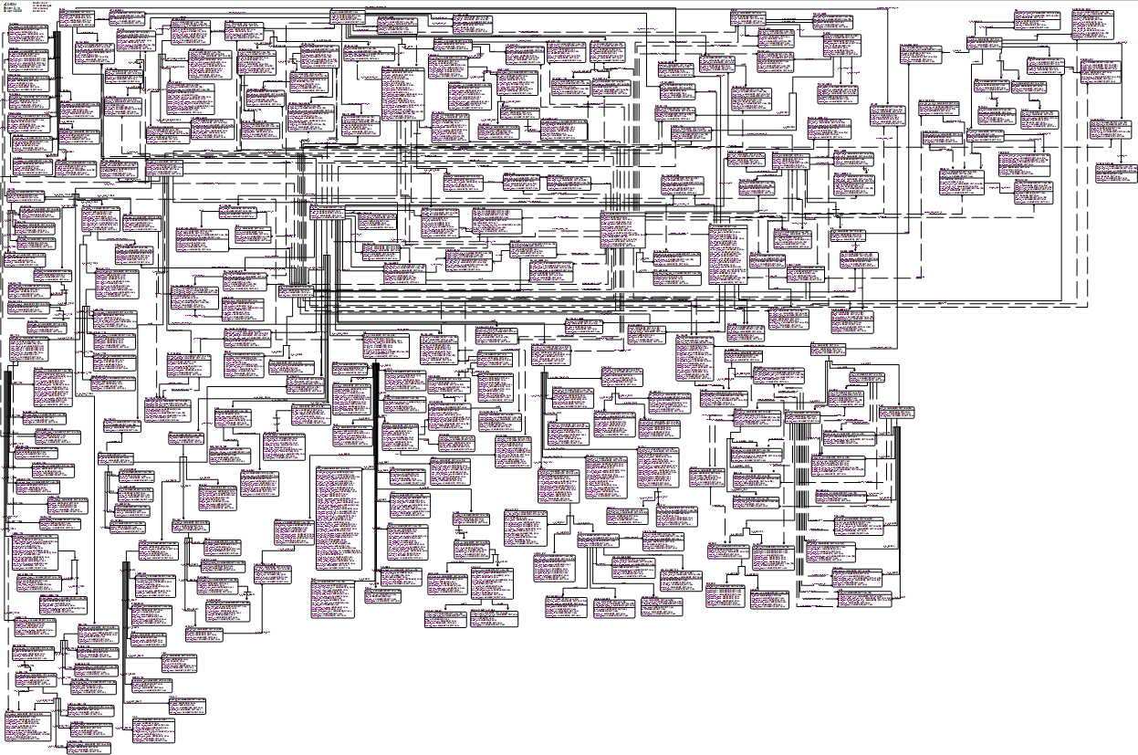
JC3IEDM Schema
Notes:
sdd

Slide 53
Integration Test
Server 1
Memory Stream
Server2
Domain
Domain

Slide 54
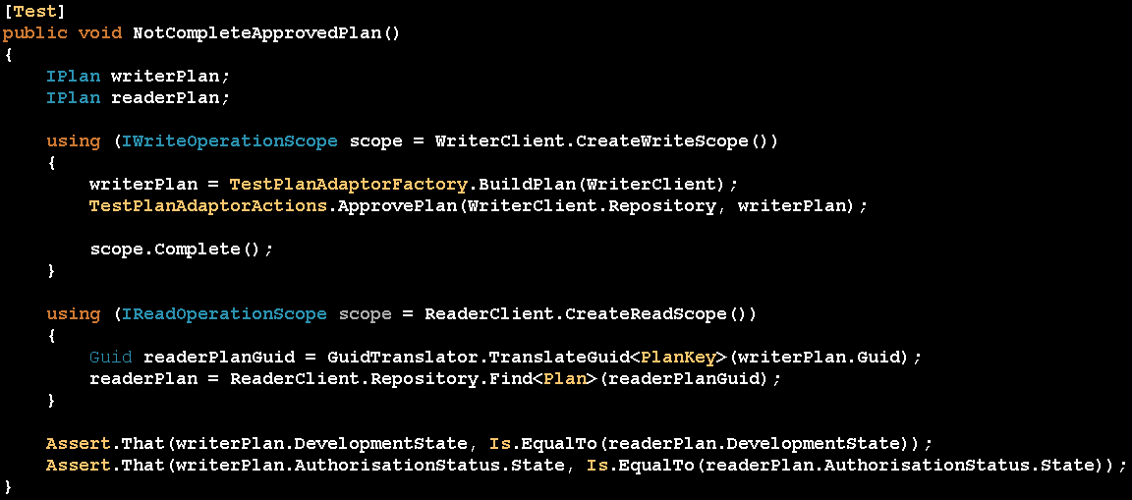

Slide 55
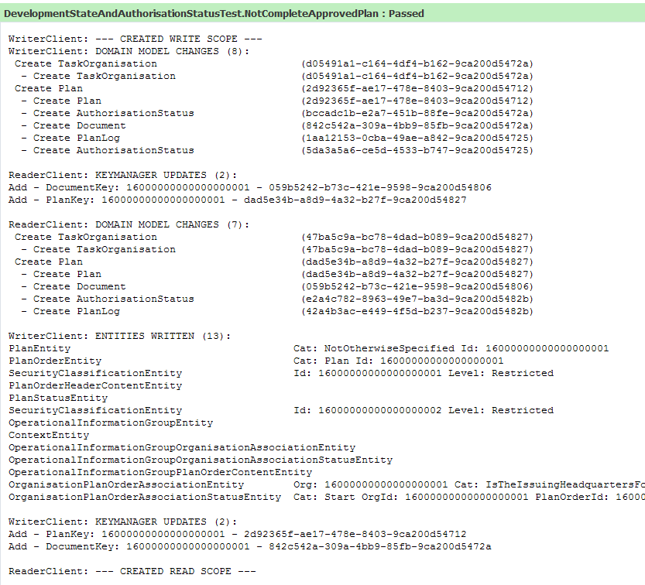

Slide 56
More Information
Object Mentor
Los Techies
Code Better

Slide 57
DONE

Slide 58
Principles / Laws / Rules
Law of Demeter
Boy Scout Rule
Liskov Substitution Principle
Principle of Least Surprise
Interface Segregation Principle
Dependency Inversion Principle
Tell Don’t Ask
Occam’s Razor
Ya Ain’t Gonna Need It
Open Closed Principle
Single Responsibility Principle
Don’t Repeat Yourself
Command Query Separation
Hollywood Principle

Slide 59
CODE

Slide 60
Maybe
LSP – Square / Rectangle
LSP – Design By Contract

