Slide 1

Annotation of Plasmid sequences

Slide 2
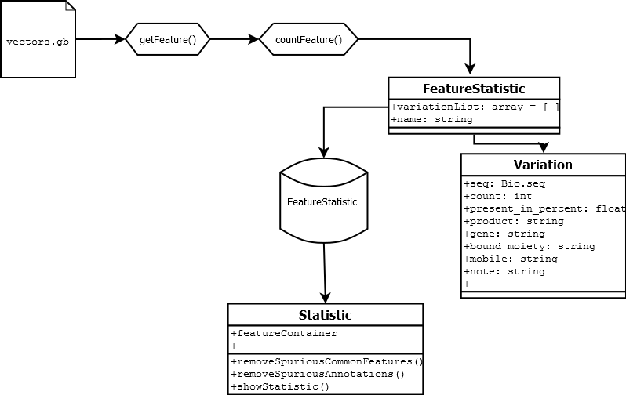
Code structure

Slide 3
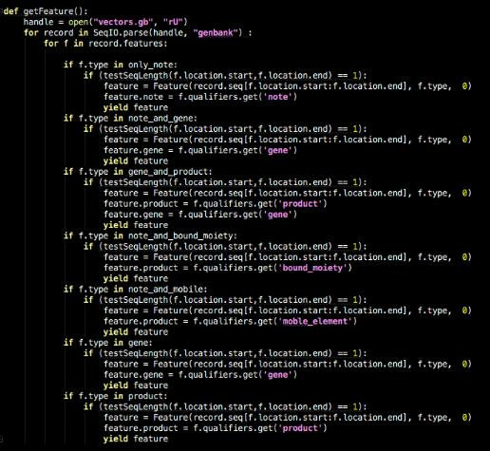
getFeature()

Slide 4
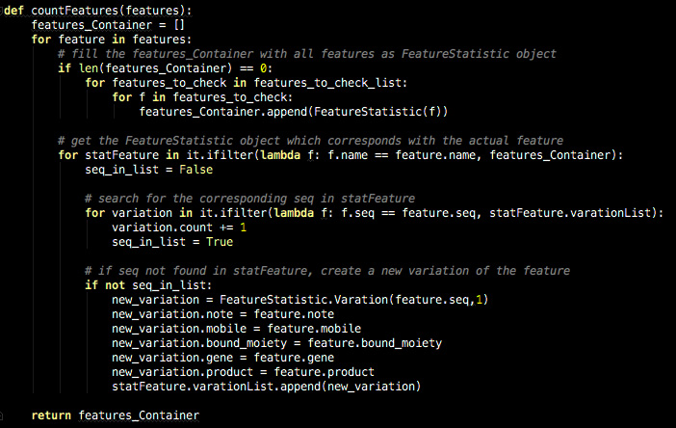
features_Container()

Slide 5
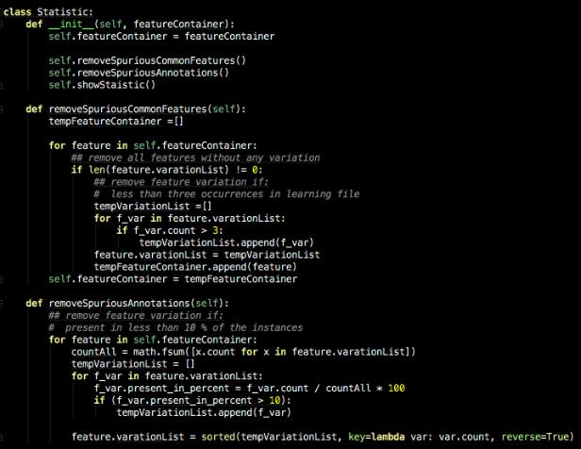
statistics()

Slide 6
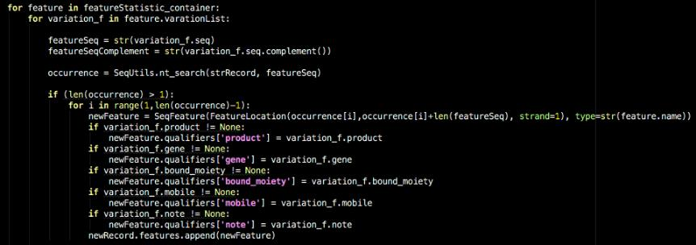
searchFeature()

Slide 7
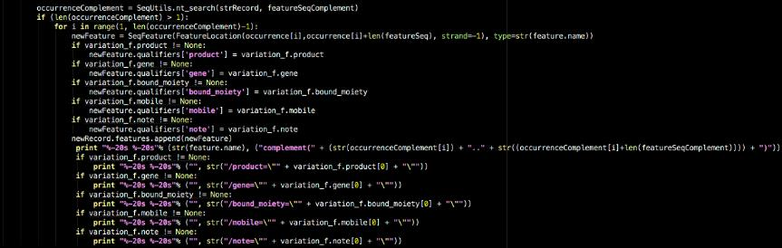
searchFeature()

