Slide 1

Annotation of Plasmid sequences

Slide 2
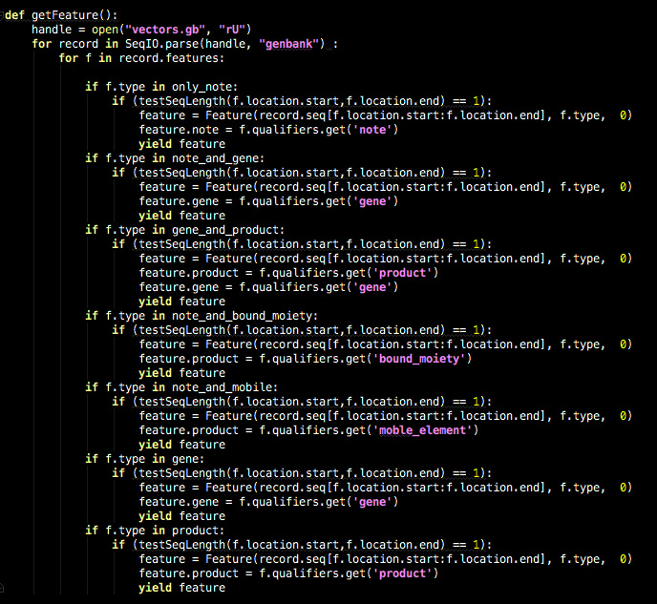
getFeature()

Slide 3
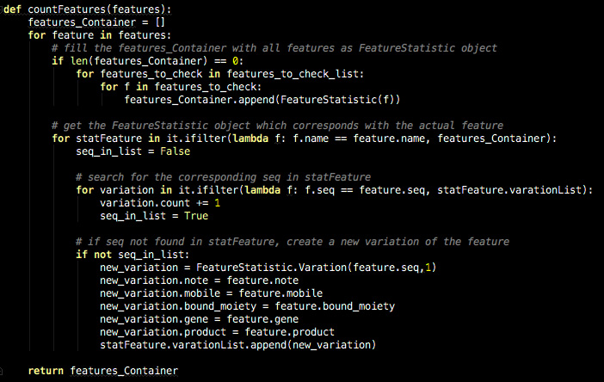
features_Container()

Slide 4
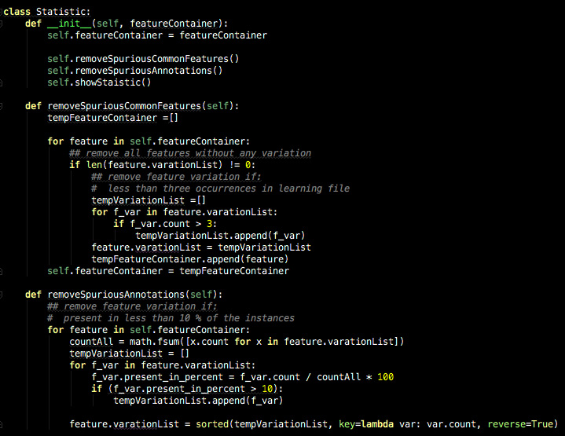
statistics()

Slide 5
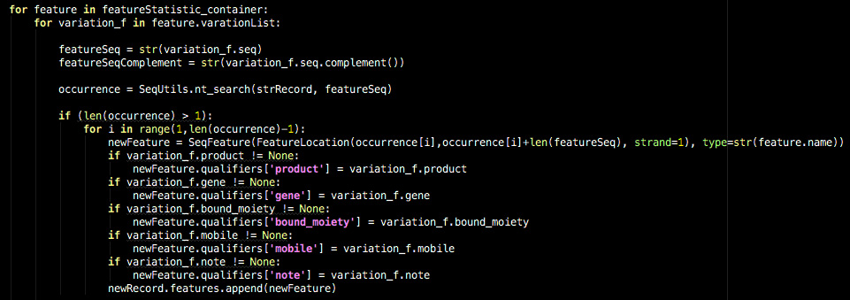
searchFeature()

Slide 6
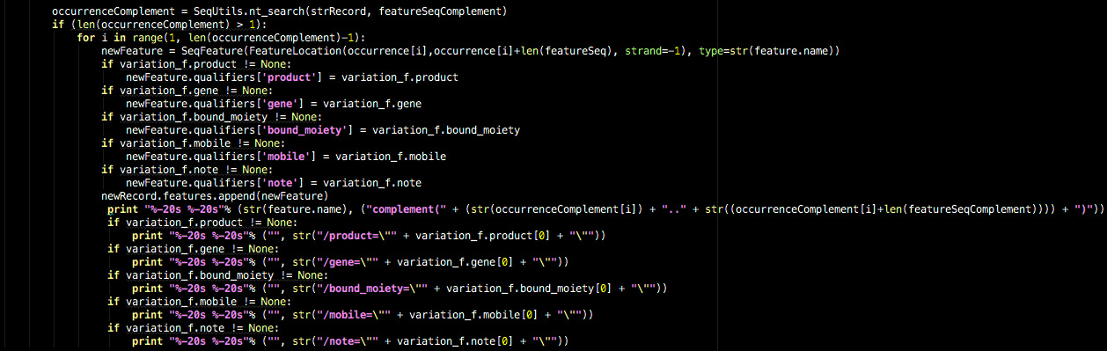
searchFeature()

