Slide 1

Annotation of Plasmid sequences
Jacob Rasmussen, Fabrizio Parrillo, Steffen Griesch 04. Januar 2016

Slide 2
Aufgabenstellung
Analyse der Nukleotidsequenz eines Plasmid
Erkennung aller genetischen Merkmale
Common Features
Primer Binding Sites
Special Translated Features
Protein Coding Genes
Erstellen eines GenBank Files mit Notation
Jacob Rasmussen, Fabrizio Parrillo, Steffen Griesch 04. Januar 2016

Slide 3
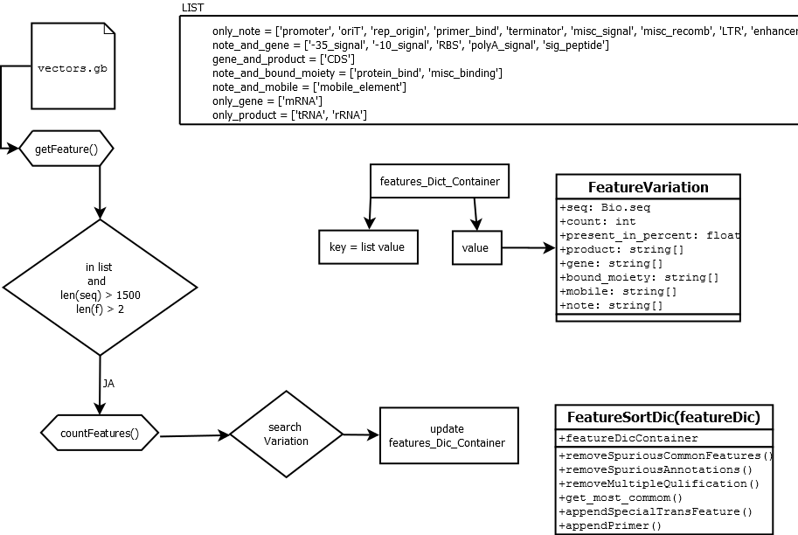
Jacob Rasmussen, Fabrizio Parrillo, Steffen Griesch 04. Januar 2016

Slide 4
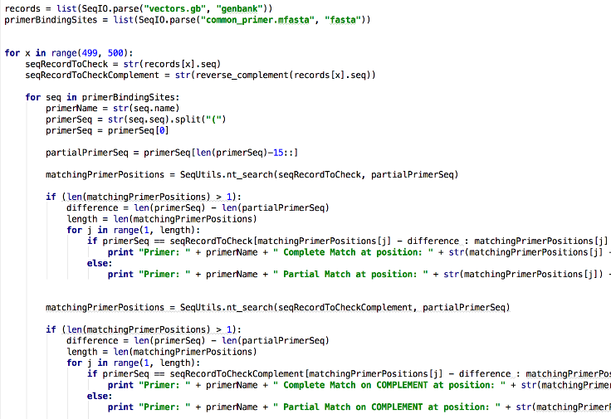
Primer Binding Sites
Jacob Rasmussen, Fabrizio Parrillo, Steffen Griesch 04. Januar 2016

Slide 5
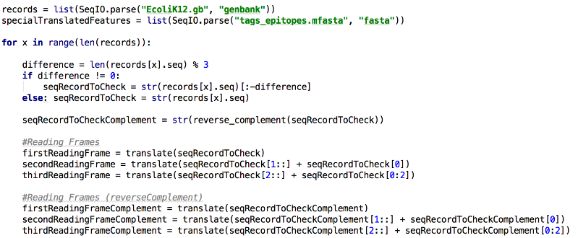
Special Translated Features
Jacob Rasmussen, Fabrizio Parrillo, Steffen Griesch 04. Januar 2016

Slide 6
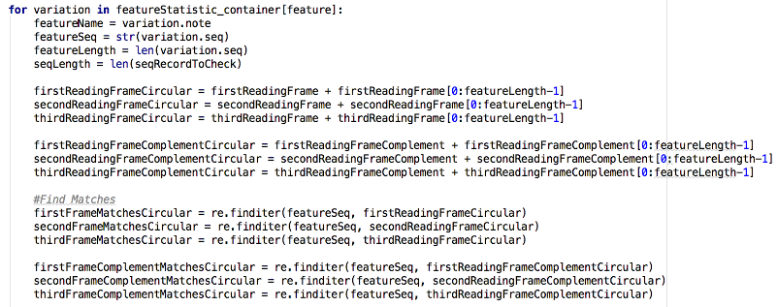
Special Translated Features
Jacob Rasmussen, Fabrizio Parrillo, Steffen Griesch 04. Januar 2016

Slide 7
Protein Coding genes
Jacob Rasmussen, Fabrizio Parrillo, Steffen Griesch 04. Januar 2016

Slide 8
Jacob Rasmussen, Fabrizio Parrillo, Steffen Griesch 04. Januar 2016

Slide 9
only_note = ['promoter', 'oriT', 'rep_origin', 'primer_bind', 'terminator', 'misc_signal', 'misc_recomb', 'LTR', 'enhancer'] note_and_gene = ['-35_signal', '-10_signal', 'RBS', 'polyA_signal', 'sig_peptide'] gene_and_product = ['CDS'] note_and_bound_moiety = ['protein_bind', 'misc_binding'] note_and_mobile = ['mobile_element'] only_gene = ['mRNA'] only_product = ['tRNA', 'rRNA'] features_to_check_list = [only_note, note_and_gene, gene_and_product, note_and_bound_moiety, note_and_mobile, only_gene, only_product] features_Dict_Container = {} # fill the features dictonary with the keys form features_to_check_list for features_to_check in features_to_check_list: for f in features_to_check: features_Dict_Container[f] = [] ################################# Functions ###################################### def getFeature(file): print("Load annotations from " + file) handle = open(file, "rU") for record in SeqIO.parse(handle, "genbank") : if len(record.seq) > 1500: for f in record.features: for list in features_to_check_list: if f.type in list and testSeqLength(f.location.start, f.location.end): countFeatures(f, record.seq[f.location.start:f.location.end]) return features_Dict_Container def testSeqLength(start, end): if (start + 2 > end): return False else: return True
Jacob Rasmussen, Fabrizio Parrillo, Steffen Griesch 04. Januar 2016

Slide 10
def countFeatures(feature, seq): accVariationList = features_Dict_Container[feature.type] note = feature.qualifiers.get('note')[0] if feature.qualifiers.get('note') != None else None gene = feature.qualifiers.get('gene')[0] if feature.qualifiers.get('gene') != None else None bound_moiety = feature.qualifiers.get('bound_moiety')[0] if feature.qualifiers.get('bound_moiety') != None else None mobile = feature.qualifiers.get('mobile')[0] if feature.qualifiers.get('mobile') != None else None product = feature.qualifiers.get('product')[0] if feature.qualifiers.get('product') != None else None seq_in_list = False for variation in accVariationList: if variation.seq == seq: if feature.type in only_note: if variation.note[0] == note: seq_in_list = True appendQualifier(variation.gene, gene) appendQualifier(variation.bound_moiety, bound_moiety) appendQualifier(variation.mobile, mobile) appendQualifier(variation.product, product) variation.count += 1 break …
…
elif feature.type in only_product: if (variation.product[0] == product): seq_in_list = True appendQualifier(variation.bound_moiety, bound_moiety) appendQualifier(variation.mobile, mobile) appendQualifier(variation.note, note) appendQualifier(variation.gene, gene) variation.count += 1 break # if seq not found in statFeature, create a new variation of the feature if not seq_in_list: new_variation = FeatureVariation(seq, 1) new_variation.note.append(note) new_variation.bound_moiety.append(bound_moiety) new_variation.gene.append(gene) new_variation.product.append(product) new_variation.mobile.append(mobile) accVariationList.append(new_variation) def appendQualifier(qualifier, value): if value is not None: qualifier.append(value)
Jacob Rasmussen, Fabrizio Parrillo, Steffen Griesch 04. Januar 2016

