Slide 1
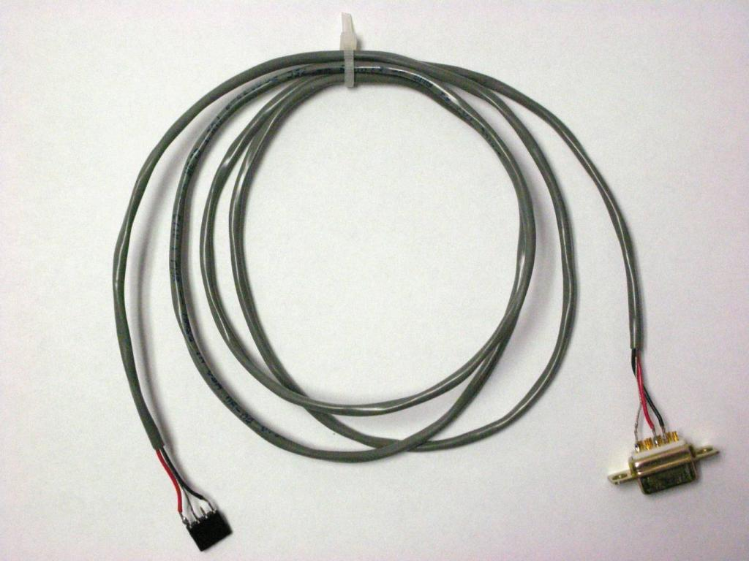
DB-9 to 4 pin header (SIL)

Slide 2
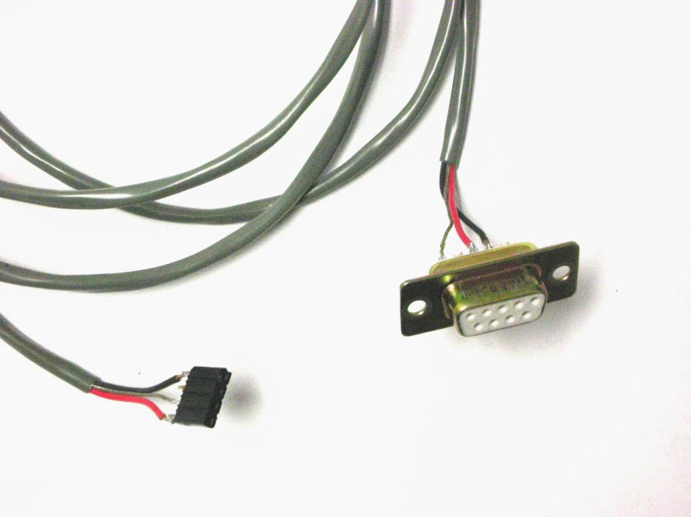

Slide 3
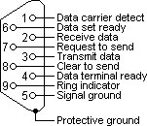
DB9 Male
Pin-out table for both ends of cable:
DB-9 female SIL 0.1" female
Pin# Pin#
--------------------------------------------------------------
2 (black) 1 (Tx)
3 (red) 4 (RX)
5 (bare wire) 3 (GND)
Note pin 2 on SIL is a no-connect

