Slide 1
Introductory Angular and React course
October 2023

Slide 2
Course Overview
Goal: Create a kick-ass reactive angular application
Create a movie search application using common Angular concepts.
Presentation of some Angular concepts
Put knowledge to use by coding

Slide 3
JavaScript
SubGoal: Learn the ins, outs and quirks of JavaScript
Quirks
Looks like known languages Java, C, C# etc.
Numbers are double (64-bit) values, based on the IEEE Standard for Floating-Point Arithmetic (IEEE 754)
Not classical object oriented, but uses Prototypal inheritance
Closures (“this” keyword) and hoisting
Truthy falsy and implicit boolean conversion, eqeqeq, null & undefined
Linting, Hinting
Array methods
Indexer, forEach, pop, push, shift, unshift, indexof, splice, find, concat, etc
Map, filter, reduce, sort
Functions
Function declaration
Function Expression (named and unnamed)
Arrow functions (fat arrow)

Slide 4
TypeScript
Subgoal: Learn what TypeScript can do for you
What it is
A superset of JavaScript
Compiles to JavaScript
Handles some of the quirks/errors of JavaScript
Modules (mentioned here even though it’s not typescript specific)
Export (named, default and barrels)
Import
Typings
Types and interfaces
Duck-typing
Type modifiers and ‘any’
Classes
Implements and extends
Constructor
Access modifiers

Slide 5
What is Angular?
A single-page client application framework and platform.
Based on TypeScript which in turn is based on JavaScript.
Why a framework and not a Library? (React)
Declarative, Imperative (jQuery), Static rendering (asp.net)
Notes:
AngularJS: 2010, Angular: 2015, TypeScript 2012

Slide 6
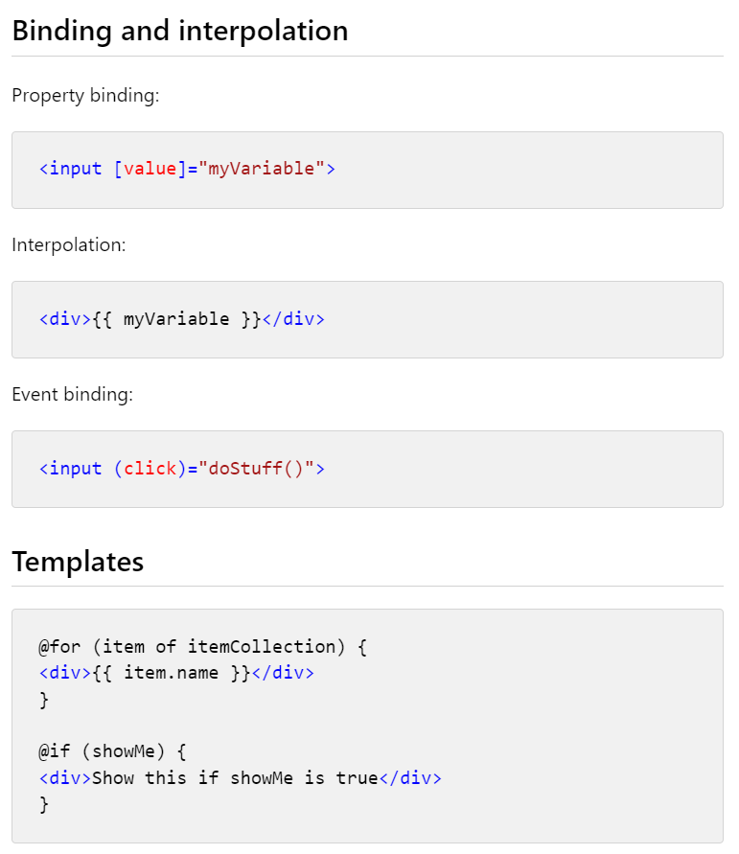
Hands-on: MVP
Subgoal: Create an angular application showing a list of movie images (with hardcoded data)
Angular CLI
Creates new project
Can add and do initial configure of new modules, components, services, etc.
Project structure
(index.html, main.ts, styles.css*, app.module.ts, app.component.ts)
Builds to an index.html, css files, js files, assets folder(s).
Property binding
Single property binding
Structual directives
Official Angular guide at https://angular.io
Notes:
Angular CLI – explain what it does
Property binding –highlight the complementary .ts and .html files
binding to properties [property] instead of {{ data }} (interpolation)
Emphasize importance of angular.io
Explain NG focus on making it easier to use for new developers – example @for and @if instead of structural directives

Slide 7
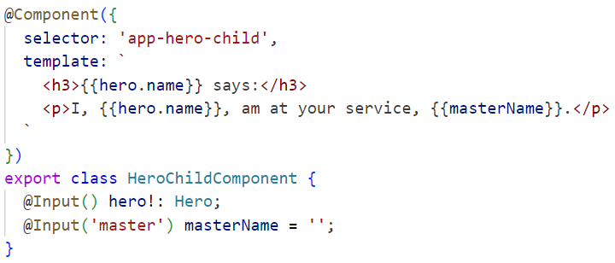
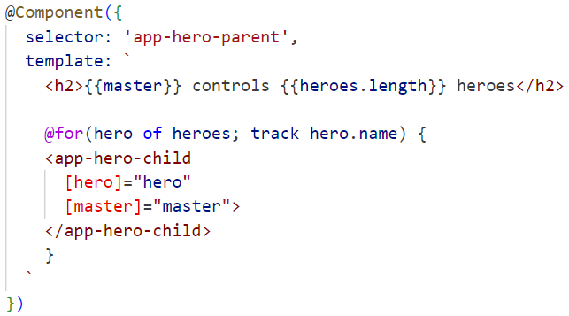
Hands-on: Components
Subgoal: Split the application into several components
What are components?
Controls a patch of the screen
Self contained
Reusable
Can belong to a module – or be standalone
Meta data
Lifecycle
ngOnChanges*, ngOnInit, ngDoCheck*, ngAfterContentInit, ngAfterContentChecked*, ngAfterViewInit, ngAfterViewChecked*, ngOnDestroy
Splitting app/component into sub components
Reusability
SRP
Leverage structural directives
Notes:
VSC shortcut ctrl+.
Husk fortæl om @Attributes (@Component, @Input, @Module, osv)

Slide 8
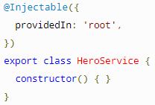
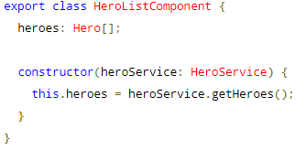
Hands-on: Services and Dependency Injection
Subgoal: Introduce DI and move data fetching functionality into a service
Constructor injection
useClass, useValue, useFactory
provideIn vs. module import
@Injectable
Notes:
Husk opfordre til at bruge CLI’en til at oprette service/components

Slide 9
Pipes
Subgoal: Create a pipe to demonstrate simple formatting
Angular pipes, a way to write display-value chainable transformations that you can declare in your HTML.
Built-in pipes
Date pipe
Uppercase pipe
Concepts
Custom pipes
Transformations like map and filter
Can be used in @for and @if as well
Change detection: pure (with input) or impure
Notes:
Custom pipes: https://angular.io/guide/pipes#custom-pipes
https://angular.io/guide/pipes#flyingheroespipe (ngFor filter)

Slide 10
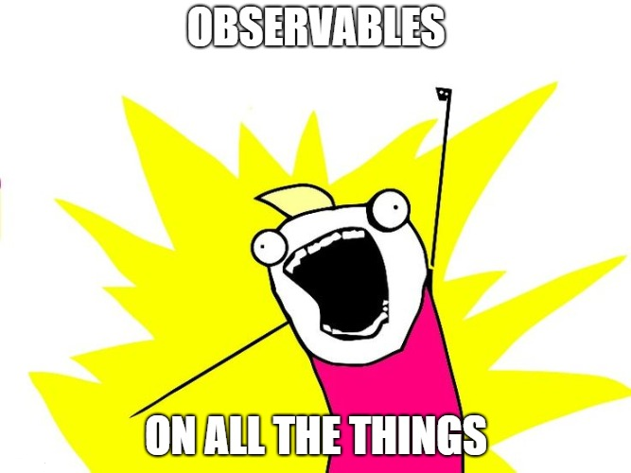
Hands-on: Observables
Subgoal: show real data fetched via http
Observables
Programming with asynchronous data streams.
Lodash for events, LINQ (.NET) on steroids
Infinite / Finite
Everything is Observables
ReactiveX: RxJs
Pipe
Pure functions
filter, map, and more…
Subscribe and Unsubscribe
HttpClient
Async methods: get, post, jsonp, etc
Returns observables, can get piped, subscribed, etc
Notes:
Other Observables concepts: Hot/cold, replay/share, subject

Slide 11
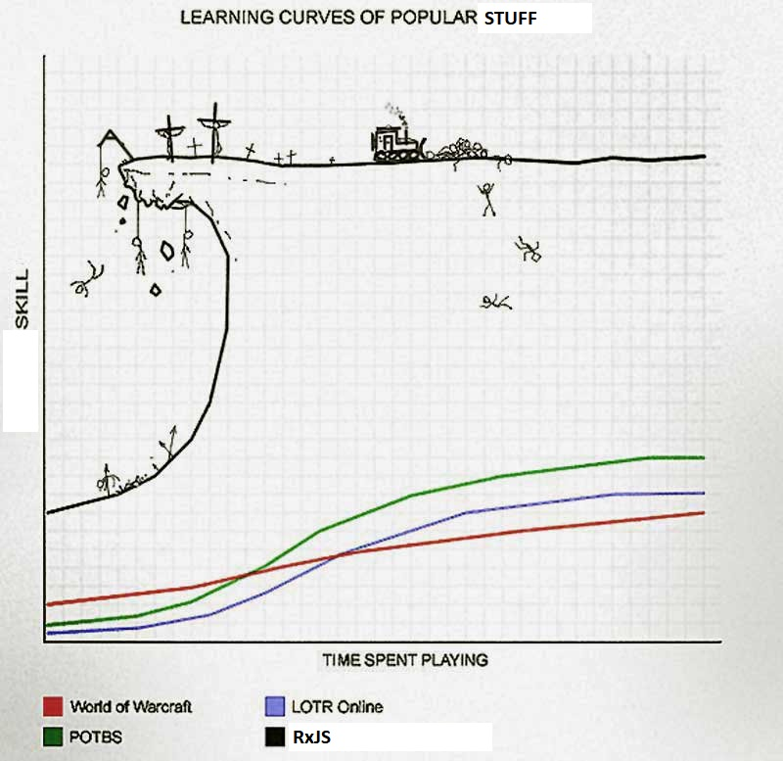
Hands-on: User input and advanced Observables
Subgoal: Work on real user input and learn to handle stream of streams
Reactive Forms
Register controls in template – binds to component model
Read value through ‘value’ property or ‘valueChanges’ observable
Alternative to template-driven forms
Observables (again)
filter, map, merge, debounceTime, tap, etc.
Handle ‘observable of observables’ with switchMap (etc.)
Async pipe
Automatic subscribe and unsubscribe
Works on both observables and promises (including null and undefined)
Notes:
Show example of using a Pipe
Import { ReactiveFormsModule } from '@angular/forms‘
Explain value of learning RxJS or similar (mostjs)

Slide 12
Hands-on: Routing
Subgoal: Learn about routing and store user input in the url and deeplinking
Each Module can have its own routes
Easily configured with the CLI
Route (path, pathMatch, component, redirectTo, outlet, canActivate, data, children)
RouterOutlet
Children
routerLink
ActivatedRoute (ParamMap), Router(.navigate)
Notes:
Bookmarking
Storing state

Slide 13
Hands-on: Animations
Subgoal: Add sweet sweet animations
CSS animations
Angular animation builds on top of CSS animations
Polyfills
trigger, state, style, animate, transition
Wildcard, void, enter, leave states
Automatic property calculations
Timing properties: Duration, Delay, Easing
Animation builder
Animation functions: Keyframes, groups, callbacks, stagger, etc.

Slide 14
Directives
Subgoal: Add functionality to an element by creating and adding a directive to it
Angular directives attach custom behaviour to elements in the DOM.
Structural directives shape or reshape the DOM's structure, typically by adding, removing, or manipulating elements. They are normally prefixed with an asterisk (*).
Built-in
Attribute Directives: ngModel, ngStyle, routerLink , ngClass, etc.
Structural Directives: *ngIf, *ngFor, ngSwitch
Writing a custom directives
Selector
Constructor injection
Lifecycle hooks
Notes:
Evt nævn strukturelle direktiver – ngIf, ngFor
https://angular.io/guide/cheatsheet - * turns the current element into an embedded template

Slide 15
Form validation
Subgoal: Validate fields and provide feedback
Validate user input in the UI and display useful validation messages using both reactive and template-driven forms. Built on top of browser validation.
Built-in HTML5 validation
Required
Maxlength and minlength
Pattern (regex)
Type (number, email, etc)
Min and max (number ranges)
Pseudo classes (:valid and :invalid)
JavaScript API
Angular validation
Function with custom logic through interface
State properties: valid, invalid, touched, untouched, pristine, dirty, pending
Handles css classes for states

Slide 16
Automated Testing
Subgoal: Create some unit and component test
Default Test framework and test runner for Angular is Jasmine and Karma.
Different types of tests
Unit tests (tests the smallest posible unit)
Component tests (needs TestBed configuration)
Integration tests (often also requires TestBed configuration)
End to end tests (popular ones includes Cypress and Playwright)
Concepts needed for the workshop
Behaviour-driven testing with specs, describe, it
TestBed
beforeEach, expect, toBe
Fixture, debugElement, detectChanges, calling lifecycle hooks
TestComponent to test directives
Notes:
Testrunner Karma: https://karma-runner.github.io/4.0/index.html
Behaviour driven test framework Jasmine: https://jasmine.github.io/

Slide 17
Catch up on ‘all’ the rest
Goal: Become best and coolest developer you possible can!
Preprocessors LESS / SASS
ngrx/store
ControlValueAccessor
WebComponents
Signals
Hostbindings and Hostlisteners
Change detection
ContentChild, ViewChild

