Slide 1
The pytorch ecosystem
Machine Learning Operations
Nicki Skafte Detlefsen,
Postdoc
DTU Compute

Slide 2
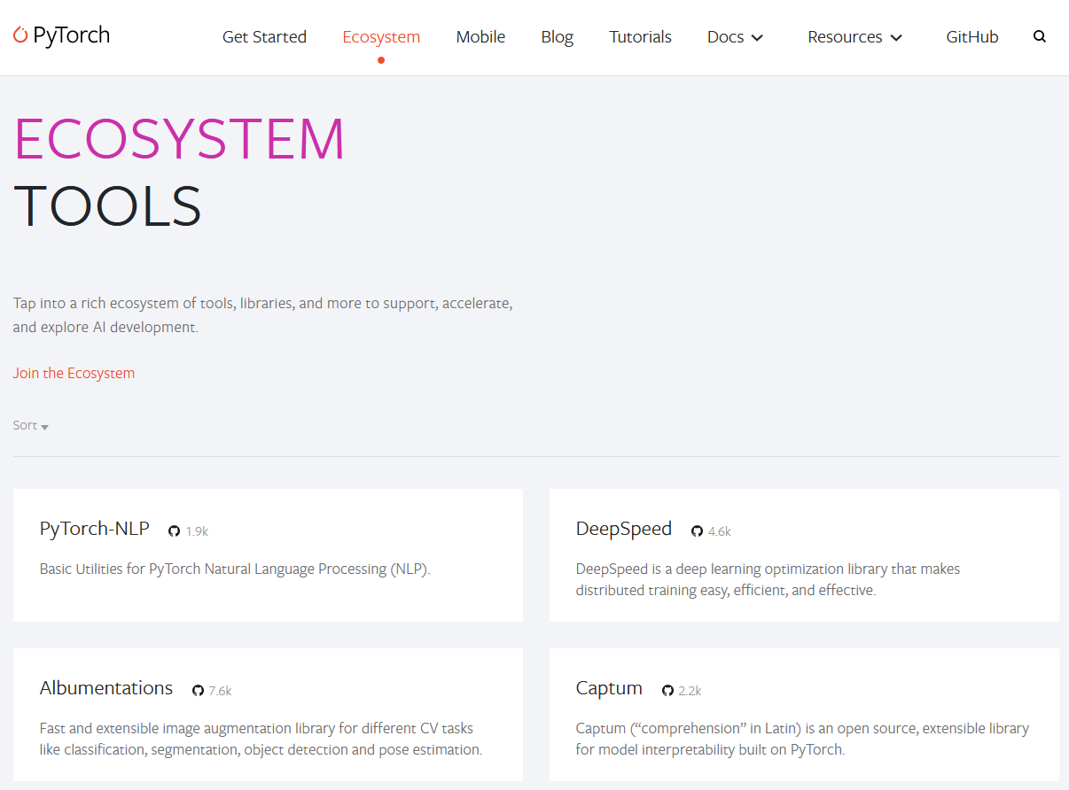
The ecosystem
Collection of frameworks build to be used in combination with Pytorch

Slide 3

Framework categorizing
Data specific frameworks | Training frameworks | Utility fremeworks
Transformers | fastai | Albumentations
Detectron2 | Ray | PySyft
Pytorch geometric | Pytorch Lightning | Pyro
Flair | Horovod | Optuna
AllenNLP | DeepSpeed | Hydra
ParlAI | ONNX Runtime | Pytorch Metric Learning
DGL | skorch | Einops
PyTorch3D | Ignite
MMF | Polyaxon
Kornia

Slide 4
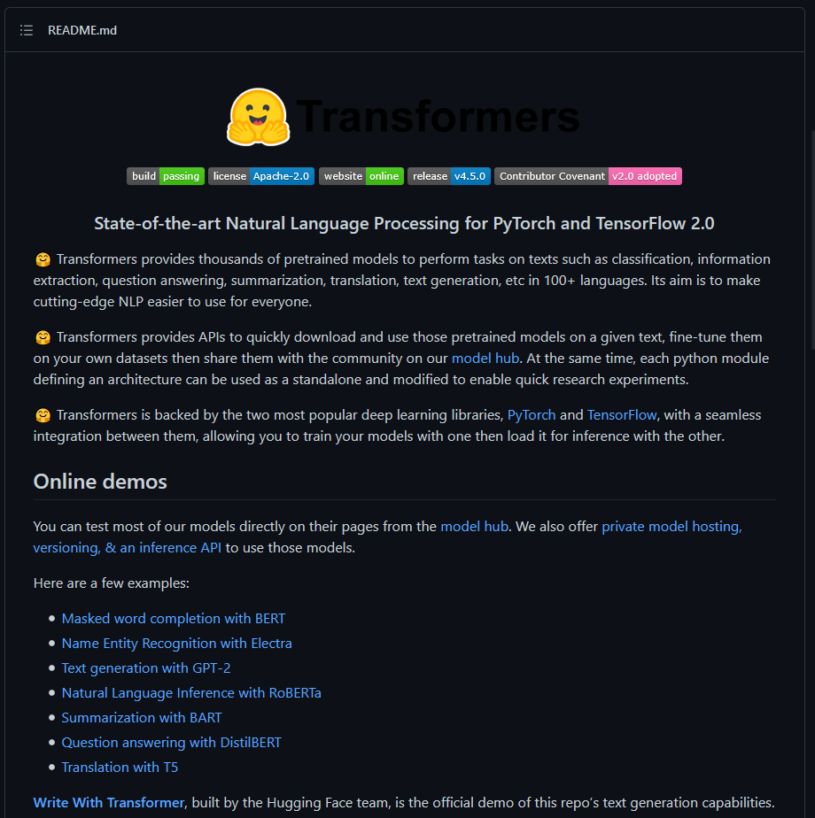
Project 1: NLP
Framework: Transformers (Huggingface)
https://github.com/huggingface/transformers
State-of-the-art NLP models
Most starred framework in the ecosystem

Slide 5
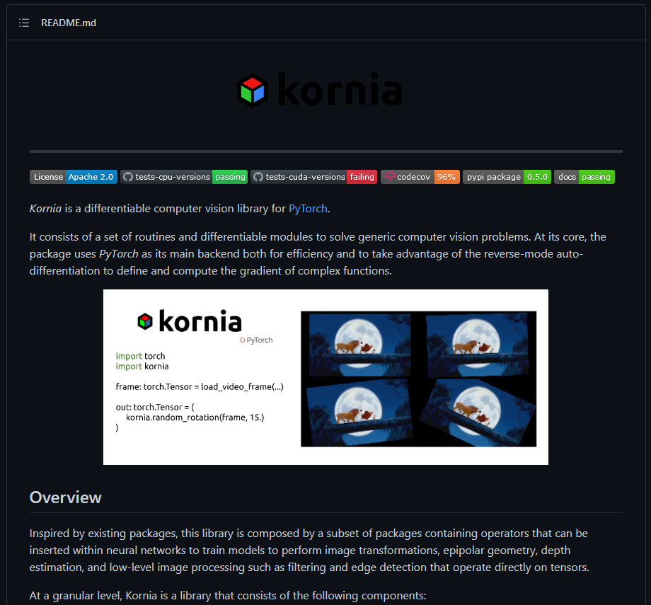
Project 2: CV
Framework: Kornia
https://github.com/kornia/kornia
Differentiable computer vision algorithms

Slide 6
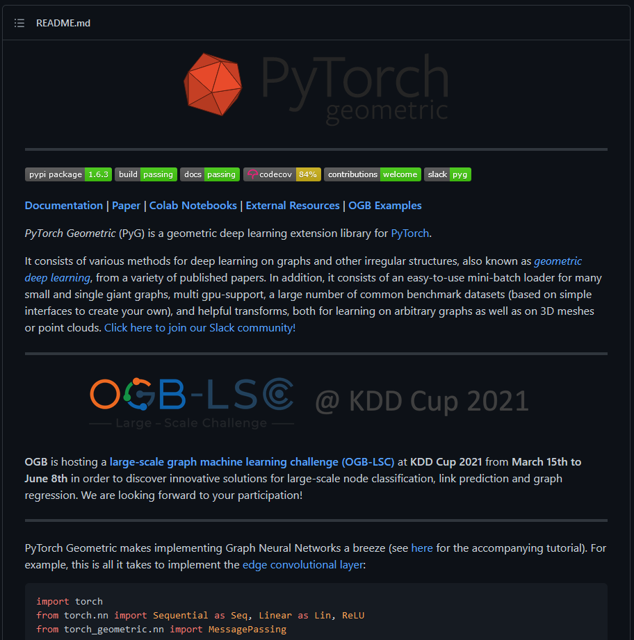
Project 3: Graphs and points
Framework: Pytorch Geometric
https://github.com/rusty1s/pytorch_geometric
Neural networks on graphs and point clouds

Slide 7
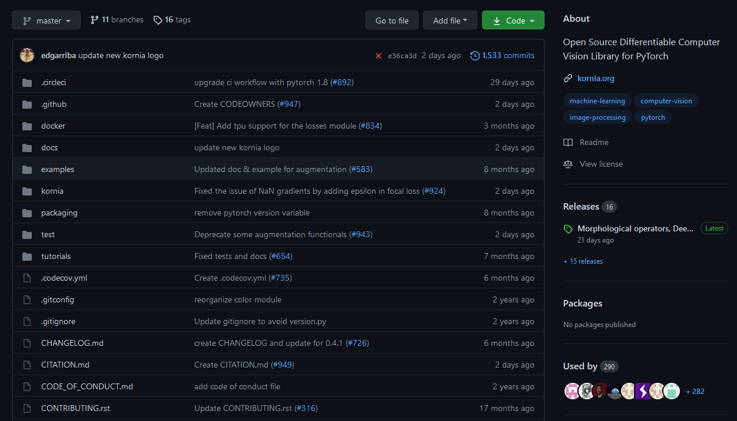
Getting a good idea

Slide 8
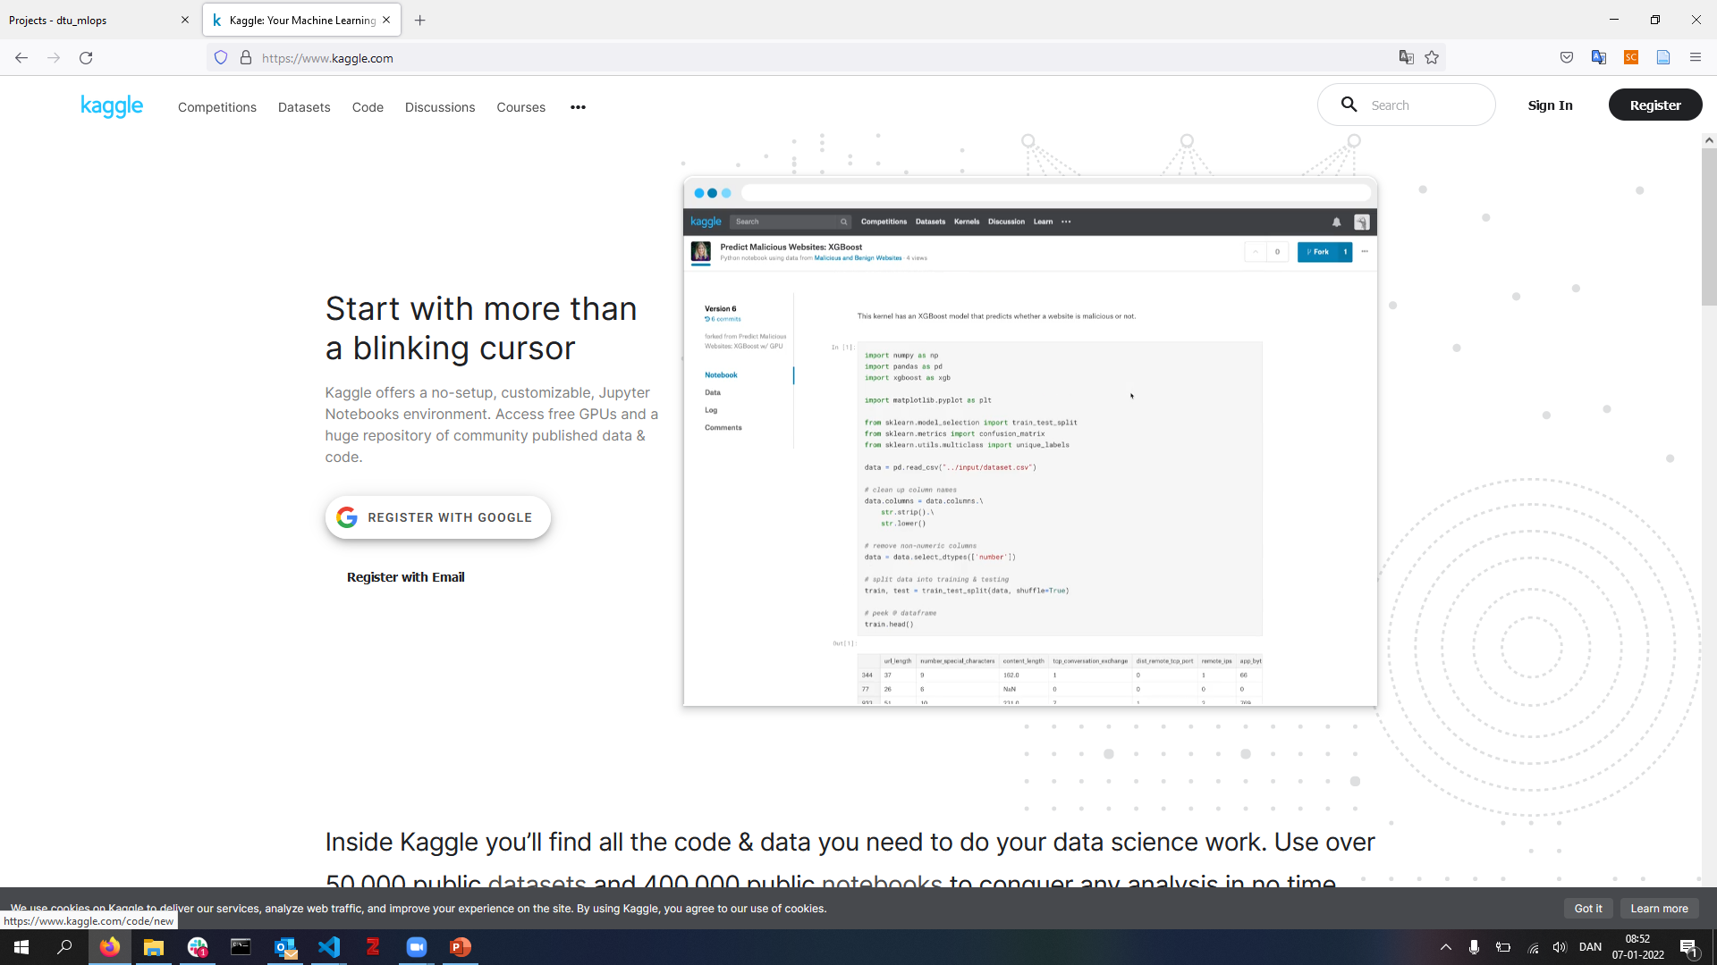
Getting a good idea

Slide 9
Summary
Pick a framework (try running their notebooks/examples!):
Project 1: NLP
Project 2: CV
Project 3: Graphs and points
Brainstorm a project. It does not have to be particular big as you only have 4½ full days for working on it
Write a small (max 1 page) project description including:
What model do intent to implement
What data are you going to use
How you think the chosen framework can be incorporated

Slide 10
Checklist (also in todays readme)
- [ ] Create a git repository
- [ ] Make sure that all team members have write access to the github repository
- [ ] Create a dedicated environment for you project to keep track of your packages (using conda)
- [ ] Create the initial file structure using cookiecutter
- [ ] Fill out the `make_dataset.py` file such that it downloads whatever data you need and
- [ ] Add a model file and a training script and get that running
- [ ] Remember to fill out the `requirements.txt` file with whatever dependencies that you are using
- [ ] Remember to comply with good coding practices (`pep8`) while doing the project
- [ ] Do a bit of code typing and remember to document essential parts of your code
- [ ] Setup version control for your data or part of your data
- [ ] Construct one or multiple docker files for your code
- [ ] Build the docker files locally and make sure they work as intended
- [ ] Write one or multiple configurations files for your experiments
- [ ] Used Hydra to load the configurations and manage your hyperparameters
- [ ] When you have something that works somewhat, remember at some point to to some profiling and see if you can optimize your code
- [ ] Use wandb to log training progress and other important metrics/artifacts in your code
- [ ] Use pytorch-lightning (if applicable) to reduce the amount of boilerplate in your code

Slide 11
Hand-in
By 17:00 today handin link to github reposatory on DTU Learn

Slide 12
Exam format
Thursday 24/6 – evaluation by Nicki and Søren
Group presentation
6 minutes of powerpoint showcase
10 minutes of discussion
What you will be evaluated on:
How well you have included what we teach you in the course
What you will NOT be evaluated on
How epic your deep learning model is

Slide 13
Some good advice
Document everything
Take screenshots of your work
Parallize work
Many of the checkpoints are independent of each other

Slide 14
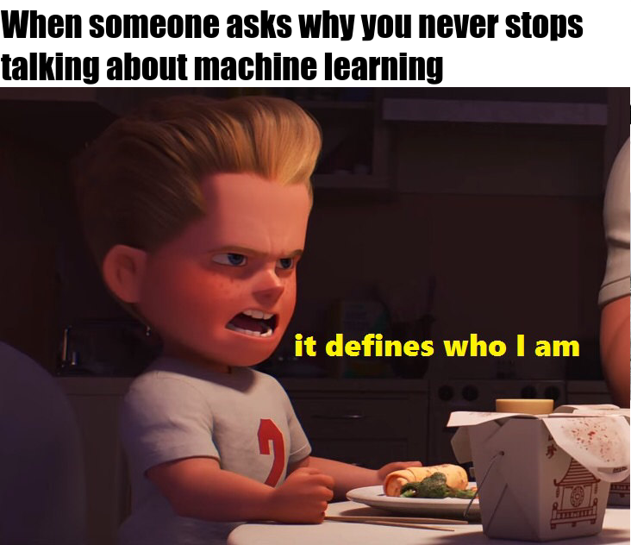
Meme of the day

