Slide 1
The reproduceability crises
Machine Learning Operations
Nicki Skafte Detlefsen,
Postdoc
DTU Compute

Slide 2
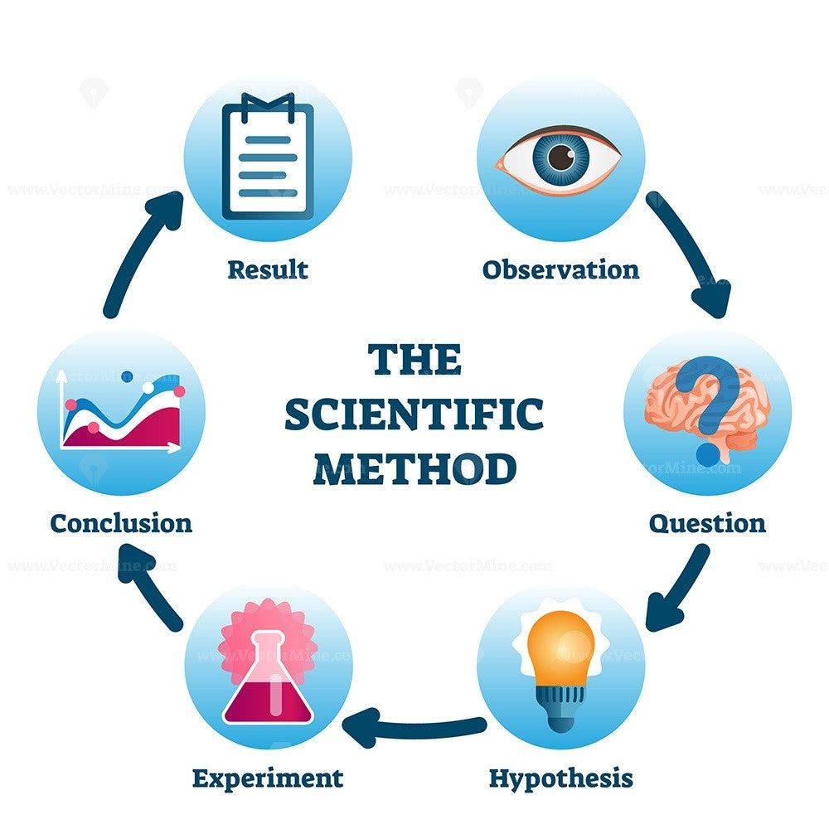
What is it?
Being able to reproduce other peoples experimental results is an essential part of the scientific method
Well known problem thoughout most fields (physics, chemestry, biology and computer science)
With the rise of deep learning, the problem has only been made worse due to competition
This is where it breaks

Slide 3
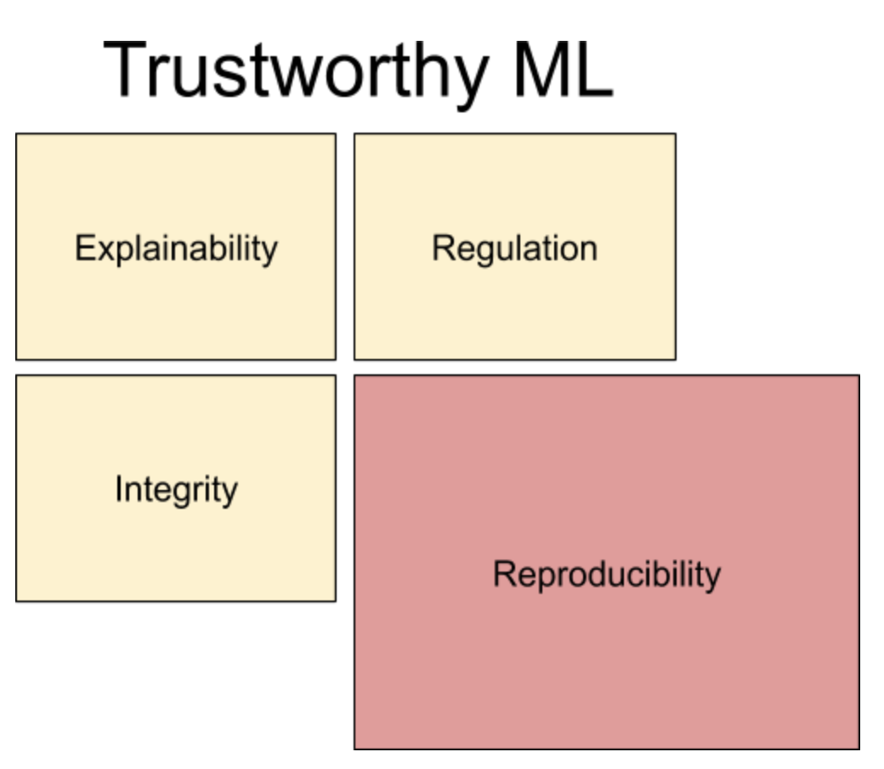
Why do we need reproduceability at all?
Reproduceability is a key component in Trustworthy ML
Case:
Imaging an AI agent used for dinostics. Without reproduceability two persons with the exact same symtomes could get different diagnosis
From https://towardsdatascience.com/reproducible-machine-learning-cf1841606805

Slide 4
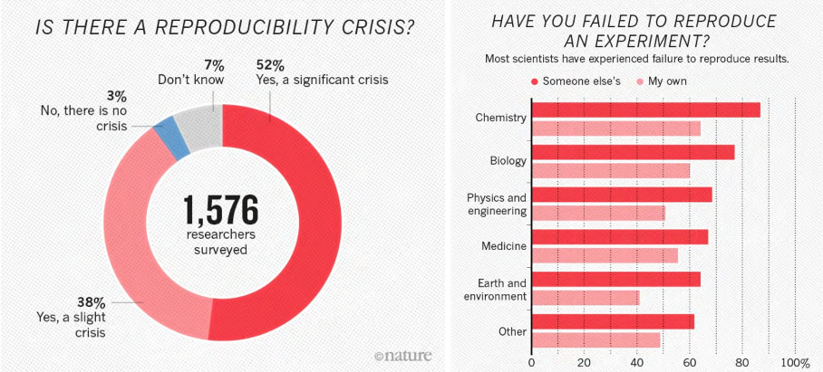
How bad is it?
Wow its bad...
Machine learning around 26% (https://www.aaai.org/GuideBook2018/17248-73943-GB.pdf)
https://www.nature.com/news/1-500-scientists-lift-the-lid-on-reproducibility-1.19970

Slide 5
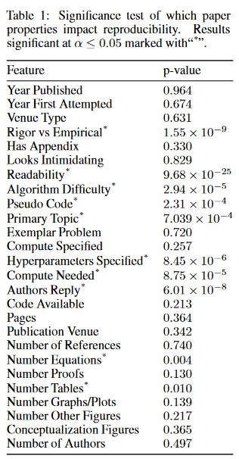
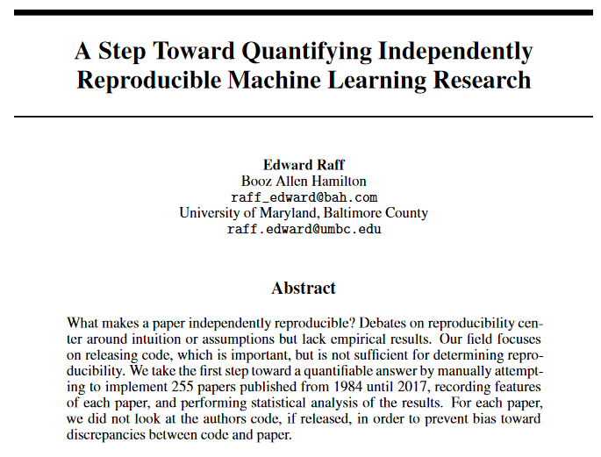
A closer look a machine learning
Reimplement 255 and do hypothesis testing on what ”paper features” have an effect

Slide 6
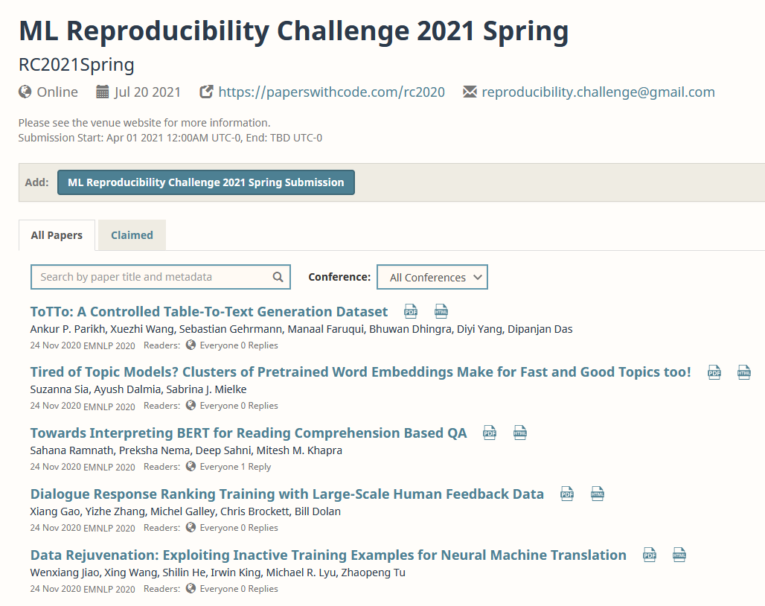
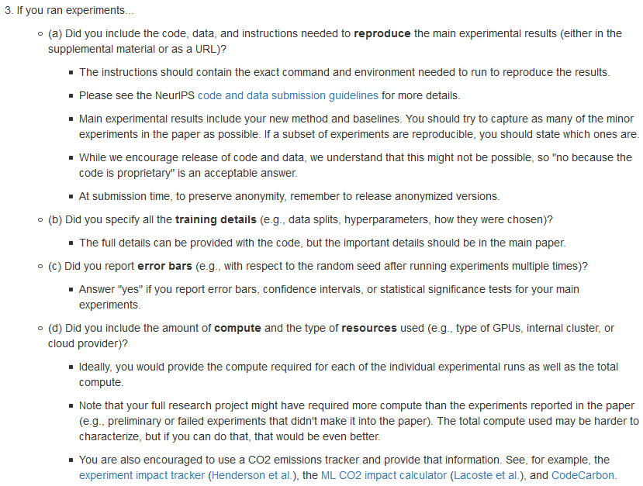
What is the field trying to do about it?
https://paperswithcode.com/ Neurips checklist:

Slide 7
What can you do about it?
Make sure to document everything about our experiments
Physical setup
Number of devices
Type of devices
Software
Operating system
Package versions
Runable code
Public data
Precise configuration
Code
Document this step as thoroughly as possible

Slide 8
Closer look
Physical setup
Number of devices
Type of devices
Docker
Software
Operating system
Package versions
Ask Conda
Runable code
Public data
Precise configuration
Seed
Code
This is your job
1/5/2022

Slide 9
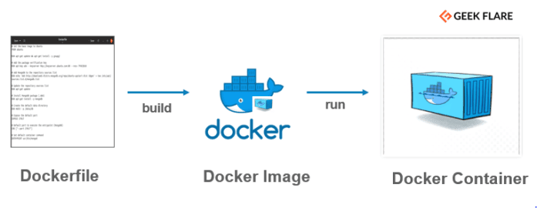
Docker
A way to create containerize applications = specialized VMs
How to construct the VM
File with the VM
Running VM

Slide 10
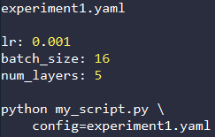


Configurations
There is a lot of subjective choices that we do when running experiments, most noteable the hyperparameters.
Parameters in script | Argparser | Config files
Not easy to configure Experiments may be lost if not carefull | Easy to configure Falls on user to save the configuration | Easy to configure Parameters are systematically saved with the experiment

Slide 11

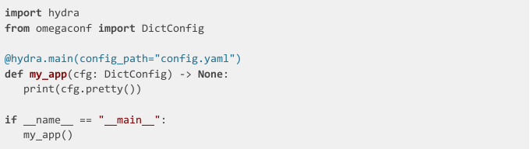
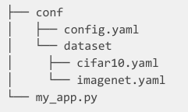
A framework for elegantly configuring complex applications.
https://github.com/facebookresearch/hydra
Correctly using configuration files makes sure that everything is documented
Example:

Slide 12
Other frameworks
https://github.com/IDSIA/sacred
https://mlflow.org/

Slide 13
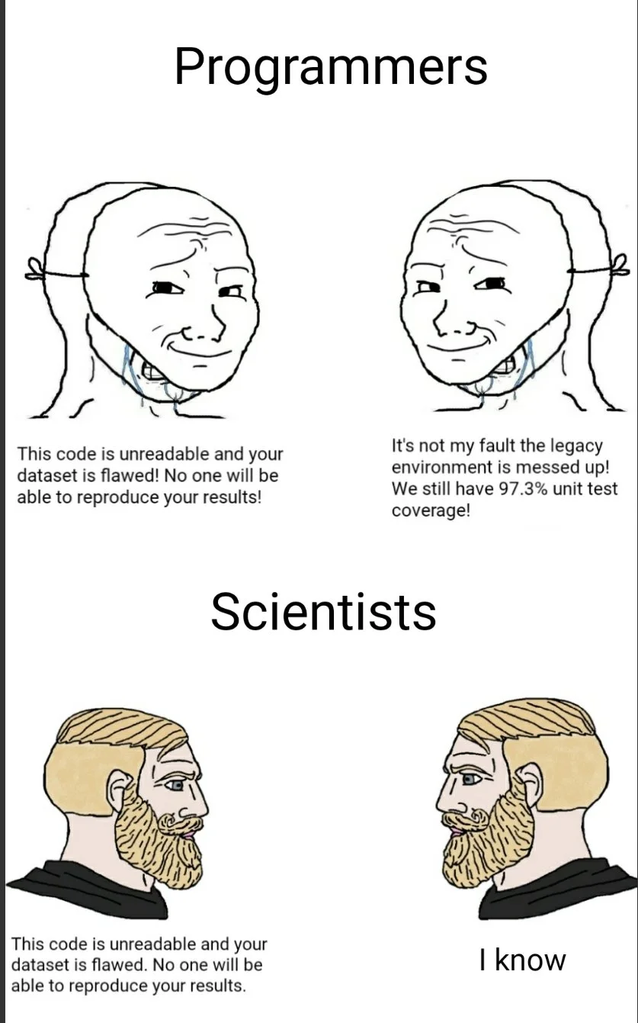
Meme of the day

