Slide 1
Debugging ML Code
02476 Machine Learning Operations
Nicki Skafte Detlefsen,
Postdoc
DTU Compute

Slide 2
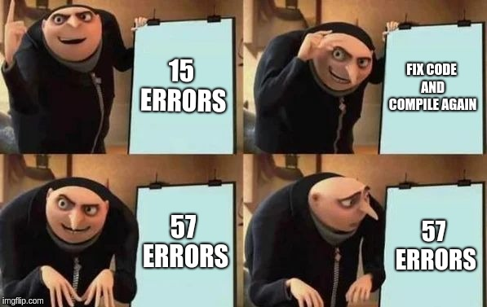
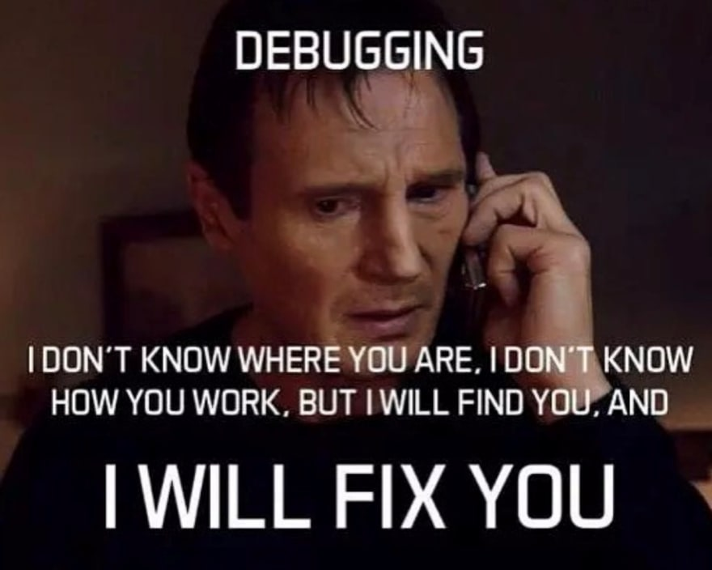
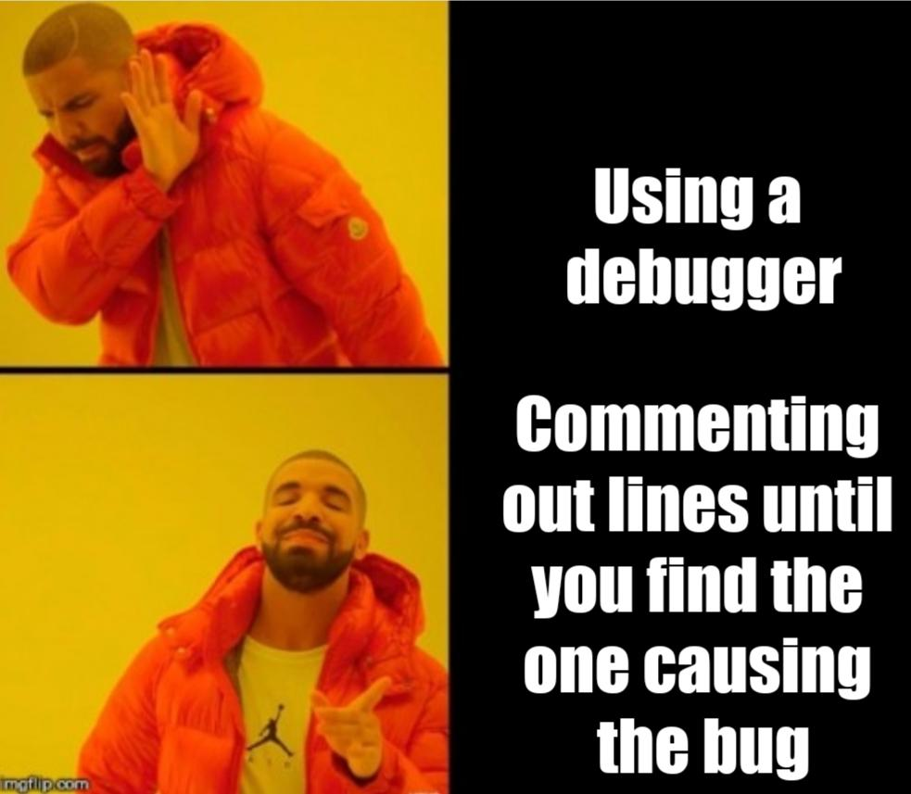
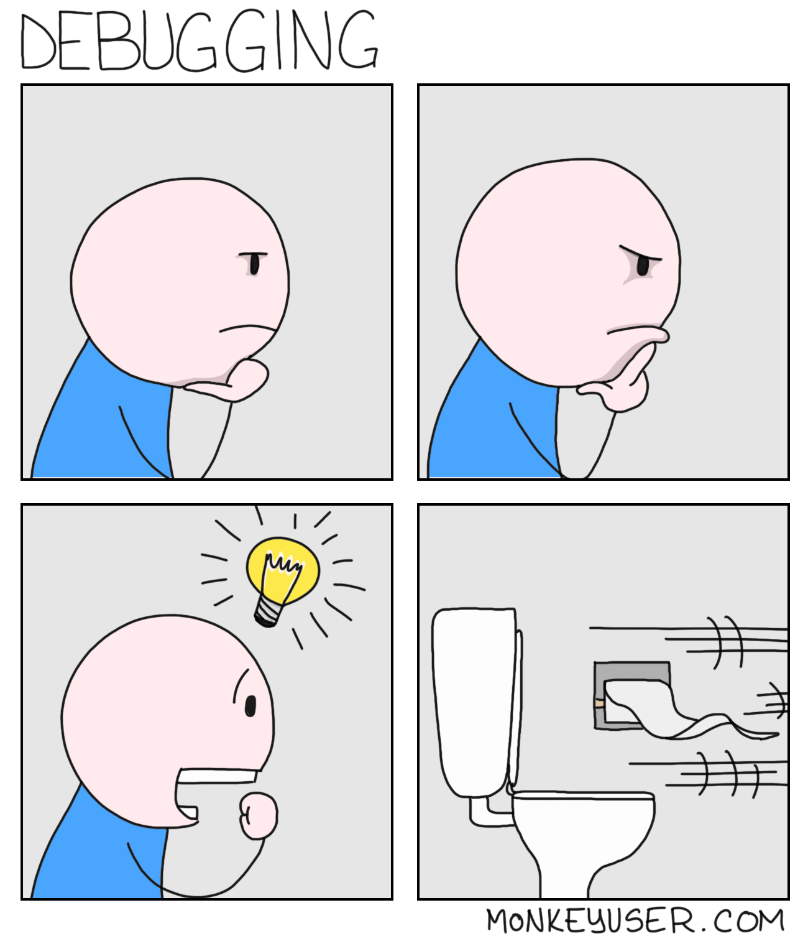
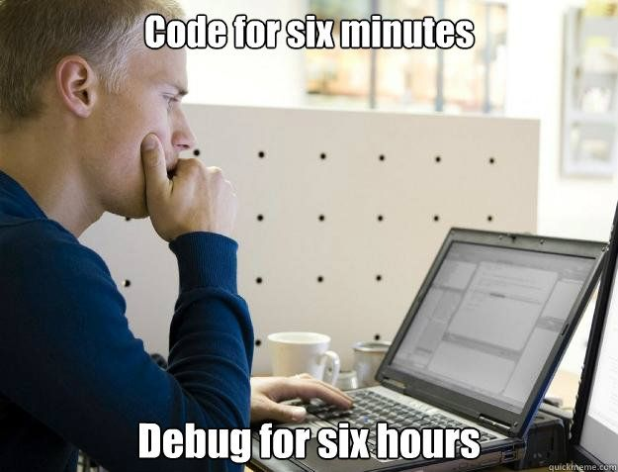
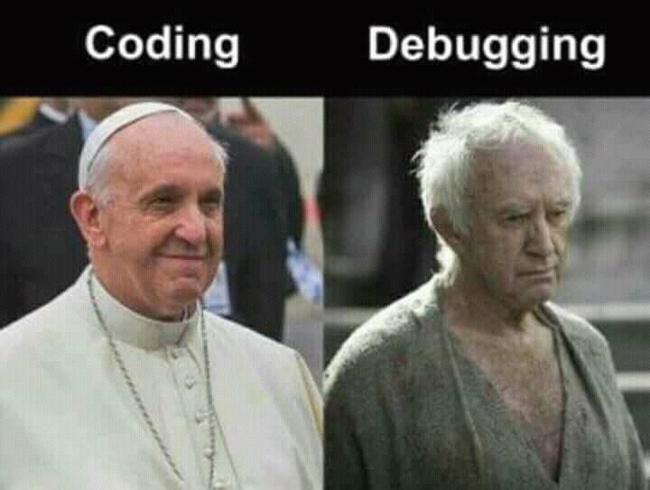
Dubugging is hard but nessesary

Slide 3




First step: Get a good enviroment
Notebooks considered mostly harmful
I know that iPython notebooks are popular and for good reason: It is easy to get started, and you don't have to worry about too much "system stuff". But eventually, the issues with notebooks outweigh the benefits. So, for you own sake: get a "real" editor and work on proper scripts.
Spyder
PyCharm
Visual Studio Code
Torchstudio
(in beta)

Slide 4
3 ways of debugging python code
Print statements in your code (yes, seriously):
print('x.shape = {}'.format(x.shape))
Stop at an interesting point in your code and interact with the code
from IPython import embed; embed()
... # do your stuff interactively here
exit() # exit ipython to let your code continue
Work in an actual debugger
import ipdb; ipdb.set_trace()
See details here: https://switowski.com/blog/ipython-debugging

Slide 5
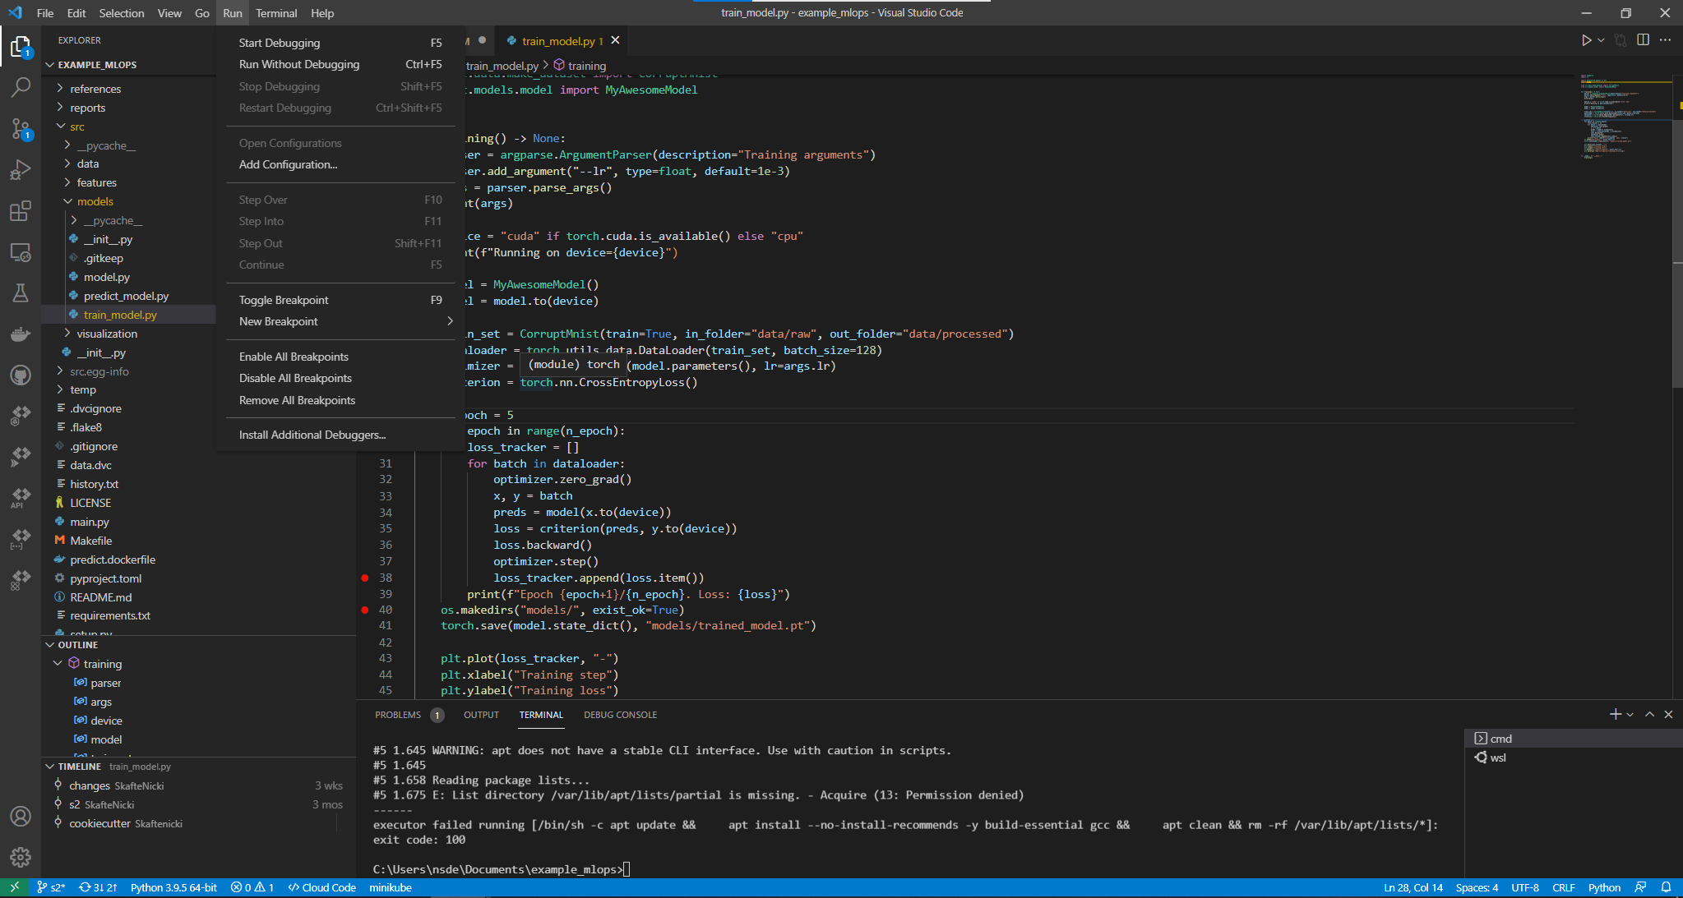
VS Code debugger (press F9)

Slide 6
When everything is running, but results are wrong
Debug the math!
Go through your code, and if you cannot do a one-to-one match between equations and particular lines of code, then rewrite the code (that will create good habits for you to follow).
Check dimensions!
The number one bug is that people get tensor dimensions wrong.
Solution: Annotate your code with comments about the shapes of all variables.
A = torch.randn(N, D) # NxD
x = torch.randn(D) # D
Ax = A.mv(x) # N

Slide 7
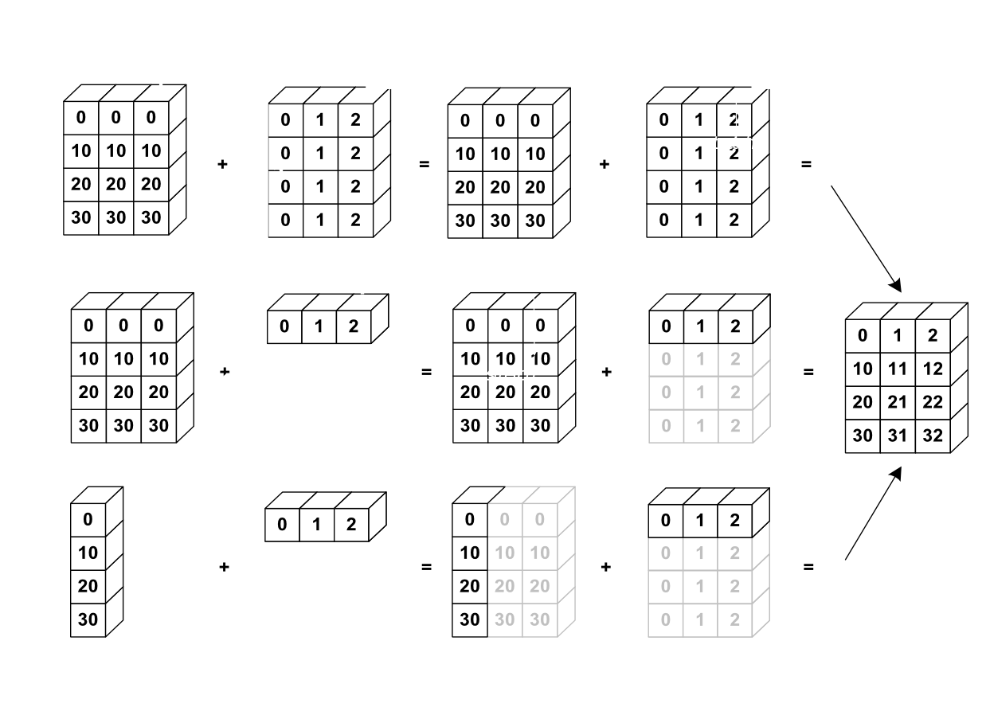
When everything is running, but results are wrong
Lookout for broadcasting!
Broadcasting is both a blessing and curse of python
It can create serious problems (real life example)
preds = torch.randn(100)
target = torch.randn(100,1)
loss = (target – preds).abs().pow(2.0).sum()
What is the problem here?

Slide 8
Software can help
You can go further and use ShapeGuard:
pip install torch-shapeguard
Then you can do
A.sg(N, D)
x.sg(D)
Ax.sg(N)
and your code will fail if dimensions aren't right. Quite neat!
See details here: https://github.com/rasmusbergpalm/shapeguard

Slide 9
Reduce Model Complexity
When things don't work, build a simpler model (ideally start with a simple model)
If you can, start with linear model. Here you often understand all aspects of the model. For instance, an autoencoder with a linear encoder and decoder should give you the same latent codes as PCA. Always, start with the settings where you can verify if your implementation does the right thing in non-trivial models, we don't know what the model should be doing, so debugging is difficult...

Slide 10
Plotting
Can you reduce data dimension (synthetically) ? That might allow you to plot stuff.
Can you reduce the number of model parameters? That might allow you to plot how the parameters evolve during training.
If you cannot reduce dimensions (are you sure?), then plot anyway. Beware of t-SNE and the likes: plots looks great but tend to be so misleading that you cannot learn from them.

Slide 11
Why do I get Nans?
An all too common issue we run into is that our code produces NaN. Generally speaking code produces NaNs if you multiply/divide by annoying combinations of Inf and 0.
Step 1: locate where that happens.
Often you cannot avoid these situations, and you should consider
working on a log-scale.
Step 2:
a = 1
for x in data:
a = a * x
log_a = 0
for x in data:
log_a = log_a + log(x)
Trade-off between precision and stability

Slide 12
Why is my loss wrong
Assuming that you model is training without errors, but loss is not behaving as it should:
Are you printing/logging the results correctly?
Did you forget either “loss.backward()”, “optimizer.step()” or “optimizer.zero_grad()”?
What about your learning rate and batch size?

Slide 13
Summary of debugging
Debug the math (check dimensions, redo derivations, ...)
Reduce model complexity (aim for a linear model)
Plan your next plot (keep plotting trustworthy)
Avoid NaNs on a log-scale

Slide 14
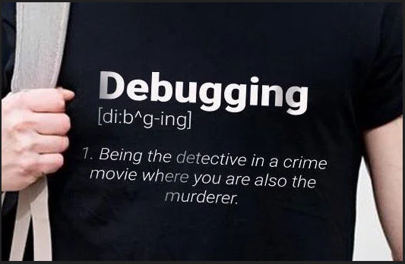
Meme of the day

