Slide 1


CMR TECHNICAL CAMPUS
UGC(Autonomous)
Kandlakoya , Medchal Road, Hyd-501401
Department of Computer Science and Engineering
Major Project Review: 02
PERFORMANCE ANALYSIS ON STUDENT FEEDBACK USING
MACHINE LEARNING ALGORITHMS
Batch No : 10
UNDER THE GUIDENCE OF: PRESENTED BY:
DR.G.MADHUKAR R.GAYATHRI :207R1A05N6
(Associate Professor) V.ARCHANA :207R1A05P4
K.DEEPESH :217R5A0524

Slide 2
Contents :
Abstract
Existing System
Disadvantages of Existing System
Proposed System
Advantages of Proposed System
Hardware and Software Requirements
Novelty of the Project
Architecture
Modules
UML Diagrams
Sample Code
Results
Conclusion
Future Scope
References

Slide 3
Abstract :
Student feedback plays a crucial role in understanding the effectiveness of teaching methodologies, course content, and institutional support. This study focuses on leveraging machine learning algorithms to perform a comprehensive performance analysis on student feedback data, aiming to extract valuable insights and improve educational outcomes.
The proposed methodology involves collecting and preprocessing student feedback data obtained through surveys or online platforms. Natural Language Processing (NLP) techniques are applied to convert the unstructured textual feedback into structured features that can be utilized by machine learning algorithms. Feature extraction involves sentiment analysis, topic modeling, and other relevant linguistic features to capture the nuances of student opinions.
Various machine learning algorithms, including but not limited to, Support Vector Machines, Random Forests,LSTM and Neural Networks, are employed to analyze the processed data. The algorithms are trained on historical feedback datasets to learn patterns and relationships between different feedback elements and overall performance indicators. The models are then validated and fine-tuned to ensure their effectiveness in predicting and understanding student sentiments.

Slide 4
Existing System :
In the given existing system of performance analysis on student feedback often relies on traditional methods, including manual evaluation and qualitative analysis. Educators typically collect feedback through surveys, interviews, or other feedback mechanisms. The data obtained is then manually categorized and analyzed, aiming to identify patterns and areas for improvement.
large volumes of feedback data is time-consuming. Educators and administrators may struggle to process the information efficiently, delaying the implementation of necessary improvements.
With the growing size of educational institutions and the increasing use of online platforms for feedback collection, manual analysis becomes impractical and often fails to scale effectively to handle large datasets.

Slide 5
Disadvantages of Existing System :
Insufficient Automation: The manual nature of the existing system lacks the automation required to efficiently process and analyze large volumes of student feedback data.
Limited Actionability: Manual analysis may result in insights that are not immediately actionable. The lack of real-time feedback analysis can delay the implementation of necessary improvements.
Risk of Oversight: Human evaluators may unintentionally overlook critical feedback elements, leading to a partial and potentially biased understanding of the overall educational experience.
Resource Intensive: The manual process demands significant human resources, both in terms of time and personnel, making it resource-intensive and potentially expensive.
Static Analysis: The existing system tends to provide static insights, often missing the dynamic nature of student sentiments and educational needs that can change over time.

Slide 6
Proposed System :
In the Proposed System The data is collected from the students in the form of the feedback of the college. The feedback consists of the textual reviews. Then the data pre-processing is done on the data that is collected. Datasets are of two types’ linear dataset and non-linear dataset.
The linear dataset is the one which is having equal properties whereas the non-linear dataset is the one which is having non-equal properties. Machine learning works well for linear datasets. The datasets contain reviews made by students.
Various machine learning algorithms such as Support Vector Machines, LSTM Random Forests, or Neural Networks are employed for the analysis. These models are trained on historical feedback datasets to learn patterns and relationships between different features and overall performance indicators.
In the process it combines the power of machine learning algorithms with advanced analytics to provide actionable insights for educators and administrators. By automating sentiment analysis, incorporating predictive modeling, and allowing for customization, the system contributes to a more data-driven and proactive approach to enhancing the quality of education based on student feedback.

Slide 7
Advantages of proposed system :
exploring the factors affecting students’ academic performance and using this information to develop a robust prediction model with high accuracy.
taking advantage of the prediction model to deliver personalize services that potentially enable students to drive behavioral change and optimize their study-life balance.
Scalability and Efficiency
Real-Time Feedback Analysis

Slide 8
Hardware and Software requirements :
Hardware requirements :
Processor : 11th Gen Intel(R) Core(TM) i3-1115G4
RAM : 4 GB (min)
Hard Disk : 20 GB
Software requirements :
Coding Language : Python.
Front-End : Python.
Back-End : MY SQL ,
Framework : Django Framework
Designing : Html, css, javascript

Slide 9
Novelty of Project :
Automation and Efficiency
Real-Time Insights
Ethical Considerations and Fairness
Predictive Modeling
Customization and Contextualization

Slide 10
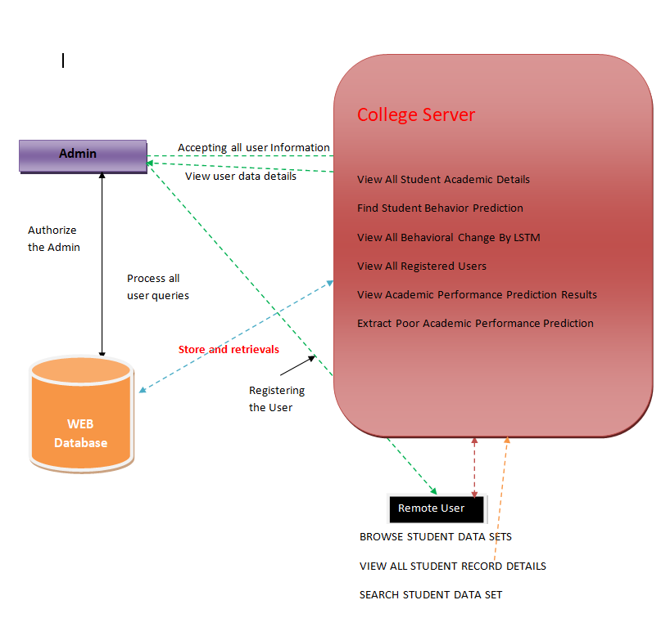
Architecture

Slide 11
Modules:
Service Provider : In this module, the Admin has to login by using valid user name and password. After login successful he can perform some operations such as View All Student Academic Details, Find Student Behavior Prediction, View All Behavioral Change By LSTM View All Registered users, View Academic Performance Prediction Results, Extract Poor Academic Performance Prediction.
Viewing and Authorizing Users: In this module, the provider views all users details and authorize them for login permission. User Details such as User Name, Address, Email Id and Mobile Number.
User: In this module, there are n numbers of users are present. User should register before performing any operations. Once user registers, their details will be stored to the database
Viewing Profile Details: In this module, the user can see their own profile details, such as their address, email, mobile number, profile Image.

Slide 12
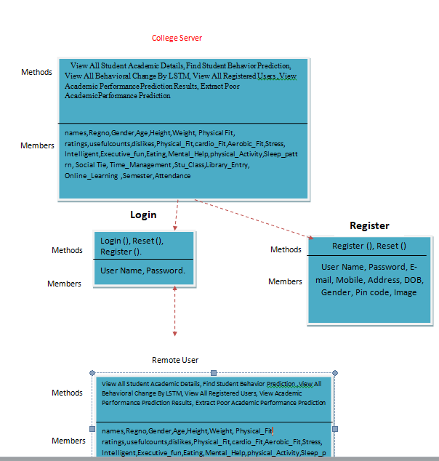
UML Diagrams:
Class Diagram

Slide 13
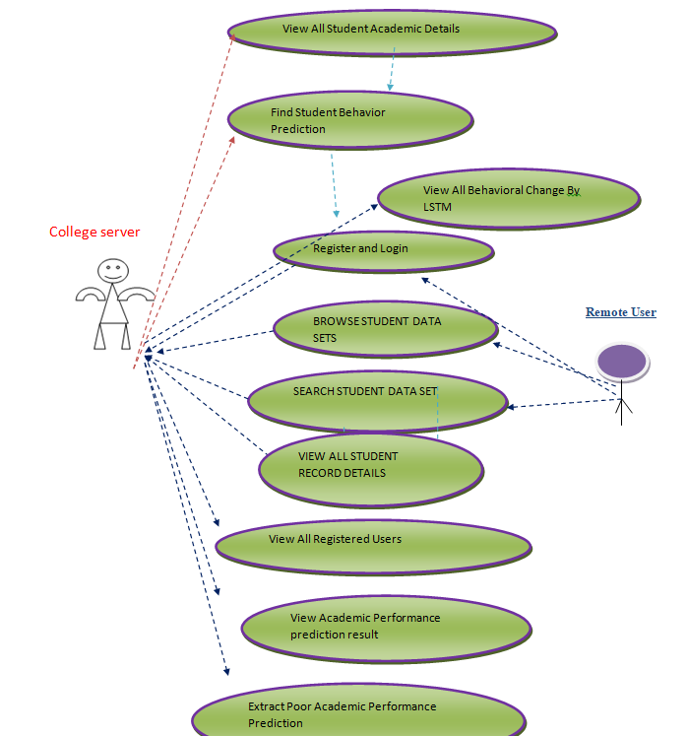
Usecase Diagram

Slide 14
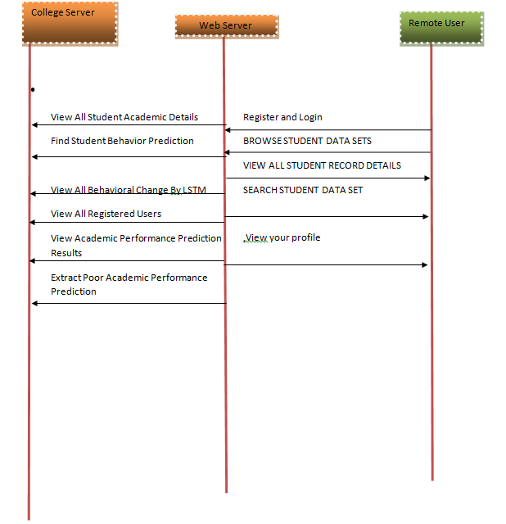
Sequence Diagram

Slide 15
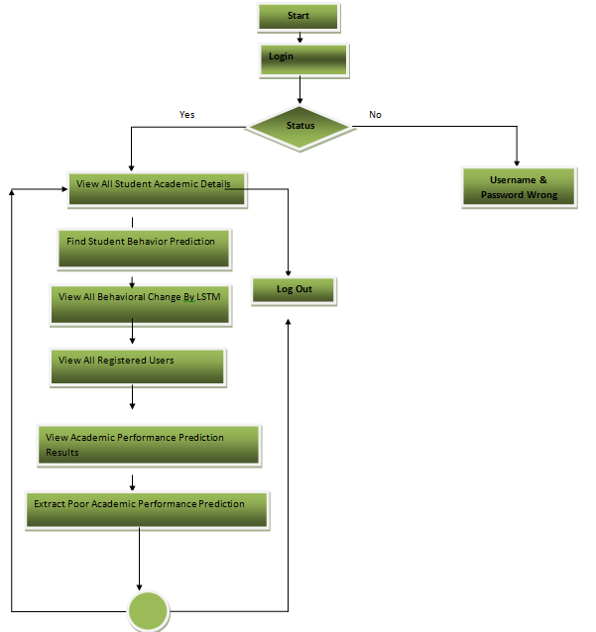
Activity Diagram

Slide 16
Sample Code
From django.db.models import Count
from django.shortcuts import render, redirect, get_object_or_404
import datetime
import openpyxl
from django.db.models import Q
# Create your views here.
from Remote_User.models import ClientRegister_Model,Clientreadings_Model,studentdata_Model
def login(request):
if request.method == "POST" and 'submit1' in request.POST:
username = request.POST.get('username')
password = request.POST.get('password')
try:

Slide 17
try:
enter = ClientRegister_Model.objects.get(username=username, password=password)
request.session["userid"] = enter.id
return redirect('Add_Data_Sets')
except:
pass
return render(request,'RUser/login.html')
def Register1(request):
if request.method == "POST":
username = request.POST.get('username')
email = request.POST.get('email')
password = request.POST.get('password')
phoneno = request.POST.get('phoneno')

Slide 18
def ViewYourProfile(request):
userid = request.session['userid']
obj = ClientRegister_Model.objects.get(id= userid)
return render(request,'RUser/ViewYourProfile.html',{'object':obj})
def Add_Data_Sets(request):
if "GET" == request.method:
return render(request, 'RUser/Add_Data_Sets.html', {})
else:
excel_file = request.FILES["excel_file"]
# you may put validations here to check extension or file size
wb = openpyxl.load_workbook(excel_file)
# getting all sheets

Slide 19
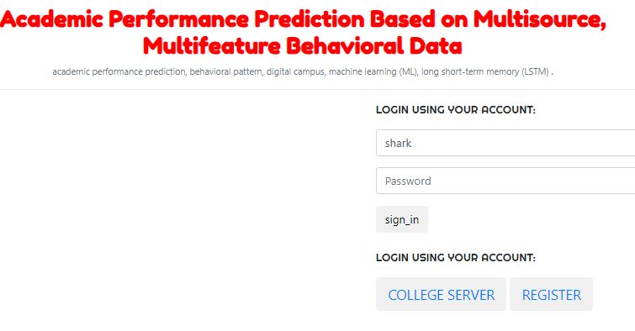
Results
In the above screen we have to sign in as user if you already had a account ,or else we have to register as a new user. after we sucessfully registered then sign in with your username and password where we browse the dataset and perform the user actions on it.

Slide 20
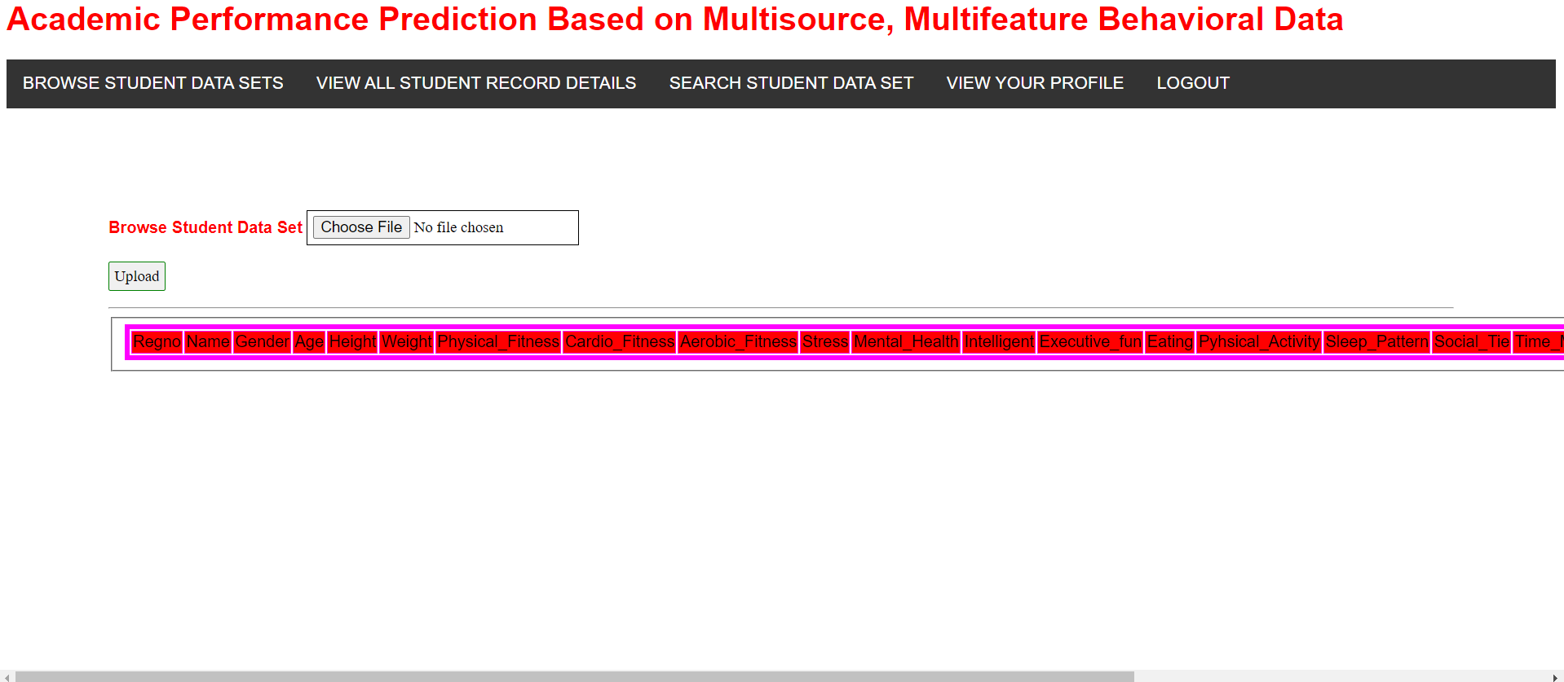
In the above screen after login as user we should upload the dataset through which performance can be analysis by browsing the student dataset.

Slide 21
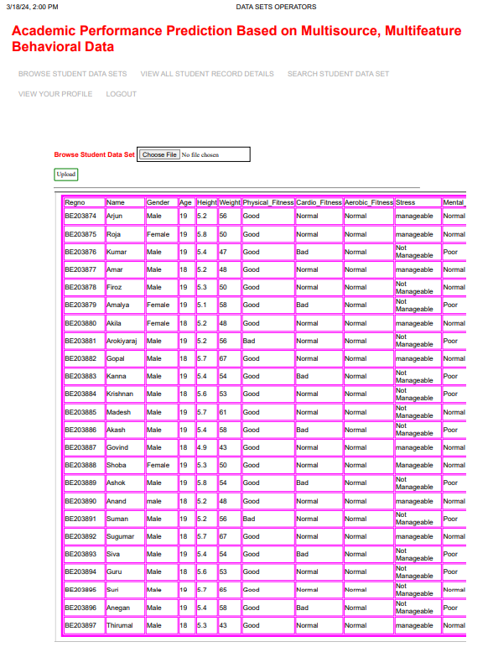
After uploading dataset of student we view the all student record details

Slide 22
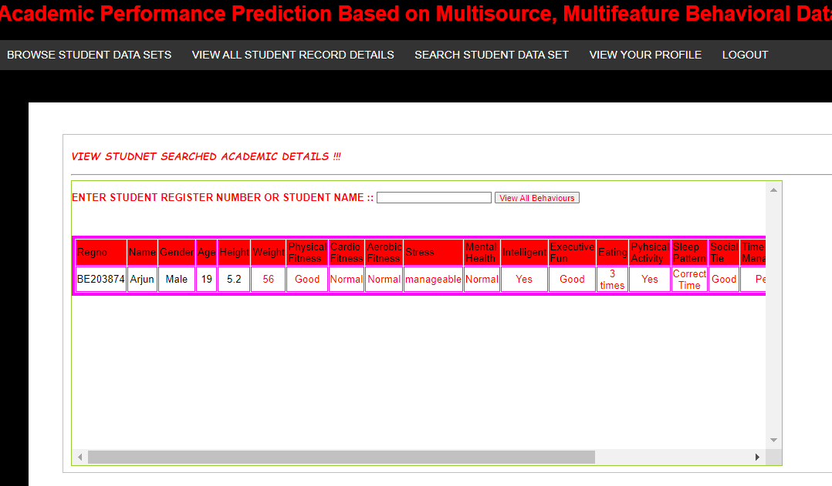
In the above screen we can see the particular student behaviour through there register number or student name.

Slide 23
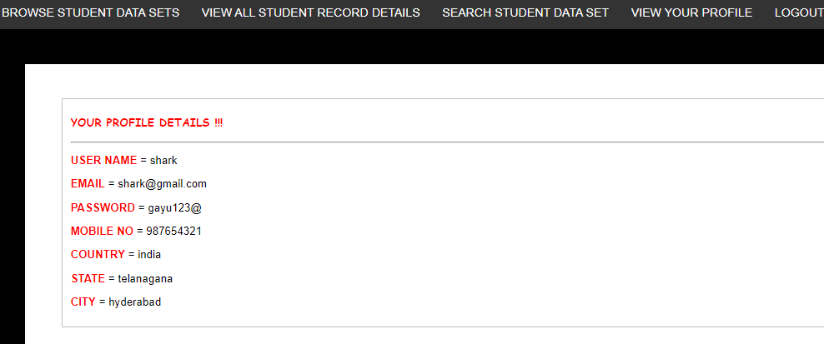
In the sreen we can view your profile through which you have sign as user.

Slide 24
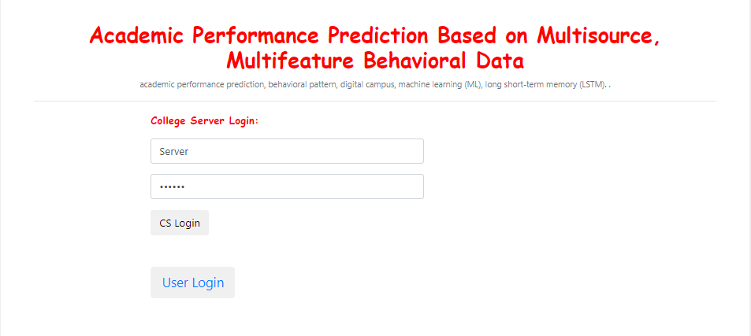
In the above screen after user feedback we login to the college server to analyze the performance of student by using machine learning algorithm.

Slide 25
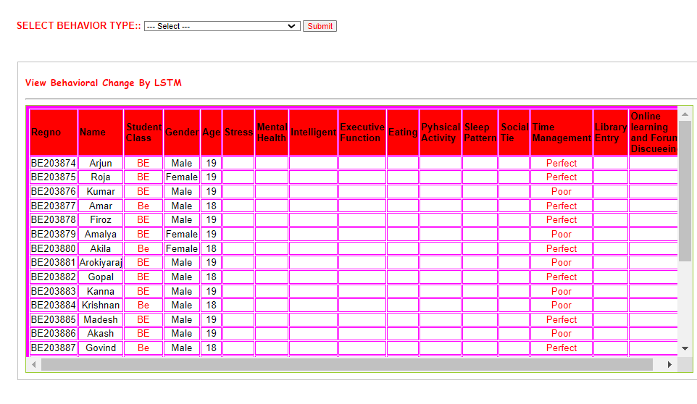
In the above screen we observe the behavioral change by Lstm of each student

Slide 26
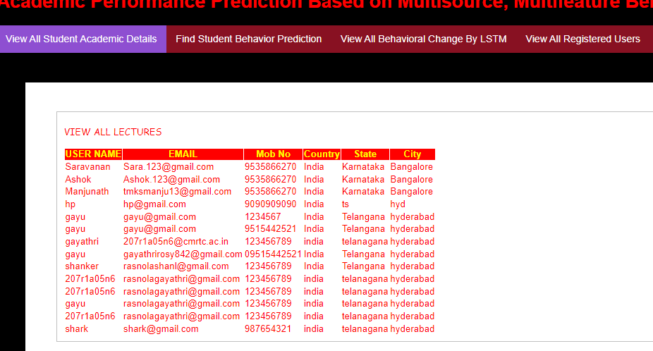
From the above screen we observe the all registered users

Slide 27
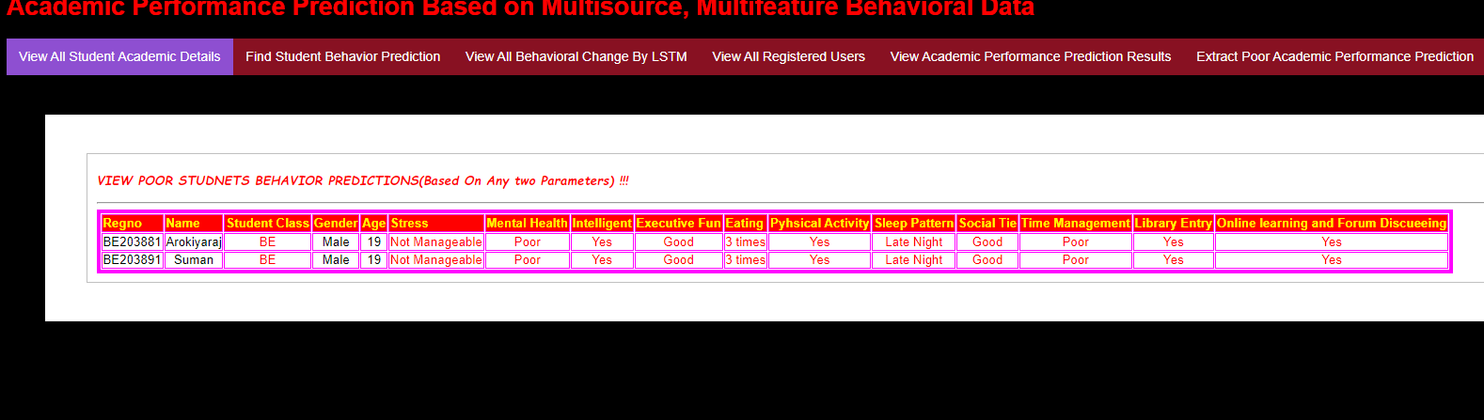
In the college server webpage we can observe the poor acadamic performance from the trained dataset of student

Slide 28
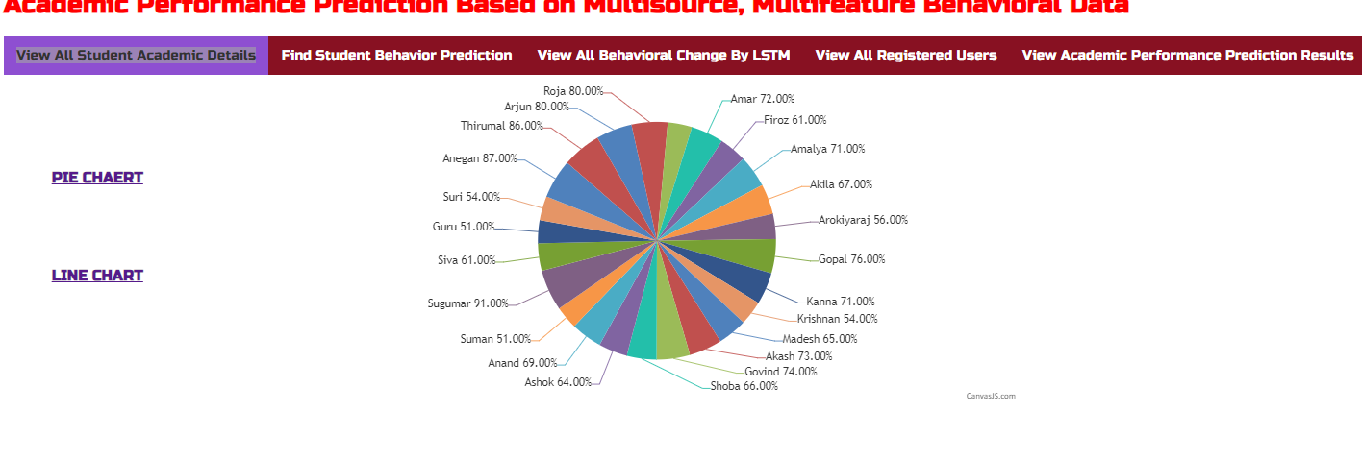
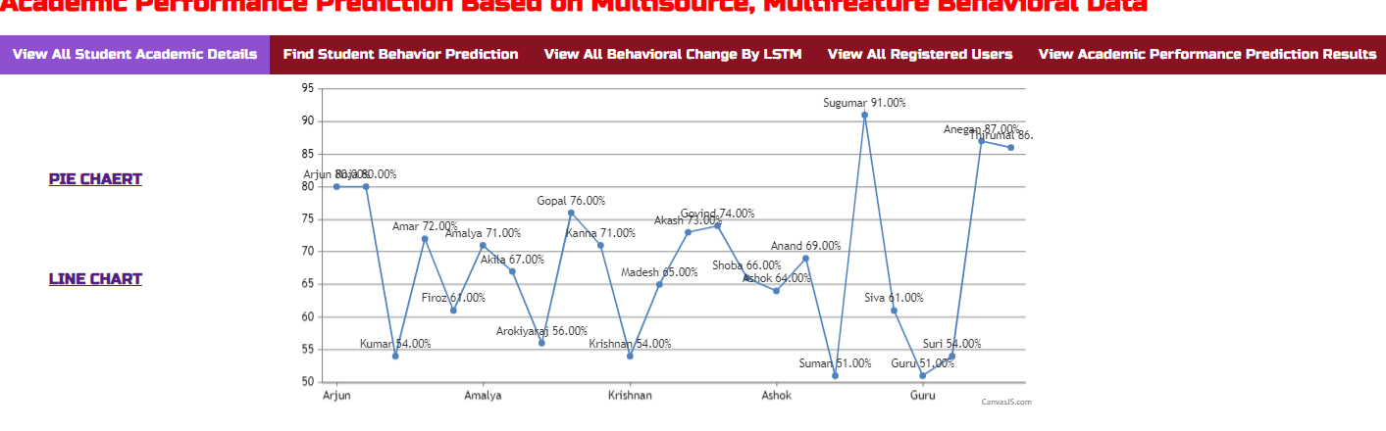
We observe in figures over all performances of the student during the Acadamic year

Slide 29
Conclusion :
we conclude the proposed system for Performance Analysis on Student Feedback using Machine Learning Algorithms represents a significant advancement in the field of educational evaluation. The innovative features and capabilities of this system address critical limitations associated with traditional manual analysis methods. The integration of machine learning algorithms introduces automation, scalability, and predictive modeling, transforming the way educational institutions interpret and act upon student feedback.
It not only addresses the limitations of existing methods but also introduces a transformative approach to performance analysis on student feedback. By harnessing the power of machine learning, this system empowers educational institutions to make data-driven decisions, enhance the learning experience, and continuously improve the quality of education provided to students.

Slide 30
Future Scope:
Using machine learning algorithms to analyze student feedback for performance evaluation and answer generation holds significant future potential in several areas:
Personalized Learning: ML algorithms can analyze feedback to understand individual student needs and preferences, enabling personalized learning experiences tailored to each student's requirements.
Predictive Analytics: By analyzing historical feedback data, machine learning models can predict future trends in student performance and provide insights into areas where improvement is needed.
Automated Answer Generation: Natural Language Processing (NLP) techniques combined with machine learning can be used to automatically generate answers to common student queries based on historical feedback data and course material.
Feedback Analysis: Machine learning algorithms can help educators quickly and accurately analyze large volumes of student feedback to identify trends, issues, and areas of improvement in course content, teaching methods, or curriculum design.
Early Intervention: ML models can detect early signs of struggling students based on their feedback patterns, enabling educators to intervene proactively and provide necessary support to prevent academic setbacks.

Slide 31
References:
A. Furnham, and J. Monsen, “Personality traits and intelligence predict academic school grades," Learning and Individual Differences,vol. 19, no. 1, pp. 0-33, 2009.
M. A. Conard, “Aptitude is not enough: How personality and behavior predict academic performance,” Journal of Research in Personality,
vol. 40, no. 3, pp. 339-346, 2006.
T. Chamorropremuzic, and A. Furnham, “Personality predicts academic performance: Evidence from two longitudinal university
samples,” Journal of Research in Personality, vol. 37, no. 4, pp. 319-338, 2003.
R. Langford, C. P. Bonell, H. E. Jones, T. Pouliou, S. M. Murphy, and E. Waters, “The WHO health promoting school framework for improving the health and well‐being of students and their academic achievement,” Cochrane Database of Systematic Reviews, vol. 4, no. 4, pp. CD008958, 2014.

Slide 32
THANK YOU.

