Slide 1
Enhancing HiC data resolution with CNN
Behnam Rasoolian
Liangliang Xu
Zheng Zhang

Slide 2
Background
Spatial conformation of chromosomes is VERY important!!!
3D positioning of genes determines how the cell functions
Gene interaction creates protein that regulates tasks

Slide 3
Background
Spatial conformation of chromosomes is VERY important!!!
3D positioning of genes determines how the cell functions
Gene interaction creates protein that regulates tasks
Methods:
- Traditional Microscopy ×
- Hi-C √

Slide 4
What is Hi-C?
High-throughput Chromosome Conformation Capture
Methodology
1. Divides a chromosome into very small equally sized sections (loci)
2. Measures pair-wise interaction frequencies across chromosome
Visualization
A N × N contact matrix

Slide 5
An Example

Slide 6
An Example
Number of loci
Number of loci

Slide 7

An Example
Each pixel indicates the number of iterations found between a pair of loci corresponding to the rows and columns.

Slide 8
What is Hi-C?
High-throughput Chromosome Conformation Capture
Methodology
1. Divides a chromosome into very small equally sized sections (loci)
2. Measures pair-wise interaction frequencies across chromosome
Visualization
A N × N contact matrix
Resolution : The size of loci the genome is divided into (1K to 1M)

Slide 9
Why use CNN
Unraveling mysteries of cell function requires more high resolution data
However, the sequencing process is costly.
- Linear increase of resolution requires quadratic increase in sequencing reads
A computational method is needed

Slide 10
Model Overview
Purpose:
- Create a CNN model that constructs high resolution contact matrix based on low resolution data
Idea:
- High resolution matrix can be predicted from its surrounding neighborhood in low resolution matrix
- “patch” to “patch” prediction

Slide 11
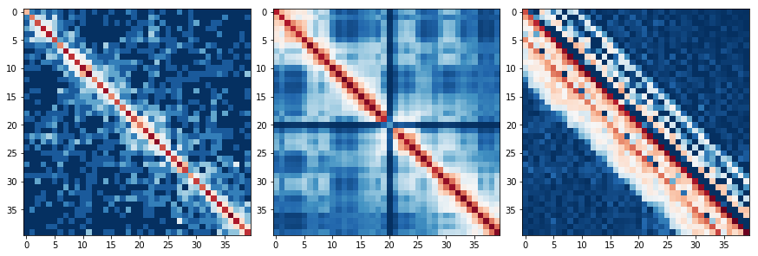
Model Overview
Low resolution High resolution

Slide 12
Model Overview
predict
Low resolution High resolution

Slide 13
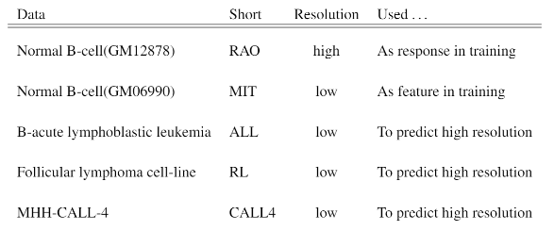
Data
Contact matrices of 4 different cells, one of which have both low and high resolution

Slide 14
Construction method
Feature : 40 × 40. Response: 784 (28 × 28)
Divided both matrices into patches of size 40 × 40

Slide 15
Construction method
Input : 40 × 40. Response: 784 (28 × 28)
Divided both matrices into patches of size 40 × 40
3 convolutional layers
No pooling. No padding. Stride 1
Relu

Slide 16
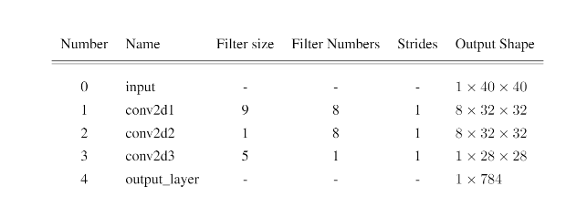
Construction method

Slide 17
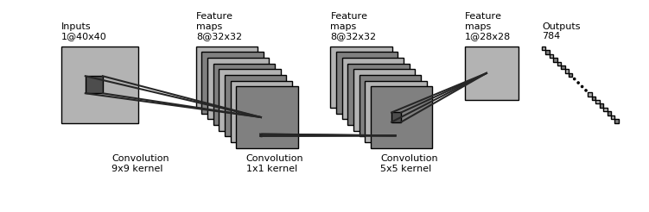
Construction method

Slide 18
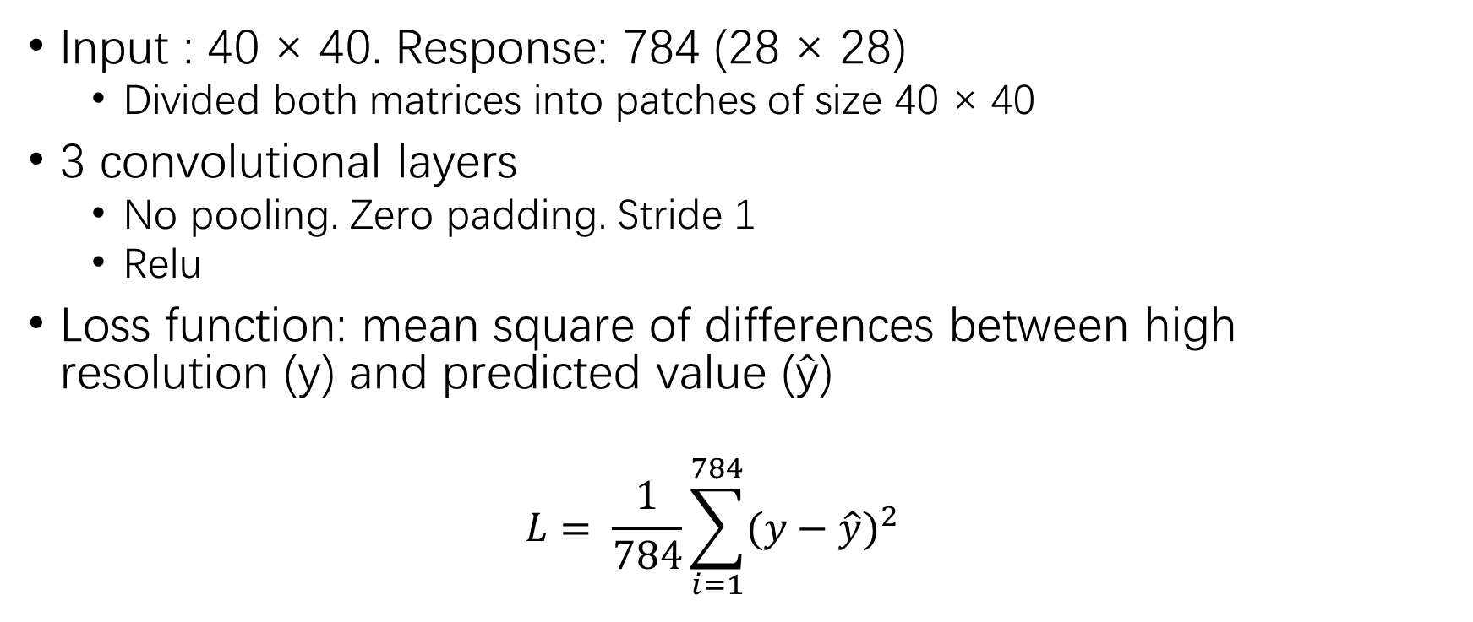
Construction method
Input : 40 × 40. Response: 784 (28 × 28)
Divided both matrices into patches of size 40 × 40
3 convolutional layers
No pooling. Zero padding. Stride 1
Relu
Loss function: mean square of differences between high resolution (y) and predicted value (ŷ)
$$L= \frac{1}{784}\sum_{i=1}^{784}{{(y−\hat{y})}^{2}}$$

Slide 19
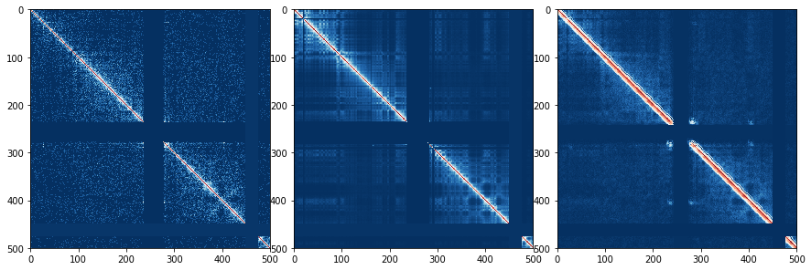
Training Result
Low resolution
High resolution
Predicted

Slide 20
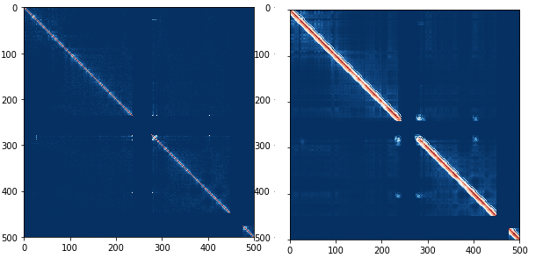
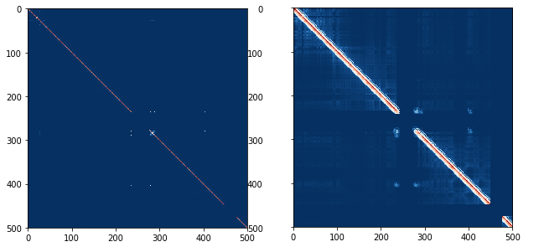
Enhancing HiC

Slide 21
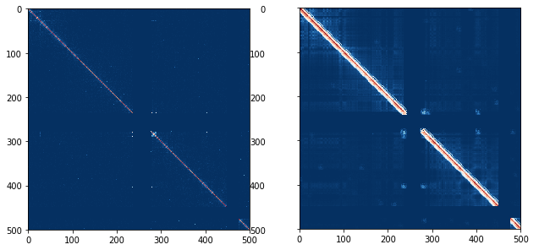
Enhancing HiC

Slide 22
Conclusion
CNN improves the resolution of HiC contact maps
This is the first phase in the process of comparing 3D structures of malignant cell with normal cells

Slide 23
Reference
Z. Wang, R. Cao, K. Taylor, A. Briley, C. Caldwell, and J. Cheng. The properties of genome conformation and spatial gene interaction and regulation networks of normal and malignant human cell types. PloS one, 8(3):e58793, 2013. 1, 2 E
. Lieberman-Aiden, N. L. Van Berkum, L. Williams, M. Imakaev, T. Ragoczy, A. Telling, I. Amit, B. R. Lajoie, P. J. Sabo, M. O. Dorschner, et al. Comprehensive mapping of long-range interactions reveals folding principles of the human genome. science, 326(5950):289–293, 2009. 1, 2
Y. Zhang, L. An, J. Xu, B. Zhang, W. J. Zheng, M. Hu, J. Tang, and F. Yue. Enhancing hi-c data resolution with deep convolutional neural network hicplus. Nature communications, 9(1):750, 2018. 2, 6
S. Feizi, D. Marbach, M. Médard, and M. Kellis. Network deconvolution as a general method to distinguish direct dependencies in networks. Nature biotechnology, 31(8):726–733, 2013. 6

Slide 24
Resources
Source code for the project: https://github.com/rasoolianbehnam/watson/tree/master/HiCPlus
Link to the low-resolution Hi-C datasets: http://sysbio.rnet.missouri.edu/T0510/tmp_download/link_to_download_genome_ data/contact_file/ Link to high-resolution Hi-C
dataset: https://www.ncbi.nlm.nih.gov/geo/query/acc.cgi?acc=GSE63525

