Slide 1


API & UI Automation Framework Task Assignment Submission
Rasool Mohammed
01-Nov-2021

Slide 2
About Framework
Current implementation of framework is a type of Hybrid Automation framework.
Behaviour driven Development
Modular Based Testing
Data Driven
HYBRID AUTOMATION FRAMEWORK

Slide 3
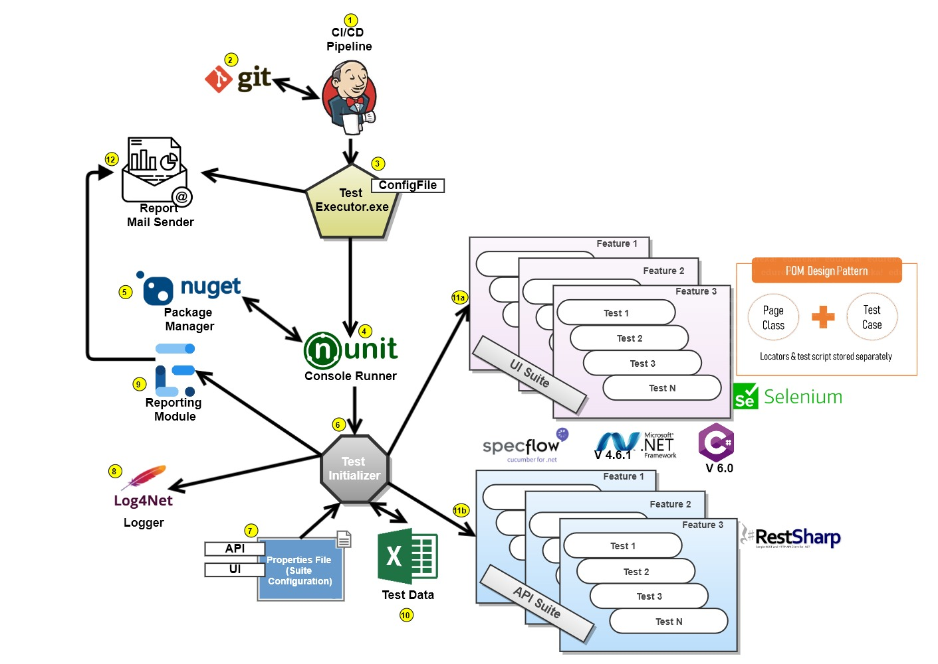
F
R
A
M
E
W
O
R
K
A
R
C
H
I
T
E
C
T
U
R
E
HYBRID AUTOMATION FRAMEWORK

Slide 4
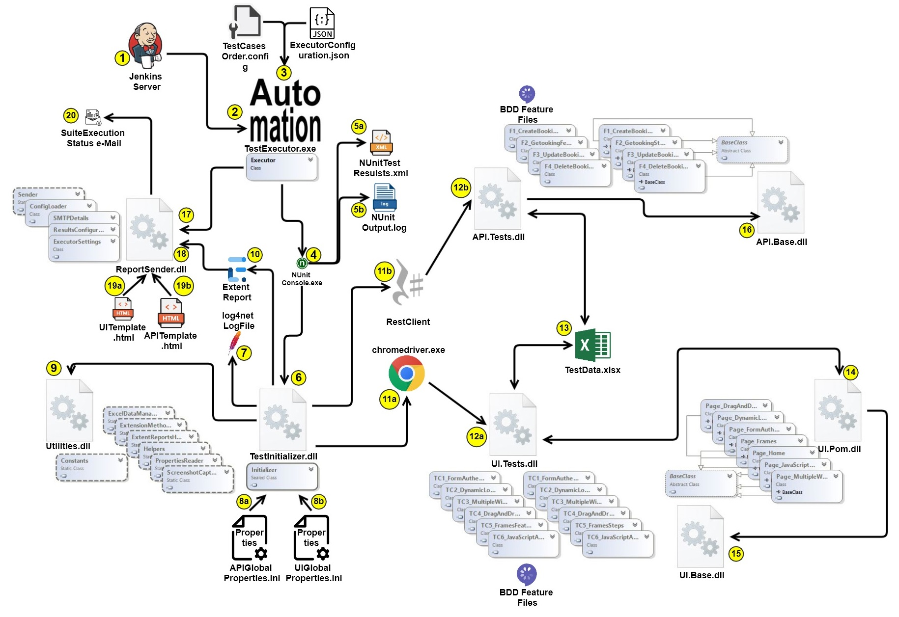
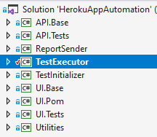
COMPONENT
DIAGRAM
HYBRID AUTOMATION FRAMEWORK

Slide 5
Work Completed
Setting up Framework.
Reporting Module
Logger Module
Feature File Implementation
Exception Handling
Test Assertions
Screenshot capture
API Automation Testcases
TC 1 | CreateBooking Positive Scenario | Completed
TC 2 | Create Booking Negative Null Check | Completed
TC 3 | Create Booking Negative Invalid Date | Completed
TC 4 | Get Booking Positive Scenario | Completed
TC 5 | Get Booking Negative Invalid Date | Completed
TC 6 | Update Booking Positive Scenario | Completed
TC 7 | Update Booking Negative Invalid Date | Completed
TC 8 | Delete Booking Positive Scenario | Completed
TC 9 | Delete Booking Negative InvalidID | Completed
TC 10 | Delete Booking Negative Invalid Token | Completed
UI Automation Testcases
TC 1 TC 2 TC 3 TC 4 TC 5 TC 6 | Form Authentication Dynamic Loading Multiple Windows Drag n Drop Frames Javascript Alerts | Completed Completed Completed Completed Completed Completed
Source Code : https://github.com/rasoolmohammedy/internetherokuapp

Slide 6
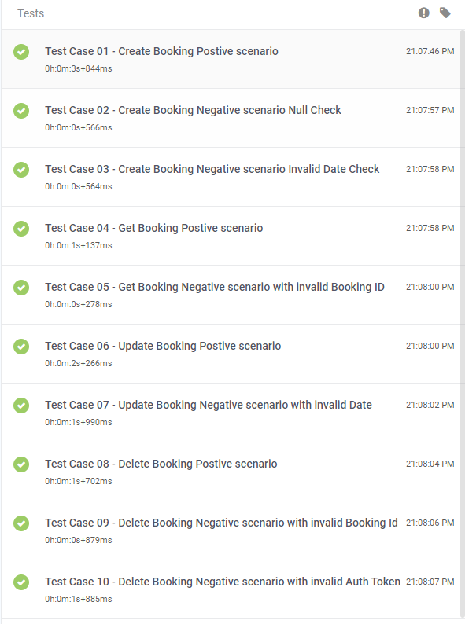
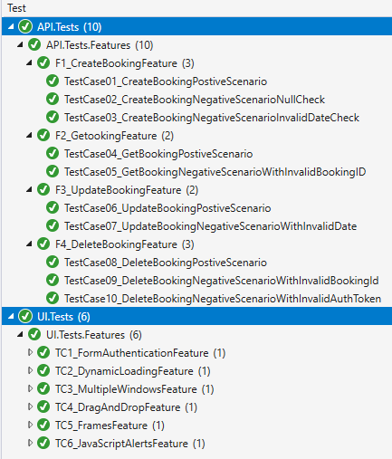
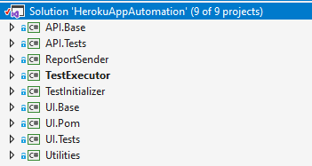
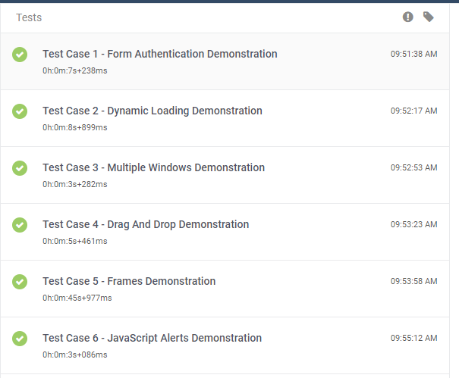
Artifacts
API Automation Execution Report
UI Automation Execution Report
Test Suite Execution Video Recording Link: https://youtu.be/PPhemafx0kg

