Slide 1
ARMENIA
The Yerevan Housing Market
Prices, Rents, Short-Term Rentals, and the Neighborhood Map
Working draft, September 2026

Slide 2
1. A policy- and migration-fueled boom, now past its peak
House prices rose about 11 percent per year in 2022 to 2024 (IMF), far more in U.S. dollar terms: the dram strengthened from 480 to about 365 per dollar.
Three demand shocks: about 110,000 Russians relocated in 2022 (60,000 to 65,000 stayed, mostly Yerevan); 100,000+ Nagorno-Karabakh refugees from late 2023; foreign and diaspora buying at a 3-year high (2,014 purchases in 2025, +27 percent).
One large subsidy underneath: the mortgage income-tax refund program, costing 0.7 percent of GDP in 2024, expired in Yerevan on January 1, 2025.
2025: Yerevan apartment prices flat (+0.3 percent), center down 1 to 2 percent, while regions rose 16 percent and houses 17 to 27 percent.
Q2 2026: growth resumed, 1 to 1.5 percent per month (Central Bank of Armenia).
2

Slide 3
2. Macro backdrop: consensus growth of 5.3 to 5.7 percent for 2026-27
Real GDP: +12.6 percent (2022), +8.3 (2023), +5.9 (2024), +7.2 (2025); H1 2026 activity +7.7 percent.
Projections converge: IMF 5.3/5.5, World Bank 5.3/5.1, EBRD 5.5/5.5, ADB 5.5/5.7, government 5.4; IMF potential-growth estimate raised from 4.5 to about 5 percent.
Inflation back at 4 to 5 percent against a 3 percent target; policy rate on hold at 6.50 percent; dram mortgage rates near 12.5 percent, cash buyers advantaged.
External soft spot: current account deficit near 6 to 7 percent of GDP; FDI at a historic low; but record reserves (US$5.7 to 6.9 billion) and a firm dram.
Fiscal solid: deficits under 4 percent of GDP, debt near 50 percent, defense cut 15 percent post-peace; Fitch, Moody's, and S&P all on Positive outlook (mid-2026).
Key risk overlap: Russia is about two-fifths of trade and tourists, two-thirds of transfers. Macro risk and housing risk are the same bet.
3

Slide 4
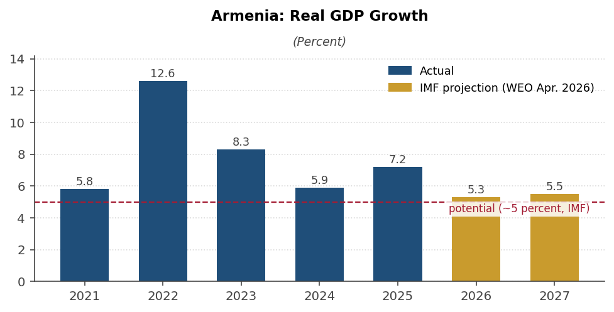
Figure 1. Armenia real GDP growth, actual and projected
Real GDP growth, 2021 to 2027, with IMF projections and estimated potential.
Sources: Armstat; IMF World Economic Outlook (April 2026); staff calculations.
4

Slide 5
3. Prices: a decade of quiet, then boom, pause, and re-acceleration
Cadastre Yerevan average: AMD 268,000 per sq m (2013); 330,000 to 350,000 (2020-21); +14 percent in 2022; AMD 426,800 (+8.8 percent) in 2024; flat in 2025.
The 2024 surge was a policy artifact: buyers rushed to lock in the expiring tax credit. Yerevan transactions +32 percent, mortgage growth peaked at 37 percent.
July 2025: first year-on-year price decline in 50 months (IMF). 2025 transactions still a record: 59,748 purchase-sales nationwide.
June 2026 levels: Kentron about US$2,500 per sq m (secondary), Arabkir US$1,830, mid-ring US$1,200 to 1,450, Nubarashen US$700.
New-build asking materially higher: Kentron minimum-asking average AMD 1,293,000 (about US$3,360); elite projects quote US$5,000 to 10,000.
Valuation estimates: IMF 8 to 25 percent overvalued (2023); CBA 16 to 25 percent above fundamentals (2022-23). Neither has been worked off.
5

Slide 6
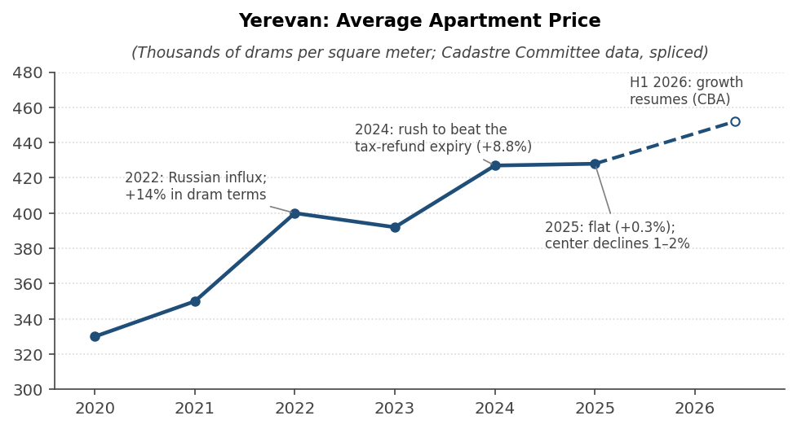
Figure 2. Yerevan average apartment price
Average apartment price, thousands of drams per square meter, 2020 to 2026.
Sources: State Real Estate Cadastre Committee via press republications; Central Bank of Armenia.
6

Slide 7
4. The tax-refund program: the boom's policy engine, now unwinding
Since 2015: salary income tax refundable against mortgage interest on new-build purchases from developers; cumulative refunds AMD 299 billion to 70,000+ beneficiaries.
Phase-out by geography: central Yerevan 2022-23, all Yerevan from January 1, 2025; four regions ringing the capital lose it January 1, 2027; nationwide end 2029.
Footprints in every series: the 2024 rush, the 2025 Yerevan stall, mortgage growth 37 to 13 percent, the 16 percent regional price surge.
Construction pipeline collapsed in Kentron and Arabkir after eligibility ended there: a medium-term scarcity argument for quality central stock.
Watch late 2026: possible anticipatory buying in the four regions before the 2027 cutoff (Grant Thornton).
7

Slide 8
5. The neighborhood map: a stable hierarchy, moving at the edges
Hierarchy stable for a decade: Kentron at 2.1 to 2.3 times the city average, Arabkir 1.5x, Nubarashen 0.55x.
Kentron: liquidity, prestige, short-term-rental demand; only district with 2025 price declines; elite US$3,000+ segment carries absorption risk.
Arabkir and satellites (Kanaker-Zeytun, Davtashen): best reported yields, 8 to 10 percent gross; steadier local demand.
Momentum in the mid-ring: Ajapnyak +13.7 percent in 2025; Shengavit's Arshakunyats corridor has the widest new-build vs. secondary gap outside Kentron.
Demand sweet spot: 50 to 75 sq m units in new or renovated buildings.
Screening criterion, not a detail: 45 percent of Yerevan buildings rated highly earthquake-susceptible; about 5 percent retrofitted.
8

Slide 9
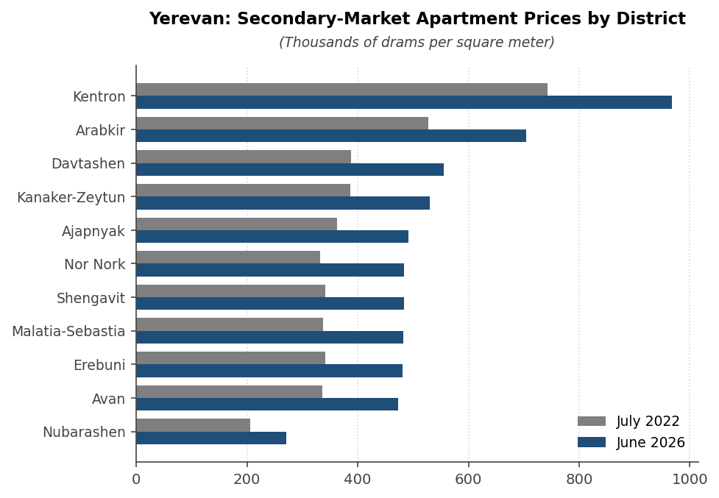
Figure 3. District prices, July 2022 vs. June 2026
Secondary-market apartment prices by district, thousands of drams per square meter.
Sources: official statistics via news.am (2022) and b24.am (2026).
9

Slide 10
6. Named neighborhoods: where growth is concentrating
Halabyan-Abelyan / Norashen (Ajapnyak): metro station #11 with a 152 m gorge bridge (design done, investment-committee approval Jul 2026, no contractor yet) plus the TUMO engineering campus; new-builds US$850 to 1,630 per sq m; the district led 2025 at +13.7 percent. Best catalyst-per-dollar in the city.
Rubinyants / Paruyr Sevak / Gogol cluster (Kanaker-Zeytun): 10+ active projects at US$1,280 to 1,850; Arabkir spillover and the tech corridor. The "Arabkir at a discount" play.
Noragyugh fringe (Kentron, gorge edge): "Yerevan Downtown" approved Jan 2026 (81 ha, about 155 buildings incl. 70-storey towers, acquisitions at market +30 percent) but no financing signed. Buy adjacent streets outside the acquisition zone for optionality.
Davtashen / Pirumyanner: fifth Hrazdan bridge and Babajanyan-Ashtarak road near completion; US$1,470 to 2,180; the lower-beta family compounder.
Already priced: Arshakunyats corridor (Shengavit) new-builds at US$1,650 to 2,310, the dearest outside the center while its secondary market dipped in 2025; Dalma/Tsitsernakaberd mid-late premium; Firdus finished at up to US$5,000 per sq m.
10

Slide 11
7. Gentrification watchlist: the rule is groundbreaking, not announcement
Yerevan does not gentrify organically: appreciation follows government mega-decisions (metro decrees, redevelopment programs, campus projects) - which makes the watchlist trackable by named milestones.
Every headline catalyst is approved but unfunded or unbuilt as of mid-2026: the Ajapnyak metro has no contractor, Yerevan Downtown no financing, Kond no action plan, and the Academic City (700 ha, 16 universities, first students 2030) a timeline analysts doubt.
Pre-gentrification, speculative: Kond (state concept presented Jun 2026; informal house market, title risk); Sari Tagh / Nor Aresh (Erebuni; metro #12 "Surmalu" still at design stage); 17th Quarter / Silikyan (Academic City zone; land play, not apartments).
Cheap but unproven momentum: Nor Nork upper massivs (US$1,100 to 1,880, cheapest new-build district); Avan / Acharyan cluster (entry tickets near AMD 16 million; Kotayk next door had +49 percent transactions in 2025).
Milestones to monitor: Ajapnyak metro contractor selection; Yerevan Downtown financing agreement; Kond action plan; Academic City groundbreaking; Isakov-Arshakunyats road completion.
11

Slide 12
8. Rents: spike, correction, settled well above pre-war
2022: rents doubled to tripled within months of the Russian influx; central 2-3 room units went from AMD 140,000 to 180,000 to peaks of 400,000 to 500,000.
2023-24: roughly 30 to 40 percent correction as relocants departed; Karabakh refugees offset at far lower purchasing power.
Now: central one-bedroom US$550 to 850; most-demanded bracket US$300 to 500; tenant shortage in the US$1,000+ premium tier; rental transactions -28.6 percent in 2025.
Rents settled 50 to 80 percent above pre-war; realtors' consensus is they will not return to 2021 levels.
Gross yields: 5.5 to 7 percent in the center, 7 to 10 percent in Arabkir and the mid-ring; net about 1.5 to 2 points lower.
CBA governor: price-to-rent ratio rising, investment attractiveness declining.
12

Slide 13
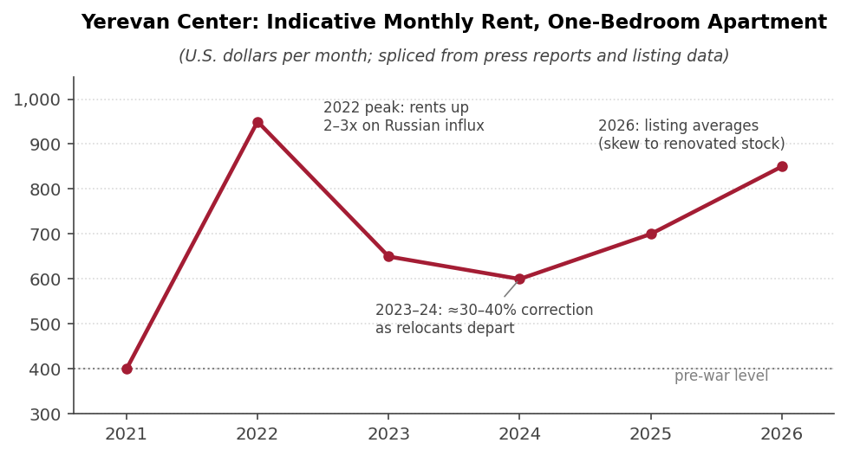
Figure 4. Central Yerevan one-bedroom rent
Indicative monthly rent, U.S. dollars, 2021 to 2026.
Sources: CivilNet; JAMnews; Mirror-Spectator; Numbeo; staff splicing.
13

Slide 14
9. Short-term rentals: workable economics, compounding supply
Market size: 2,400 to 6,000 active listings depending on provider definitions; supply growing 14 to 34 percent per year; only 0.2 percent professionally managed.
Economics: ADR US$60 to 76; realistic occupancy 50 to 65 percent; a well-run central one-bedroom grosses US$10,000 to 15,000 per year.
Thin premium over long-term letting once cleaning, fees, management, and voids are deducted; real mainly for Kentron units in the May to September window.
Demand has plateaued: tourist arrivals flat at 2.2 to 2.4 million since 2023, Russian share falling; supply growth exceeds demand growth.
Tax and regulation light: flat 10 percent on gross rent either mode; no STR permit; the 2026 notification system exempts individuals letting one apartment.
14

Slide 15
10. What the specialists say
IMF: overvaluation 8 to 25 percent (2023); market "now cooling" (Dec 2025); subsidy phase-out credited with the cool-down.
CBA: the most cautious voice; 2024 completions doubled, excess-supply and credit-loss warnings; construction credit +30 percent for two years running.
ADB (2025): prices +100 percent since 2014; bottom three income deciles priced out; market "may be approaching the peak of its cycle."
Local consensus: soft landing; 3 to 7 percent annual growth in prime areas for 2026-27; the skeptics (Luys, Mikaelian, Parsyan) worry about credit, not a crash.
Nobody credible calls Yerevan cheap; nobody credible forecasts a bust.
15

Slide 16
11. Outlook and risks
Base case 2026-27: low-single-digit growth in Yerevan apartments (3 to 7 percent in prime areas), continued outperformance of houses and regions.
Dominant downside: durability of Russia-linked flows. Non-resident deposits 7.2 percent of GDP; IMF adverse scenario (remittances -45 percent) cuts growth to 3 percent.
Supply risk: completions doubled in 2024; absorption risk concentrated in the elite new-build segment.
Currency: the dram flattered every recent dollar return; depreciation would cut dollar values even with stable dram prices.
Upside: August 2025 peace treaty and TRIPP corridor, possible Turkiye border opening, EU-accession process, tourism diversification.
16

Slide 17
12. Considerations for a purchase
Timing: defensible entry; the blow-off is behind the market and central prices are 1 to 2 percent off peak, but the flat window is closing as growth resumes.
Two favored configurations: quality Kentron secondary stock, 50 to 75 sq m (liquidity, capital preservation, STR option), or Arabkir and the strong mid-ring for income.
Avoid the elite US$3,000+ new-build segment: absorption risk, thinnest secondary market.
Income math: expect 4.5 to 6 percent net yield either rental mode; total return roughly 8 to 12 percent in dram terms; the exchange rate decides the dollar outcome.
Mechanics: foreigners own apartments freely; cash purchase is the default (mortgages at 12.5 percent); rent taxed at a flat 10 percent.
The residency binary: investment-residence rules due around November 1, 2026; whether residential property qualifies is open. Sequencing the purchase after that decision costs little and may be worth a great deal.
17

Slide 18
DATA ANNEX
The Official Data, Drawn
18

Slide 19
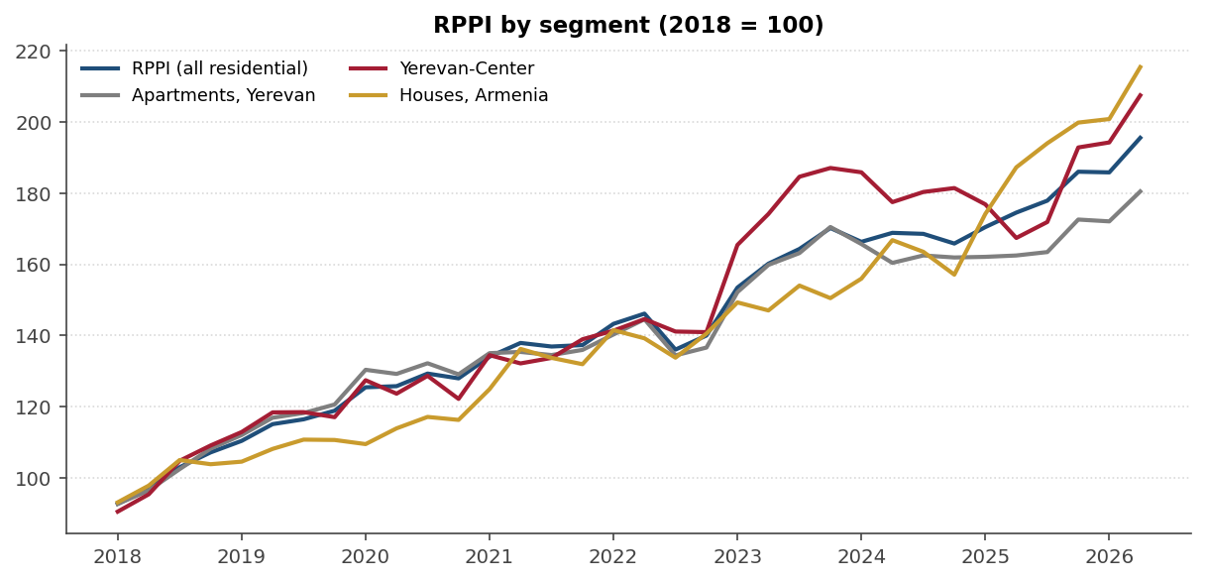
Figure A1. CBA price index: prices nearly doubled since 2018
Residential property price index by segment, quarterly, 2018Q1 to 2026Q2 (2018 = 100).
Source: Central Bank of Armenia RPPI data export, downloaded September 2, 2026.
19

Slide 20
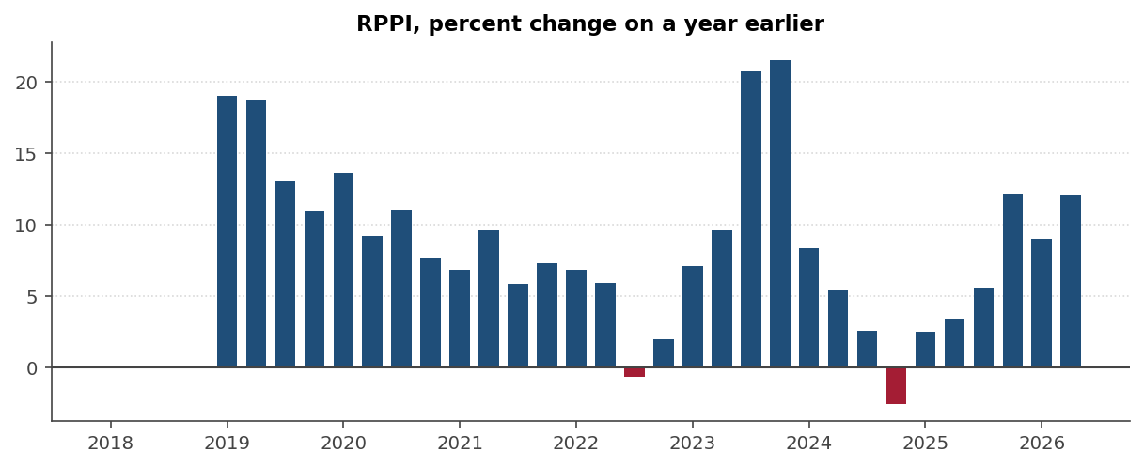
Figure A2. Year-on-year growth: boom, 2025 pause, 2026 re-acceleration
RPPI, percent change on the same quarter a year earlier; 2026Q2: +12.0 percent.
Source: CBA RPPI data export; staff calculations.
20

Slide 21
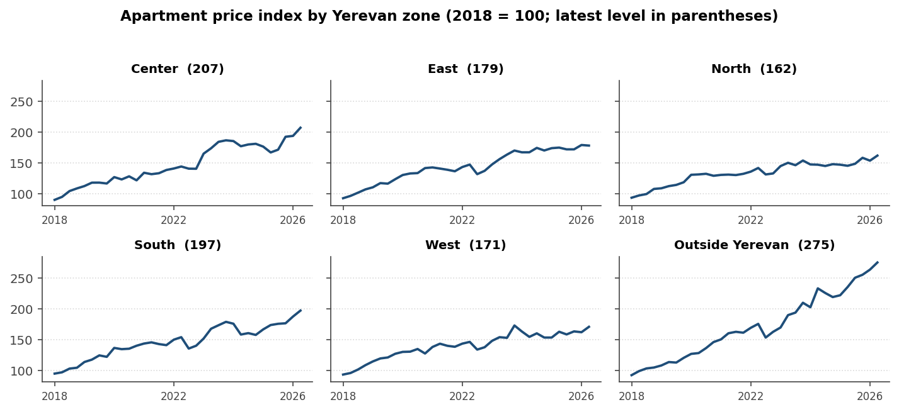
Figure A3. Apartment prices by Yerevan zone
Apartment price index by Yerevan zone (2018 = 100); Yerevan-Center +24.0 percent y/y in 2026Q2.
Source: CBA RPPI data export.
21

Slide 22
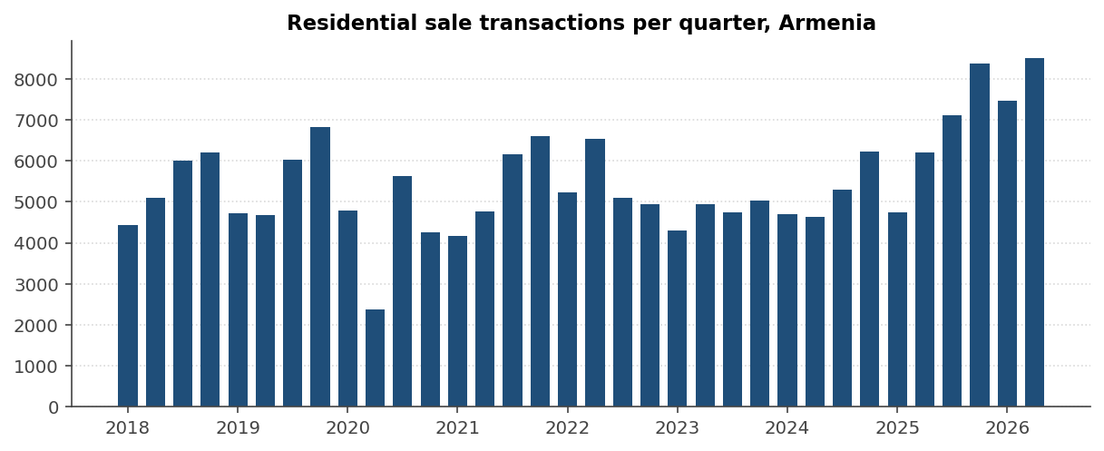
Figure A4. Transactions at record levels
Residential property sale transactions per quarter; 2026Q2: 8,497 deals worth AMD 289.7 billion.
Source: CBA RPPI data export.
22

Slide 23
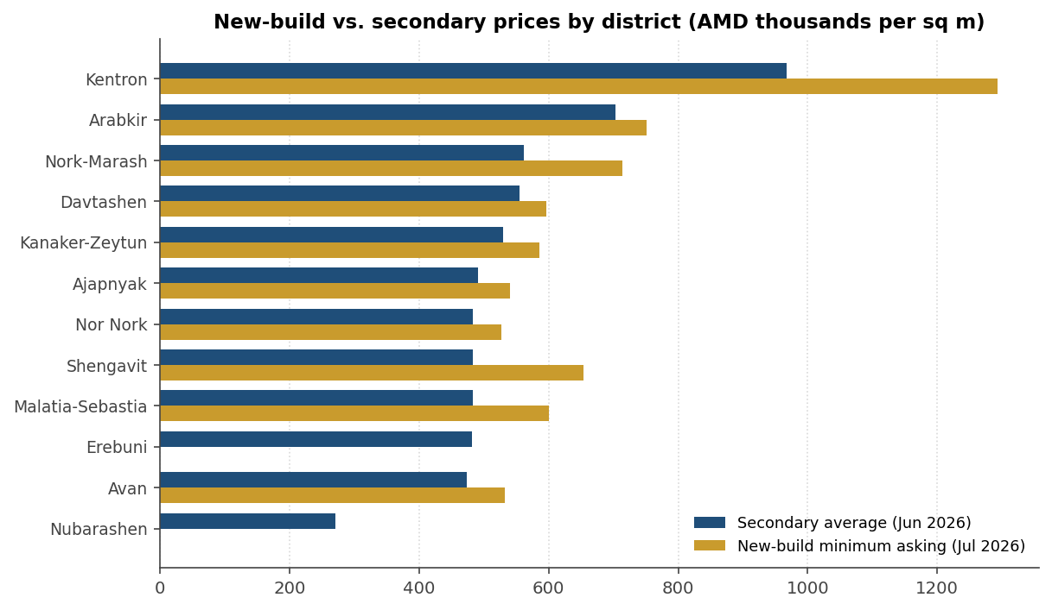
Figure A5. The new-build premium by district
Secondary-market average vs. new-build minimum asking, AMD thousands per sq m, mid-2026.
Sources: b24.am district tables (Jun 2026); karucapatoxic.am new-build asking prices (Jul 2026).
23

Slide 24
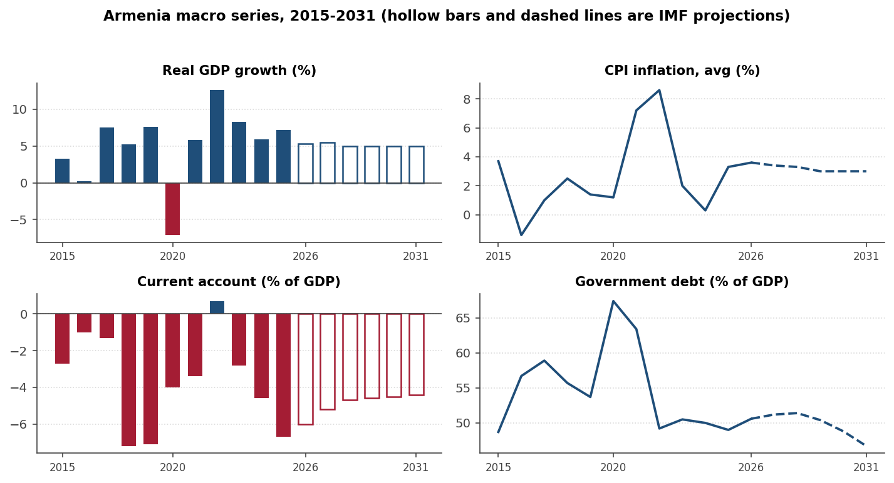
Figure A6. Macro backdrop: IMF WEO series and projections
Growth, inflation, current account, and debt, 2015 to 2031; projections from 2026.
Source: IMF World Economic Outlook database, April 2026.
24

