Slide 1
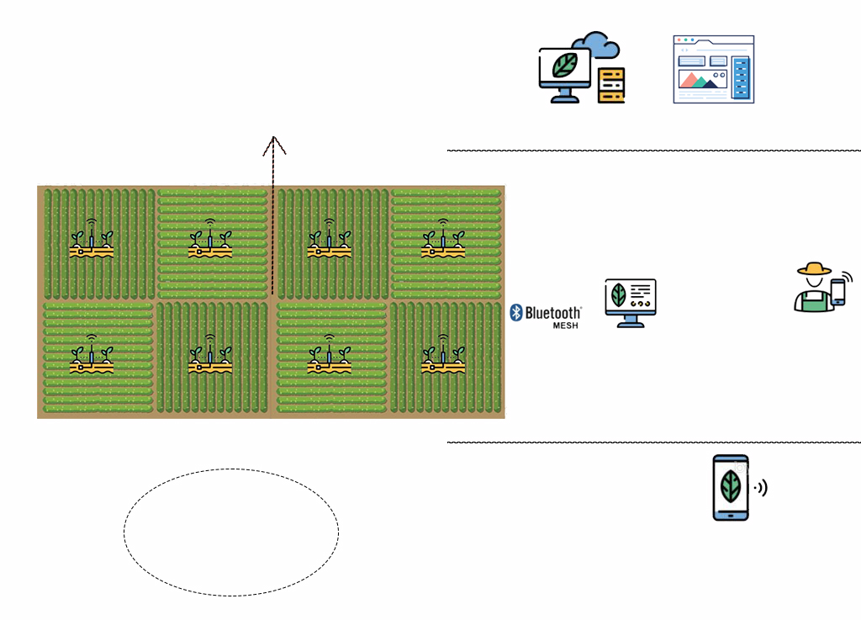
Bluetooth Mesh Network
Cloud
Dashboard (ThingsBoard)
Internet Access
Farmer
Embedded Board
GSM Network
Temp Sensor Oxygen Sensor
PH detector Humidity sensor long life Battery + solar panel Bluetooth/ZigBee module
SMS

