Slide 1
Agricultural IoT and Blockchain: A Tomato’s Journey from the Field to Supply
Blockchain 5576: Final Pitch Presentation
Kylee Willis
Notes:
https://github.com/raspberrymilkyway/blockchain-project

Slide 2
Table of Contents
01.
Problem Overview
04.
Live Demo
02.
Key Features
05.
Future Potential
03.
Technical Architecture

Slide 3
01
Problem Overview

Slide 4
Goal
My project is designed to monitor a farmer’s use of chemicals on their crops. This is done via a blockchain, and can be added both manually and automatically via an IoT simulator.

Slide 5
Why?
Food supply chains would find it easier to prove their food doesn’t, for example, have pesticides.
Trustless
Transparent
Integrate blockchain technology into agricultural IoT, ultimately answering:
How could blockchain be integrated into agricultural IoT?
How would agricultural IoT benefit from the use of blockchain technology?

Slide 6
Technology Stack
Backend:
Hardhat
Solidity
Node.js (+npm)
IoT device simulator
Frontend:
Vue.js
Web3.js
Screen Recording:
Zoom
Wallet Integration:
MetaMask

Slide 7
02
Key Features

Slide 8
Backend
Start a blockchain/Node network
Deploy Smart Contract
Start the frontend
Run IoT randomizer infinitely
Can interact with Smart Contract

Slide 9
Frontend
Connect via MetaMask
View chemical spending limits
Deployer can set chemical limits for accounts
Manually add chemical usage to blockchain
Automatically add chemical usage to blockchain
View chemical history on the blockchain

Slide 10
03
Technical Architecture

Slide 11
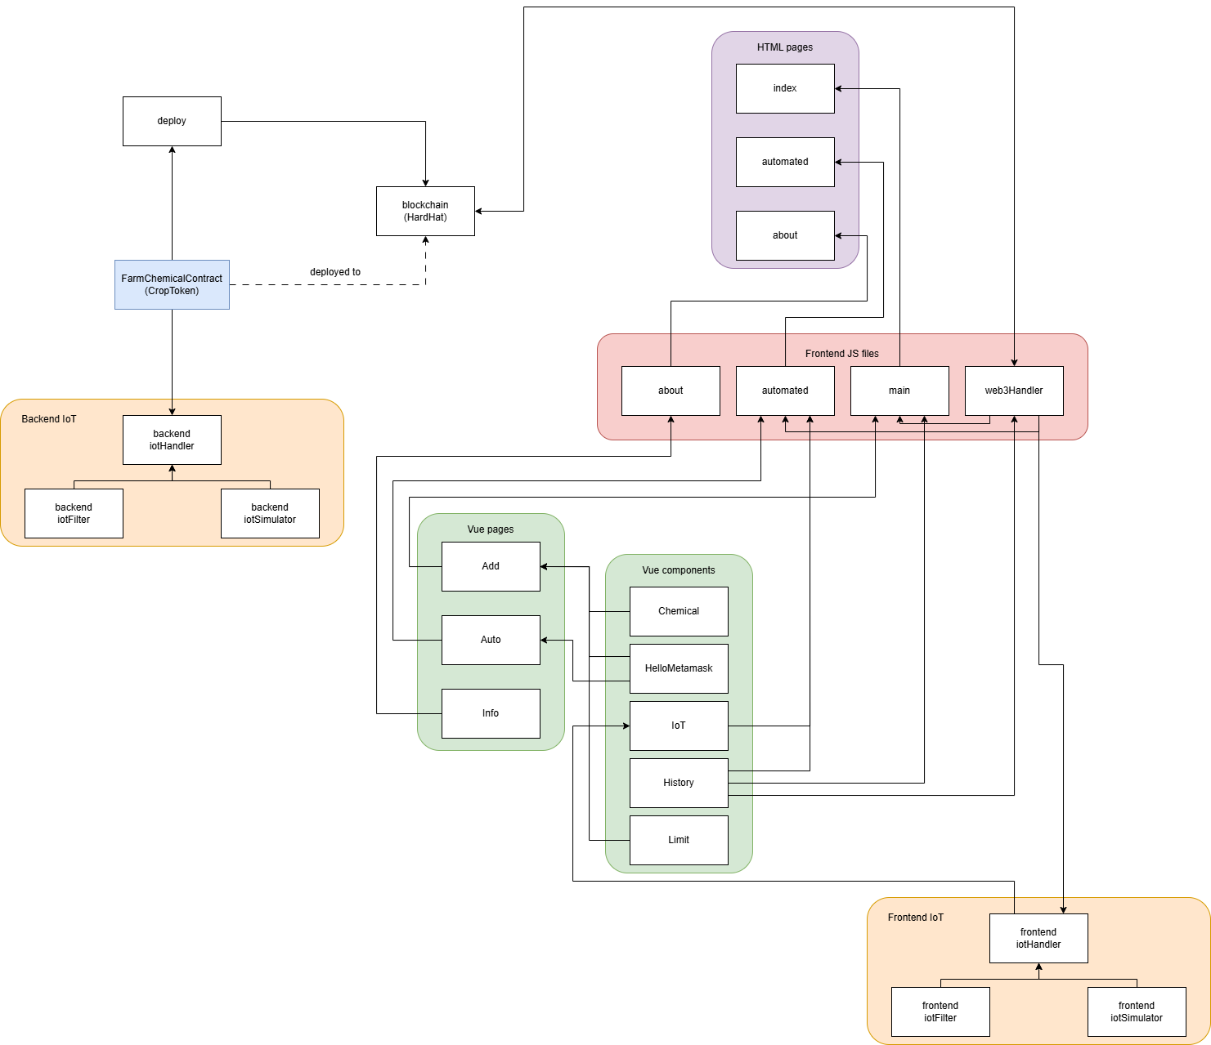
Overall architecture

Slide 12
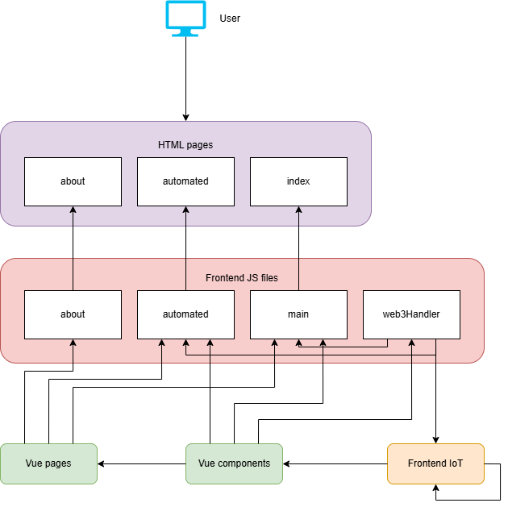
Frontend Architecture

Slide 13
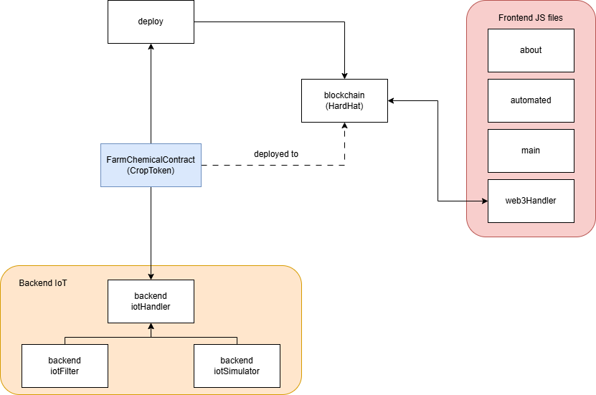
Backend Architecture

Slide 14
04
Live Demo

Slide 15
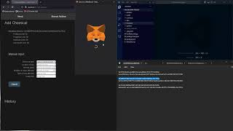
YouTube Video
(A fall-back YouTube video for if the live demo fails, for some reason.)
Notes:
Video presentation: https://youtu.be/EhfaThwgMBI

Slide 16
GitHub Link
A GitHub repository for this project can be found here:
https://github.com/raspberrymilkyway/blockchain-project
Notes:
https://github.com/raspberrymilkyway/blockchain-project

Slide 17
05
Future Potential

Slide 18
Potential Future Extensions
Encrypt data
Current approach makes encryption fairly useless, so a different approach would have to be used
Improve frontend
Display information more cleanly on the page
Organize history better
Allow filtering through history for specific values
Extend IoT simulators
Image detection
More variety and realism in data
Find project limitations (How many IoT devices can be supported at once? etc.)
Connect actual IoT devices + test on an actual farm
Fix any remaining weird behavior (multiple history entries on frontend)

Slide 19
Thank you!

