Slide 1
Description of what’s happening on the screen.
Mock up
Voice-over

Slide 2
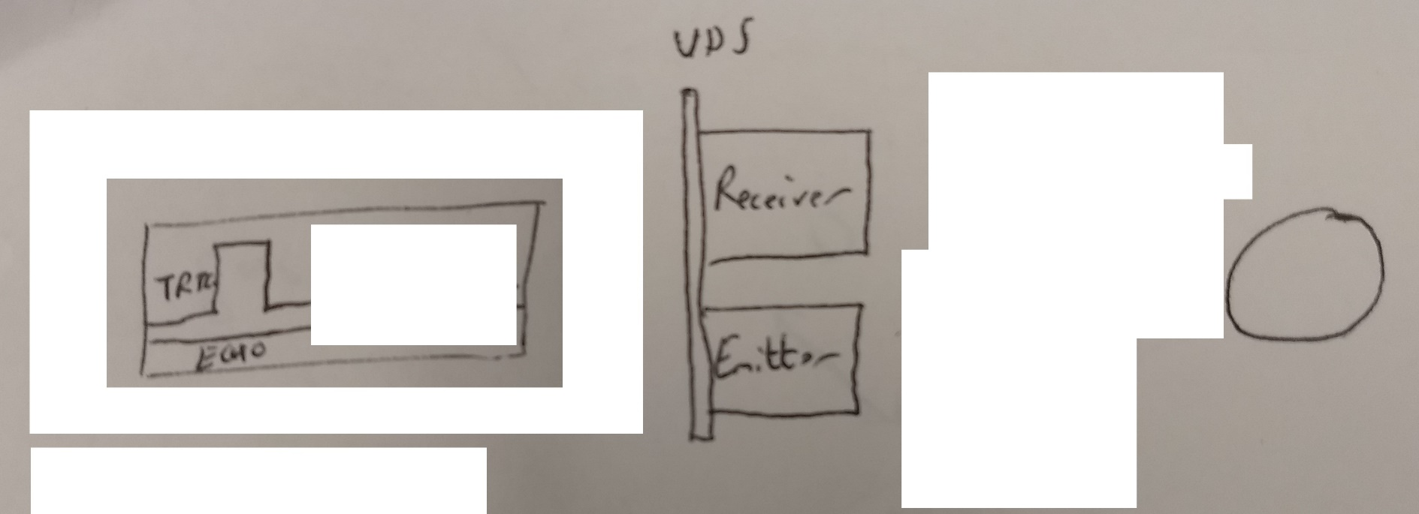
The Trig pin on the UDS is set to “high” for a short time.
An ultrasonic distance sensor (UDS) works by sending out a burst of ultrasound.

Slide 3
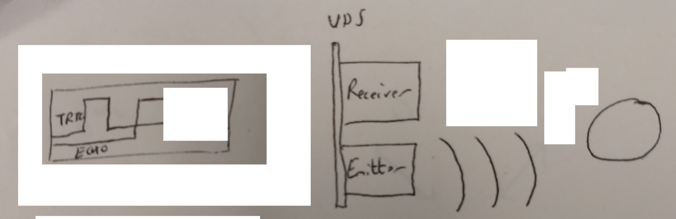
The Trig pin on the UDS returns to low and a set of 8 waves head out from the emitter of the UDS, spreading out towards the object on the right. Once the waves have been emitted, the Echo pin on the UDS changes from low to high. As the waves hit the object, they start to reflect back towards the receiver of the UDS.
This sound will travel through air, but reflect back (echo) off hard surfaces.

Slide 4
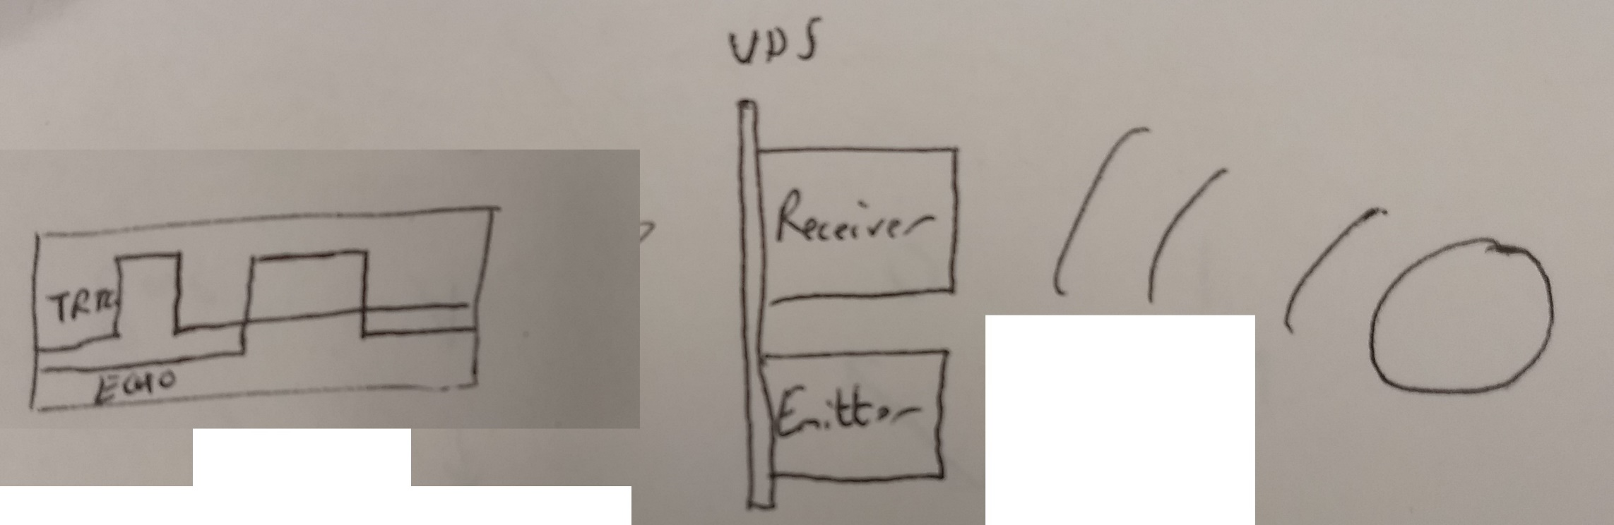
When the waves hit the receiver, they are absorbed. As soon as the first wave hits, the Echo pin returns from high to low.
The sensor can detect the echo, when it returns.

