Slide 1


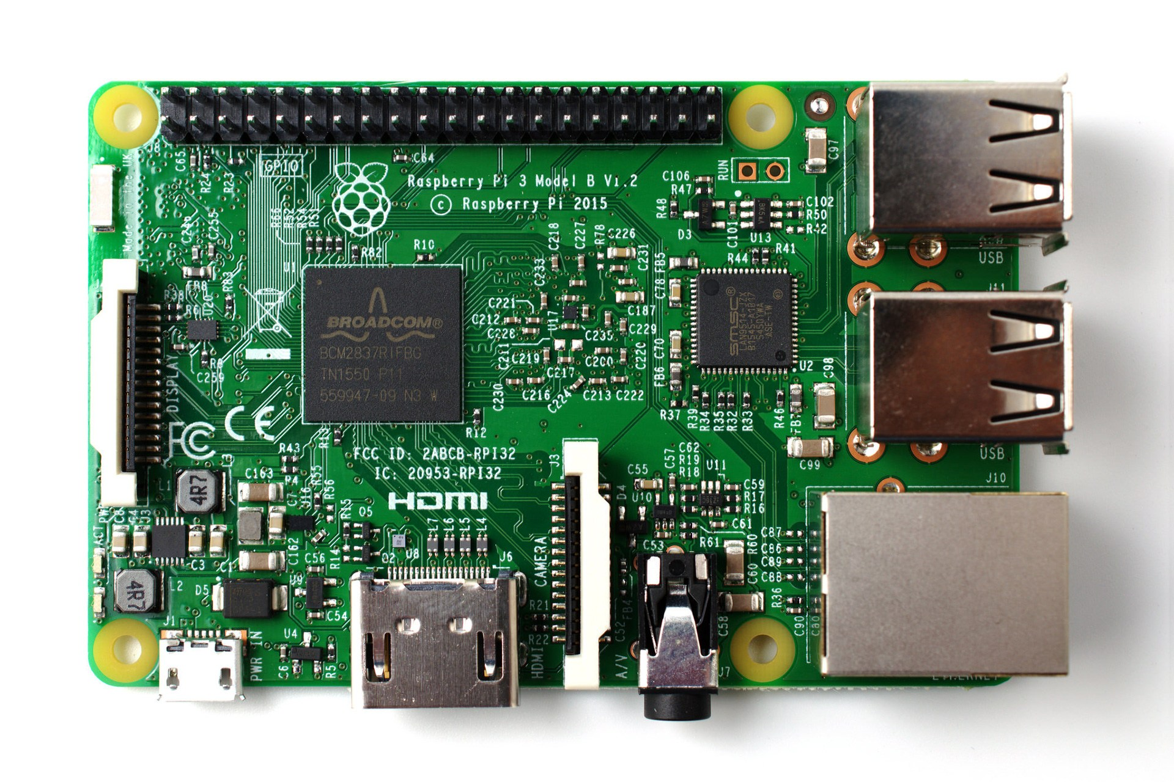
Traffic Lights controller with gpiozero and guizero

Slide 2
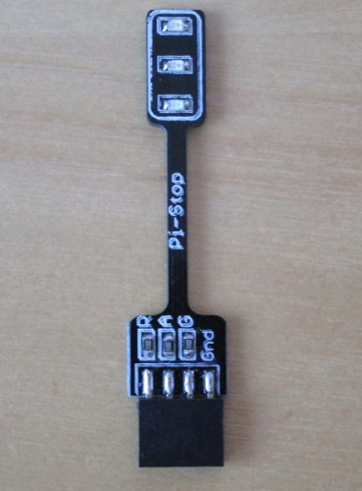
pi-stop
GND
GPIO17 (green)
GPIO27 (amber)
GPIO22 (red)

Slide 3
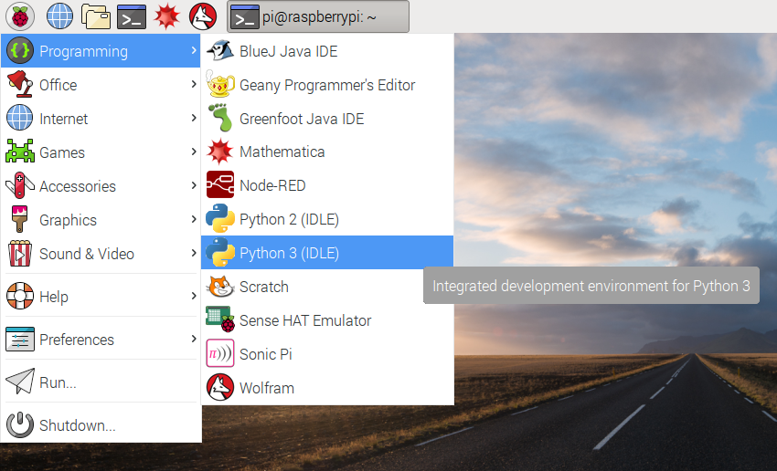
Open Python 3

Slide 4
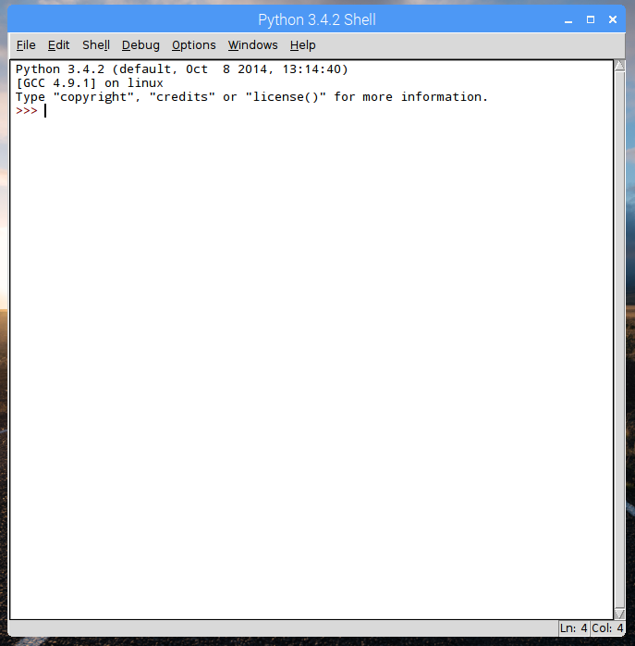
Type into the Python shell

Slide 5
gpiozero LED
>>> from gpiozero import LED
>>> red = LED(22)
>>> red.on()
>>> red.off()
>>> red.blink()

Slide 6
gpiozero LED blink
>>> red.blink(2, 2)

Slide 7
gpiozero LED blink
>>> red.blink(0.1, 0.1)

Slide 8
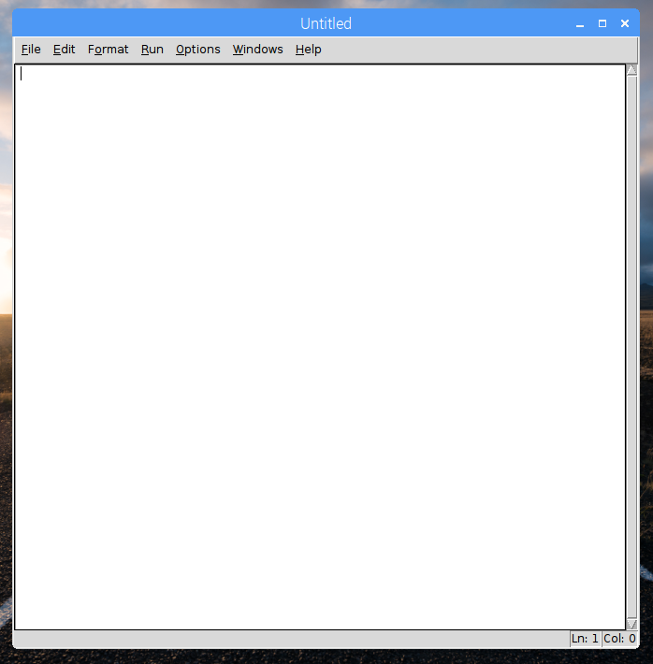
Open a new window

Slide 9
gpiozero Traffic Lights
from gpiozero import TrafficLights
lights = TrafficLights(22, 27, 17)
lights.blink()
Note the capitalisation
Save and run:
Ctrl + S
F5

Slide 10
gpiozero Traffic Lights
from gpiozero import TrafficLights
lights = TrafficLights(22, 27, 17)
lights.red.blink(1, 1)
lights.amber.blink(2, 2)
lights.green.blink(3, 3)
What do these numbers mean?

Slide 11
gpiozero Traffic Lights
from gpiozero import TrafficLights
from time import sleep
lights = TrafficLights(22, 27, 17)
lights.green.on()
sleep(1)
...

Slide 12
guizero
from gpiozero import TrafficLights
from guizero import App, Text, PushButton
lights = TrafficLights(22, 27, 17)
app = App()
PushButton(app, command=lights.red.on, text="on")
app.display()

Slide 13
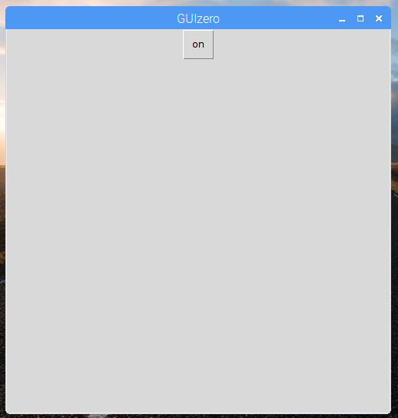
guizero

Slide 14
guizero buttons
app = App()
Text(app, "Red")
PushButton(app, command=lights.red.on, text="on")
PushButton(app, command=lights.red.off, text="off")
app.display()

Slide 15
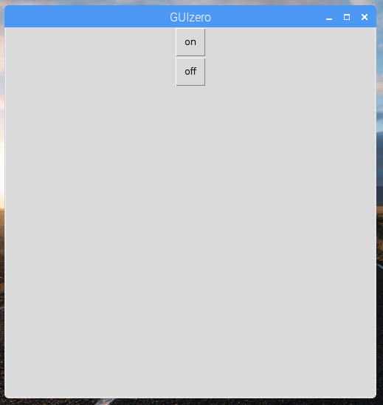
guizero buttons

Slide 16
guizero grid layout
app = App("Traffic Lights controller", layout="grid")
Text(app, "Red", grid=[0, 0])
PushButton(app, command=lights.red.on, text="on", grid=[0, 1])
PushButton(app, command=lights.red.off, text="off", grid=[0, 2])
app.display()
This line MUST go at the end

Slide 17
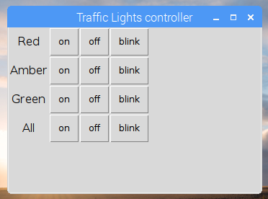
Challenge

Slide 18
More challenges
Can you use a different blink speed?
Can you make the blink speed variable?
Can you add a traffic lights sequence button?
Can you add multiple traffic lights?

