Slide 1


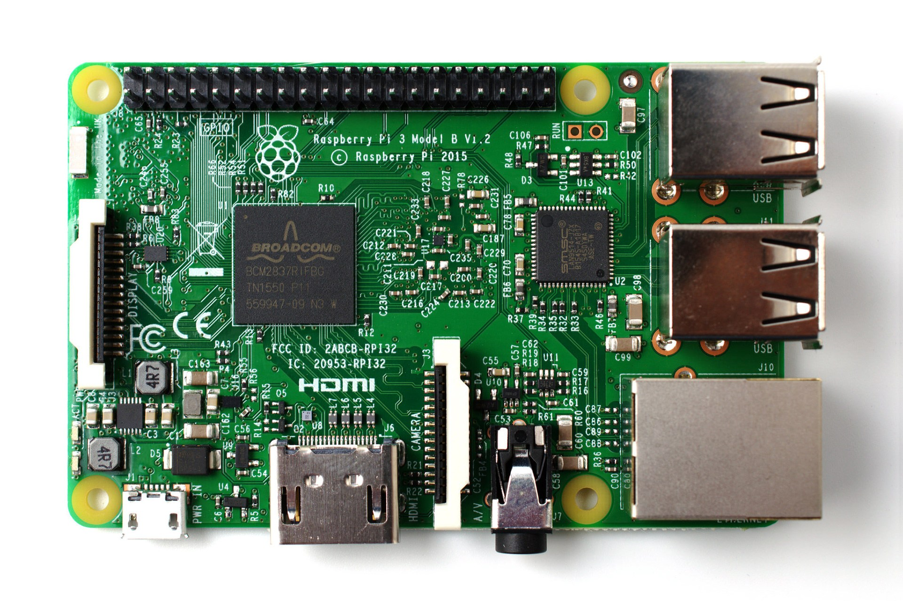
Traffic Lights controller with gpiozero and guizero

Slide 2
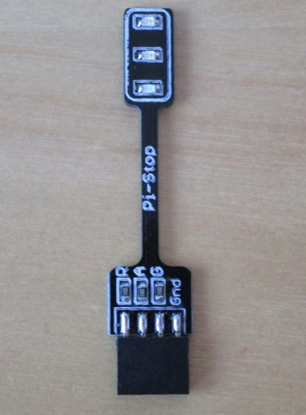
pi-stop
GND
GPIO17 (green)
GPIO27 (amber)
GPIO22 (red)

Slide 3
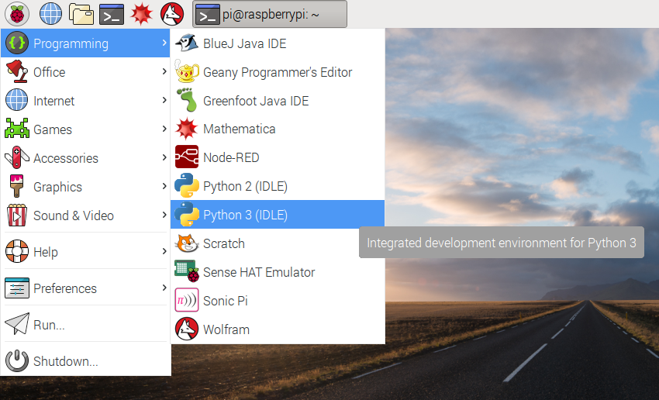
Open Python 3

Slide 4
gpiozero
from gpiozero import LED
red = LED(22)
red.blink()

Slide 5
gpiozero
from gpiozero import TrafficLights
lights = TrafficLights(22, 27, 17)
lights.blink()

Slide 6
gpiozero
from gpiozero import TrafficLights
lights = TrafficLights(22, 27, 17)
lights.red.blink(1, 1)
lights.amber.blink(2, 2)
lights.green.blink(3, 3)

Slide 7
guizero
from gpiozero import LED
from guizero import App, Text, PushButton
lights = TrafficLights(22, 27, 17)
app = App()
PushButton(app, command=red.on, text="on")
app.display()

Slide 8
guizero
app = App()
Text(app, "Red")
PushButton(app, command=lights.red.on, text="on")
PushButton(app, command=lights.red.off, text="off")
app.display()

Slide 9
guizero
app = App("Traffic Lights controller", layout="grid")
Text(app, "Red", grid=[0, 0])
PushButton(app, command=red.on, text="on", grid=[1, 0])
PushButton(app, command=red.off, text="off", grid=[2, 0])
...
app.display()

Slide 10
Challenges
Controls for all 3 LEDs – red, amber and green
Properly aligned in grid
on/off/blink buttons
All on / all off button
Traffic Lights sequence button

