Slide 1

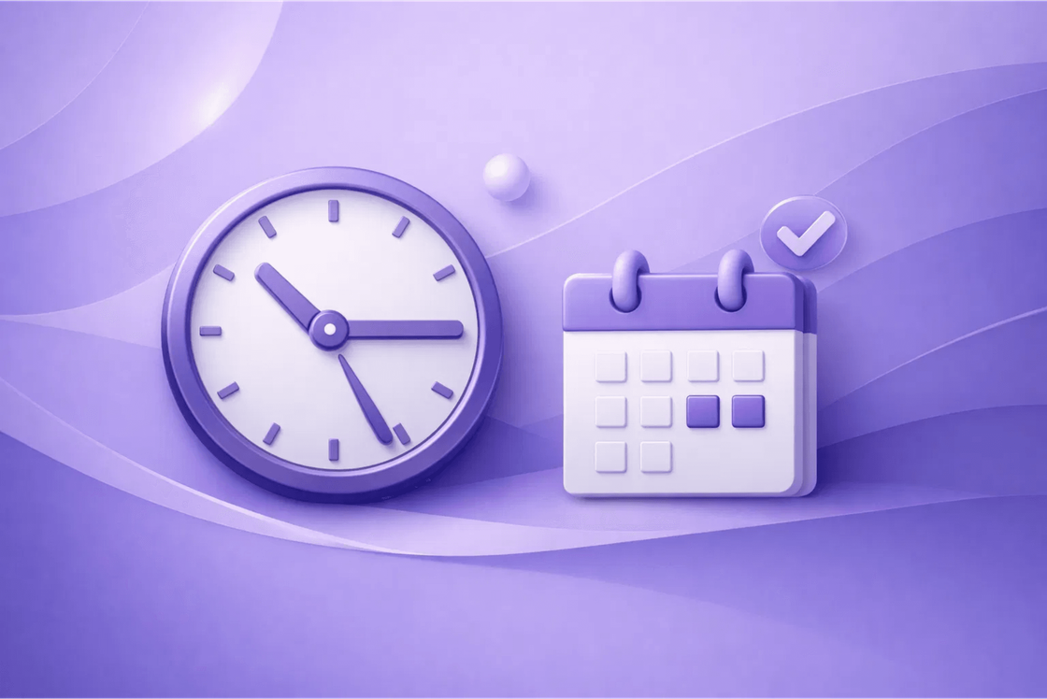
Master Your Day
Simple Ways to Manage Your Time and Tasks

Slide 2





Why is Time Management Important?
Better Results
Less Stress
You finish your work on time and with high quality.
No more worrying about missing deadlines.
More Free Time
More Energy
Time for family, friends, and your favorite hobbies.
You don't feel tired or overwhelmed all the time.
"Small steps every day lead to big success."

Slide 3

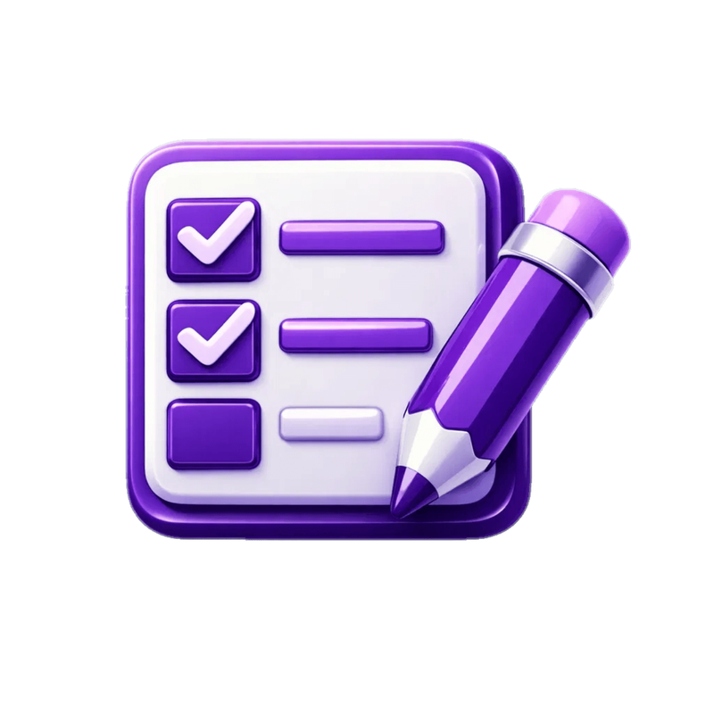
Step 1 - Write Everything Down
The Brain is for Ideas
Don't use your brain to remember long lists. Write them down!
Use a Tool
Use a simple notebook or an app on your phone.
Clear Your Mind
Writing helps you feel calm and ready for work.

Slide 4



Step 2 - Choose What is Important
The "Big Frog" Rule
Do the hardest or most important task first.
Start your big task in the morning when you have energy.
Finish one important thing before starting others.
ONE BIG WIN PER DAY IS ENOUGH!

Slide 5
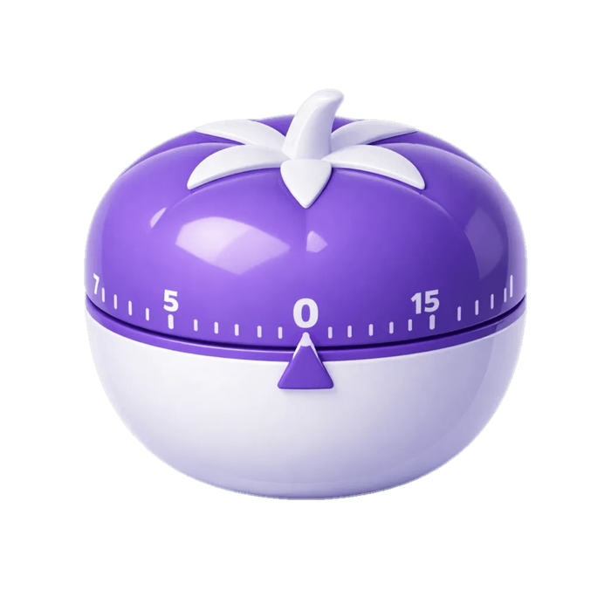
Step 3 - Use the 1-3-5 Rule
1
Big Task
Something very important that needs focus.
3
Medium Tasks
Things that must be finished today.
5
Small Tasks
Quick things like emails or short calls.
This keeps your day balanced and realistic!

Slide 6





Step 4 - Focus for 25 Minutes
Work
Break
Repeat
Rest
Focus on one task for 25 minutes.
Take a short 5-minute break.
Do this 4 times in a row.
Take a long 20-minute break.
Pro Tip:
Put your phone away to stay focused!

Slide 7
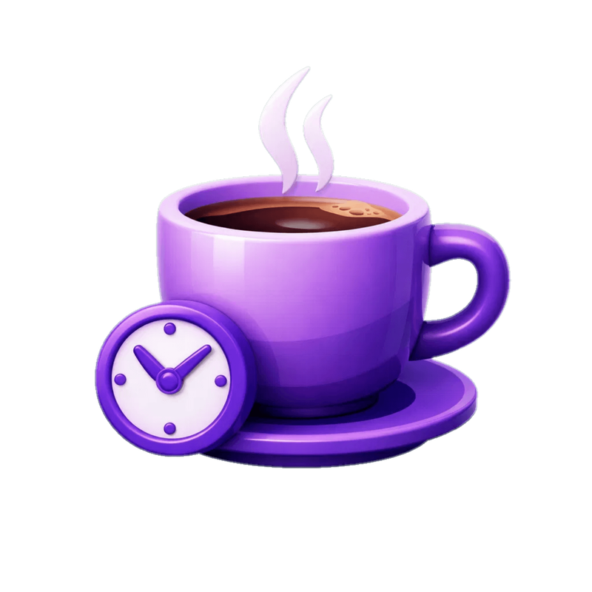



Step 5 - Learn to Say "No"
Protect Your Time
You cannot do everything for everyone. It's okay to say no.
Be Polite
"I would love to help, but I am busy right now."
Ask for Help
If you have too much work, talk to your team or family.

Slide 8






Step 6 - Take Breaks to Stay Strong
Rest is Productive
Move Your Body
Sleep Well
You work faster and better after a short rest. Your brain needs to recharge.
A short walk or stretching can give you new energy and fresh ideas.
A good night's sleep is the best tool for a productive day tomorrow.
Drink Water
Eat Healthy
Rest Early

Slide 9



Summary - Your Daily Plan
Morning
Afternoon
Evening
Do your "Big Frog" (Hardest task) when you have the most energy.
Finish your medium and small tasks. Use the Pomodoro technique.
Plan for tomorrow, clear your desk, and take time to relax.
"Consistency is key. Doing a little every day is better than doing a lot once."

Slide 10



Thank You!
Any Questions? I am happy to help.
Start Today
Good Luck
Contact Me
"Time is what we want most, but what we use worst."
— William Penn

