Slide 1

Conversational AI
Demo presentation
First week
April 2022

Slide 2
Content
Project overview and objectives
Global approach
Progress of the week
Next step

Slide 3


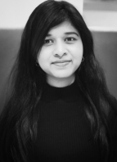
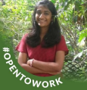


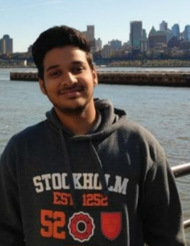
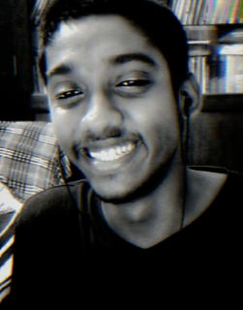
Our Team

Slide 4
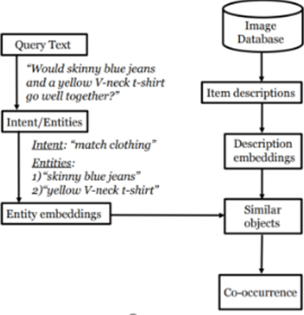
Project overview
Build a conversational agent that can suggest what piece of clothing can match with another.
Given a text query, the agent extract the clothing entities, search for similar objects and return the most occurring items.
Work done by the previous Cohort : Attribute extraction and complementary search.

Slide 5
Global approach
Divide and conquer
First, get familiar with the previous cohort’s work.
Achieve a first pipeline that returns a concrete output.
Improve the pipeline and build the query extraction and the response generator.
Build a UI of the application and writing a paper.

Slide 6
Timeline
Create a pipeline
Query extraction + Response generator
Building an App + Writing a paper
27/04/2022
10/05/2022
05/06/2022

Slide 7
Progress
A research phase: reading articles, understanding the project.
Project planning with the team.
Agreeing on what dataset to use (Polyvore).
Building an occurrence matrix from the Polyvore dataset using VinVL.

Slide 8
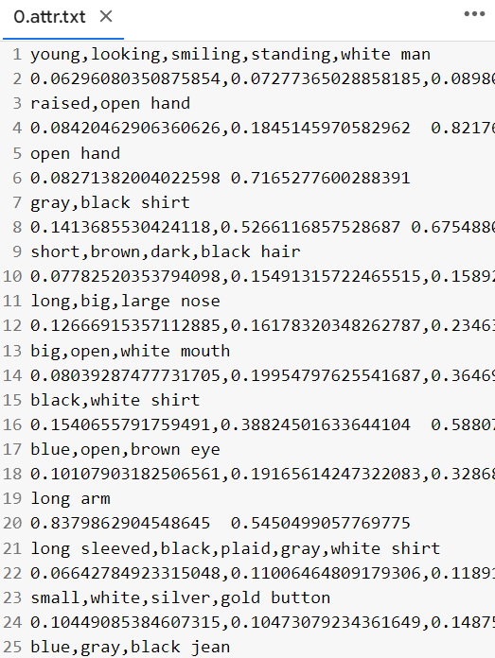


Slide 9
Next step
Working on the occurrence matrix to get only the desired results (Clothes attribute).
Improve the complementary search.
Test the results of the pipeline to see what needs to be improved.

Slide 10
THANK YOU!
Time for questions

