Slide 1
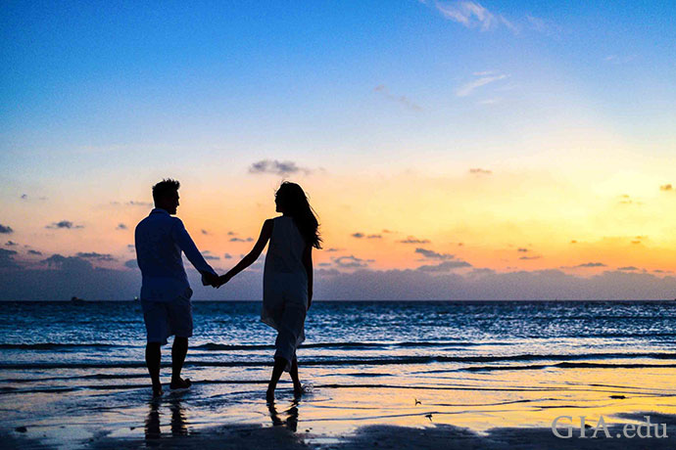
Conversational AI
Demo presentation
Second week
May 2022

Slide 2
Content
Quick Recap
Progress of the week
Attribute extraction from images
Preprocessing the data
Next steps
Questions

Slide 3
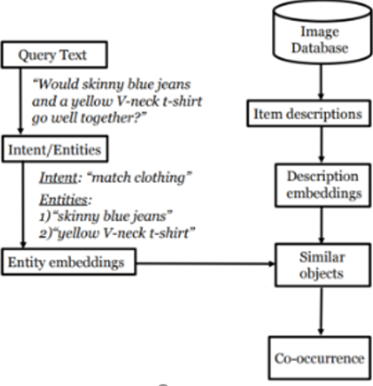
Quick Recap
Attribute extraction from images
Prepare the data to build a co-occurrence matrix
Make a working pipeline
Attribute extraction from query and generating response
Make an app

Slide 4
Progress of the week

Slide 5
Attribute extraction from images
Parsing the image data trough VinVl to get text attributes (33000 images)
Generate the dataset with specified format agreed by the team to satisfy the needs (Image name, Attributes, Boundaries)

Slide 6
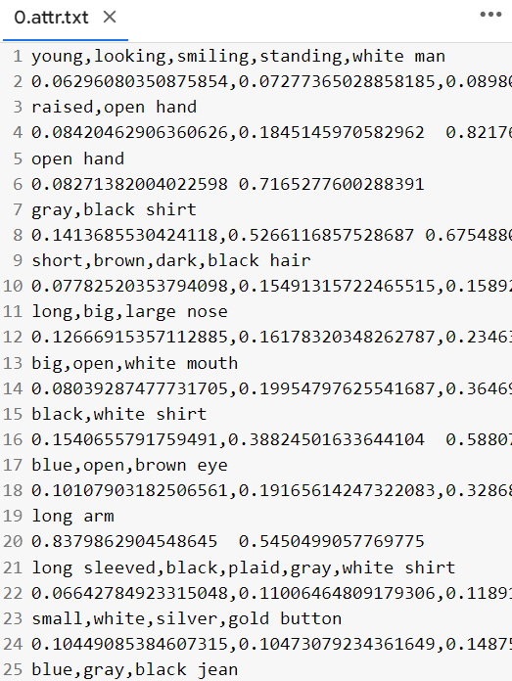
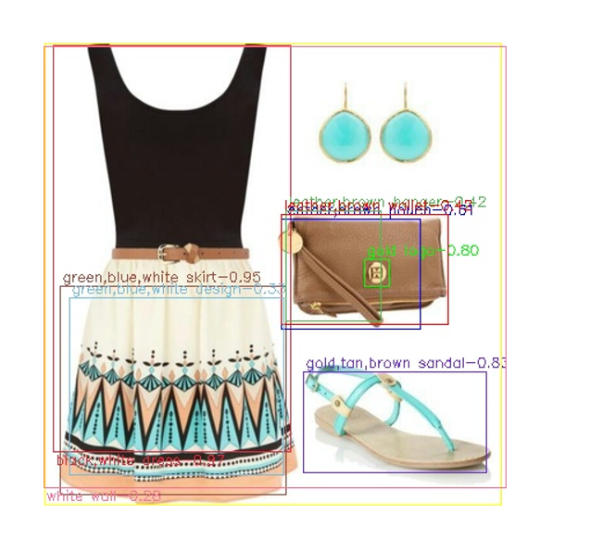
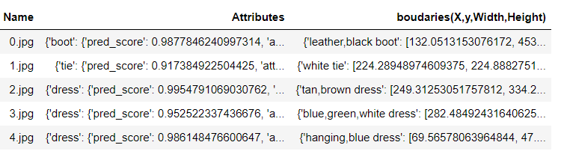
Results

Slide 7
Preprocessing the data (1)
Filtering fashion from non-fashion attributes. 3 approaches:
SimCSE embedding K-means clustering
Filtering using a list of English clothing words
BERT classifier

Slide 8
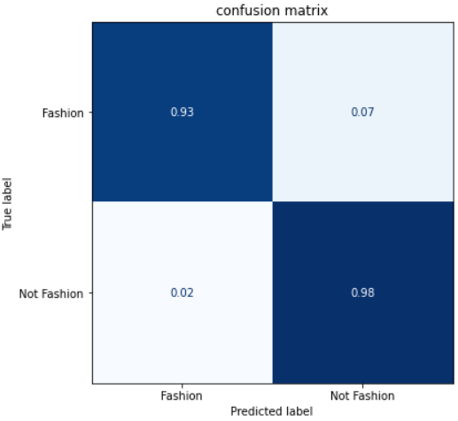
Results

Slide 9
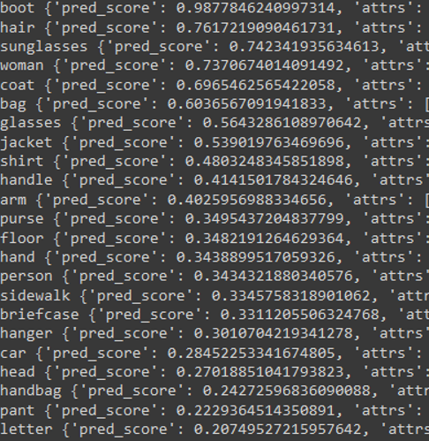
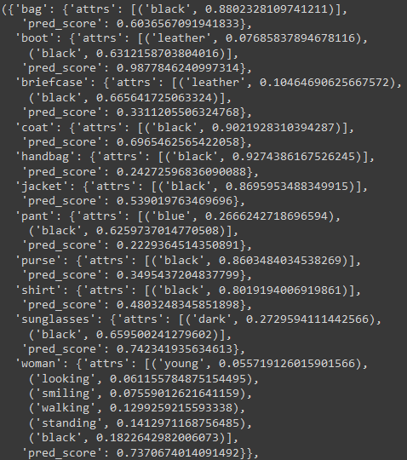
Results

Slide 10
Preprocessing the data (2)
Choose what colors to keep in case of multiple colors per item
Keep all the colors
Keep the color with the highest confidence level

Slide 11
Next steps
Finalize the preprocessing and generate a first co-occurrence matrix
Get a first pipeline and test with attributes
Start the Attribute extraction from query and generating response phase

Slide 12
Questions
Once we get a finalized model, shall we build an app ? (mobile or web ?)
TODO : suggest more questions

Slide 13
THANK YOU!
Time for your questions

