Slide 1
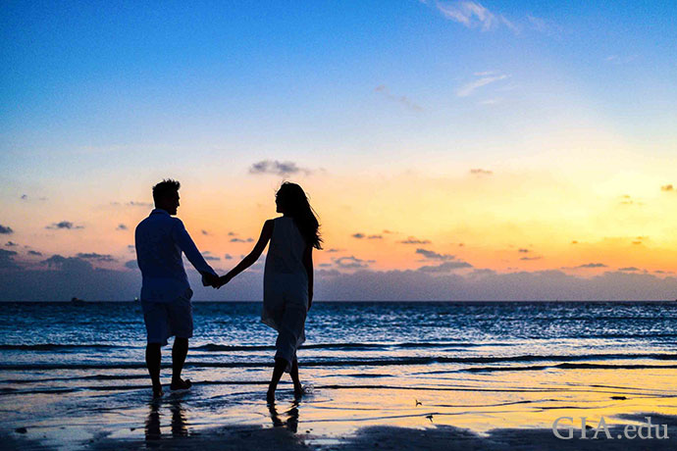
Conversational AI
Demo presentation
Third week
May 2022

Slide 2
Content
Quick Recap
Progress of the week
Preprocessing the data
Co-occurrence matrix
Attribute extraction from the user’s query
Next steps
Questions

Slide 3
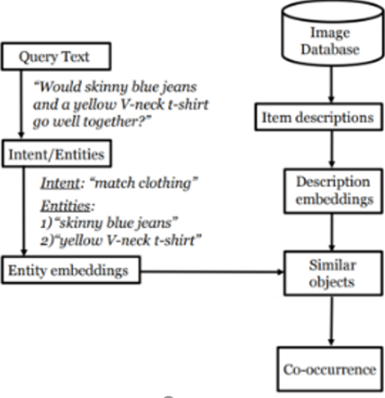
Quick Recap
Attribute extraction from images
Prepare the data to build a co-occurrence matrix
Make a working pipeline
Attribute extraction from query and generating response
Make an app

Slide 4
Progress of the week

Slide 5
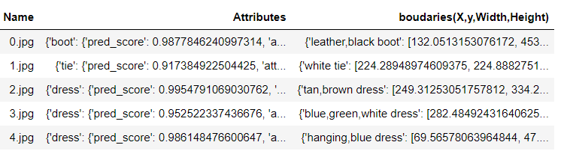
Preprocessing steps
Generating all the 33000 samples of the dataset.
Filtered the fashion items on both the attributes and the boundaries column.
Some other preprocessing ( splitting the man/woman fashion) were put aside to later so we can advance in the project.

Slide 6
Co-occurrence matrix
A matrix that counts how frequent each combination of clothes occurs together and will perform matching fashion items with the user’s query.
A first version was generated with a small sample, but not with the full dataset since it is computationally expensive.
We are working further for improvement.

Slide 7
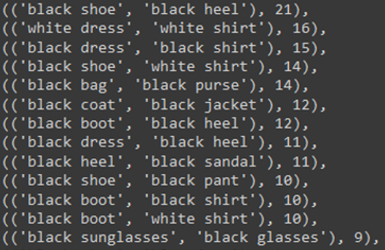
Results

Slide 8
Attribute extraction from the user’s query
First researches done, some approaches discussed.
Implemented a simple (no modelling or training) but efficient technique to extract the attributes.
It is based on some POS-tagging manipulations to extract all the attributes. Those attributes are filtered using our previous model to keep only the fashion entities.
This method requires to know the intent of the user to know how to generate the question.

Slide 9
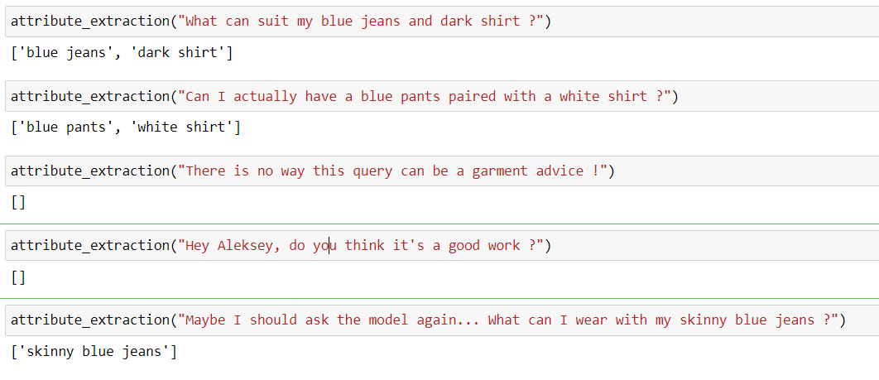
Results

Slide 10
Next steps
Working on the user’s intent classification.
Keep working on improving co-occurrence matrix.
Start working on response generation

Slide 11
THANK YOU!
Time for your questions

