Slide 1
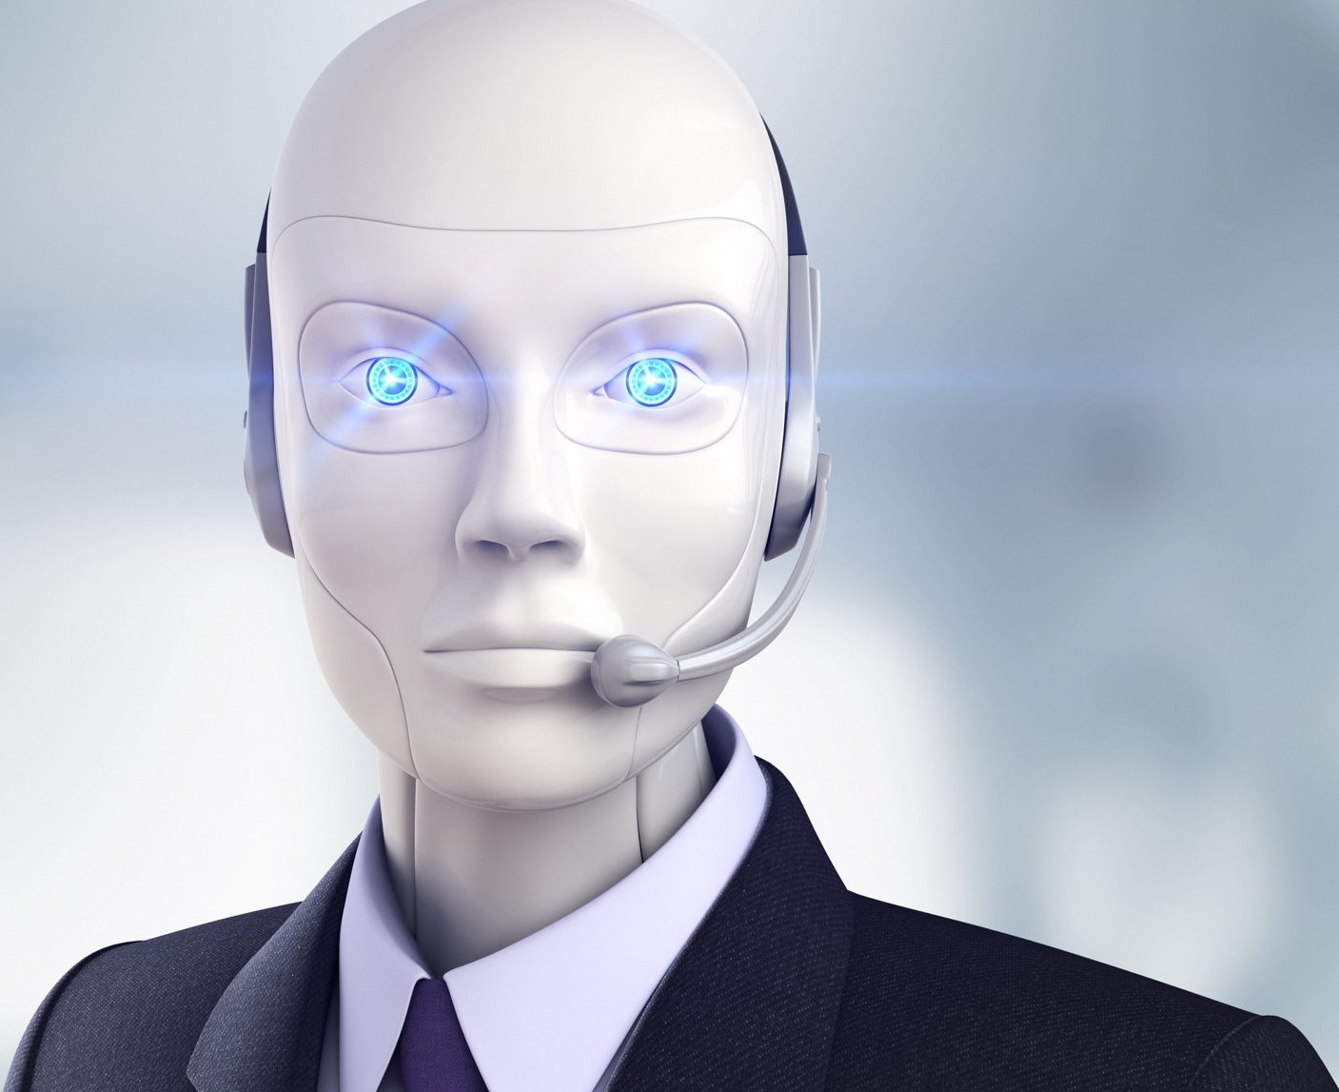

Conversational AI
The first version of the "Conversational AI" telegram bot is now available! Check it out! @FashionAdv_bot
Demo presentation
Fourth week
May 2022

Slide 2
Content
Quick Recap
Progress of the week
End-to-end model
Telegram bot
Semantic analysis of the user's query
Next steps and challenges
Questions

Slide 3
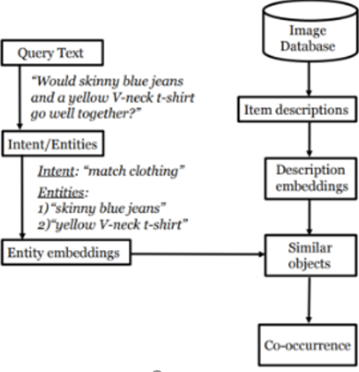

Quick Recap
Attribute extraction from images
Create a co-occurrence matrix
Make a working pipeline
Get attributes and semantics from a query and generate a response
Create and deploy a chatbot/telegram bot

Slide 4
Progress of the week

Slide 5
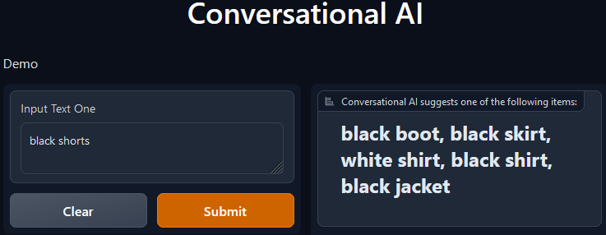
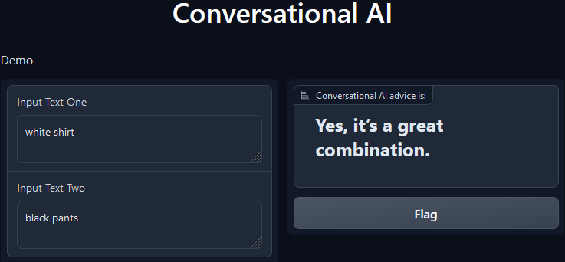
End-to-end model
The first reliable end-to-end solution has been implemented. We are constantly improving it in order to have a product that fully satisfies customers.

Slide 6
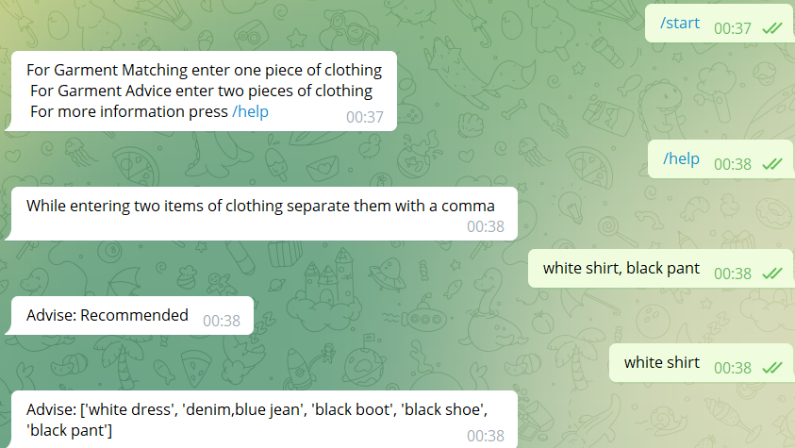
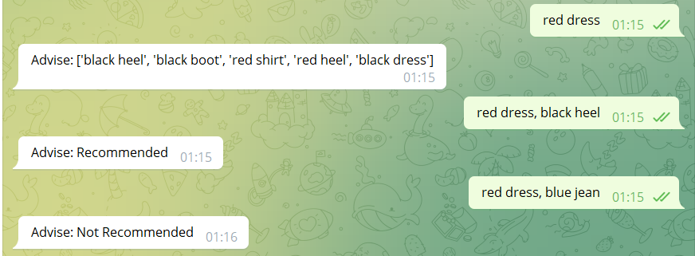
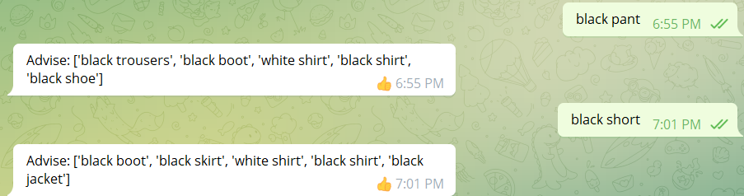
Telegram bot
A Telegram bot has been developed and deployed.
Please find our bot @FashionAdv_bot and give it a try!

Slide 7
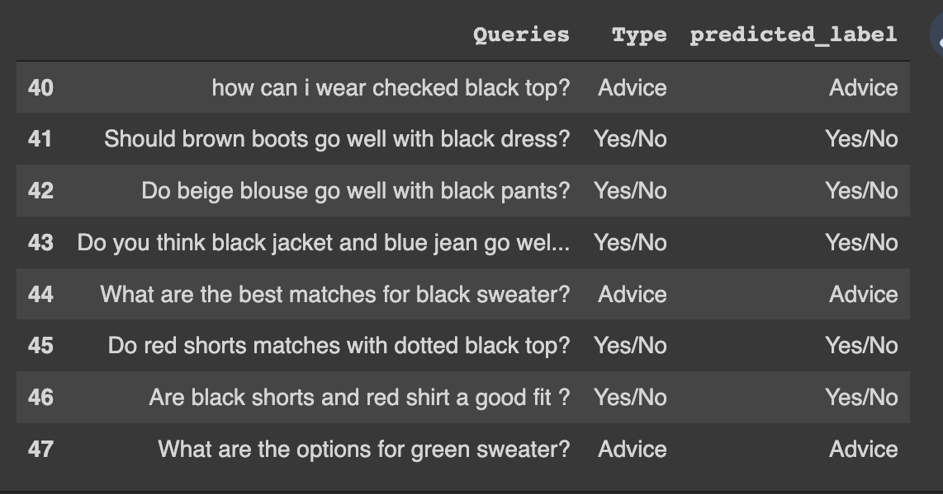
Semantic analysis of the user's query
Classification of user intent has been implemented for the first two types of intents (giving an answer "yes" or "no" and giving advice).

Slide 8
Next steps and challenges
Next steps:
Challenges:
Improve the telegram bot so that it can accept an interrogative sentence (question) and give an image as an answer along with a text message.
Complete the intent classification model.
Extend the correlation between the co-occurrence matrix and the user’s query.
Determine the conditions under which we can give a recommendation to the user.
The VinVL model we use to extract attributes from images gives us the limited number of color and material attributes as well as treats some of the different clothing types as the same item. For the fashion domain, it is crucial to have as many colors, types of materials, and types of clothing as possible.

Slide 9

THANK YOU!
Time for your questions

