Slide 1
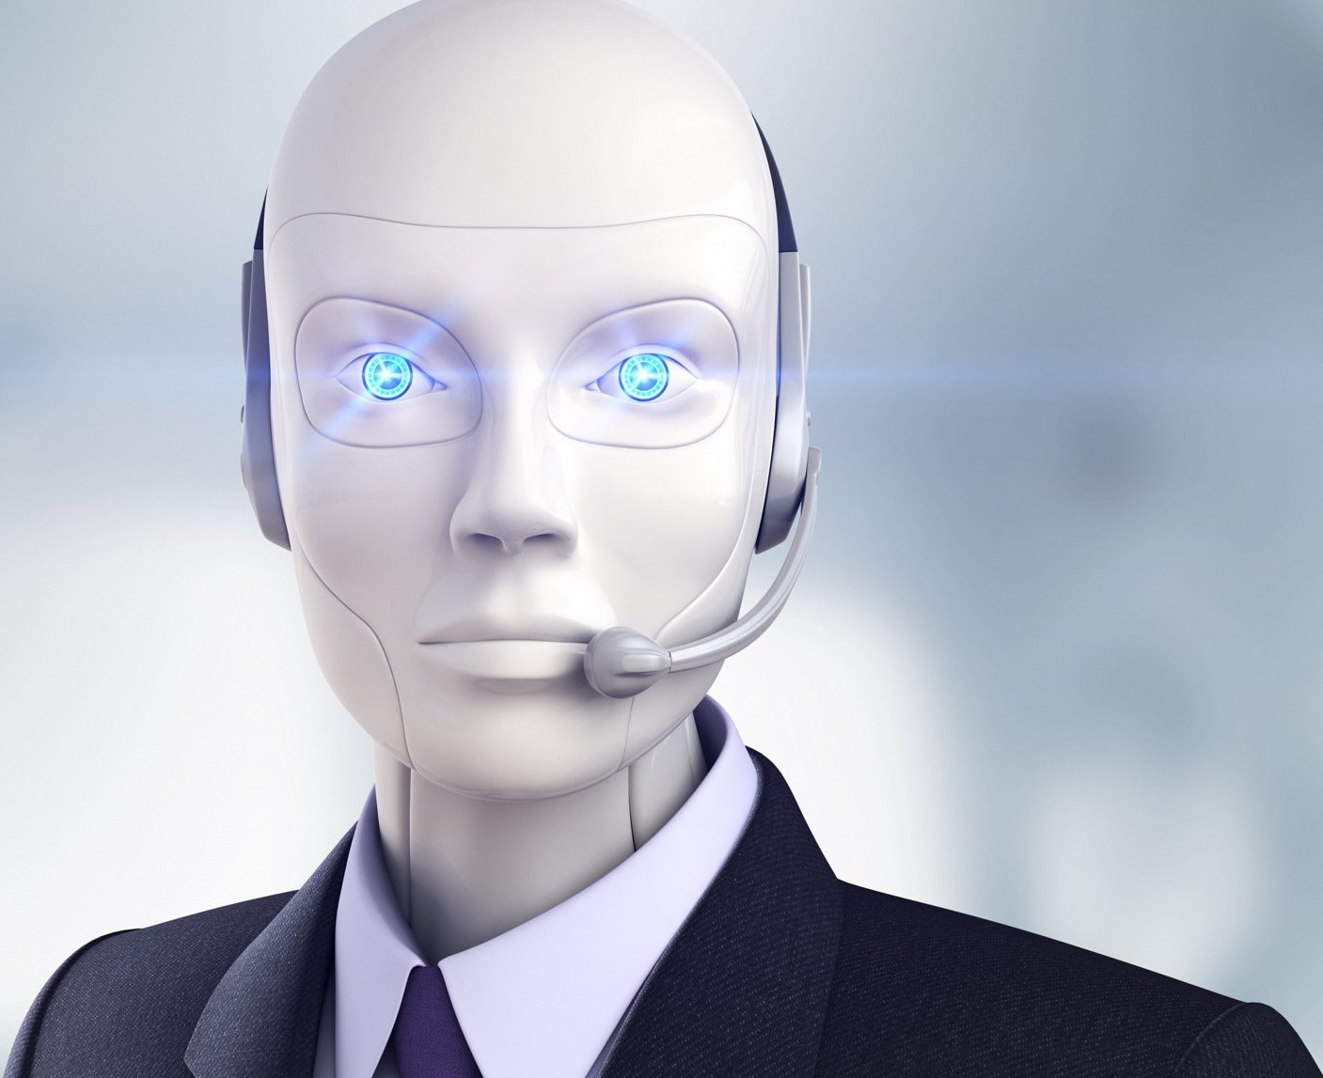

CONVERSATIONAL AI
Conversational AI
@FashionAdv_bot
Demo presentation
Fifth week
May 2022

Slide 2
Content
Quick Recap
Progress of the week
Word embeddings
End-to-end model
Image displaying
Next steps
Questions

Slide 3

CONVERSATIONAL AI
TELEGRAM BOT
Quick Recap
Would a yellow long-sleeved shirt and skinny blue jeans go together?
Intent: match clothing
Features: Skinny blue jeans, Yellow long-sleeved shirt
768-Dimensional Vectors
Query Text
Intent/ Features
Feature Embeddings
Answer to the Query
Image Database
Feature Extraction
Feature Embeddings
Domain agnostic, it can be fashion, interior design, etc.
Items with Descriptions
768-Dimensional Vectors

Slide 4
Progress of the week

Slide 5
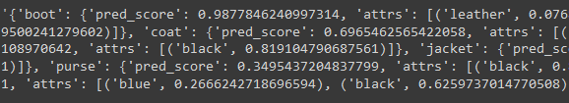
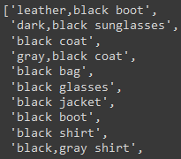
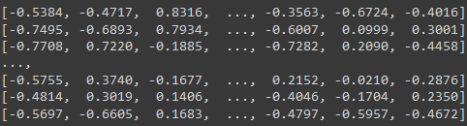
Word Embeddings
The most significant improvements have been made to the similarity check.
We have word embeddings so we can expand the application in any possible direction.

Slide 6
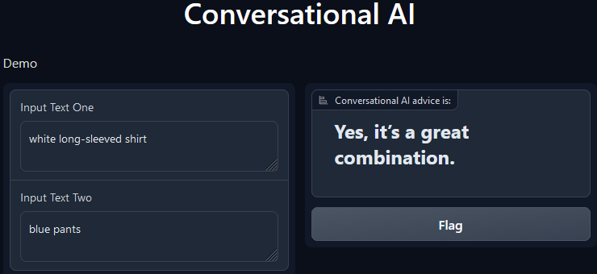
End-to-end model
End-to-end model has been improved. We have created a domain-independent approach based on the cosine similarity of word embeddings.

Slide 7
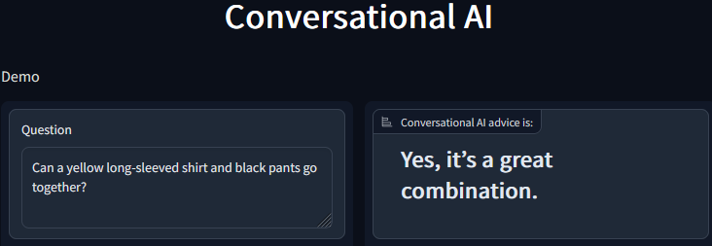
End-to-end model
Several improvements have been made to the intent classification. Now the application can handle simple questions.

Slide 8
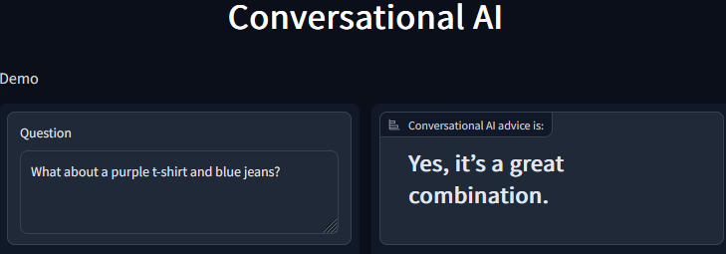
End-to-end model
Several improvements have been made to the intent classification. Now the application can handle simple questions.

Slide 9
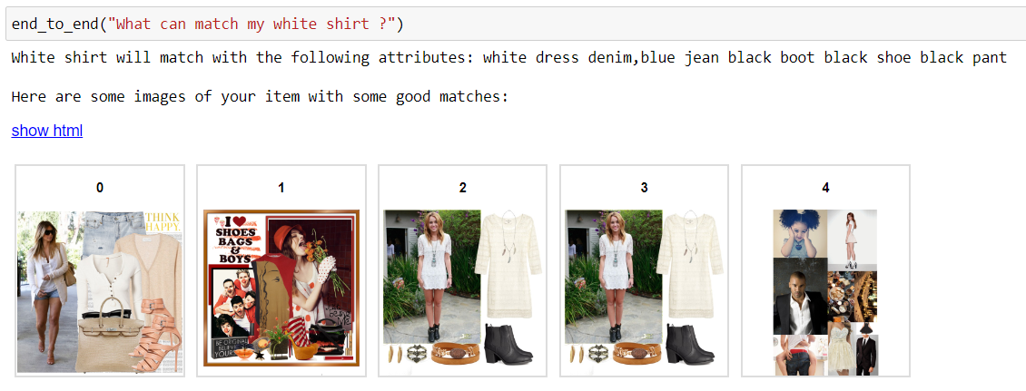
Image displaying
Image display option has been added.

Slide 10
Next steps and challenges
Next steps:
Improve the telegram by connecting different parts together so that the bot can give an image as a response along with a text message.
Implement a reliable solution for the intent classification problem.
Improve similarity check.

Slide 11

THANK YOU!
Time for your questions

