Slide 1
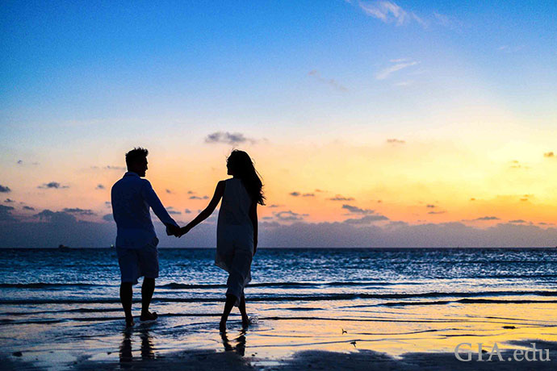
Conversational AI
Demo presentation
Last week
June 2022

Slide 2
Content
Problem definition
Last cohort
Presenting our solution
Further improvements for next cohort
Live Demo

Slide 3
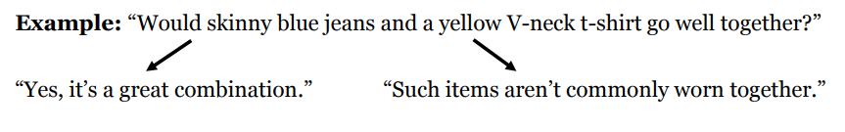
Problem definition : Conversational AI
Answering questions based on information from images.
Domain : fashion but should be extensible to other domains

Slide 4
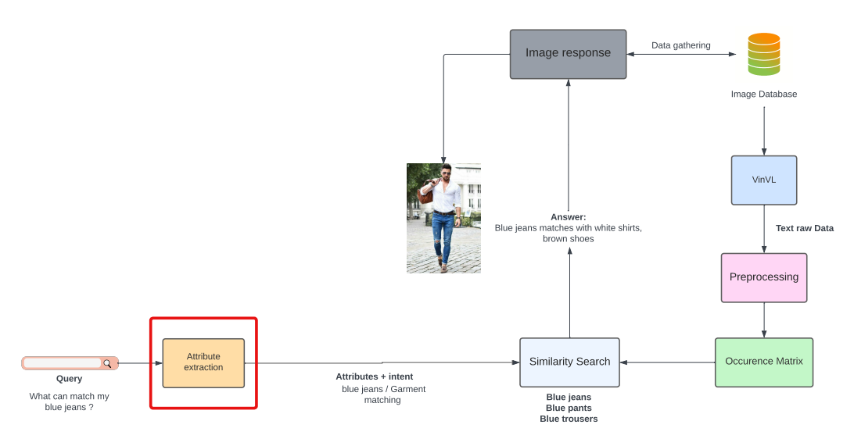
Detailed architecture

Slide 5
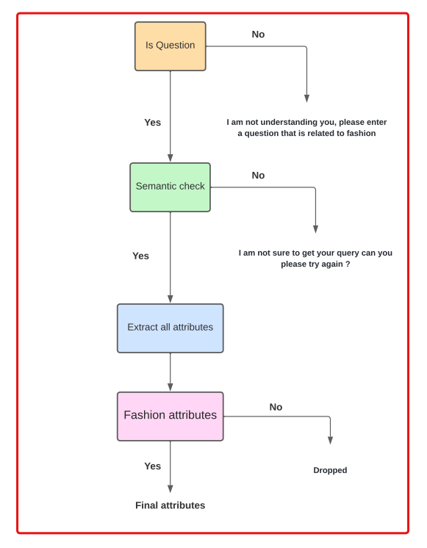
Detailed architecture

Slide 6
Last cohort
Finding a list of promising datasets
Getting a working version of VinVl
Generating and basic preprocessing of the co-occurrence matrix

Slide 7
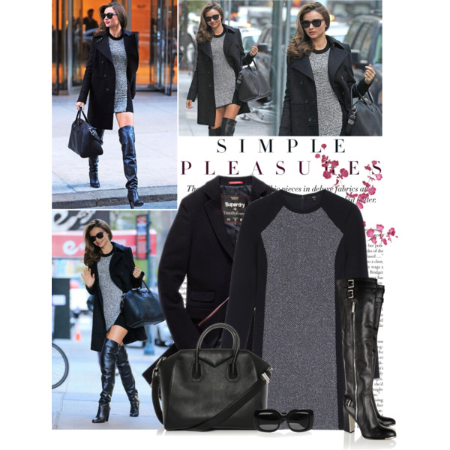
Image data
Polyvore dataset
33000 samples of mixed fashion gender
Multi distributed data

Slide 8
Models trained and data used
Semantic check model
Fashion attributes detection models
Both NLP models based on pre-trained BERT architecture (distilBERT base uncased ) with manually annotated dataset

Slide 9
Image response
Display image of matches from our own dataset
Some preprocessing in order to get normalized answers
Promising results (sometime even better that a google query search)

Slide 10
Metrics & Evaluation
Manuel annotations of fashion clothes vs results of our model (100 rows)
Accuracy : 87 %
Can be improved by getting more data and some quick modifications in the pipeline

Slide 11
Deployment
Telegram chatbot
Intents: Garment matching / Garment advice / Other
Deploying on Heroku using Docker containers in order to avoid ressources restrictions

Slide 12
Advantages of our approach
Easily Portable from a domain to another
Data dependant approach
Incremental process that improved team work and obtained fast results

Slide 13
Further improvements for next cohort
Make a more responsive bot (Add more intents and interactions)
Improving the quality of the dataset will improve the prediction (manual cleaning or find a more promising one).
Get a confidence level to the prediction
Limited by VinVL in terms of detailed fashion

Slide 14
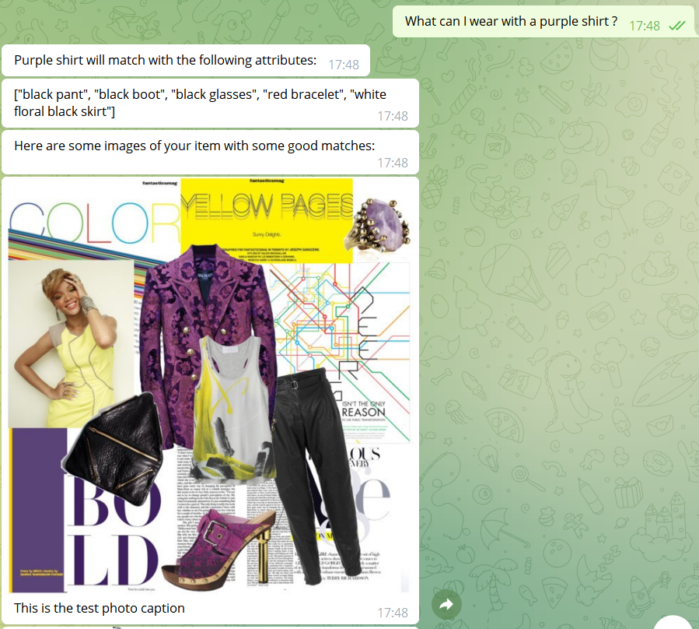
Live demo !

Slide 15
THANK YOU!
Time for your questions

