Slide 1
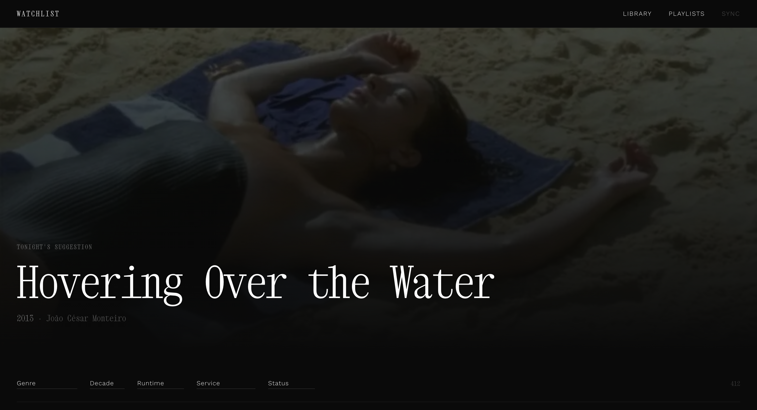
Personal project — 2026
Watchlist
A personal film library rebuilt from a Letterboxd export.
1 / 13

Slide 2
01 — PROBLEM
Letterboxd is a social platform.
This needed to be a personal one.
[object Object],[object Object][object Object],[object Object][object Object],[object Object][object Object],[object Object]
"I know what I like. I don't always know what I want to watch."
2 / 13

Slide 3
02 — BRIEF
Three things Letterboxd doesn't do.
[object Object],[object Object][object Object],[object Object][object Object],[object Object]
The question was never "how do we display films?" It was "what is the right relationship with this collection?"
3 / 13

Slide 4
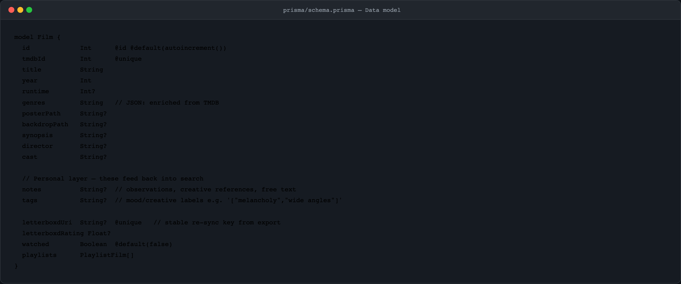
03 — SETUP
The data was a starting point,
not the product.
A Letterboxd export is a flat CSV — title, URI, date added, rating. Every entry was enriched via TMDB: backdrop, poster, synopsis, director, cast, streaming.
The schema also carries a personal layer — notes and tags that feed back into search. That transforms a spreadsheet into a library.
4 / 13

Slide 5
04 — DESIGN DIRECTION
A library, not a watchlist.
TYPOGRAPHY
PALETTE & LAYOUT
TONE OF VOICE
Xanh Mono for display — monospaced, editorial, precise. Not consumer. Work Sans 300 for body — light and unobtrusive.
Near-black, neutrals. Films as objects, not content. Full-bleed backdrops at low opacity — atmosphere before information.
"Tonight's suggestion" not "Featured." "A moment." not "Loading…" The copy is curatorial throughout.
5 / 13

Slide 6
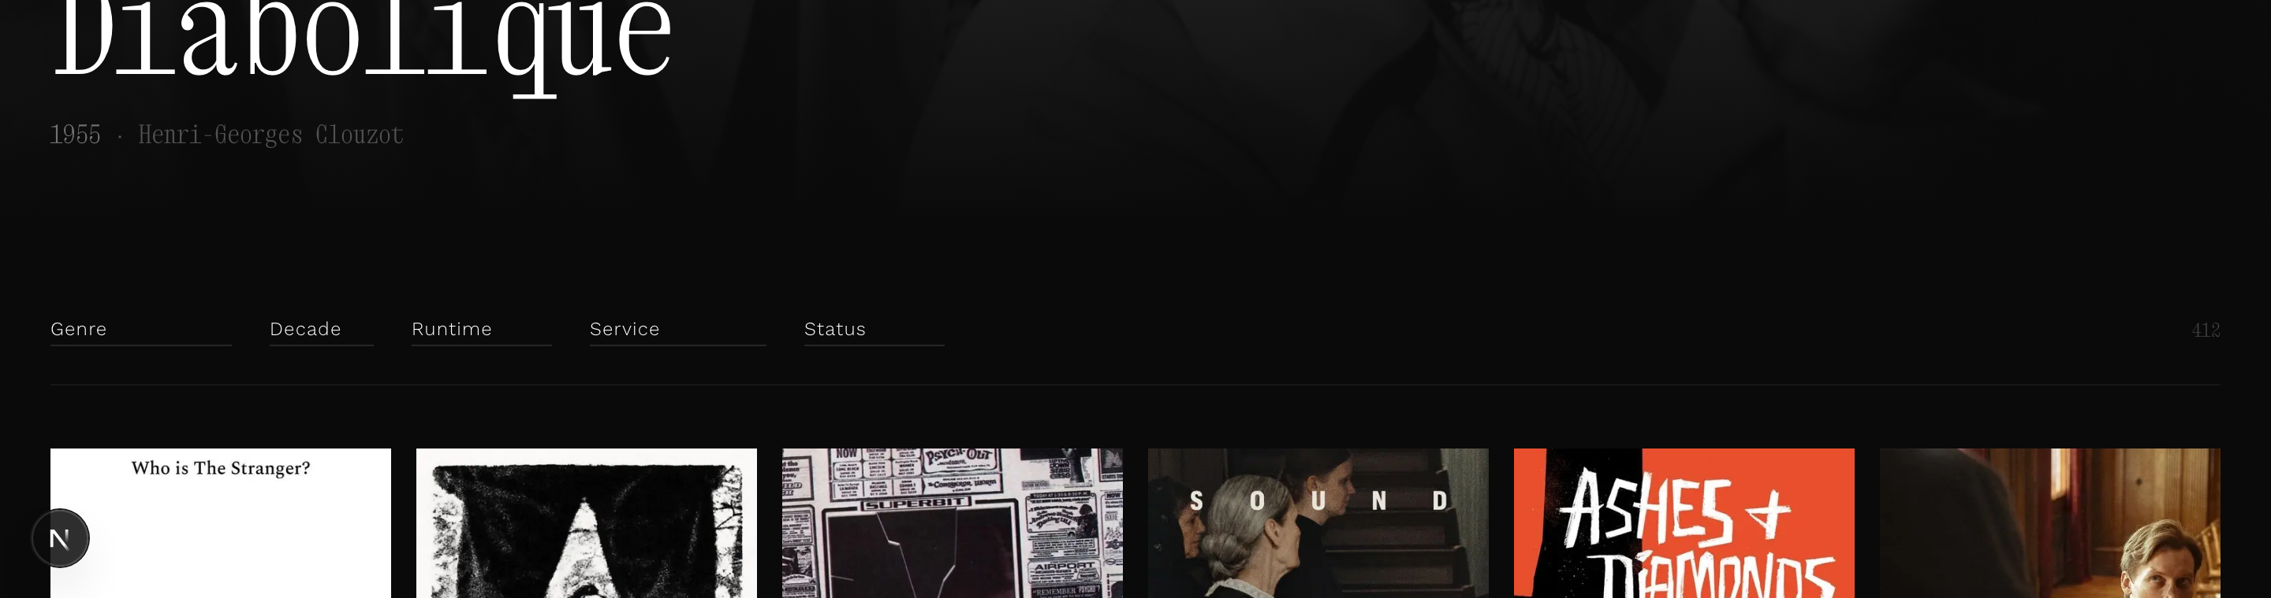
05 — THE LIBRARY
Browse.
Filter by genre, decade, runtime, streaming. "Tonight's suggestion" — a random pick from films with backdrops, resets on refresh. Serendipity as a feature, not an afterthought.
Watched indicator: a single pixel-thin line at the top of the poster card. Minimal — enough.
6 / 13

Slide 7
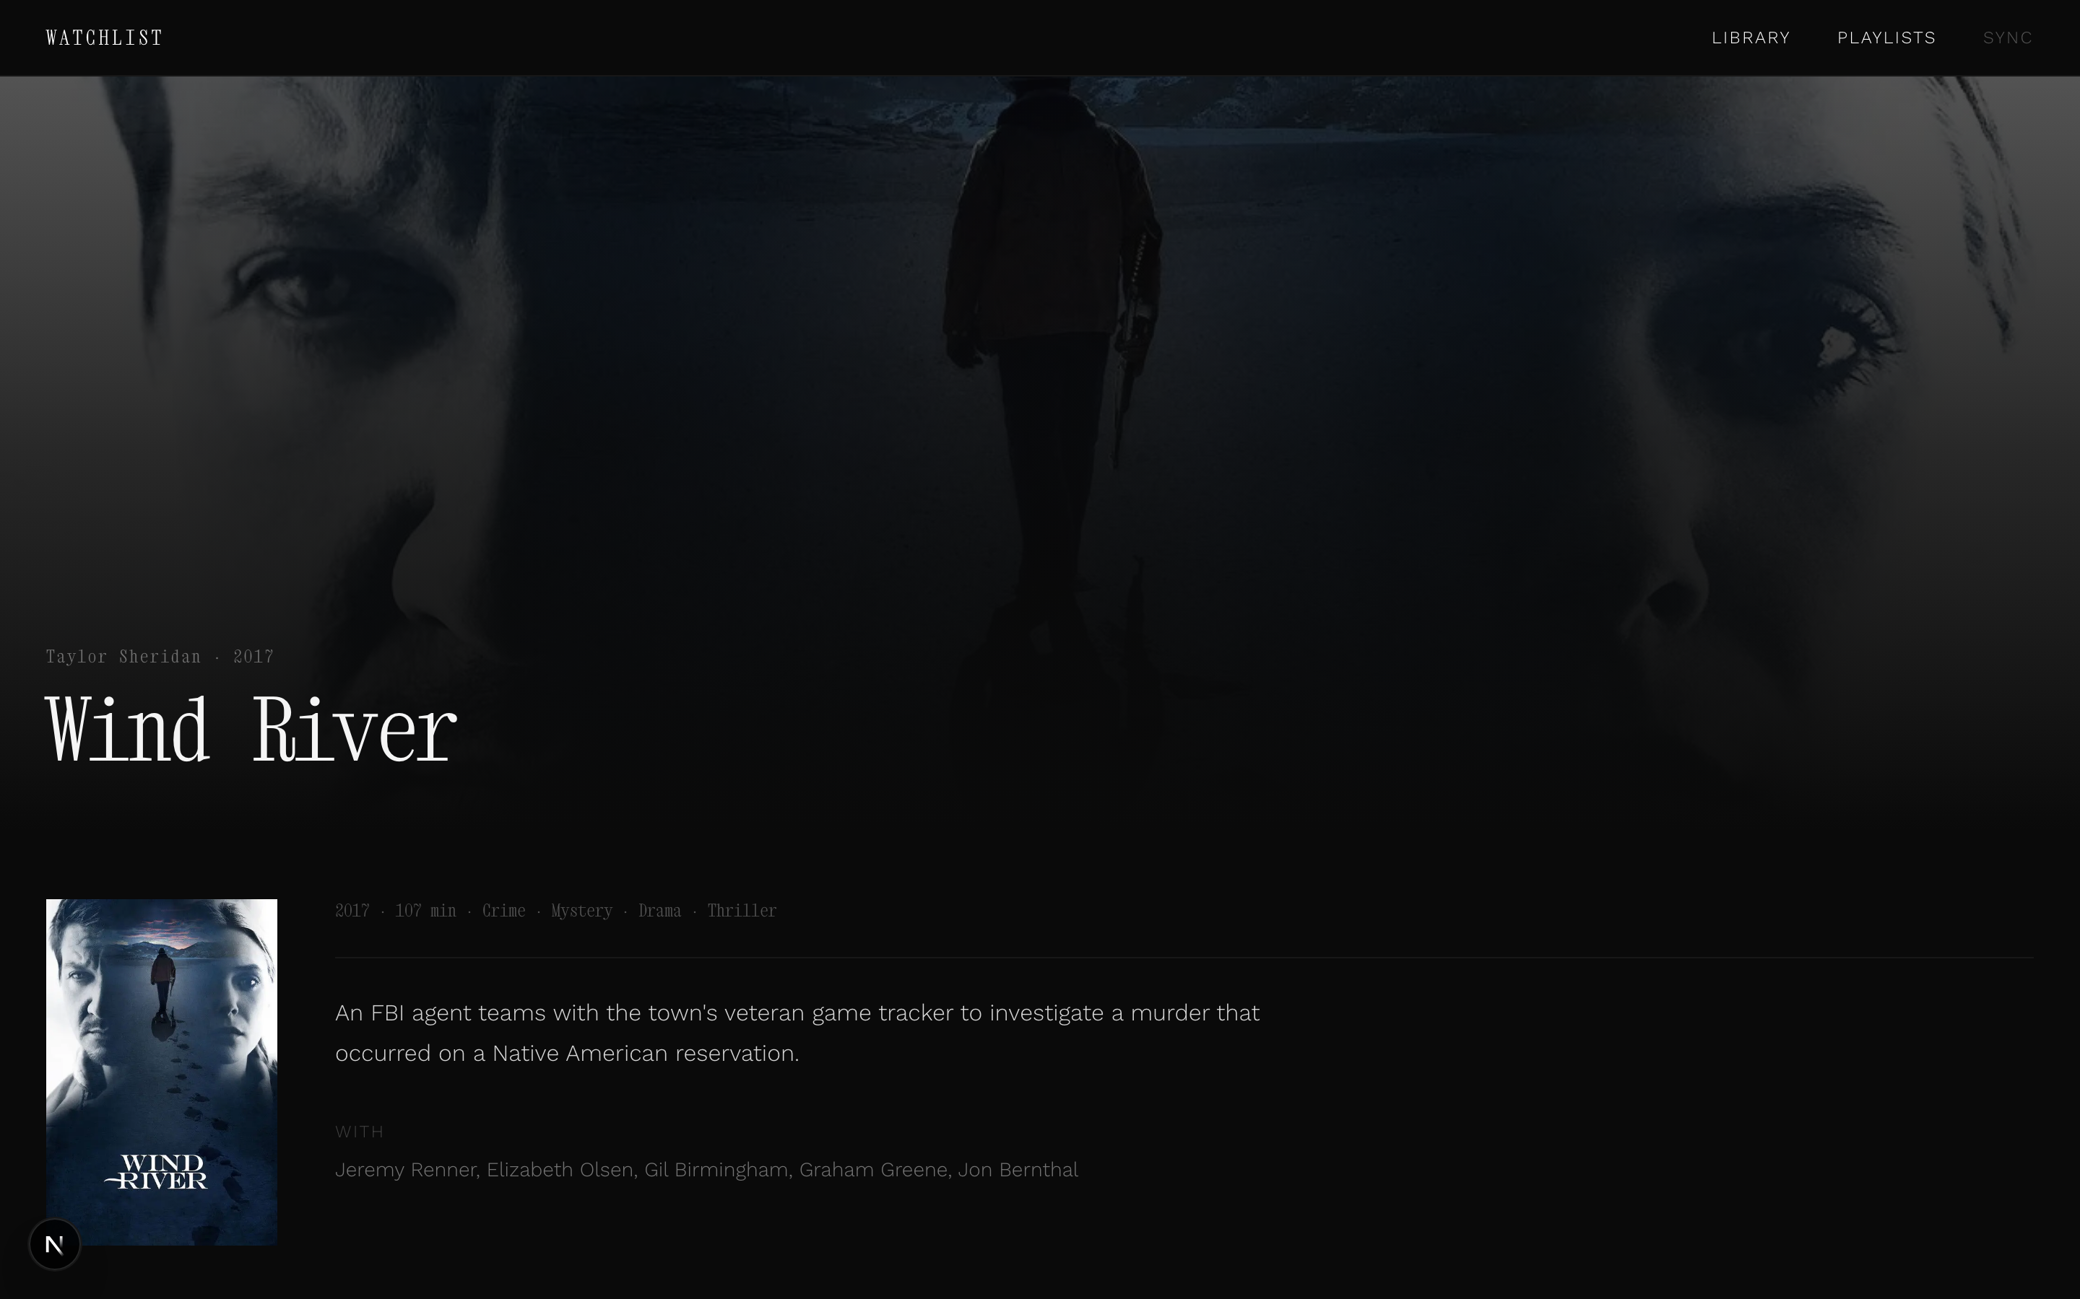
06 — FILM PAGE
Atmosphere before information.
Full-bleed backdrop at low opacity. Personal notes field — free text, for your own references and observations. Custom tags: mood labels, visual references, anything.
The annotations feed back into search. The more you write, the sharper the library gets.
7 / 13

Slide 8
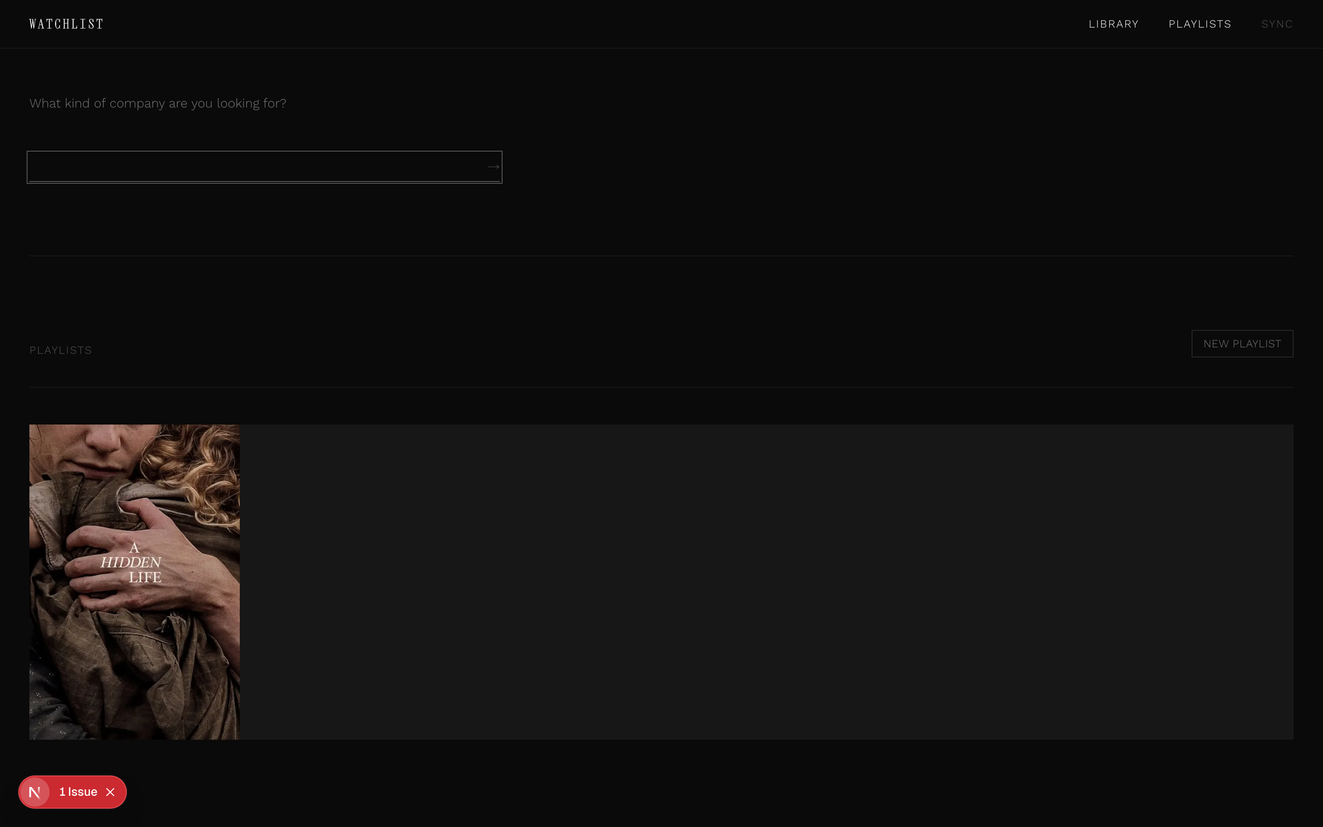
07 — ITERATION
The search box was wrong.
First version: a search box. Problem: search is transactional — it assumes you know what you want.
The insight: most of the time you know how you feel, not what you want. So the interface needed to meet you there.
Decision: make it conversational. Two steps — mood, then sharpener. The follow-up questions pattern-match emotional vocabulary and ask one precise question back.
8 / 13

Slide 9
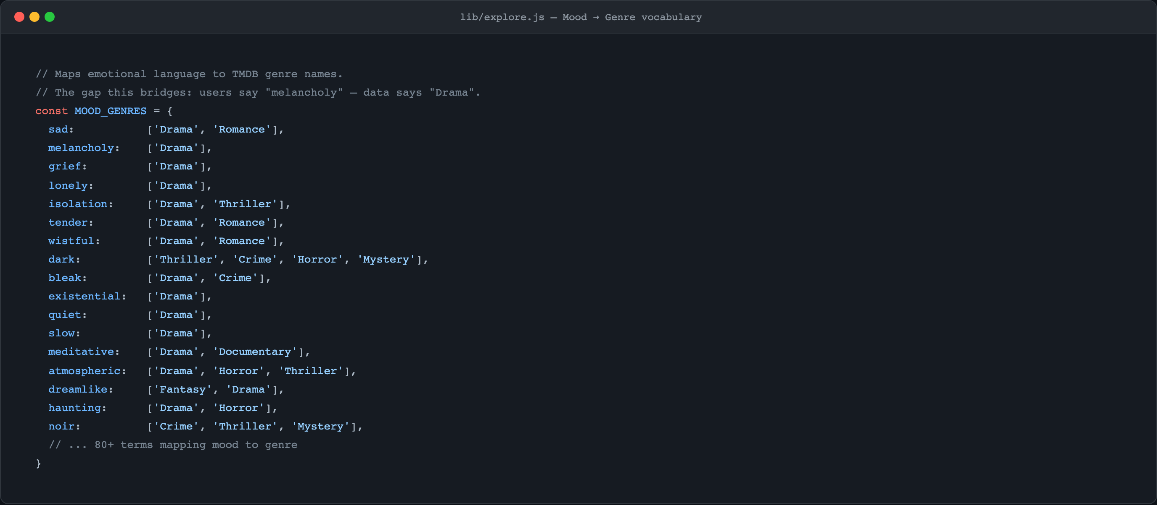
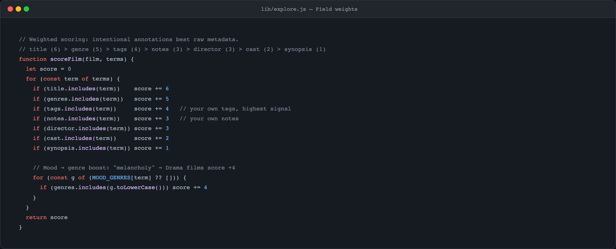
08 — PROCESS
No AI. Pure vocabulary.
In-memory keyword scoring, runs in under 5ms. A hand-built table maps emotional language to genres. "Melancholy" → Drama. "Noir" → Crime, Thriller, Mystery.
Why not an LLM? Latency felt wrong for something immediate and private. Being explicit about the vocabulary is also more honest — you can see exactly what the system knows about your taste.
9 / 13

Slide 10
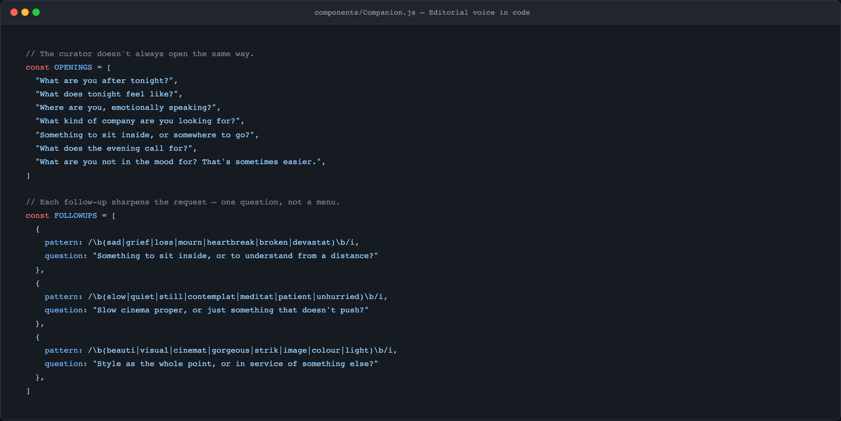
08 — PROCESS
Editorial voice
written as code.
The opening questions rotate. The follow-ups don't offer a menu — they ask one more precise question. The copy was written before the code.
"Something to sit inside, or to understand from a distance?"
"Slow cinema proper, or just something that doesn't push?"
"Style as the whole point, or in service of something else?"
10 / 13

Slide 11
09 — ITERATION
Decisions made.
DECISION
FIRST VERSION
WHY IT CHANGED
Hero framing
Featured film
"Tonight's suggestion" — editorial framing changes the relationship with the content
Discovery
Search box
The Companion — search assumes prior knowledge you often don't have at 11pm
Mood → genre
Genre filter only
MOOD_GENRES vocabulary bridges how you think to how data is tagged
Search engine
Explored Claude API
Latency + cost felt wrong; hand-built vocabulary is more immediate and honest
Watched marker
Badge / icon overlay
1px top border — present enough to register, absent enough not to dominate
11 / 13

Slide 12
10 — LEARNINGS
What this taught.
ON DESIGN
ON PRODUCT
[object Object],[object Object][object Object],[object Object][object Object],[object Object]
[object Object],[object Object][object Object],[object Object][object Object],[object Object]
12 / 13

Slide 13
11 — NEXT
Where it goes.
[object Object],[object Object][object Object],[object Object][object Object],[object Object]
13 / 13

