Slide 1
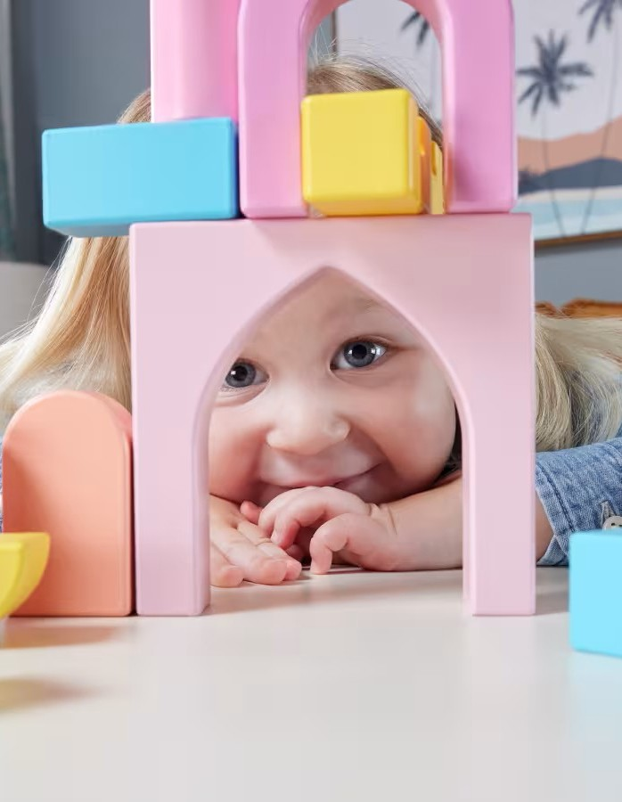

AMAZON TOY CATEGORIES ANALYSIS -
Pricing, Popularity & Positioning
Liliia Rastorhuieva | Portfolio Project | 2025

Slide 2

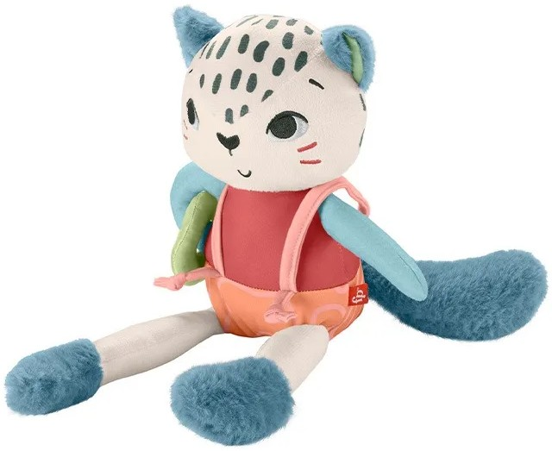
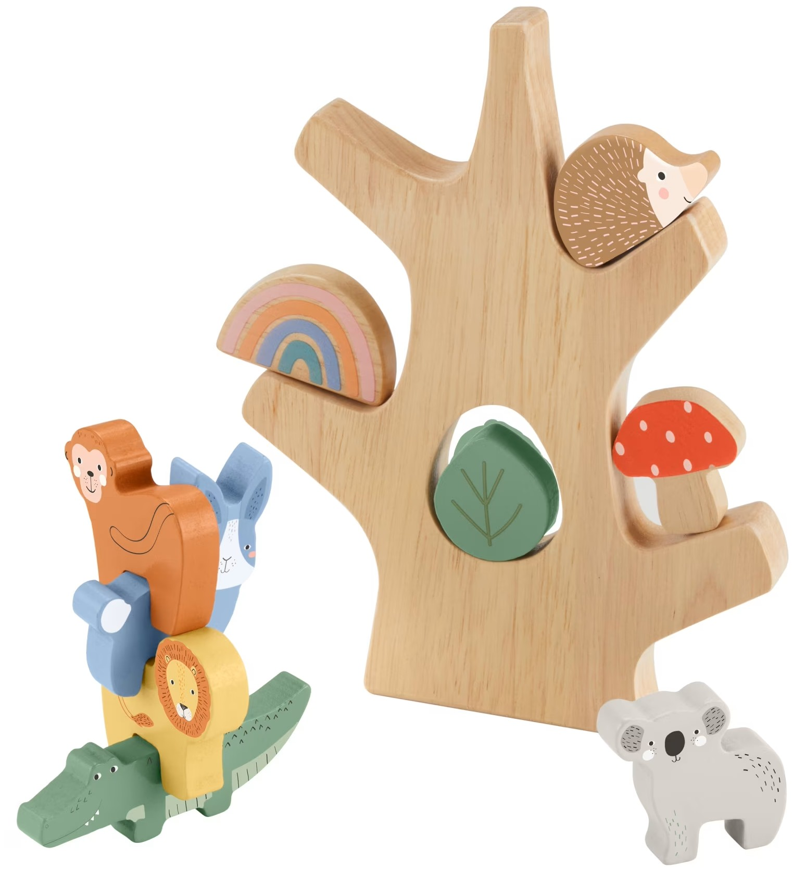











Data Context / Overview
Store: | Fisher-Price products on Amazon.de
Dataset includes: | Key product info (price, old price, discount, stock, reviews count, age, weight, description); Calculated metrics (€/g, price per year, value for money, review density); Keyword flags (emotional, educational, eco); Price buckets: <10 € 10-20 € 20-30 € 30-40 € >=40 € Outliers (prices & reviews)
Categories analyzed: sustainable toys wooden toys baby toys
Purpose: | Provide insights into pricing, popularity, and positioning across toy categories.

Slide 3
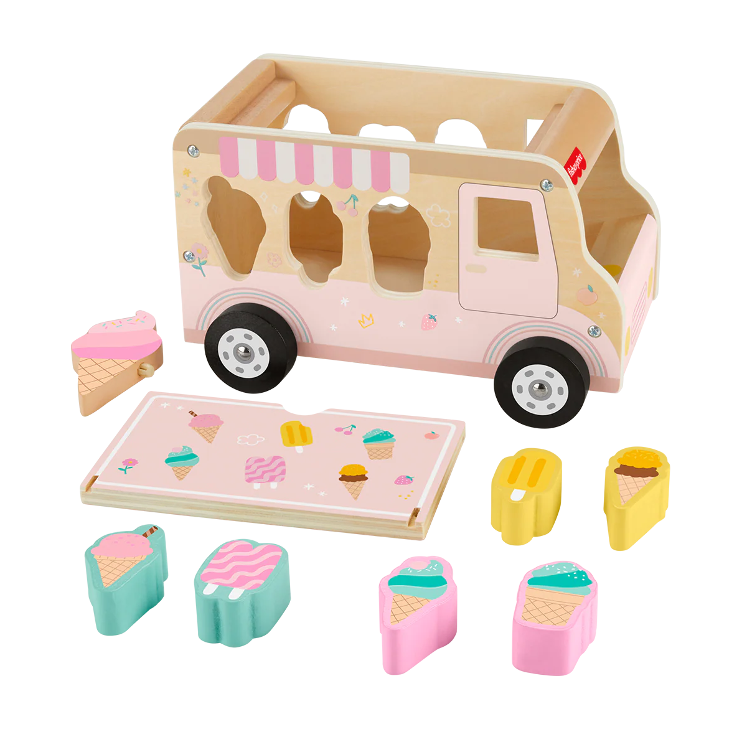
Key product info
price | old_price | discount | stock | reviews_count | min_age | max_age | weight_grams
€12.99 | €22.99 | 43% | 16 | 140 | 1.50 | 3.00 | 1050
€8.53 | €9.17 | 7% | 12 | 31 | 3.00 | 7.00 | 640
€17.47 | €19.99 | 13% | 3 | 157 | 1.00 | 3.00 | 495
€13.90 | €15.99 | 13% |  | 29279 | 0.25 | 3.00 | 470
© 2025 Liliia Rastorhuieva | Data Analytics Project

Slide 4

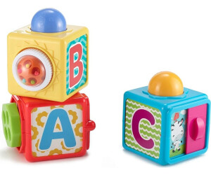
Data Workflow
Collect toy data from marketplace
Remove duplicates, fix formats, unify currencies
Summarize data, calculate shares, medians, and category splits
Data scraping
CSV Export
Data Cleaning & Normalization
Feature Engineering
Pivot Tables & Aggregation
Visualization & Insights
Store raw structured data in tables
Derived metrics, flags & outliers
Charts + interpretation for business questions

Slide 5
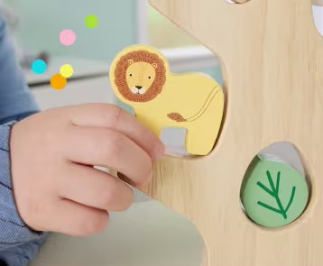
Main Research Question:
Which toy categories have the highest potential for sales considering price segments, popularity (reviews), and positioning (keywords)?
Sub-questions:
How do prices and discounts differ across categories?
Which categories are most popular and why?
Where is the best balance of price vs value (value for money)?
How are categories positioned via keywords (emotional, Montessori, eco)?
Where are anomalies or super-hit products?

Slide 6
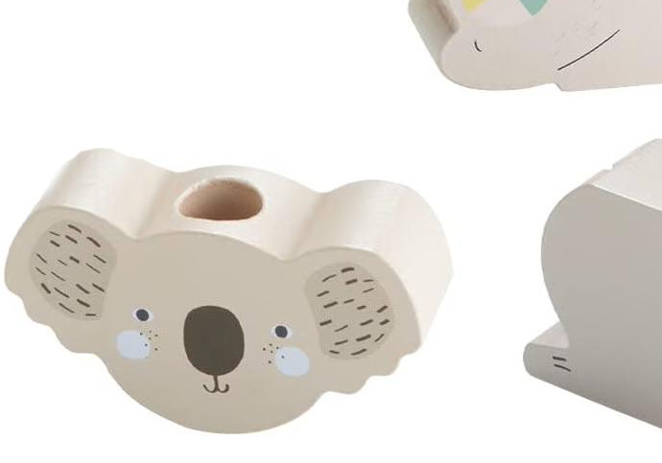
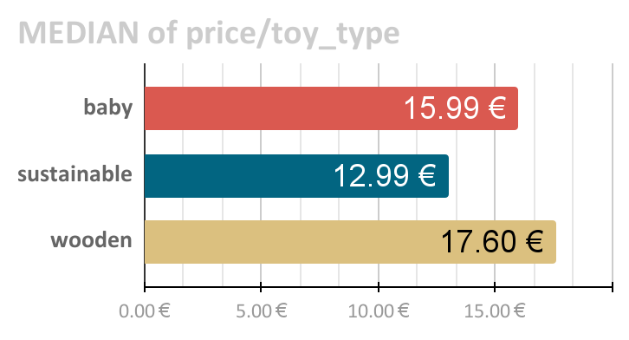
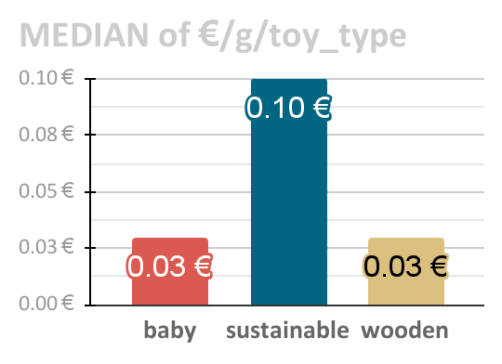
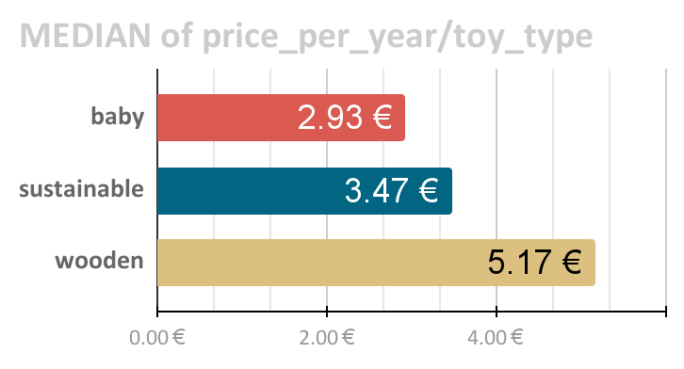
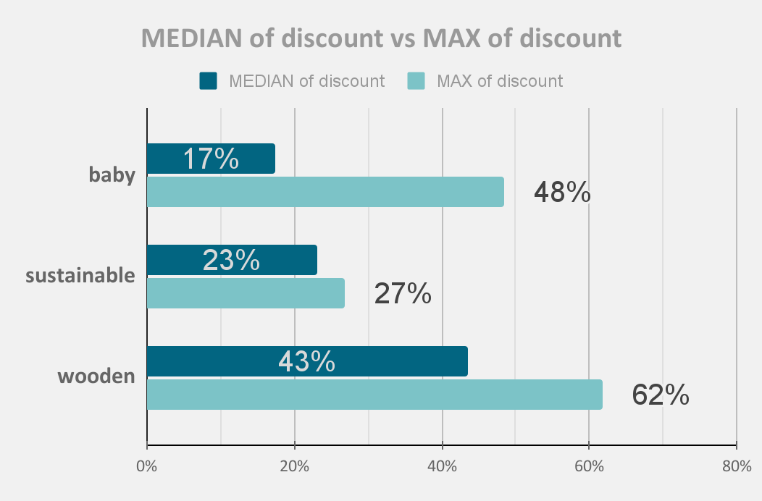
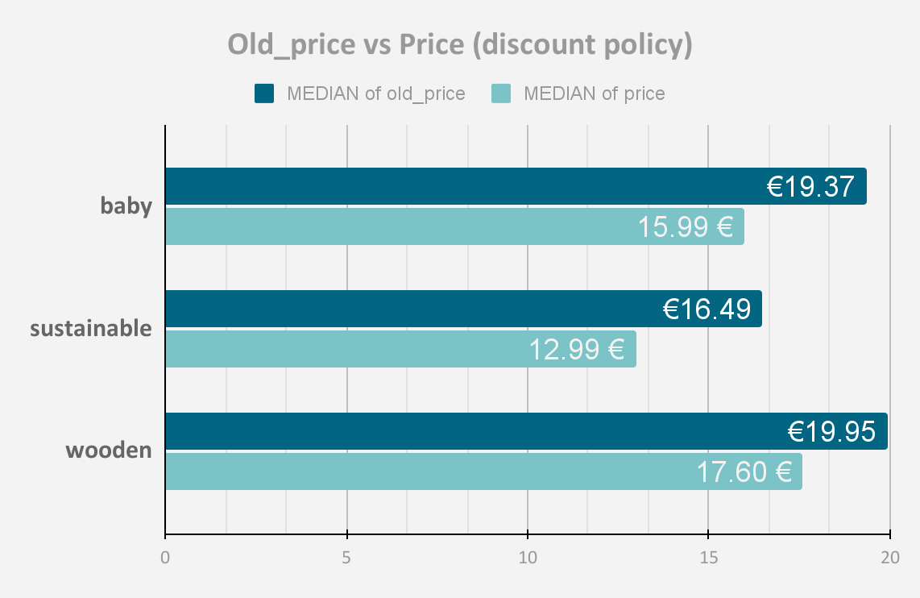
Pricing & Discounts

Slide 7
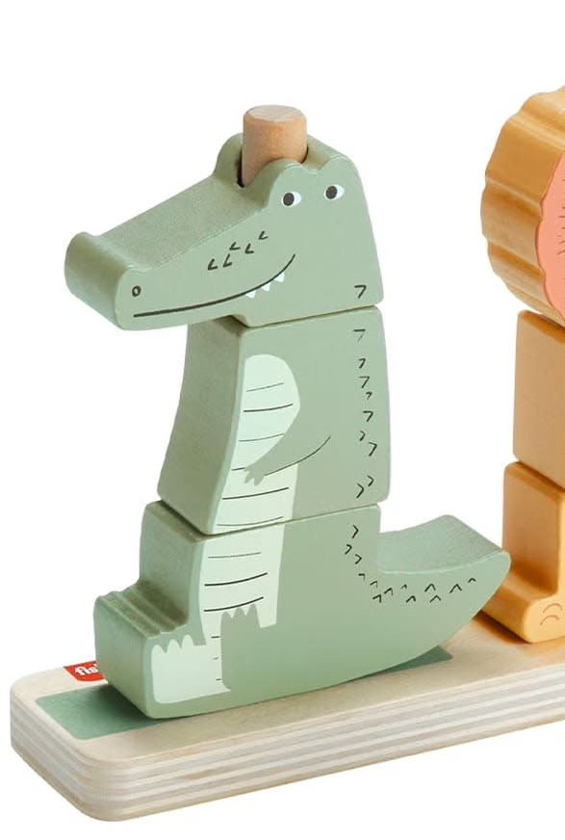
Pricing & Discounts Insights
Wooden: Premium segment - median price €17.60, median price per year €5.17. High median discounts 43% (max 62%) suggest discounts are used to stimulate sales of premium products. Low €/g median (€0.03) suggests higher material density and/or heavier construction, which may indicate premium or durable materials.
Baby: Mid-market segment - median price €15.99, median price per year €2.93. Median discount 17% (max 48%) reflects moderate discounts; median €/g (€0.03) signals accessible materials and mass-market appeal. Highlights strategic focus on wide selection and mass appeal.
Sustainable: Budget-friendly segment - median price €12.99, median price per year €3.47. Median discount 23% (max 27%) shows moderate, stable pricing. Median €/g €0.10 suggests lighter/smaller items, delivering transparent and “honest” pricing without artificial inflation.

Slide 8

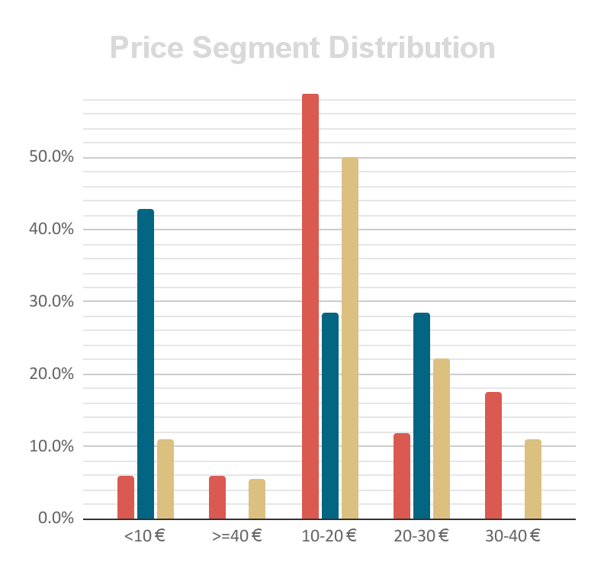
Assortment Insights
Baby: concentrated in the 10-20 € range (59%), with additional presence in 30-40 € (18%). Very limited budget (<10 € = 6%) and premium (>=40 € = 6%). This indicates a strong mid-market focus, with a smaller but notable premium tier.
Sustainable: almost half are budget (<10 € = 43%), another large share in 10-20 € (29%), and 20-30 € (29%). No presence in premium (>=40 €). Clearly positioned in the affordable segment. Unlike Baby and Wooden, Sustainable avoids premium tiers, emphasizing cost-effective options.
Wooden: majority fall in 10-20 € (50%), with some in 20-30 € (22%) and 30-40 € (11%). Small premium tier (>=40 € = 6%), and very limited budget (11%). This reflects a balanced mid-to-premium assortment, with stronger value perception compared to Baby.

Slide 9
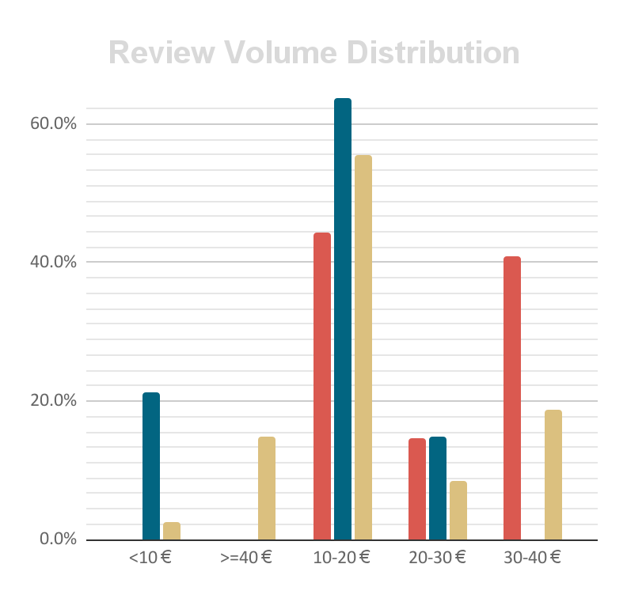
Demand Insights
Wooden: 10-20 € (56%), plus notable >=40 € (15%) and 30-40 € (19%) - real premium demand.
Sustainable: concentrated in 10-20 € (64%), some in <10 € (21%) and 20-30 € (15%). No premium.
Baby: demand split - 10-20 € (44%) and 30-40 € (41%). Almost no premium (>=40 € = 0,1%).
All categories show strong mid-range (10-20 €) demand.
Wooden is unique in showing additional premium demand (>=40 € = 15%) and higher-price interest (30-40 € = 19%).
Baby shows a dual mid-range peak (10-20 € and 30-40 €). Several super-hit products drive.
Sustainable remains concentrated in mid-range (10-20 €). Steady, consistent demand.

Slide 10
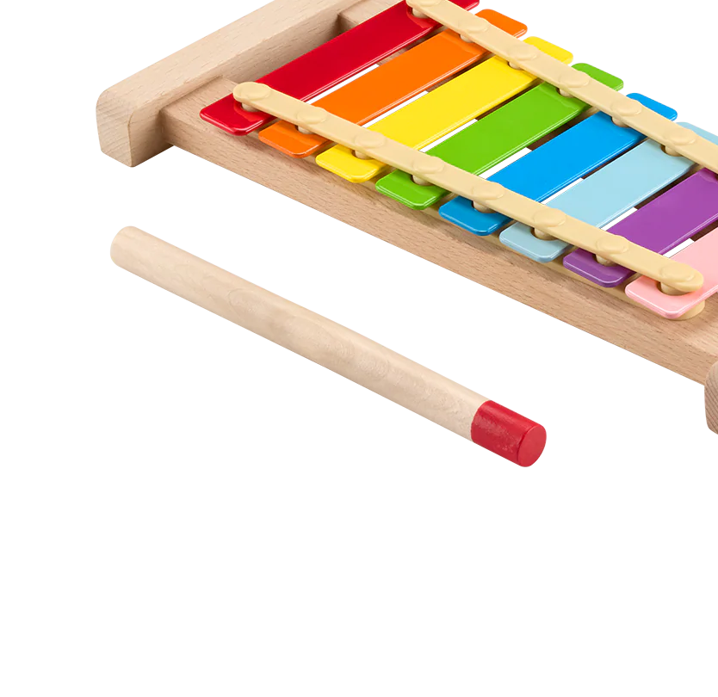
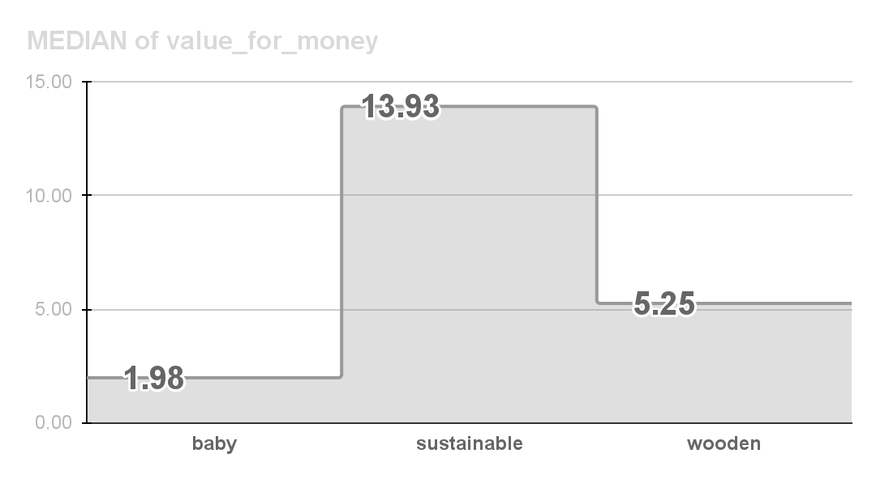



Customer Perceived Value
 | Median Value for Money | Median Reviews | Median Price/Review
 | 1.98 | 39 | 0.091
 | 13.92 | 136 | 0.072
 | 5.25 | 83 | 0.2
Sustainable: highest value (13.93), consistent popularity (median reviews = 136).
Wooden: moderate value (5.25), higher price per review (0.2) -
premium positioning.
Baby:
low value (1.98) despite moderate popularity - mid-market with super-hit products driving reviews.

Slide 11
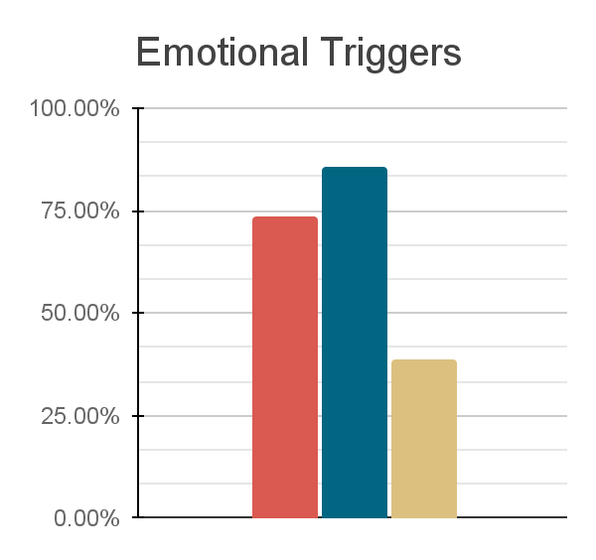
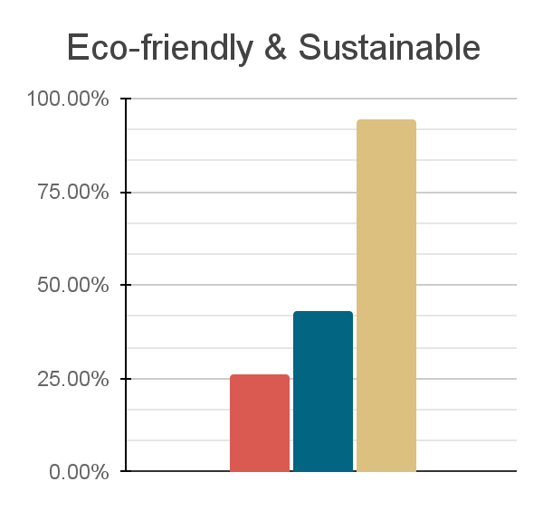
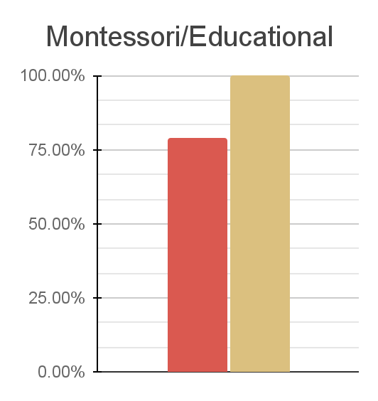

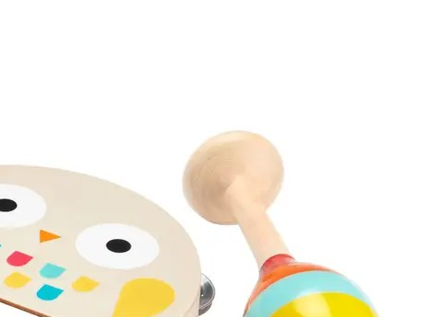
Positioning & Keywords
86% - Sustainable
74% - Baby
39% - Wooden
94% - Wooden
43% - Sustainable
26% - Baby
100% - Wooden
79% - Baby
0% - Sustainable

Slide 12

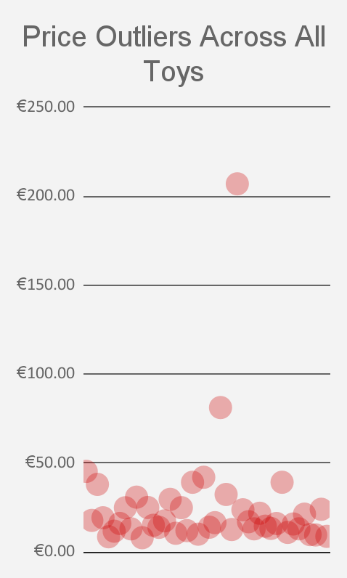
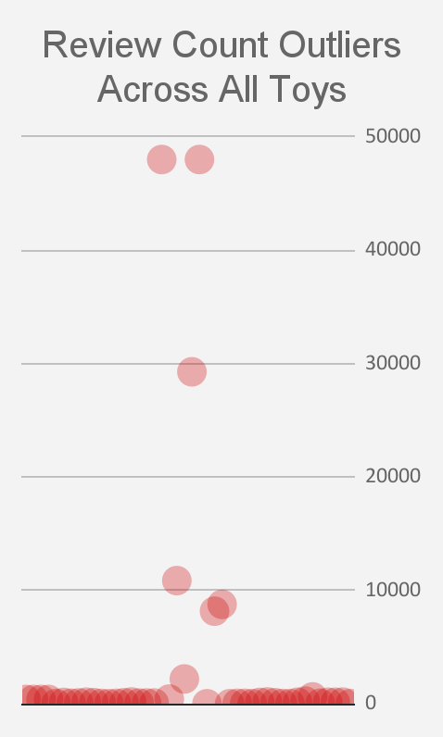
Outliers & Anomalies
A few “super-hit” Baby toys show extreme review counts and were excluded to maintain clarity in the analysis.
48002
€206,99
Most toys fall around €50. Two items are significantly higher in price and were excluded from the analysis to avoid skewing results.
29279
€81,19
10862

Slide 13
Category Insights (Summary Table)
Category | Assortment Focus | Demand & Reviews | Perceived Value | Positioning (Emo/Eco/Edu tags)
 | 59% in 10-20 €, 18% in 30-40 €, limited budget and premium. Mid-market + higher-mid | Demand split: 44% in 10-20 €, 41% in 30-40 € (dual peak) A few “super-hits” in <10 € | 1.98 | - 79% - 74%
 | 43% <10 €, 29% in 10-20 €, 29% in 20-30 € Budget + mid-market, no premium | Highly concentrated 64% in 10-20 € Steady mid-range | 13.93 | - 86% - 43%
 | 50% in 10-20 €, 22% in 20-30 €, 11% in 30-40 €, limited budget and premium.Mid-to- premium | Unique premium demand (15% in >=40 €, 19% in 30-40 €) | 5.25 | - 100% - 94%
*
Baby
Sustainable
Wooden

Slide 14

Business Recommendation & Strategy
Main Question:
Which toy categories have the highest sales potential considering price segments, popularity, and positioning?
Answer:
Baby - Mass-market, high demand, but crowded - short-term volume strategy
Wooden - Premium, low competition, strong eco/educational perception - strategic brand positioning in high-value segment
Sustainable - Budget-friendly, stable demand - core eco line, niche but reliable

Slide 15
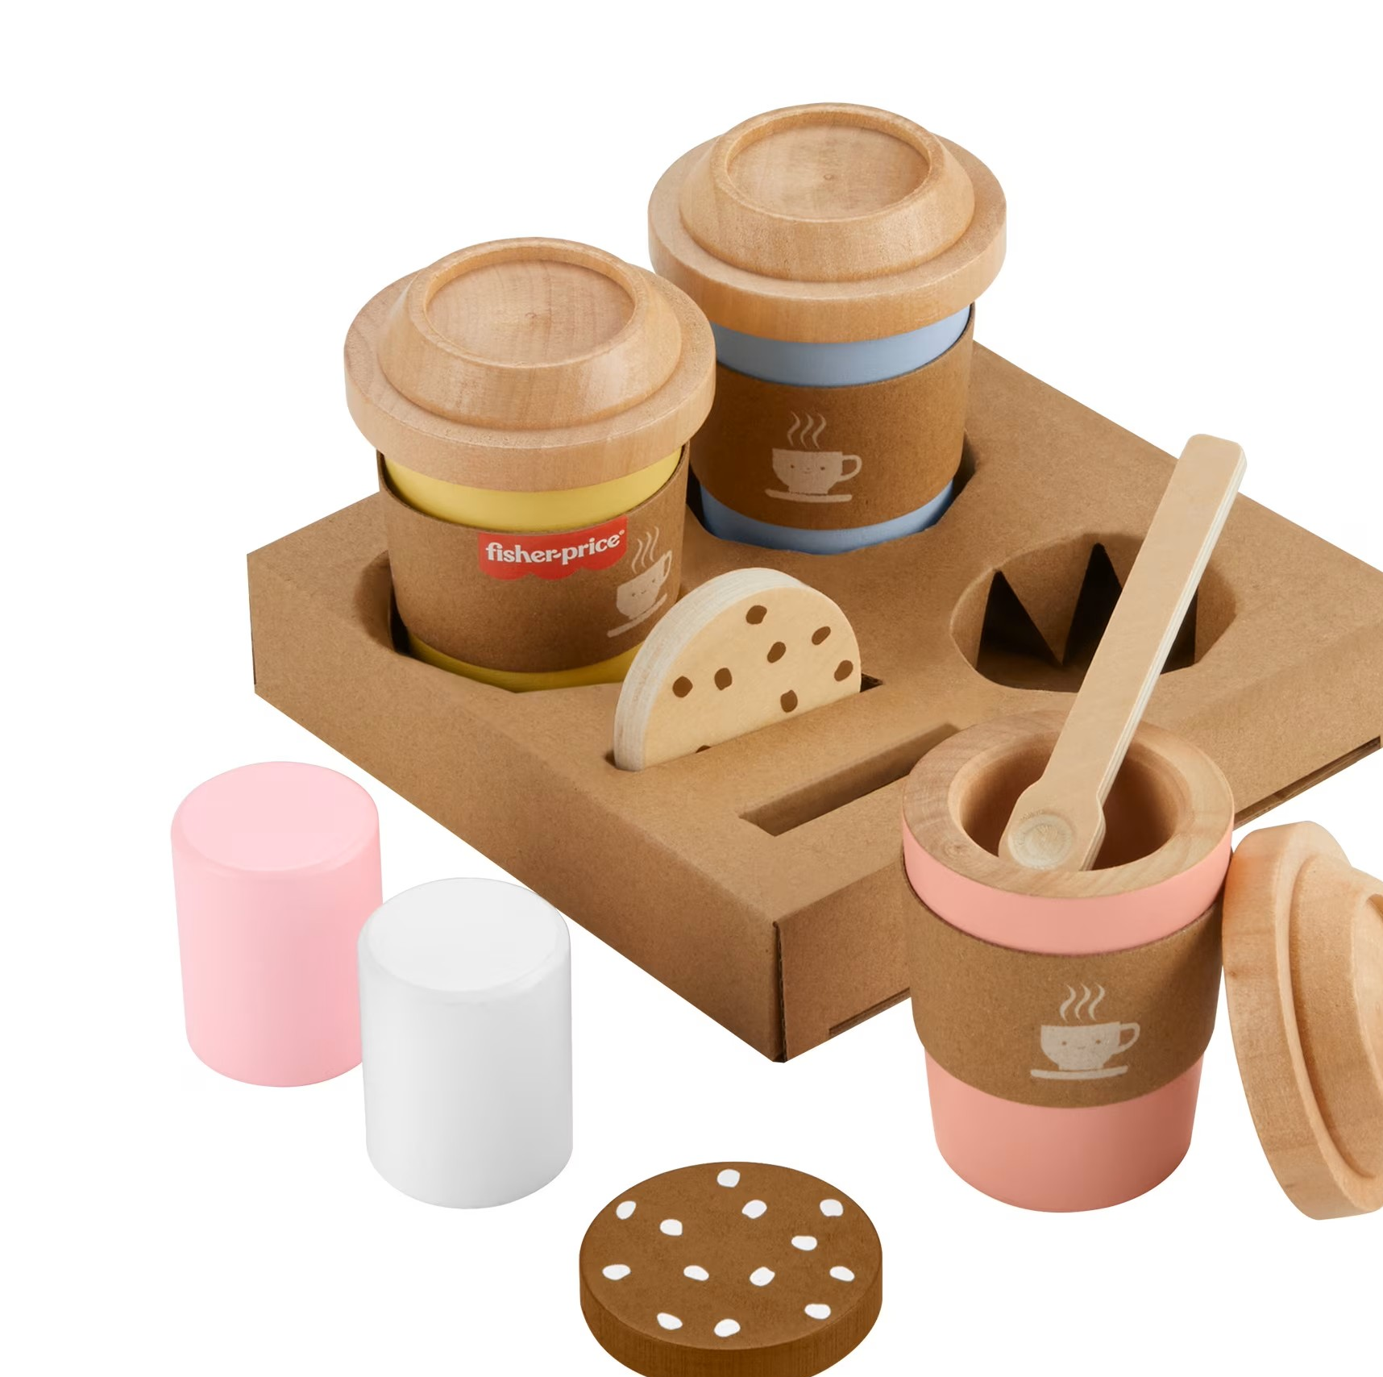
Limitations & Next Steps
Limitations:
Single store data only
Focused on 3 base categories: Wooden, Sustainable, Baby (all non-Wooden, non-Sustainable); functional/marketing ones overlap and were excluded
Quantitative scope only (price, reviews, keywords)
Seasonality, marketing, social trends not included
Next Steps:
Collect data from 10–15 stores / marketplaces
Analyze social media trends (TikTok, Instagram, Pinterest)
Conduct detailed review text analysis: frequency, pain points
Competitive analysis: prices, positioning, promo messages
Consider seasonality and marketing campaigns

Slide 16
Data: Amazon.de (scraped, 2025)
Images: Open web sources (Google Images / product pages), used for educational & non-commercial portfolio purposes only

