Slide 1
Lead Scoring Analysis
Submitted By: Ujjwal Rastogi
(DS C57)

Slide 2
Index
Objective
Analysis approach
Data preparation: Categorial columns
Data preparation: Numeric columns
Dummy variables preparation
Model building: Baseline model
Model building: RFE
Model Evaluation

Slide 3
Index
Finding the cutoff
Making predictions
Conclusion

Slide 4
Objective
The objective of this analysis is to train a logistic regression model and assign a lead score between 0 and 100 to each of a lead coming in to X Education, where higher score means a higher probablity of conversion and vice versa.
This score will then be used by the sales team to target leads that have higher chance of conversion.

Slide 5
Analysis Approach
The data is studied, Select value treated, then the columns that have high null or low variance are removed.
Columns that have outliers get imputed with a maximum and minimum values.
Numeric columns with low percentage of nulls are imputed with median.
Dummy variables are then made and numeric value scaled.
Then a model is build using RFE to identify the best features.

Slide 6
Data Preparation: Categorical columns
Some variables contains a keyword “Select” which is replaced with null.
Variables with high null percentage and low variance are removed.
Tags column, which seems to have information that we don’t get when a lead comes in, is also removed.
Some columns that have high null value but have a high converted percentage variance are not removed.

Slide 7
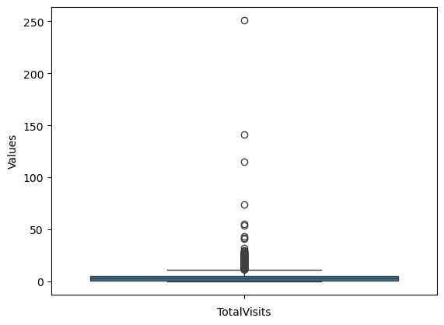
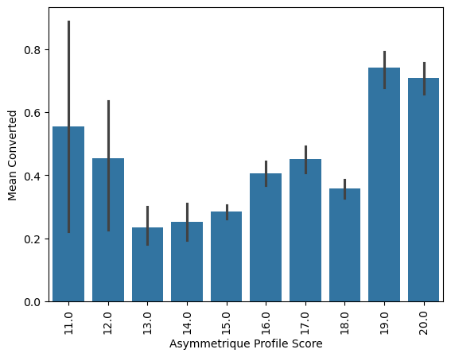
Data Preparation: Numeric columns
Some columns have outliers, such columns have values capped based on a set floor and ceiling.
“Asymmetrique Activity Score” and “Asymmetrique Profile Score” are added into a new column named “Asymmetrique Score” and the original columns are dropped.

Slide 8
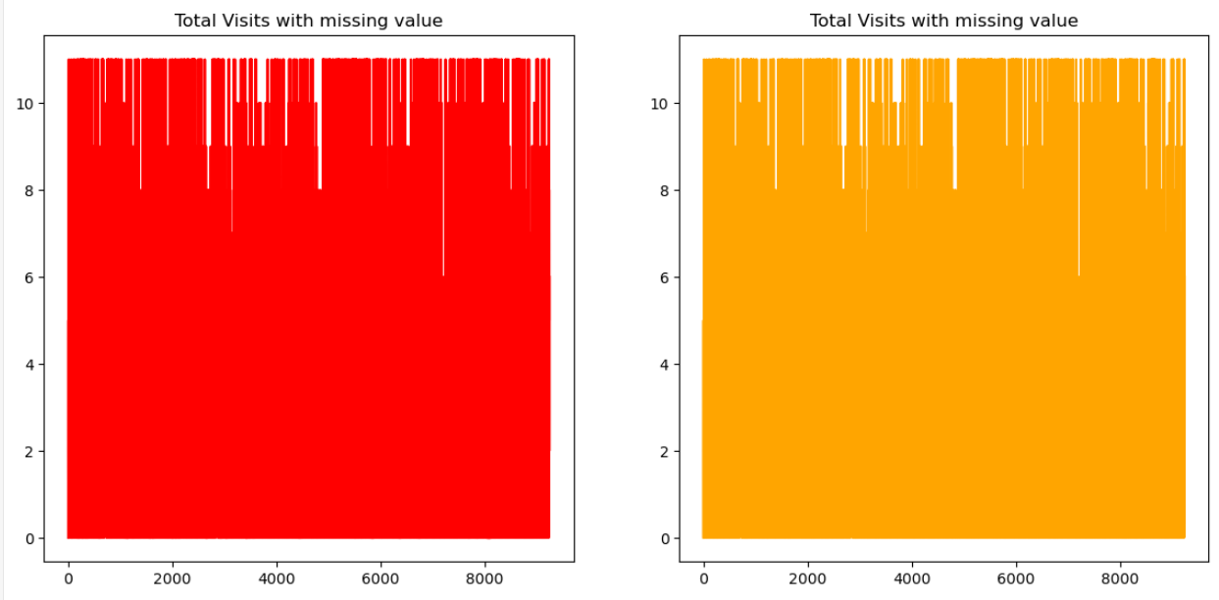
Data Preparation: Numeric columns
Some variables with low percentage of nulls are imputed using SimpleImputer with median strategy.

Slide 9
Dummy Variables Preparation
Total categorical columns are divided into two parts, one with high null values and one with no or low null values.
In categories with high null values, null is treated as a separate column by not adding “drop_first=True” parameter.
For low or no null categories, dummies are prepared normally, with “drop_first=True”.
Then all these are joined back to the original dataset and the original columns are dropped.

Slide 10
Model building: Baseline model
Data is split into test and train dataset using a technique called “Test-train split”. 80% of the data is used to train while 20% is used to verify the model.
Numeric Data is then scaled to avoid any bias due to scale of data.
After that, a baseline model is trained to get an idea about the accuracy and other metrics of the dataset.
In this baseline mode, the train accuracy is 0.852 while test accuracy is 0.849.

Slide 11
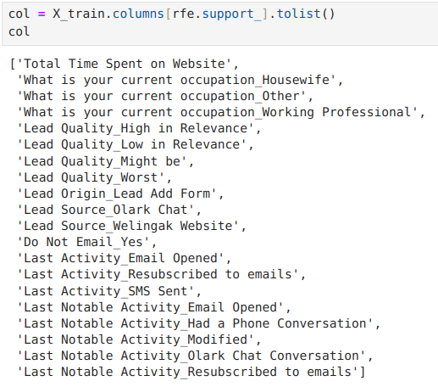
Model building: RFE
After building a baseline model, Recursive Feature Elimination (RFE) is used to find out the most important feature.

Slide 12
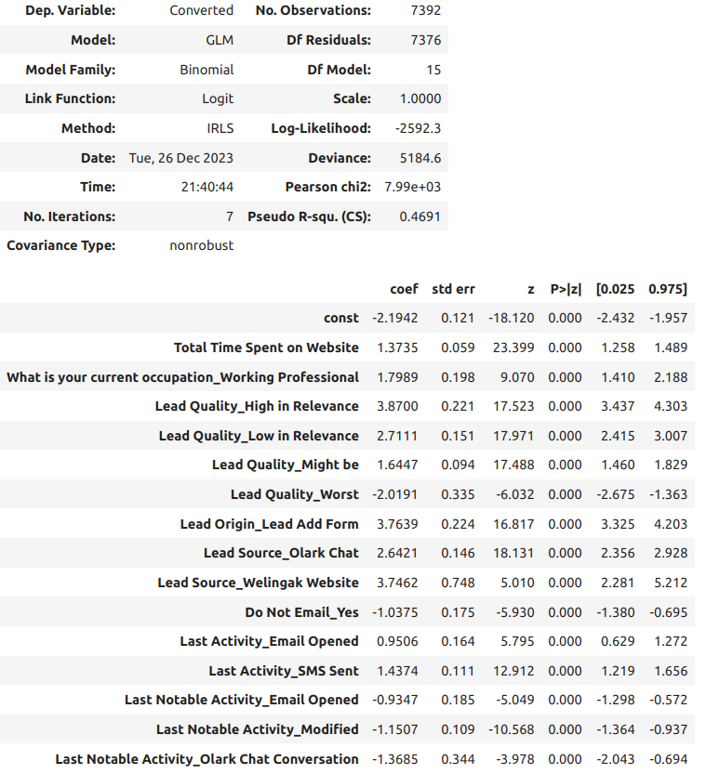
Model building: RFE
The model is then built using these columns and features with high VIF and p values are removed.
This is the final model we get.

Slide 13
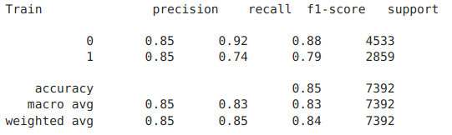
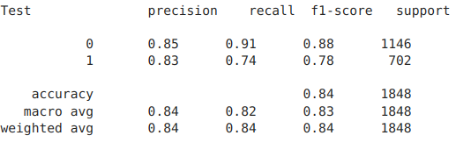
Model Evaluation
Model is evaluated using not just accuracy but other important matrices too.

Slide 14
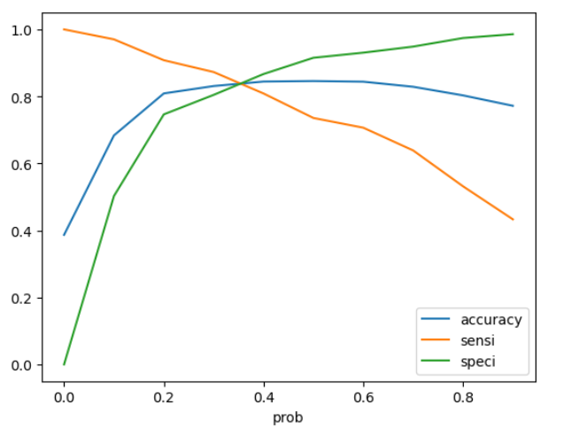
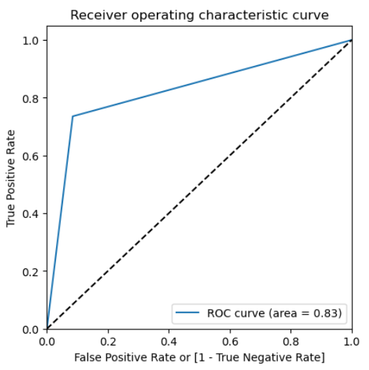
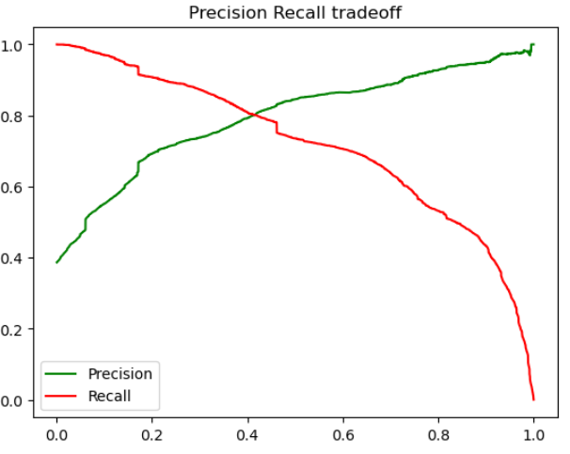
Finding the cutoff
By default, the cutoff is 0.5, but that may or may not be true. These plots will help us understand that better.

Slide 15
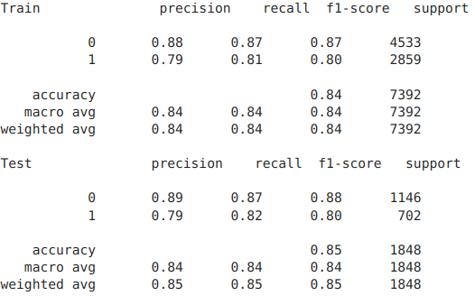
Finding the cutoff
Using the above plots, we can see that value of 0.4 or 40% should be the cutoff point for our model.

Slide 16
Making predictions
The above model is used to assign a Lead Score between 0 and 100 to every lead, where a high lead score means the lead is more likely to be converted.
The cutoff can be changed depending on the organization’s goal at any given time. Higher cutoff means higher chances of conversion while a lower cutoff means a large number of leads.

Slide 17
Conclusion
Lead Quality is one of the most important columns and sales team should be trained on how to assign lead quality.
Lead coming from “Lead Add Form” and “Welingak website” has more probablity to convert. These sources should be prioritised and marking team can also use this infomation to tune their campaigns.
Last activity and last notable activities are also a good indication of the quality of a lead.
The organization can use different cutoff for the lead score according to their goals.

Slide 18


