Slide 1
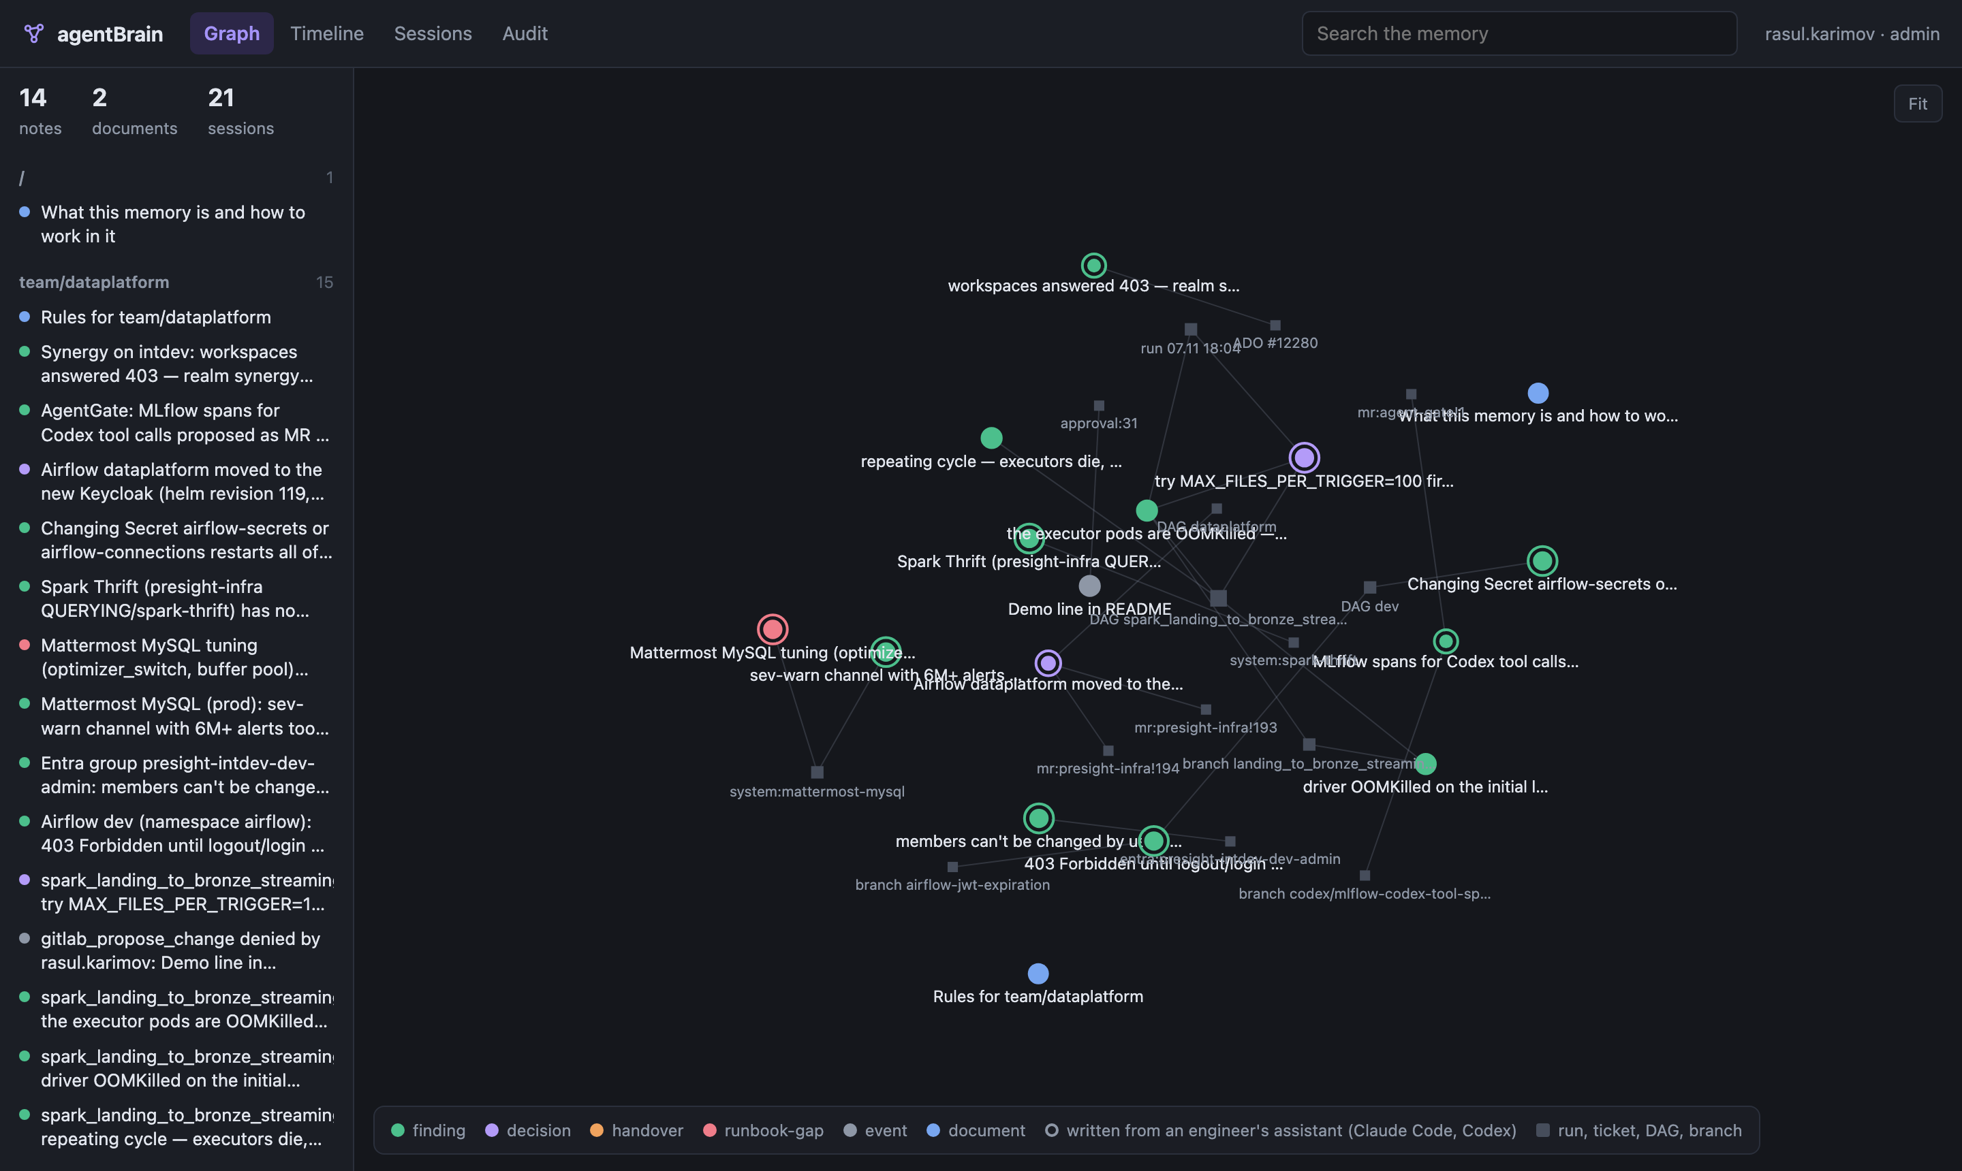
agentBrain
AI agents that remember
One governed, shared memory for every assistant a team uses — on Presight's own infrastructure.
Working today with
AgentGate on-prem agent
The live memory: notes from three assistants and what they link
Claude Code
Codex
Sovereign & Responsible AI · Rasul Karimov, Technical Operations
Notes:
agentBrain is the shared memory of a team's AI agents. Three different assistants already use it on our internal cluster.

Slide 2
What an agent learns stays locked in one conversation
One engineer, one failing Airflow job: three days, 19 messages, a single AgentGate conversation
Day 1
Day 3 · 08:45
Day 3 · 11:17
Day 3 · 12:53
"the DAG uses spark-delta-streaming.yaml with a specific image…"
"changed the version in the yaml, still failing"
"why did the first try fail?"
"why has this failed?"
Driver out of memory, the fix, then a new failure cycle — all found, all living only in that thread.
No colleague, new conversation or other assistant can see it
Twice in October work started in Claude was continued in Codex — Codex had to be told to read Claude's session log by hand.
Every assistant keeps its own memory, locked in one vendor's tool, invisible to the others and to colleagues.

Slide 3
Memory a regulated site can accept
Assistants' built-in memory can't run on sites that cannot call out — and where agents do run, nothing controls what they remember
Requirement | Built-in assistant memory | agentBrain
Stays inside the perimeter | Lives in the vendor's cloud | On our cluster; no model inside, no external calls
Rights: who may read what | Per user, or nothing | Workspaces by Keycloak group; agents get exactly the user's rights
Every write attributed | Not visible | Author, assistant, session and links on every note; full audit
A bad change can be undone | No history | Every session is one change, rolled back in one click
No secrets stored by accident | No control | A write with a secret-looking value is refused

Slide 4
One thin memory service, reached through MCP
AgentGate on-prem agent
agentBrain
Platforms
Workspaces of notes and documents
Changesets: one session = one change
Rules for agents live in the memory
Audit of every call
AgentGate writes facts — approvals, merge requests, runs — deterministically, not through the model
Claude Code
Codex
MCP · Keycloak sign-in, as the user
GitHub Copilot (next)
The platform records facts, the model records conclusions
No model inside: works on sites that cannot call out
Any approved assistant plugs in — the memory outlives the tool

Slide 5
Working today: picking up where the last session stopped
Asked AgentGate, on the on-prem model, with no hint about memory: "The job failed again tonight with Max number of executor failures. What's going on and what should I try?"
1
2
3
4
Opened the memory first
Started from the open question
Did not redo old work
Wrote its finding back
Read the two earlier findings — driver OOM (fixed), and the open question: why do executors die?
Found OOMKilled at every lost executor; checked memory and batch size in the config
Said the driver issue was already fixed instead of investigating it again
Linked to the job, the branch and its run — for the next session, anyone's
Real run on the dev cluster: 24 tool calls, 3 of them to the memory, ~5 minutes. Time saved is measured on the bench, not claimed from one run.

Slide 6
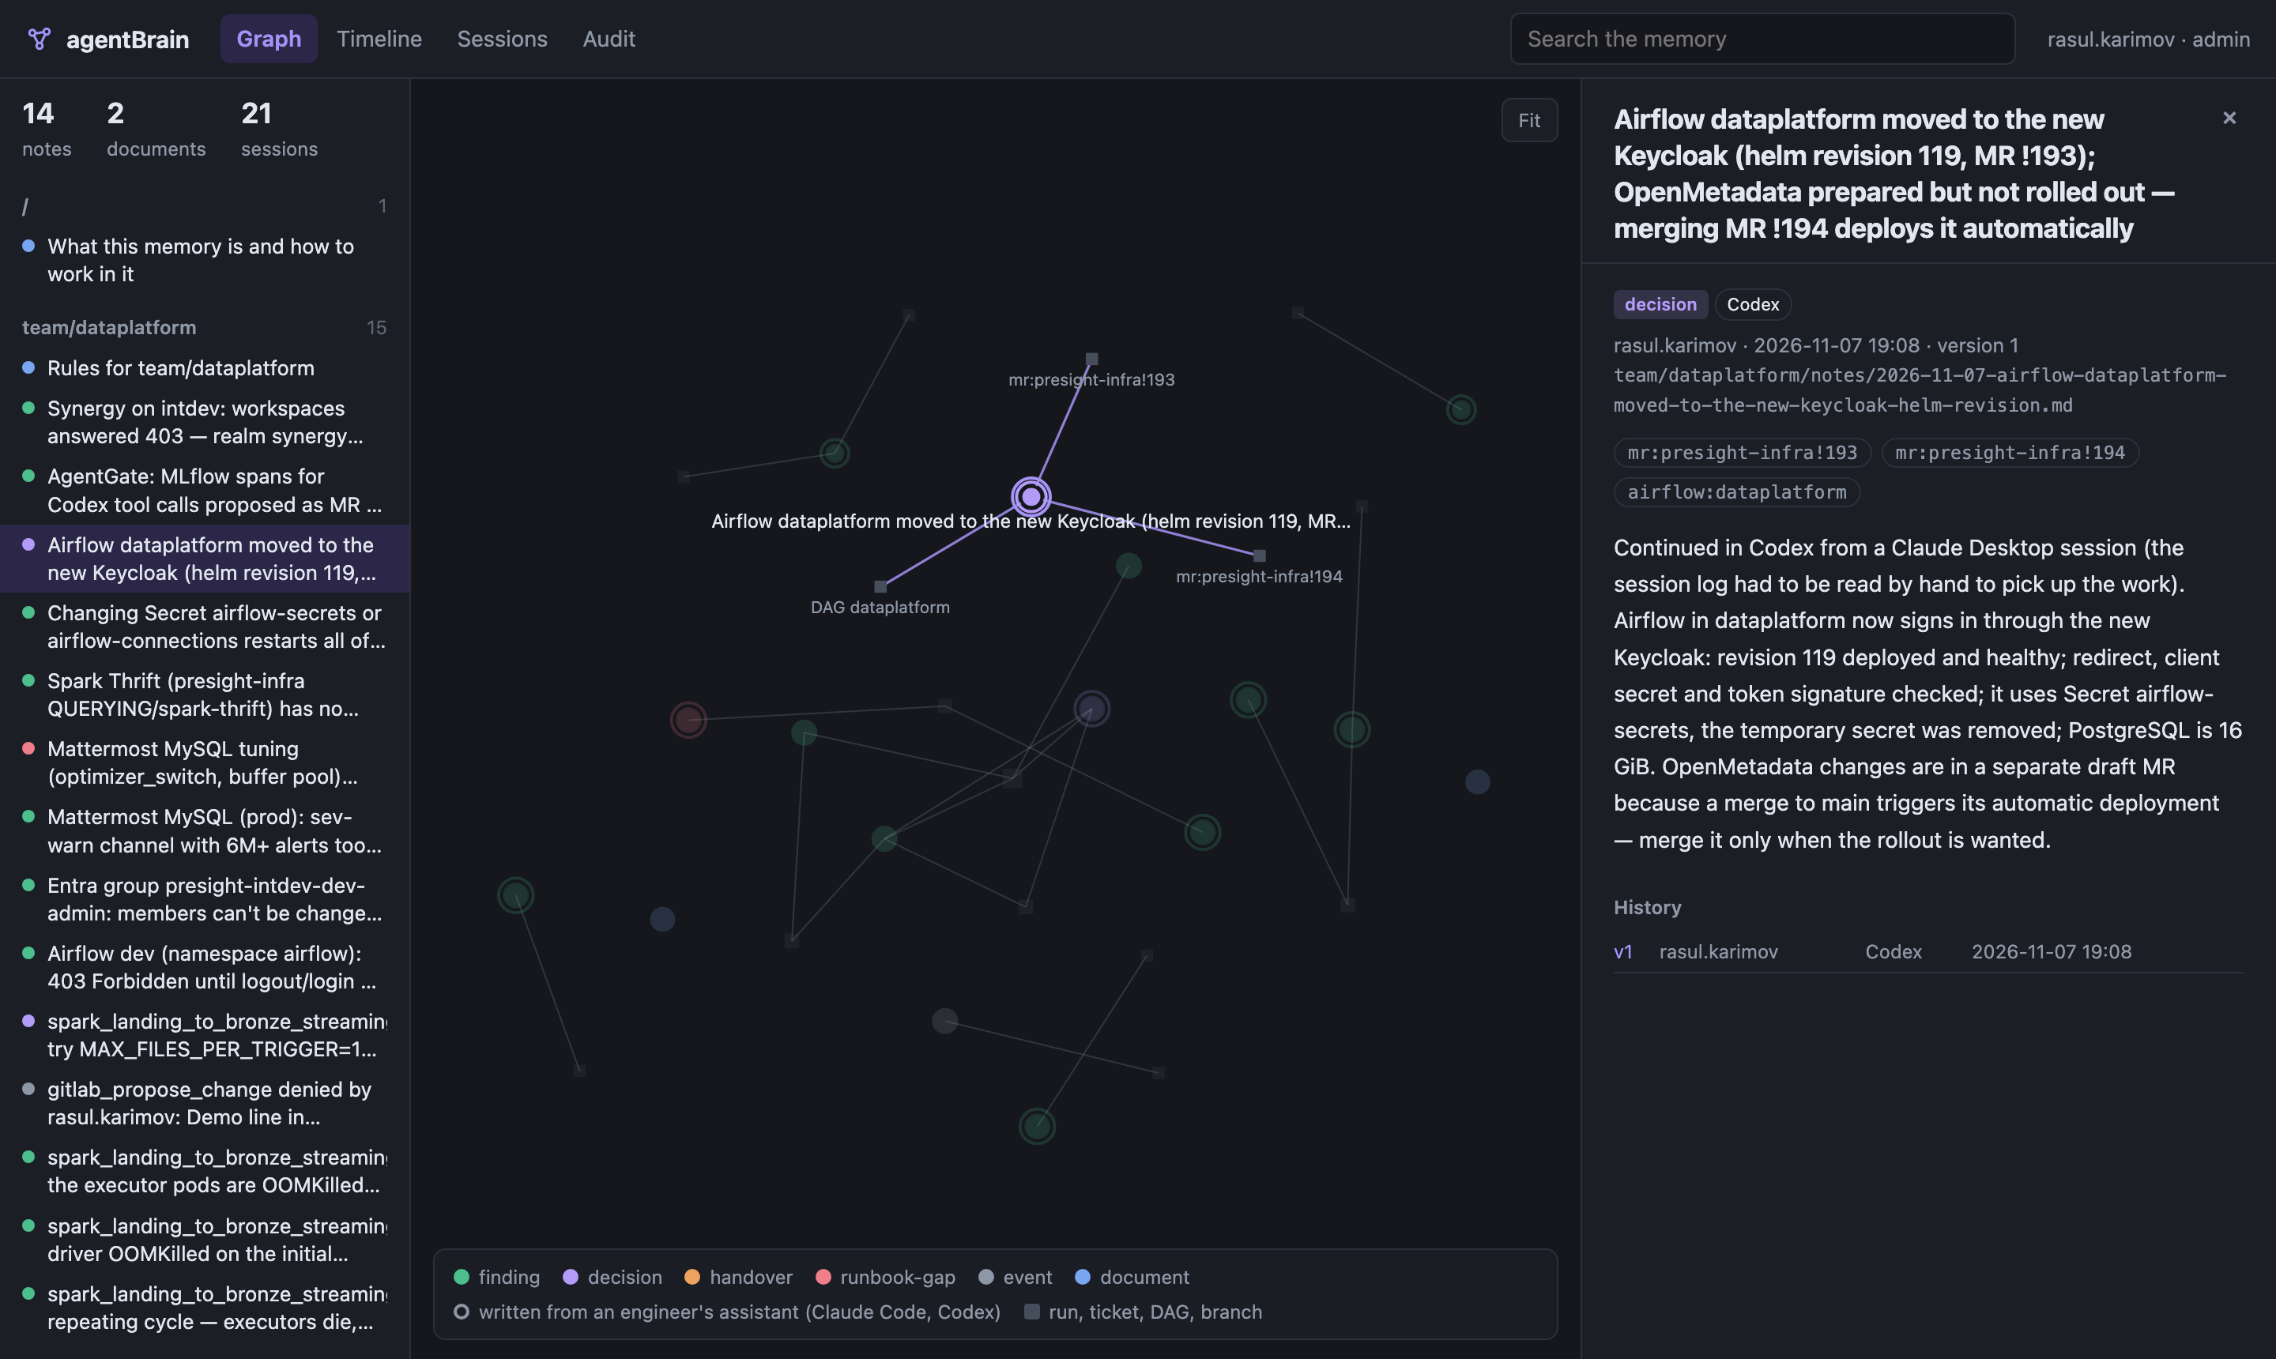
Claude and Codex continue each other's work
No log reading any more
Codex recorded what it finished and what is pending.
Claude Code was asked only: "I'm picking up the Keycloak migration — what's done, what's pending, who recorded it?"
One brain_start: done (by Codex), the dev fix (by Claude Code), and the three open items.
Every note shows who wrote it and through which assistant
A decision recorded by Codex: Airflow moved to the new Keycloak, MR !194 still pending

Slide 7
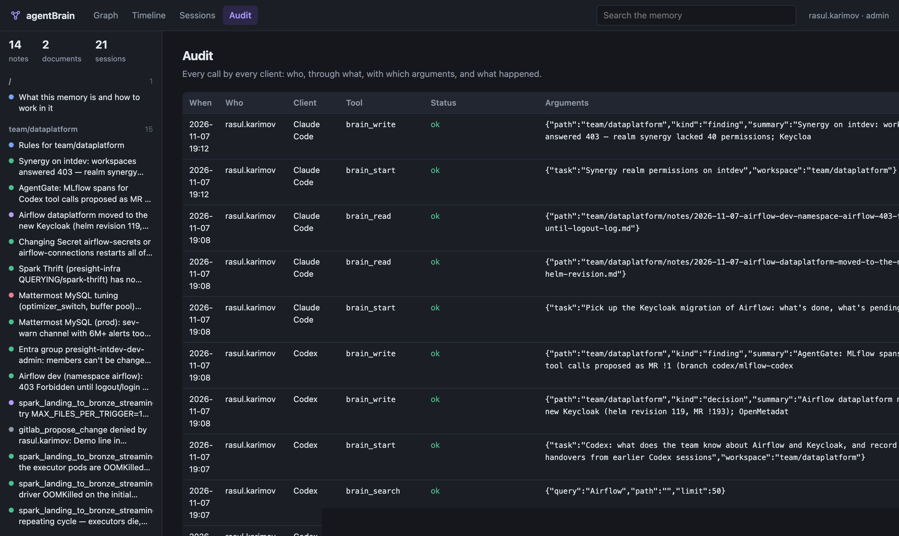
Governed by the platform, not asked of the model
A secret in a note
refused: say where it lives instead
An agent rewriting the rules
refused: needs a person's approval
Editing someone's note
refused: write a new note that links it
A document changed since read
conflict, not an overwrite
A bad session
rolled back in one click
Audit: every call by Claude Code, Codex and AgentGate — refusals included

Slide 8
Impact: measured in the pilot, not claimed
Repeated investigations
Handover
Follow-up conversations that start from an earlier note instead of from zero — from the audit; hours from a one-week time log before and after
Time from a handover to the receiver's first useful action, before and after
Repeated mistakes
Control
Follow-up runs that repeat a denied action — near zero on the bench
Writes attributed and audited, rules changed only with approval — 100%
Lean: no GPU — one small container and a database. Reuse: any team with agents adds a workspace, not code. Pilot: TechOps (10) and Data Engineering (14).

Slide 9
TRL 5
Next
Pilot
TechOps and Data Engineering; baseline week, then with memory
Running on the internal dev cluster with the corporate sign-in; tested end to end with three assistants on real investigations. Not yet in daily team use.
Distill
Notes become up-to-date documents; repeated gaps become procedure changes
Business owner: Atul Vishwakarma, Director – Technical Operations
Bench
Tasks with and without memory; a fixed failure must stay fixed
Demo: agentbrain.intdev.presight.ai (VPN)
More assistants
GitHub Copilot connected the same way; team workspaces from groups
The memory outlives the assistant.

