Slide 1
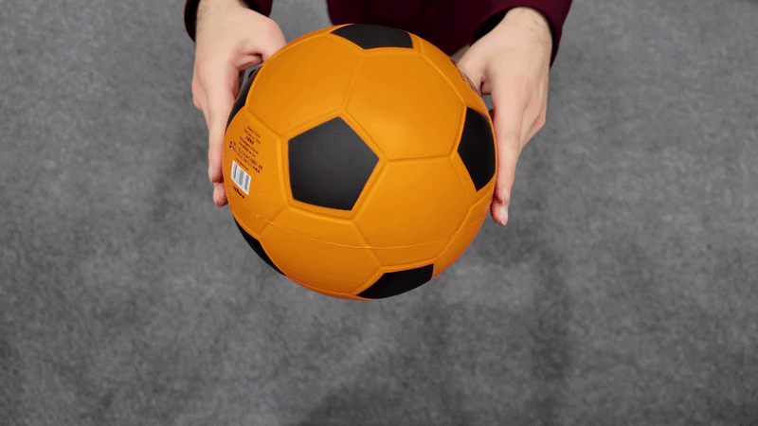
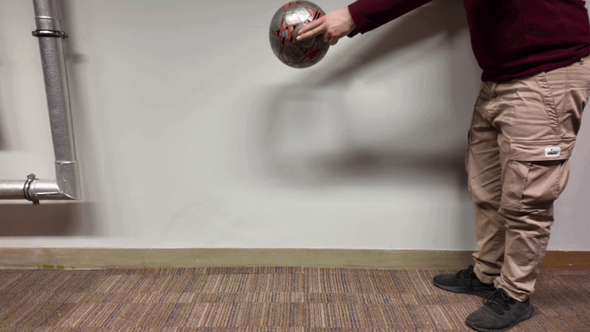
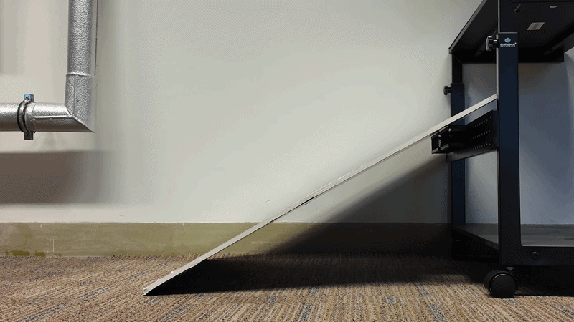
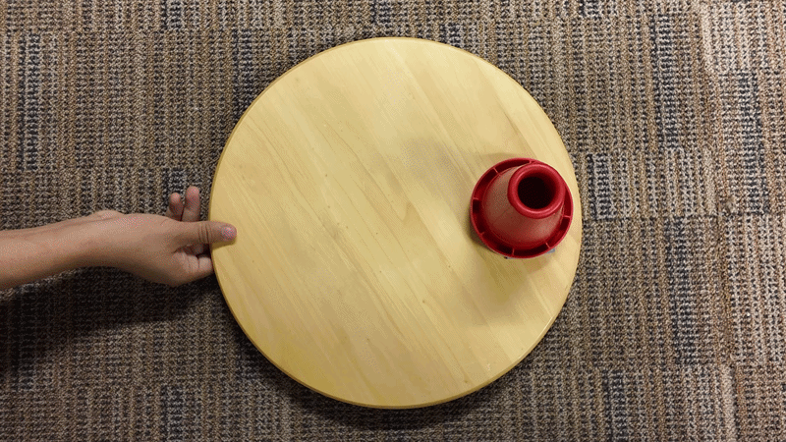
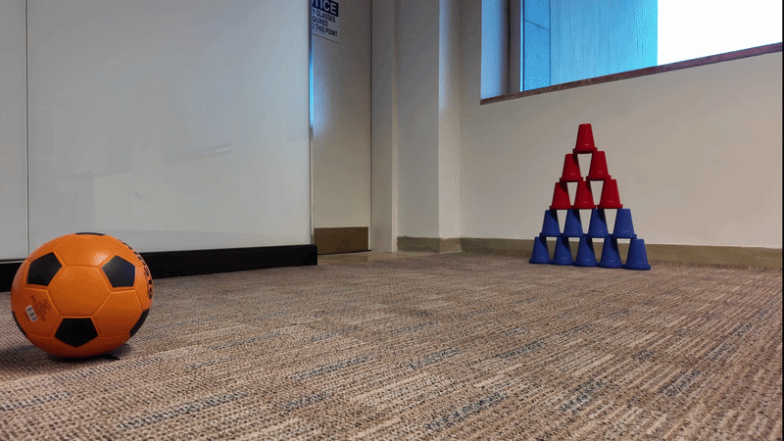
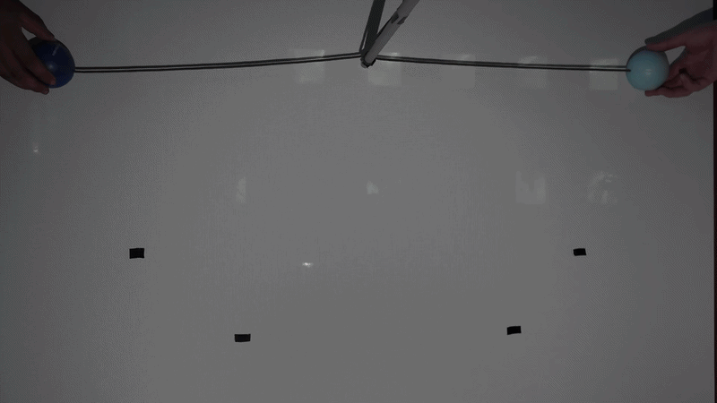
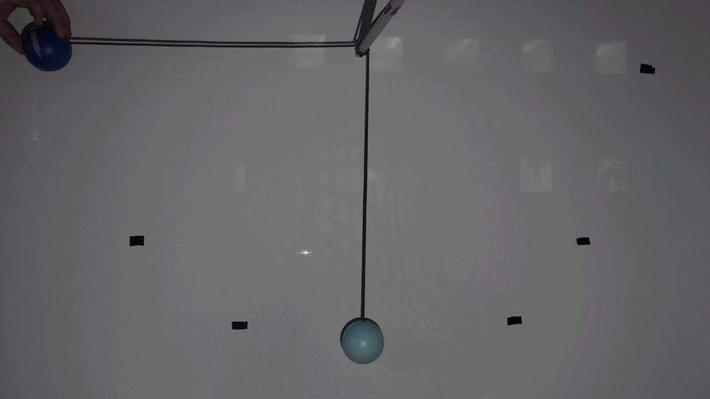
IRIS
A Real-World Benchmark for Inverse Recovery and Identification
of Physical Dynamic Systems from Monocular Video
ECCV 2026 • Anonymous Submission #13771

Slide 2
Motivation: What is Missing?
Existing methods suffer from:
Delfys75 — Prior State of the Art
• Evaluated on synthetic data only
(cartoon objects, black backgrounds)
Videos
75
Resolution
1080p / 25fps
• Only single-body real-world data exists
Phenomena
5 (single only)
Multi-body
None
• No multi-body or interaction scenarios
Trials/setting
5
• No standardised evaluation protocol
IRIS — This Work
Videos
220
• Equation family must be given manually
at test time (oracle condition)
Resolution
4K / 60fps
Phenomena
8 (multi-body)
Multi-body
3 novel
Trials/setting
10

Slide 3
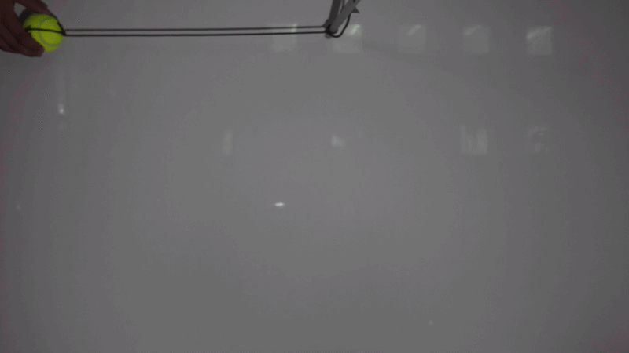
The IRIS Dataset — 8 Phenomena, 220 Videos
Dropping ball
Falling ball
Sliding cone
Rotating cone
g, β
g, r₀
μ, α
α, β
Hitting cones
Two moving pendulums
One static pendulum
Single Pendulum
κ, ζ
Lᵢ, ζᵢ, κᵢⱼ
Lᵢ, ζᵢ, κᵢⱼ
Lᵢ, ζᵢ
4K / 60fps • 10 trials per setting • Independently measured ground truth • Uncertainty estimates • SAM2 segmentation masks

Slide 4
Standardised Evaluation Protocol
Train-per-clip protocol
ODE Bank (5 families)
• Each video clip trained independently from scratch
Dropping / Falling ball
z'' + βz' + αz = 0
g = α
• No parameter sharing across clips
Pendulum
θ'' + ζθ' + (g/L)sinθ = 0
L = g/α
• Fixed random seed (42) for reproducibility
Rotating cone
φ'' + βφ' + αφ = 0
α, β direct
• Equation family selected automatically
Sliding cone
Constant acceleration block
μ = β
Five evaluation axes:
Multi-body
Graph ODE + coupling κᵢⱼ
κᵢⱼ fitted
1. Parameter accuracy
MAE vs. ground truth (primary)
2. Equation selection
Classification accuracy + confusion
3. Identifiability
Gradient norms, ODE residual
4. Robustness
Consistency across configurations
5. Extrapolation
Prediction beyond training horizon

Slide 5
Key Finding: Critical Gradient-Flow Bug in Baseline
Original Euler step (Garcia et al. 2025):
Impact on Delfys75 — Parameter MAE
ż(t+1) = ż(t) + Δt · z̈(t)
z(t+1) = z(t) + Δt · ż(t) ← Missing term!
Setting
Param
Original
Fixed
Δ MAE
pendulum_45
L [m]
95.07
3.80
-91.3
pendulum_90
L [m]
50.15
2.93
-47.2
Missing Δt² · z̈(t) → ∂z(t+1)/∂γ = 0
Physics parameters receive ZERO gradient throughout training.
pendulum_150
L [m]
29.83
0.71
-29.1
LED 2s
γ
2.30
0.40
-1.90
Corrected Euler-Cromer step:
Torricelli lg
k
6.07
2.91
-3.16
ż(t+1) = ż(t) + Δt · z̈(t)
z(t+1) = z(t) + Δt · ż(t) + Δt² · z̈(t) ✓
Torricelli sm
k
7.67
5.69
-1.99
Benchmark evaluation exposed this bug — demonstrating the
diagnostic value of rigorous real-world benchmarking.

Slide 6
Equation Identification: VLM vs. CNN vs. Path-Based
Why automatic identification matters:
Key Insight
• Garcia et al. use path-based oracle selection
VLM ranking REVERSES across benchmarks:
Temporal reasoning wins on Delfys75 (familiar, single-body phenomena)
Describe-then-classify wins on IRIS (diverse, multi-body phenomena)
— requires manual labelling per clip
• IRIS benchmarks 4 automatic routing strategies
• Goal: remove human-in-the-loop for equation routing
Method
Delfys75
IRIS
CNN vs. VLM Trade-off
CNN (in-distribution)
98.4%
99.3%
CNN achieves near-perfect accuracy in-distribution BUT cannot generalise to unseen phenomena without full retraining.
VLMs operate zero-shot across any phenomenon set.
VLM temporal reasoning
73.3%
65.0%
VLM describe-then-classify
61.1%
72.9%
Path-based (oracle)
100%
100%
First systematic comparison of automatic
equation routing for physics estimation.

Slide 7
Summary and Contributions
1. IRIS Benchmark
Open Challenges
220 real-world 4K/60fps videos · 8 dynamical systems · 3 novel multi-body scenarios
Independently measured ground truth with uncertainty estimates · 10 trials per setting
• VLM routing: 65–73% (far from oracle)
• Damping poorly identifiable across all methods
2. Standardised Protocol
5 evaluation axes (accuracy, equation selection, identifiability, robustness, extrapolation)
Train-per-clip · fixed seeds · fully traceable results
• Latent-to-SI calibration is phenomenon-specific
• Additional motions to add: multi objects colliding, and Torricelli experiment on multi object
3. Equation-ID Benchmark
Release
First systematic comparison of 4 routing strategies
VLM ranking reverses across benchmarks · CNN generalisation bottleneck identified
Dataset · Annotations
Evaluation toolkit
All baseline implementations
CC BY 4.0 upon acceptance
4. Diagnostic Findings
Gradient-flow bug in state-of-the-art pipeline fixed (+91m improvement on pendulum)
Multi-step loss catastrophically unstable on multi-body dynamics

Slide 8
Thank You
IRIS · 220 videos · 8 phenomena · 4K/60fps · Open benchmark
ECCV 2026 • Submission #13771

