Slide 1
WEEKLY REPORT GENERATOR & TEAM DASHBOARD
A full-stack review workflow for weekly team reporting
Technical presentation — architecture, database design, and workflow implementation
Next.js 16
Express + TypeScript
PostgreSQL + Prisma
Vercel + Render
Weekly Report Generator & Team Dashboard — Technical Assignment Submission

Slide 2
OBJECTIVE
What This System Does
T
Team Member
CORE WORKFLOW
1
Draft — team member fills in the report
Creates, edits, and submits a fixed-structure weekly report; sees its status and the manager's feedback if changes are requested.
2
Submitted — appears on manager dashboard
Manager
3
Needs Correction — manager leaves a comment
M
Reviews submitted reports, approves or requests changes with a comment, and gets a consolidated dashboard across the whole team.
4
Edited & resubmitted — back to Submitted
5
Approved — review cycle complete
02

Slide 3
OVERVIEW
System Architecture
Frontend
Backend API
Database
Next.js 16 (App Router)
Express + TypeScript
PostgreSQL + Prisma ORM
Client components
fetch() wrapper
AuthContext (JWT in memory)
REST endpoints
Zod validation
Role middleware
Users, Projects
Reports & Versions
Review Comments
HTTP / JSON — JWT bearer token on every request
Prisma queries
Deployed on Vercel
Deployed on Render
Render managed Postgres
Auth: JSON Web Tokens (access + refresh), refresh tokens hashed and stored server-side so logout can actually revoke a session — not purely stateless.
CORS restricted to the deployed frontend origin · Helmet security headers · Every gateway call validated with Zod schemas server-side.
03

Slide 4
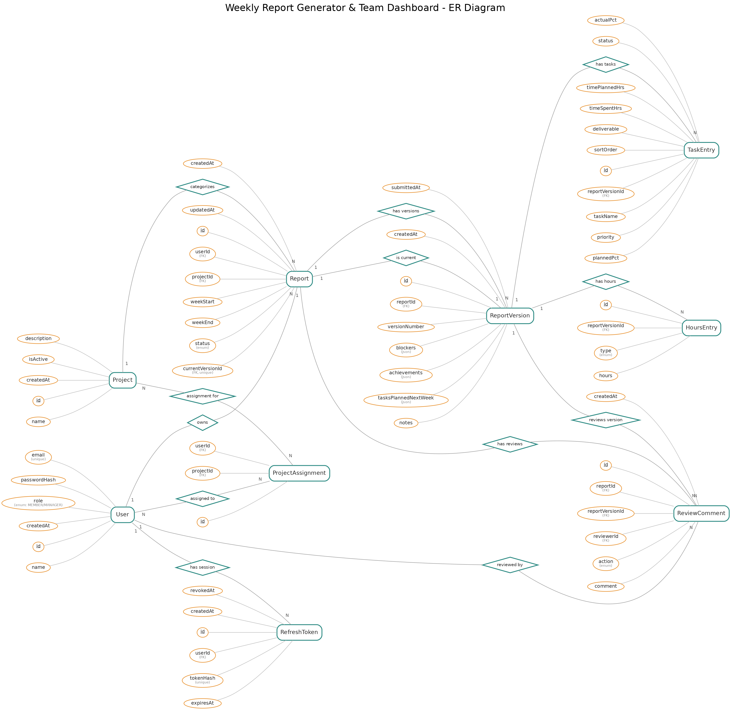
ENTITY-RELATIONSHIP MODEL
Database Design
Report vs. ReportVersion
A Report is the slot for one (user, week, project). Content lives in ReportVersion — every correction cycle writes a NEW version instead of overwriting, which is what gives free version history.
ReviewComment links both
Each comment references reportId AND reportVersionId, so it's always clear which exact version a manager's feedback was made against.
Task & Hours as child tables
TaskEntry and HoursEntry are 1:N off ReportVersion — the task table and optional hours breakdown, each a real row, not JSON blobs.
04

Slide 5
BACKEND
API Design & Role-Based Access
Module | Base path | Key endpoints | Access
Auth | /api/auth/* | register, login, refresh, logout | Public
Reports | /api/reports/* | list, create, get, update, submit, get version | Member (own) · Manager (read)
Review | /api/review/* | approve, request-changes, history | Manager only
Projects | /api/projects/* | list, get, create, update, delete, assign members | Read: all · Write: Manager
Users | /api/users/* | me, list, profile, invite, update role, remove | Manager only (except /me)
Dashboard | /api/dashboard/* | summary, tasks-trend, status-by-member, workload, hours, activity | Manager only
Enforcement pattern
requireAuth verifies the JWT and loads the user → requireRole("MANAGER") gates manager-only routes → service-layer ownership checks stop a Member from ever reading another Member's report, even with a valid token.
05

Slide 6
CORE FEATURE
Report Review & Correction Workflow
DRAFT
SUBMITTED
NEEDS CORRECTION
APPROVED
Only visible to the author
Appears on manager dashboard
Manager's comment shown on report
Review cycle complete
Needs Correction → edited → resubmitted moves the status back to Submitted for another review pass.
A manager can Approve, or Request Changes with one required comment explaining what to fix.
Members see and edit only their own reports; managers see every report but can only touch status/comment fields — never rewrite report content.
Version history (bonus): each resubmission creates a new ReportVersion row. Past versions stay fully visible — a manager can open any prior version and see exactly which version a given comment targeted.
06

Slide 7
KEY COMPONENTS
Frontend Structure
Personal Report Page
Report History
Team Dashboard
/reports/new, /reports/[id]/edit
/reports/history, /reports/[id]
/manager/dashboard, /manager/reports
— ReportForm — create + edit modes
— Paginated list, status badges
— Summary cards + 4 Recharts visualizations
— Task-level table (FlaggableListEditor)
— Separate from the create/edit page
— Filter by member, project, date, status
— Blockers/achievements with “key” flag
— Read-only detail view (shared component)
— Manager Review page (Approve / Request Changes)
— Client-side validation before submit
— Correction comment banner
— Team member profile page
Shared, reusable primitives used everywhere: Button, Modal, PageHeader, StatusBadge, LoadingSpinner, ErrorMessage, EmptyState, Pagination — kept in components/common/.
Responsive shell: collapsible sidebar on desktop, bottom nav on mobile — verified at desktop / tablet / mobile breakpoints.
07

Slide 8
MANAGER VIEW
Dashboard & Visual Insights
Total reports submitted this week
Submission compliance rate
Reports in Needs Correction
Open blockers across the team
Charts (Recharts)
ACTIVITY FEED
Tasks completed trend line chart, per person / team-wide, over time
Recent reports and review actions — approvals and “sent back for correction” events — surfaced in one chronological feed so a manager can see team activity at a glance without opening every report.
Submission / approval status by team member — stacked bars
Workload by project task distribution across active projects
Filters available: team member · project/category · date range · status
Time spent by task type team-wide: Development vs Testing vs Meetings vs Docs
08

Slide 9
13 OF 7+ REQUIRED
Pages Delivered
Login / Register
Personal weekly report (create/edit)
Report history
Report detail (read-only)
1
2
3
4
Manager dashboard
Manager team reports
Manager review (approve/request changes)
Report version history
5
6
7
8
Projects / categories management
User management (admin)
Team member profile
Responsive nav shell (desktop/mobile)
9
10
11
12
Account-level role routing
13
09

Slide 10
ENGINEERING NOTES
Challenges Faced & How They Were Solved
Issue | Root cause | Fix
TypeScript build broke on Render | TS 6-era compiler removed moduleResolution="node" and baseUrl | Migrated to module/moduleResolution "nodenext"; scoped rootDir to src/ so dist/server.js lands where npm start expects it
Prisma engine mismatch | Client generated on Windows didn't include the Linux query engine | Added debian-openssl-3.0.x to binaryTargets alongside native
Render build missing devDependencies | NODE_ENV=production during build silently skipped typescript/@types/* | Build command explicitly runs npm install --include=dev
CORS + env var mismatches across environments | Wrong CORS_ORIGIN, and NEXT_PUBLIC_ vars are baked in at build time, not read at runtime | Matched CORS_ORIGIN to each real frontend origin; rebuilt after every env change
10

Slide 11
ROADMAP
Possible Future Improvements
AI Chat Assistant
Not implemented in this submission. Planned approach: a manager-facing chat widget backed by an LLM with tool-use over the reports API — “What did the design team work on last week?” answered by querying real report data, not a static prompt.
Automated RBAC test suite
Expand beyond the current access-control tests to cover every endpoint pairing (member vs. manager, own vs. other's data) as a CI gate.
Notifications
Email or in-app notification when a report is sent back for correction or approved, instead of requiring a page visit to discover it.
Bulk export
CSV/PDF export of a week's reports for offline review or archiving.
11

Slide 12
Thank you
Questions & live coding walkthrough welcome
GITHUB REPOSITORY
github.com/rasunM/weekly-report-generator-team-dashboard-assignment
LIVE FRONTEND
https://weekly-report-generator-team-dashbo-rho.vercel.app
LIVE BACKEND
weekly-report-generator-team-dashboard-7gl8.onrender.com

