Slide 1


Hybrid AI-based Detection of fileless malware in IOMT Healthcare systems
R26-CS-006
Supervisor – Mr. Kanishka Yapa
Co-Supervisor – Mr. Dinith Primal

Slide 2




Team Members
Member | IT Number | Individual Component
Chathuranga L.A. S | IT22108272 | DICOM medical imaging network anomaly detection.
Fernando M.S. V | IT22080530 | PowerShell-based fileless malware detection.
Pagodaarachchi R.T. | IT22135070 | Next-24-hour IoMT threat forecasting.
Shakya W.A.R. | IT22210142 | Cross-layer lateral movement correlation and XAI dashboard.
Chathuranga L.A. S
Fernando M.S. V
Pagodaarachchi R.T.
Shakya W.A.R.

Slide 3



Problem Statement, Stakeholders & Objective
Hybrid AI-based Detection of Fileless Malware in IoMT Healthcare Systems
Problem statement
Stakeholders
Main objective
Fileless attacks misuse tools such as PowerShell. Evidence can span healthcare endpoints and medical networks.
Primary users
Develop and evaluate a hybrid AI framework integrating:
SOC analysts and IT/security administrators
Clinical stakeholders
DICOM network monitoring
PowerShell detection
Next-24-hour risk forecasting
Explainable incident correlation
Doctors and radiology staff
Separate analysis can obscure related activity and potential lateral movement.
Beneficiaries
Healthcare organisations and patients
MediRecon / R26-CS-006

Slide 4
Solution Overview
Solution Summary: A hybrid AI framework combining network and endpoint monitoring, threat prediction and explainable correlation to support fileless malware detection in IoMT healthcare systems.
Key Features:
FR1: DICOM medical imaging network anomaly detection.
FR2: PowerShell-based fileless malware detection.
FR3: Next-24-hour IoMT threat prediction.
FR4: Cross-layer lateral movement correlation and XAI dashboard.
Non-Functional Focus: Data privacy, reliable event processing, timely analysis, efficient resource use, and clear, usable dashboards.

Slide 5




Solution Overview
Four complementary components support one IoMT investigation workflow
DICOM security
Medical-network anomaly detection and a separate image-integrity check.
PowerShell detection
XGBoost classification with behavioural indicators of malicious execution.
24-hour risk prediction
LSTM estimates future risk from sequential telemetry.
Correlation and explanations
Connect available events through time and host relationships, with supporting evidence.
Design priorities
Privacy, reliable processing, timely analysis, efficient resource use and usability.
MediRecon / R26-CS-006

Slide 6
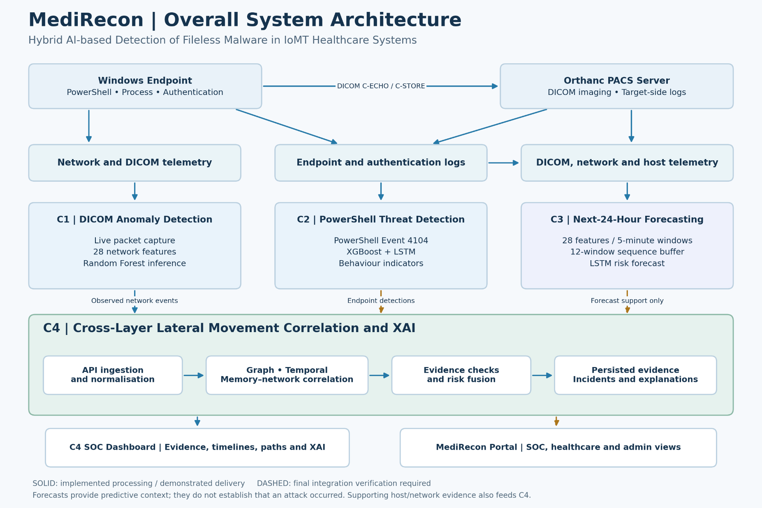

Slide 7
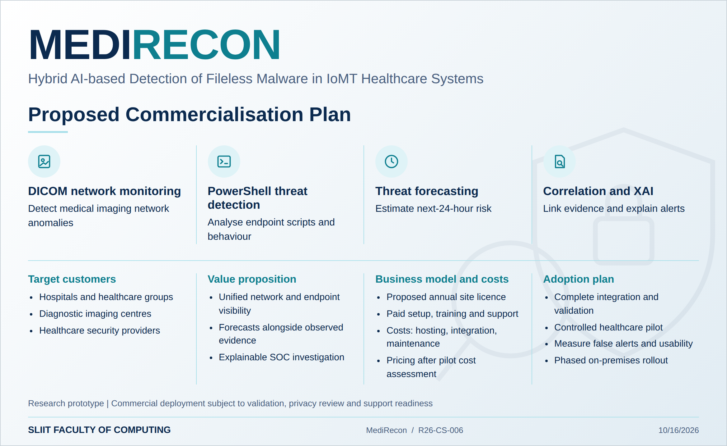
Commercialization

Slide 8
Hybrid AI-based Detection of fileless malware in IOMT Healthcare systems
R26-CS-006
Demonstration Of The Research Project

Slide 9


