Slide 1


Hybrid AI-based Detection of fileless malware in IOMT Healthcare systems
R26-CS-006

Slide 2

Team Members
Supervisor – Mr. Knishka Yapa
Co-Supervisor – Mr. Dinith Primal
Student Nama | ID Number
Chathuranga L.A. S | IT22108272
Fernando M.S. V | IT22080530
Pagodaarachchi R.T. | IT22135070
Shakya W.A.R. | IT22210142

Slide 3
Hybrid AI-based Detection of fileless malware in IOMT Healthcare systems
Main research Problem
The existing solution for the IOMT security cannot effectively detect fileless malware attacks and lateral movement.
These attacks abuse the legitimate process to bypass the security of the IOMT environment.
Problem Impact
Patient safety risk.
Healthcare service disruptions.
Sensitive patient data exposure.
Attacks would not be detected.
Users that benefits from our solution
Hospital and healthcare organizations.
SOC Analyst and cyber security teams .
Patients.
Medical device manufactures.
Healthcare regulator bodies.
Targeted Users.
Soc Analyst.
Doctors.

Slide 4

IT22108272 CHATHURANGA L A S
DICOM Medical Imaging Network Anomaly Detection
Combines DICOM network anomaly detection with DICOM image integrity verification to generate a unified security risk level, SOC alert, and doctor decision.
PP01 Completed Work.
Identified the DICOM/PACS security problem
Selected the CICIoMT dataset
Identified relevant network traffic features
Developed the initial Random Forest anomaly detection model
Designed the component architecture and workflow
Current Progress.
Completed Normal/Abnormal network traffic detection
Integrated Orthanc + Wireshark for DICOM/PACS traffic validation
Implemented SHA-256 DICOM image integrity verification
Developed SOC Dashboard + Doctor Portal
Implemented dynamic threat scoring and SOC alerts
Validated the system using 4 security scenarios
IT22108272 | CHATHURANGA L A S | R26-CS-006

Slide 5

Power shell based file less malware detection
IT22135070 Fernando M.S.V
Power shell based file less malware detection
Traditional antivirus mainly looks for malicious files. But fileless malware may execute directly through PowerShell and memory without dropping a normal malware file. Therefore, it can be difficult to detect using traditional signature-based techniques.
PP01 – Completed Work
Identified the research problem and gap
Selected PowerShell-based fileless malware as the main threat
Identified suitable datasets
Planned the ML/DL-based detection approach
Created the final dataset using existing malicious + collected benign data
Current Progress
Trained and evaluated XGBoost & LSTM models
Developed the Behavioral Analysis Engine
Implemented near-real-time monitoring
Developed the FastAPI backend
Integrated the Streamlit Dashboard
IT22080530 | Fernando M.S.V | R26-CS-006

Slide 6

Predictive IoMT Threat Forecasting Engine
IT22135070 | PAGODAARACHCHI R. T.
Forecasting engine combines ML probabilities from host and network-side behaviors to provide Forecasting for the next 24 hours.
PP 01 Completed work
Developed initial Host and Network ML models
Established the Late Fusion architecture
Addressed dataset suitability by avoiding direct raw-data merging
Created a UI of the Dashboard.
Current Progress
Completed Host RF + Network RF → Hybrid Risk pipeline
Developed 24-hour risk projection
Built Flask API + interactive forecasting dashboard
Added Early Warning, Threat Behaviors, IoMT Device Risk & Threat Spread
Added automated containment + Security Action History
IT22135070 | Pagodaarachchi R. T. | R26-CS-006

Slide 7
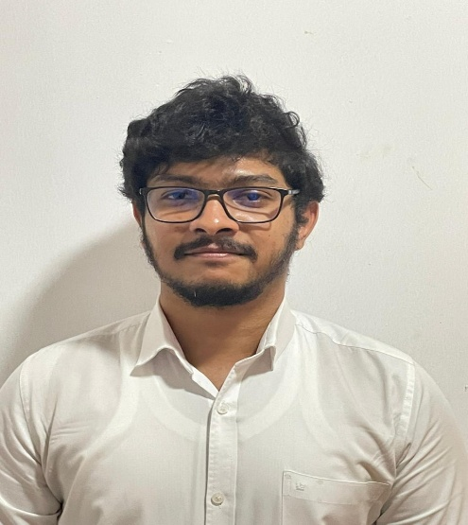
Cross-Layer Lateral movement correlation detection engine and XAI dashboard.
Student Must add a professional photo to this cage
IT22210142 | Shakya W.A.R
Correlates multi-layer IoMT security evidence to reconstruct lateral movement, calculate incident risk, and explain decisions using XAI and MITRE ATT&CK.
PP01 Completed Work
Identified the research gap and cross-layer correlation concept.
Designed the architecture and correlation workflow.
Defined required network, endpoint, and memory evidence.
Planned graph-based detection, XAI, and SOC dashboard.
Developed initial prototypes and integration design.
Current Progress
Built the Component 4 correlation backend.
Implemented ML, graph, temporal and memory/network correlation.
Implemented SHAP-based XAI + MITRE ATT&CK mapping.
Added SQLite persistence and SOC/XAI dashboard.
IT22210142 | Shakya W.A.R | R26-CS-006

Slide 8
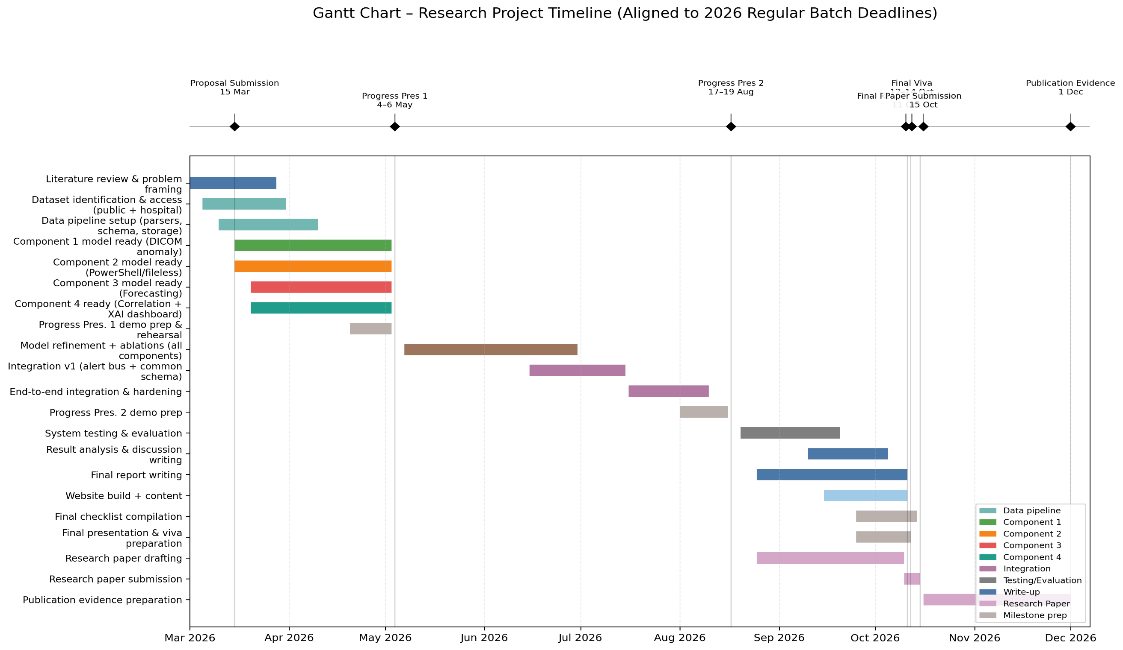

Slide 9


