Slide 1


Hybrid AI-based Detection of fileless malware in IOMT Healthcare systems
R26-CS-006

Slide 2

Team Members
Supervisor – Mr. Knishak Yapa
Co-Supervisor – Mr. Dinith Primal
Student Nama | ID Number
Chathuranga L.A. S | IT22108272
Fernando M.S. V | IT22080530
Pagodaarachchi R.T. | IT22135070
Shakya W.A.R. | IT22210142

Slide 3
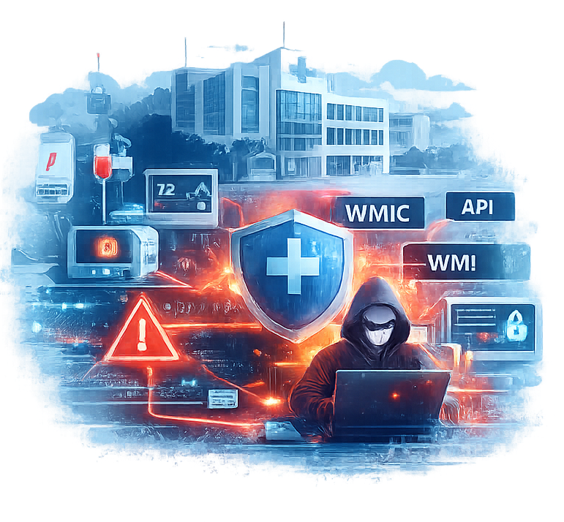
Introduction
Problem ?
Increase use of the IOMT device in the Healthcare infrastructure.
Fileless malware executes mainly in memory using legitimate tools (PowerShell/WMI), leaving minimal disk artifacts.
This makes detection difficult for traditional signature/file-based security tools.
Why?
Attackers increasingly use stealth techniques to evade defenses and stay persistent.
A single foothold on a Windows endpoint can enable lateral movement to critical systems, causing downtime and safety risk.

Slide 4

User and Stakeholders
Stakeholders
Hospital and healthcare infrastructures.
Medical IT administrations.
Cyber security analyst.
Patients.
After initial foothold, the attacker could manipulate medical images, disrupt clinical services , patient data theft and spread ransomware.

Slide 5

Existing solutions and limitations.
Existing cyber security solution has one important limitation on IOMT malware detection.
Therefore, existing solutions fails to detect,
  Fileless malware.
  Multi-stage cyber attacks.
  Lateral Movement across the networks.
Also lack the explainability .

Slide 6

Proposed Solution.
Proposed solution is a hybrid multi-layer cybersecurity system for IOMT environments.
System integrates multiple detection mechanism in multiple layers.
The systems consist of four components,
  Detects anomalies in DICOM medical imagine traffic.
  Detects Powershell based fileless malware behavior at the endpoint.
  Predict the emerging attack patterns using the threat forecasting engine.
  Correlates alerts from multiple layer and

Slide 7
Cross-Layer Lateral movement correlation detection engine and XAI dashboard.
Student Must add a professional photo to this cage
IT22210142 | Shakya W.A.R
This component focuses on detecting lateral movement attacks within the IOMT healthcare infrastructure.
IT22210142 | Shakya W.A.R | R26-CS-006

Slide 8

Cross layer lateral movement correlation detection engine and XAI dashboard.
Problem Definition and Novelty
Lateral movement is a critical phase in any cyber attacks.
Major challenge is that traditional systems analyze these event independently.
Resulting many individual alerts without proper understanding on how these are connected.
The main goal is to correlate security events across multiple systems layers and detect lateral movement patterns.

Slide 9
Cross layer lateral movement correlation detection engine and XAI dashboard
Objectives
Sub-Objectives
Main objective.
  To develop cross layer lateral movement correlation engine that detects multi stage cyber attacks.
Collecting alerts from different layers and available dataset
Correlate the collected alerts to find patterns.
Vulnerability assessment data.
Apply explainable ai to provide insight.

Slide 10

Cross layer lateral movement correlation detection engine and XAI dashboard
Applied cybersecurity domain knowledge
  Lateral movement tactics.
  Kill chain / MITRE ATT&CK mapping.
  Incident response + SOC workflow.
  Healthcare IoMT constraints.
Helps define what relationships are “suspicious”, and also Helps define what relationships are “suspicious”

Slide 11



Cross layer lateral movement correlation detection engine and XAI dashboard
Used Technologies.
Neo4j
SHAP/LIME.
MITRE ATT&CK technique .

Slide 12

Cross layer lateral movement correlation detection engine and XAI dashboard
System validation.
Correlation performance
  Incident clustering.
  Chain/path accuracy.
  Alert reduction ratio.
Operational usefulness.
  Time-to-trigger.
  Prioritization quality.
Explainability.
  Analyst feedback.
  Consistency check.

Slide 13

Cross layer lateral movement correlation detection engine and XAI dashboard
Data Availability
Primary public datasets-
LANL Cyber1 / Authentication dataset – timestamped user↔host events for lateral-movement chain reconstruction
OTRF Security-Datasets / EVTX-to-MITRE-Attack – Windows event logs (process/auth/network) for multi-source incident correlation

Slide 14
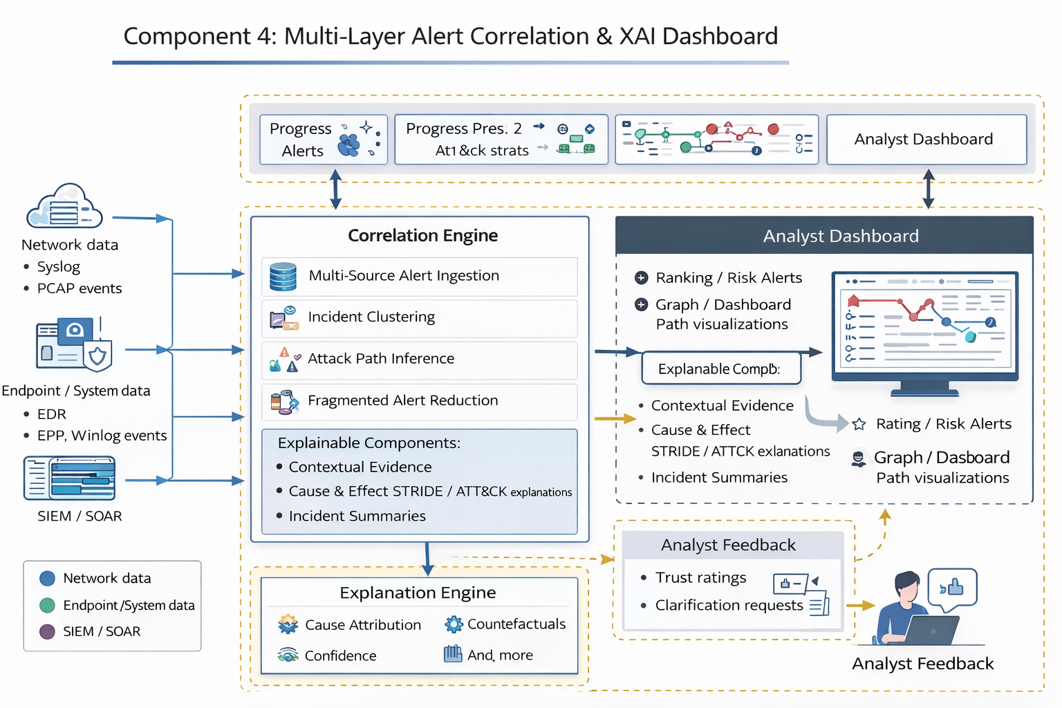
System Overview of the Individual Component

Slide 15
Commercialization Plan.
Target Market & Customer Profile
Market.
Customers.
Value Proposition
Detects fileless PowerShell/WMI attacks + protects PACS/DICOM workflows.
Cross-layer correlation reduces alert overload → faster triage & response.
Non-intrusive monitoring overlay (suitable for high-availability healthcare).

Slide 16
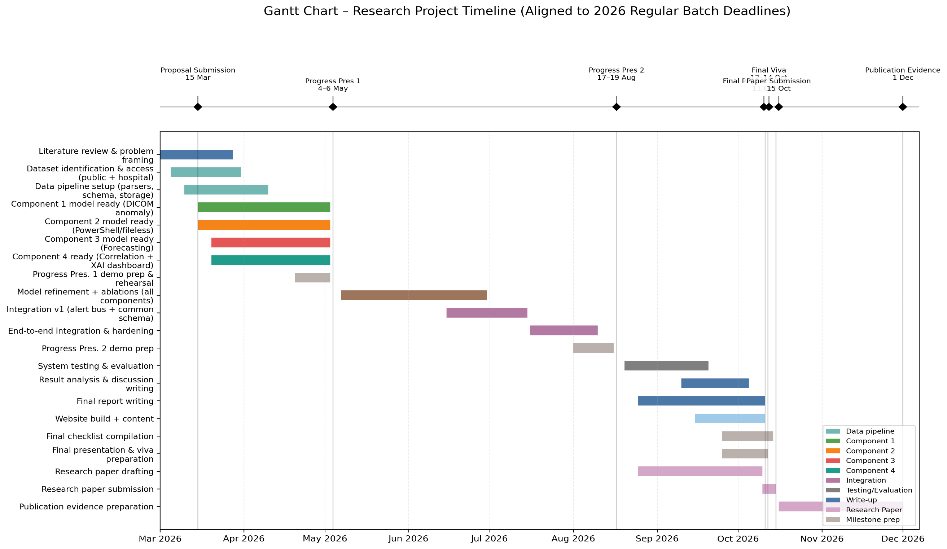

Slide 17
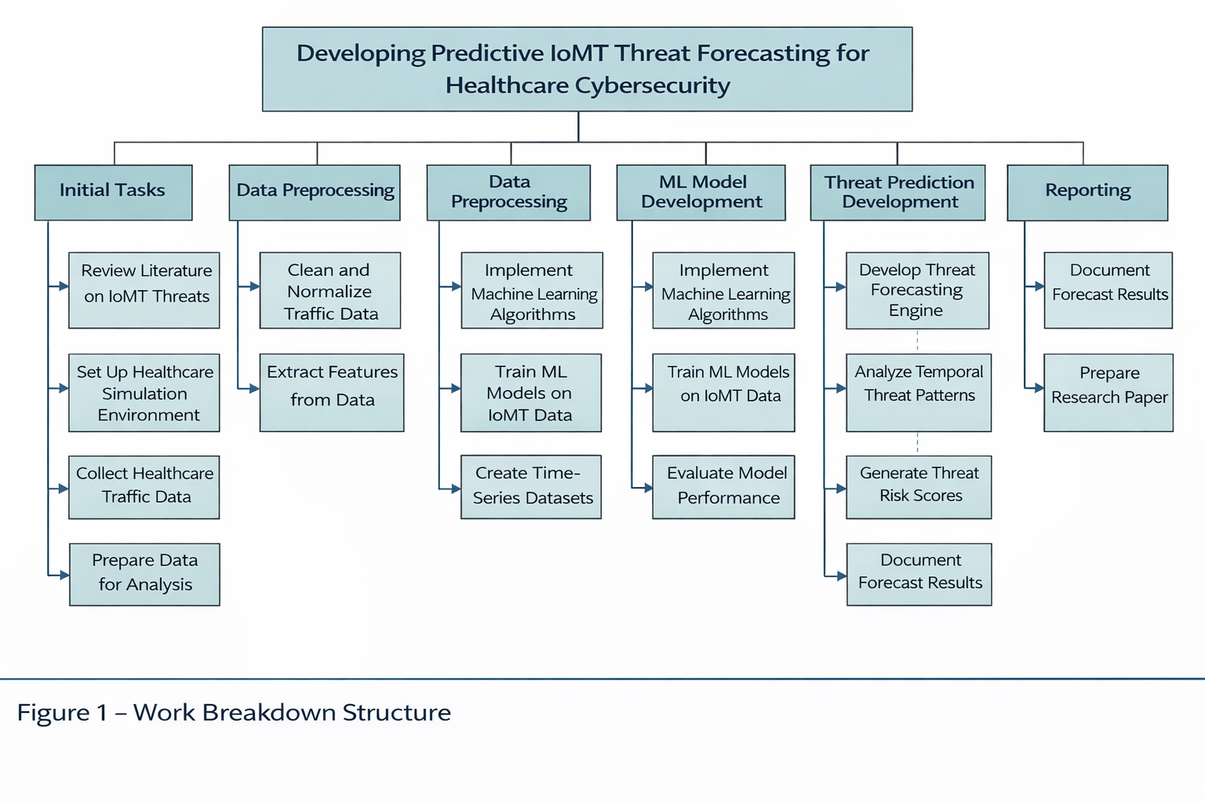
Work breakdown structure.

