Slide 1
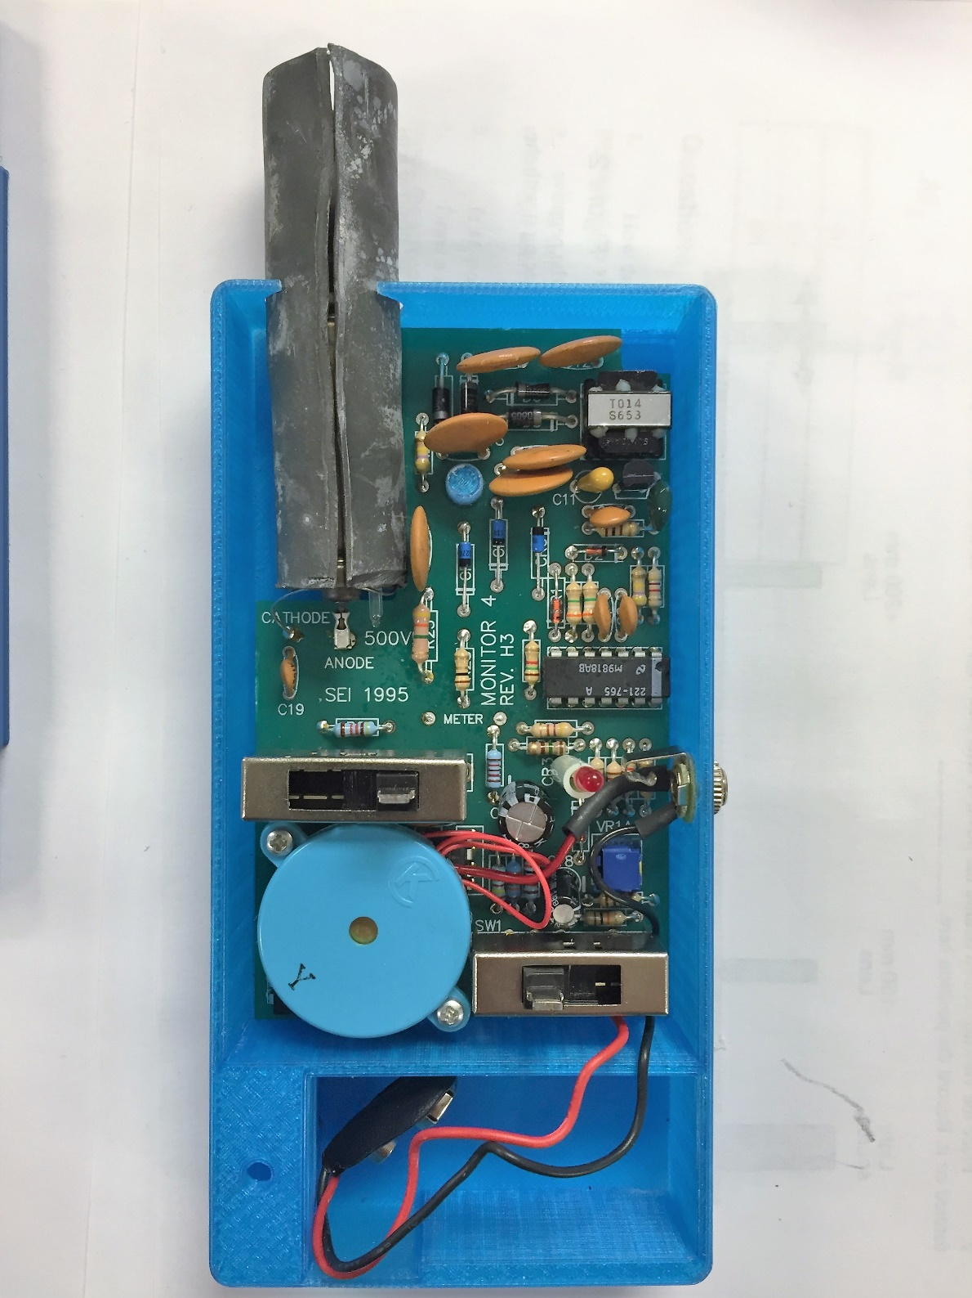
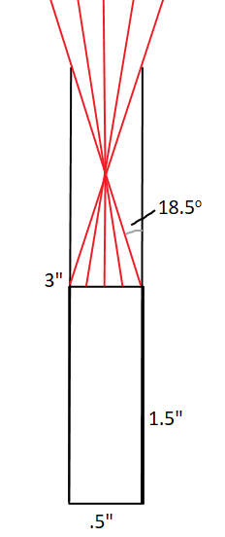
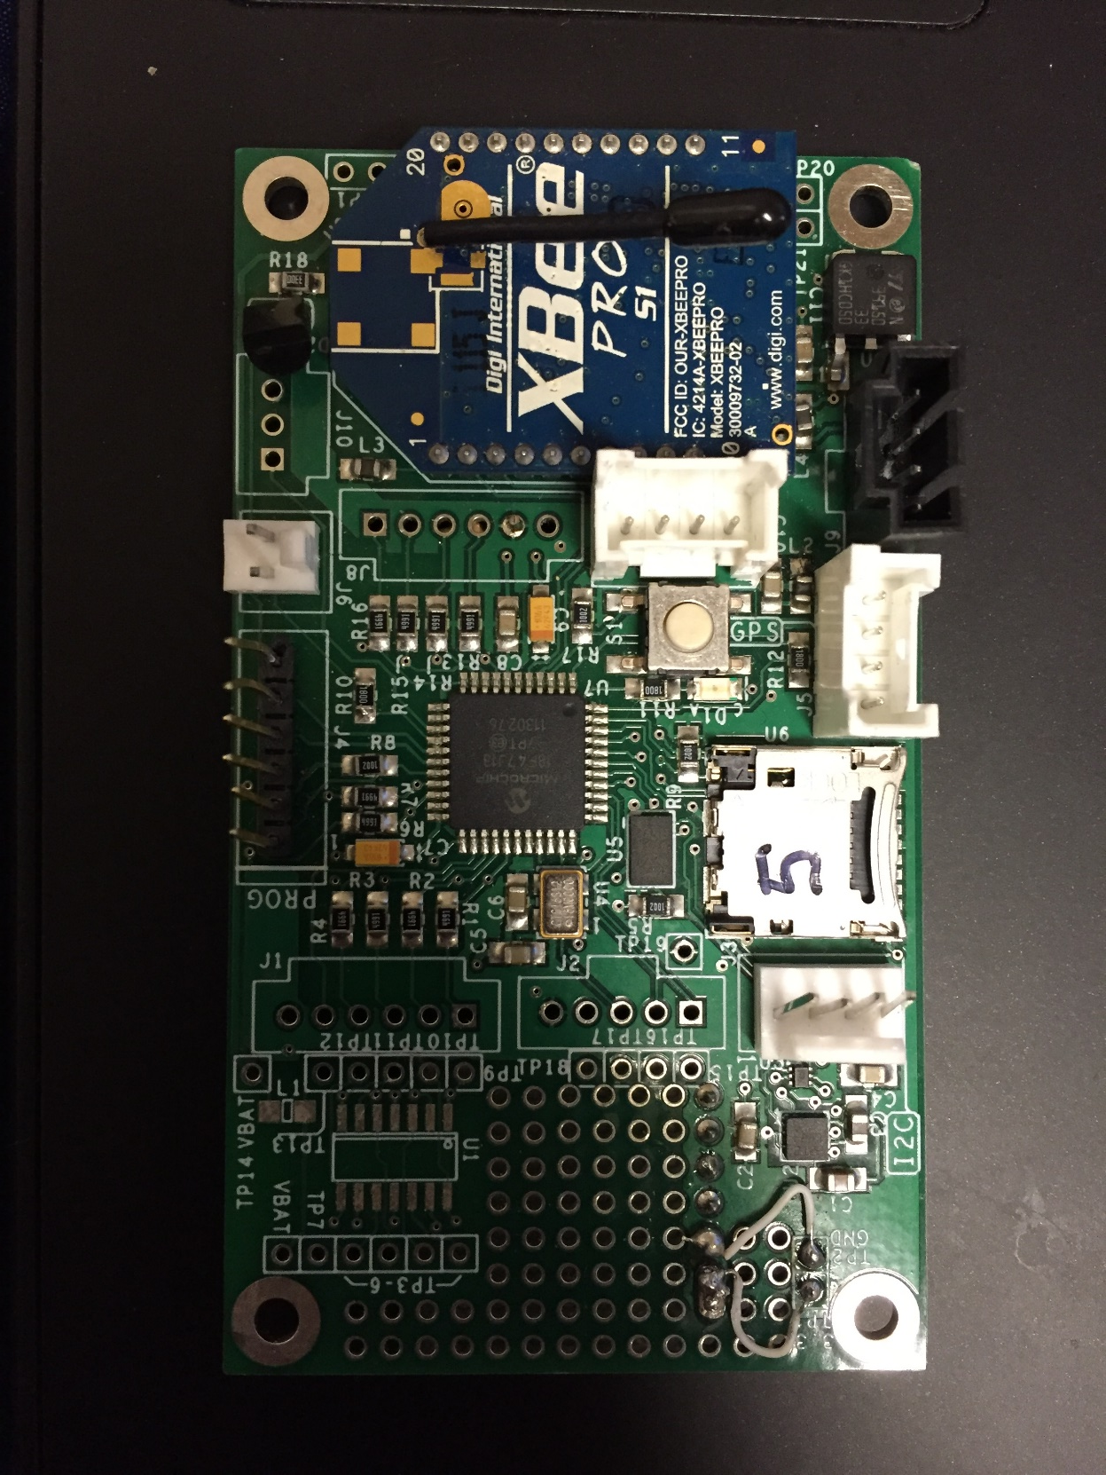
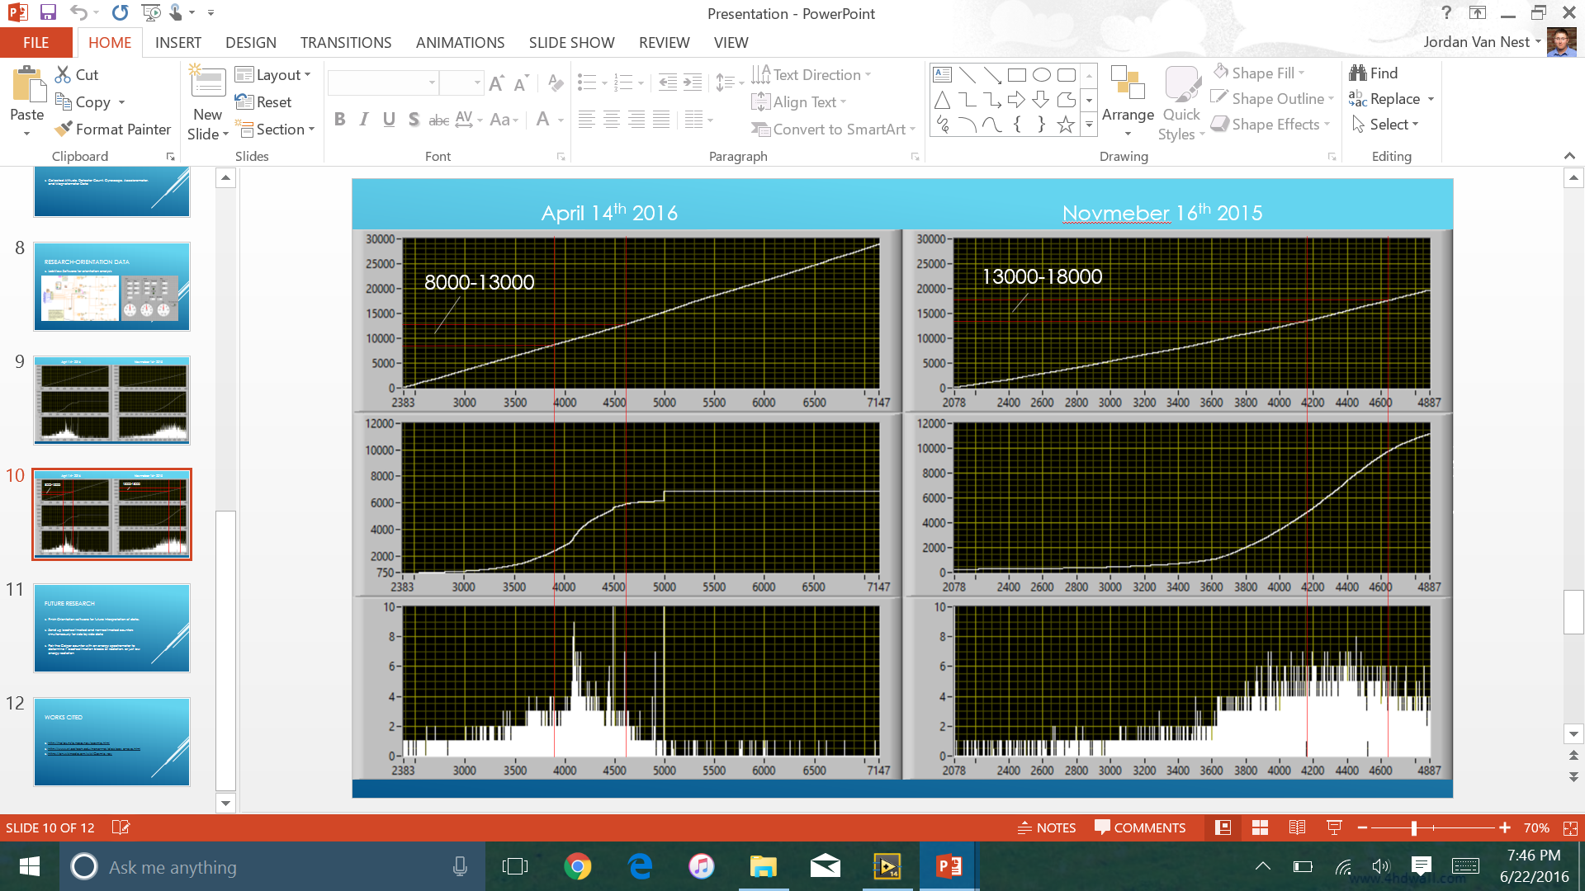

High Altitude Cosmic Ray Detection
Background
Cosmic rays are high energy atomic nuclei travelling near the speed of light that collide with atoms and molecules in Earth’s upper atmosphere (primarily with nitrogen and oxygen), breaking down into a shower of particles of various energies in the stratosphere. As they travel earthward, these particles continue to break down and lose energy which results in relatively little ionizing radiation reaching the surface. Due to the scattering of cosmic rays, the angle at which the rays enter the atmosphere can affect the number and energies of ionizing particles detected at various altitudes. When using a standard Geiger counter on a high altitude balloon flight, cosmic rays of all energies and orientations are counted in the same manner making it impossible to determine the origin and history of a particular detection.
Jordan D. Van Nest
Academic High Altitude Conference
St. Catherine University – St. Paul, Minnesota
June 29th – July 1st, 2016
Advised by Dr. Matthew Huddleston
Analysis and Discussion
The flight from 2016 utilized the Geiger counter from Figure 2, applying the lead column. The flight from 2015 used the same Geiger counter without the lead column. It is clear that the flight with the collimated counter gathered significantly less radiation counts within the first 15 kilometers than that of the flight only 6 months prior. Initial reactions would suggest that the collimation was successful in blocking some, if not all, of the peripheral radiation. While cosmic rays increase and decrease inversely with sunspot cycles, these cycles are 11 years long, and 6 months would not explain such a significant variation in radiation. Further examination of the data shows that the highest influx of radiation counts (per time) occurred around 5 kilometers lower on the 2016 flight than that of the one in 2015. While it was expected that the total radiation counts would be lower, it is unclear why the spike in radiation occurred at a lower elevation. After 15 kilometers, however, some technical failure occurred with either the Geiger counter or the Pic Pod. It is unknown why, but the data levels out after 6000 radiation counts and remains there for the remainder of the flight. Unfortunately, this calls into question the validity of the entire data set.
Experimental Setup
Materials and Procedure
Materials:
An “off the shelf” Geiger-Muller tube (ranged from .5 to 50 mR/hour and referenced to Cs-137)
A 1.57”x3” lead sheet
Trevecca Nazarene University’s Pic Pod data logging board (Figure 1) with adaptor cord and MicroSD card
Portable battery pack and charging cord
LabVIEW (32-bit) Software
Procedure:
The Geiger-Muller tube was fitted with the lead sheet to form a column around the detection chamber that would theoretically minimize peripheral radiation detection within 18.5^{O} of the length axis of the tube (Figure 2). The Geiger counter and Pic Pod board were launched on a high altitude latex balloon with fixed relative positions. While the Geiger counter was gathering radiation counts, the Pic Pod board was tracking their altitude and additional data with its internal gyroscope, accelerometer, and magnetometer.
Figure 1: Trevecca’s Pic Pod
data logging board
Figure 2: The lead collimated Geiger counter with adjusted peripheral detection range
Data
Future Research
April 14th 2016 November 16th 2015
Completion of the LabVIEW orientation software could provide definitive information on the frequency of incoming radiation from specific zenith angles
Launching the collimated Geiger counter alongside one without the lead could provide more definitive evidence of the lead’s success in blocking peripheral radiation
Launching the Geiger counter alongside an energy spectrometer would provide information about which levels of altitude provide more high energy cosmic rays. This could also verify whether the lead collimation blocks all peripheral radiation or only low energy radiation
Orientation Software
With the Pic Pod’s internal instruments, a LabVIEW software was created with the purpose of determining a physical orientation of the board in 3Dimensional space. This software would provide information about the zenith angle of detected radiation. The software would ideally provide the pitch, roll, and yaw angles of the board and Geiger counter. Unfortunately, the software in its current state is unable to correctly identify the yaw angle by utilizing the magnetometer’s detection of true North.
References
“Cosmic Rays.” Nasa’s Cosmocopia. Web. 18 April. 2016.
<http://helios.gsfc.nasa.gov/cosmic.html>
“Cosmic Rays and the Solar Cycle.” University of Delaware. Web. 20 June.
2016. <http://neutronm.bartol.udel.edu/catch/cr3.html>
Mewaldt, R. A. “Cosmic Rays.” Caltech. Web. 17 April.
2016. <http://www.srl.caltech.edu/personnel/dick/cos_encyc.html>
Figure 3: LabVIEW rendered graphs of altitude (meters), total radiation counts, and binned radiation counts (from top to bottom) from two separate flights

