Slide 1
Consumer Goods AD-HOC INSIGHTS

Slide 2
Goal
Answer ad-hoc requests ,visualize the result and present the insights.
Tools used
MySql DBMS for loading the database and running sql queries.
Tableau Desktop for visualizing the sql query results
Google slide to present the data

Slide 3
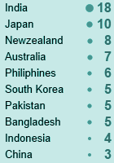
* Provide the list of markets in which customer "Atliq Exclusive" operates its
business in the APAC region.
*/
select market from dim_customer
where customer='Atliq Exclusive' and region = 'APAC'

Slide 4
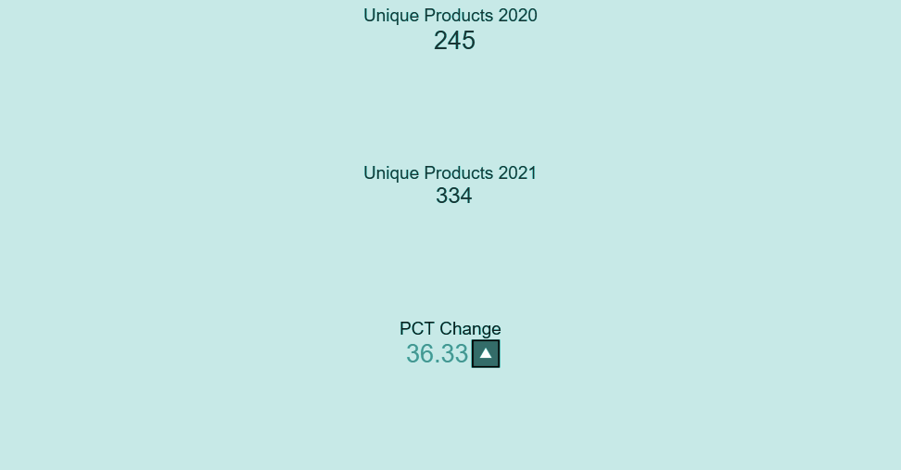
What is the percentage of unique product increase in 2021 vs. 2020? The
final output contains these fields,
unique_products_2020
unique_products_2021
percentage_chg*/
with
products_2020 as
(select count(distinct(product_code)) as unique_products_2020 from fact_sales_monthly
where fiscal_year=2020),
products_2021 as
(select count(distinct(product_code)) as unique_products_2021 from fact_sales_monthly
where fiscal_year=2021)
select unique_products_2020 ,unique_products_2021,
round((unique_products_2021-unique_products_2020)/(unique_products_2020)*100,2 )
as percentage_chg from products_2020,products_2021;

Slide 5
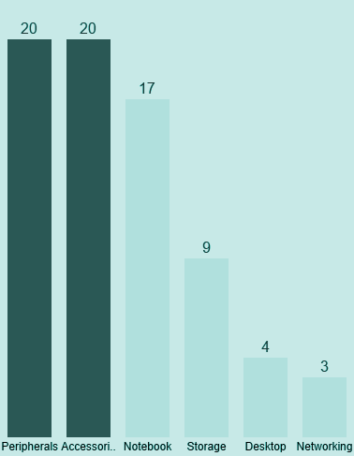
/* Provide a report with all the unique product counts for each segment and
sort them in descending order of product counts. The final output contains
2 fields,
segment
product_count*/
select count(distinct(product_code)) as product_count from dim_product
group by segment
order by product_count desc

Slide 6
with pc2020 as
(select dp.segment,count(distinct(dp.product_code)) as product_count_2020 from fact_sales_monthly fsm
join dim_product dp on fsm.product_code=dp.product_code
where fsm.fiscal_year=2020
group by(dp.segment)),
pc2021 as
(select dp.segment,count(distinct(dp.product_code)) as product_count_2021 from fact_sales_monthly fsm
join dim_product dp on fsm.product_code=dp.product_code
where fsm.fiscal_year=2021
group by(dp.segment))
select pc2021.segment,product_count_2020,product_count_2021,(product_count_2021 - product_count_2020)
as difference from pc2020 join pc2021 on pc2020.segment=pc2021.segment
order by difference desc
/* Which segment had the most increase in unique products in
2021 vs 2020? The final output contains these fields,
segment
product_count_2020
product_count_2021
difference*/

Slide 7
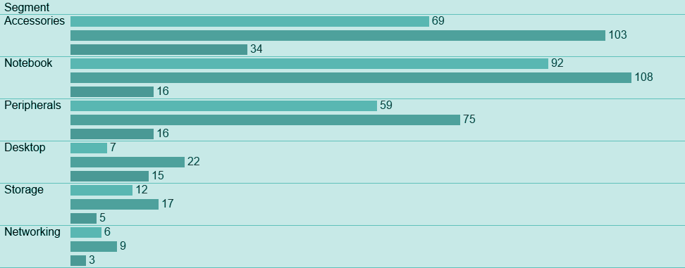
The highest unique product increase is in Accessories followed by Notebook and Peripherals.The demand in digital product is on the rise due to lockdown .

Slide 8

*Get the products that have the highest and lowest manufacturing costs.
The final output should contain these fields,
product_code
product
manufacturing_cost*/
select fmc.product_code,product,manufacturing_cost from fact_manufacturing_cost as fmc
join dim_product dp on dp.product_code=fmc.product_code
where manufacturing_cost =(select min(manufacturing_cost) from fact_manufacturing_cost)
union
select fmc.product_code,product,manufacturing_cost from fact_manufacturing_cost as fmc
join dim_product dp on dp.product_code=fmc.product_code
where manufacturing_cost =(select max(manufacturing_cost) from fact_manufacturing_cost)
There is huge difference between manufacturing cost of highest and lowest .Further analysis could include their demand , sales and margin of profit.

Slide 9
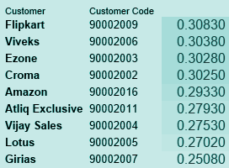
/*Generate a report which contains the top customers who received an
average high pre_invoice_discount_pct for the fiscal year 2021 and in the
Indian market. The final output contains these fields,
customer_code
customer
average_discount_percentage*/
select fpd.customer_code,pre_invoice_discount_pct,customer from fact_pre_invoice_deductions fpd
join dim_customer dc on dc.customer_code=fpd.customer_code
where pre_invoice_discount_pct >(select avg(pre_invoice_discount_pct) from fact_pre_invoice_deductions)
and market='India' and fiscal_year=2021
order by pre_invoice_discount_pct desc
There is not much difference in discount percentage between highest discount of 30.83% given to flipkart to the lowest discount 25.08% given to Girias .The criteria of discount is not disclosed in this dataset.

Slide 10
*Get the complete report of the Gross sales amount for the customer “Atliq
Exclusive” for each month. This analysis helps to get an idea of low and
high-performing months and take strategic decisions.
The final report contains these columns:
Month
Year
Gross sales Amount
*/
select monthname(date) as month ,extract(year from date) as Year,
sum(round(gross_price*sold_quantity,2)) as 'Gross sales Amount' from fact_sales_monthly fsm join
fact_gross_price fgp on fsm.product_code=fgp.product_code
where customer_code in (select customer_code from dim_customer where customer ='Atliq Exclusive')
group by month,Year
order by Year

Slide 11
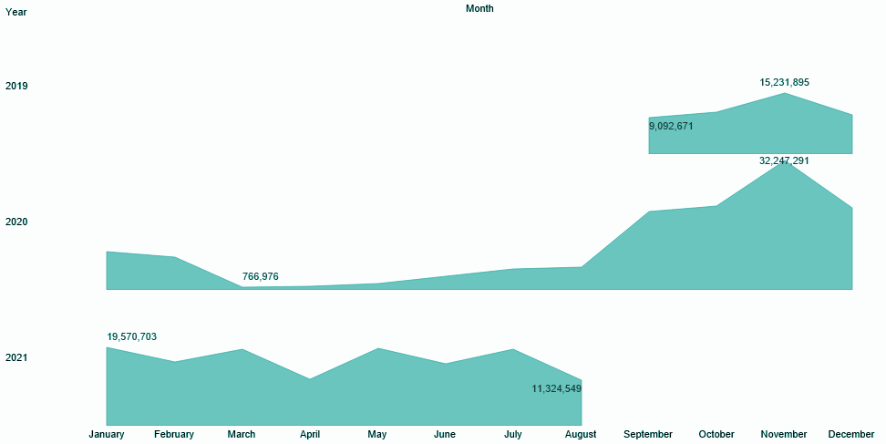
/
The sales of 2020 is on the lower side and Corona virus pandemic may have been the major reason.However the good thing is that there is substantial improvement in 2021 sales

Slide 12
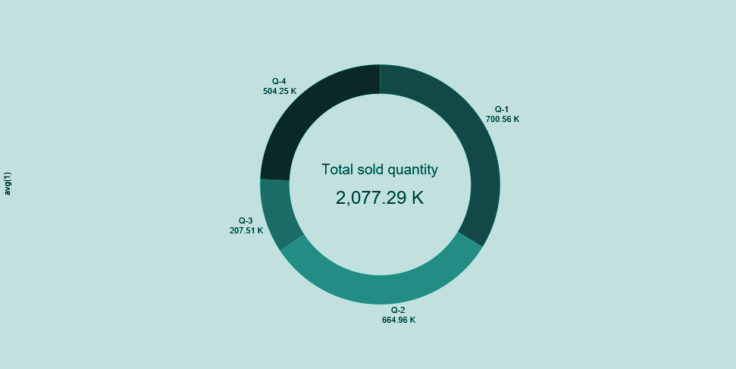
In which quarter of 2020, got the maximum total_sold_quantity? The final
output contains these fields sorted by the total_sold_quantity,
Quarter
total_sold_quantity
given Quarter starts from september
*/
select
case when month(date) in (9,10,11) then 'Q-1'
when month (date) in (12,1,2) then 'Q-2'
when month (date) in (3,4,5) then 'Q-3'
when month (date) in (6,7,8) then 'Q-4'
end as 'Quarter'
,sum(sold_quantity)/10000 as total_sold_quantity_K from fact_sales_monthly
where fiscal_year=2020
group by Quarter
order by total_sold_quantity_K desc
700.56 thousand quantities were sold in quarter 1 of 2020 followed by 2nd ,4th and 3rd quarter

Slide 13
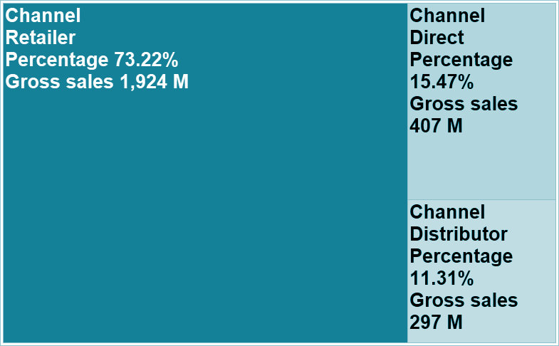
*Which channel helped to bring more gross sales in the fiscal year 2021
and the percentage of contribution? The final output contains these fields,
channel
gross_sales_mln
percentage
*/
with gs2021 as
(select round(sum(sold_quantity*gross_price)/1000000,3) as gross_sales_mln,channel
from dim_customer dc join fact_sales_monthly fsm on
dc.customer_code=fsm.customer_code join
fact_gross_price as fgp on fsm.product_code=fgp.product_code
where fsm.fiscal_year=2021
group by(channel)
order by gross_sales_mln desc)
select *,gross_sales_mln*100/sum(gross_sales_mln) over() as percentage from gs2021
There is a huge gap between gross sales of Retailer Channel (73.22%.) and other channel.Further analysis is required to determine the reason of this disparity among channel sales.

Slide 14
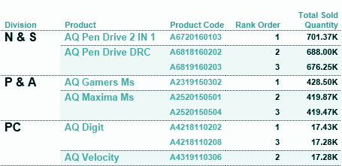
*Get the Top 3 products in each division that have a high
total_sold_quantity in the fiscal_year 2021? The final output contains these fields,
division
product_code
product
total_sold_quantity
rank_order
*/
with tp2021 as
(select sum(sold_quantity) as total_sold_quantity,
division,product,fsm.product_code,
rank() over(partition by division order by sum(sold_quantity) desc) as rank_order
from fact_sales_monthly fsm
join
dim_product dp on fsm.product_code=dp.product_code
where fsm.fiscal_year=2021
group by division,product,fsm.product_code)
select * from tp2021
where rank_order<4
Digital products division sales are highest among the division .N&S division has sold maximum number of products.

