Slide 1

SENSORS INTEGRATION TUTORIAL
Project RAT_EOS_PC
ACTIVITY 3. BIOPHYSICAL INDICES FUEL Mediterranean climate

Slide 2
TTN Integration - Steps
Step 1: TTN Application creation.
Step 2: Device importing through .csv file.
Step 3: Decoder aplication.

Slide 3
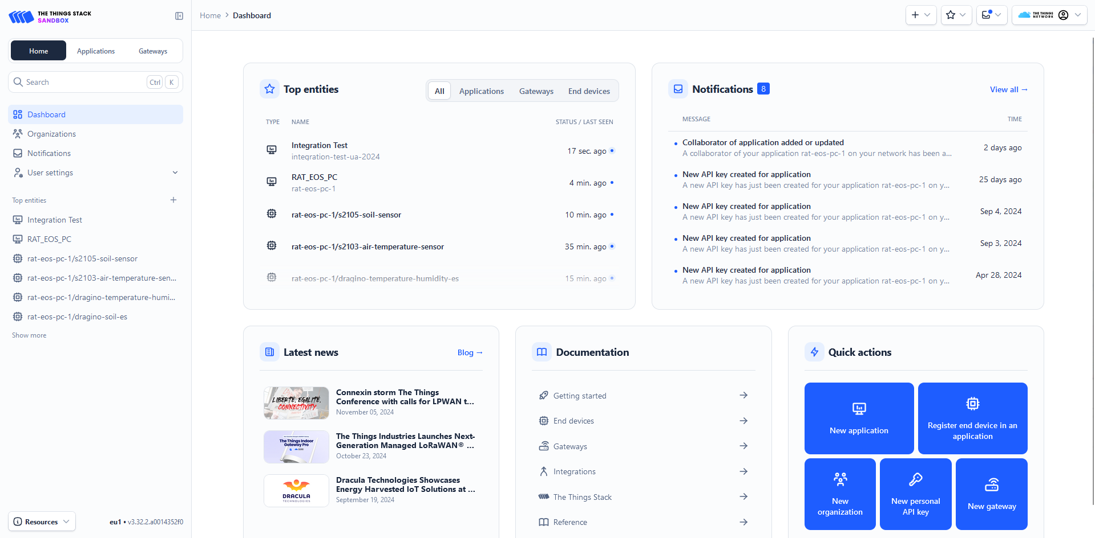

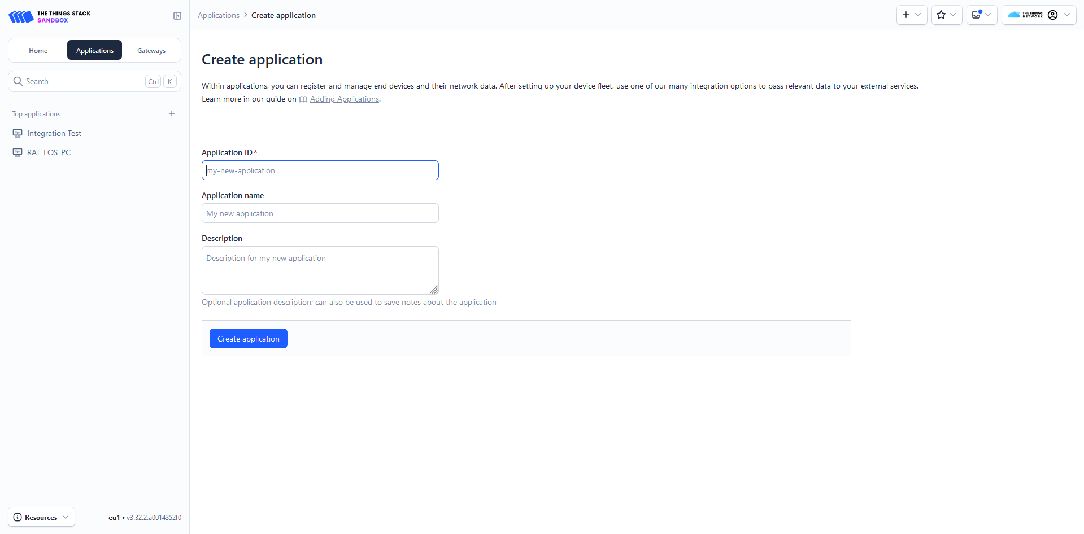
TTN Integration - Step One: Create Application

Slide 4
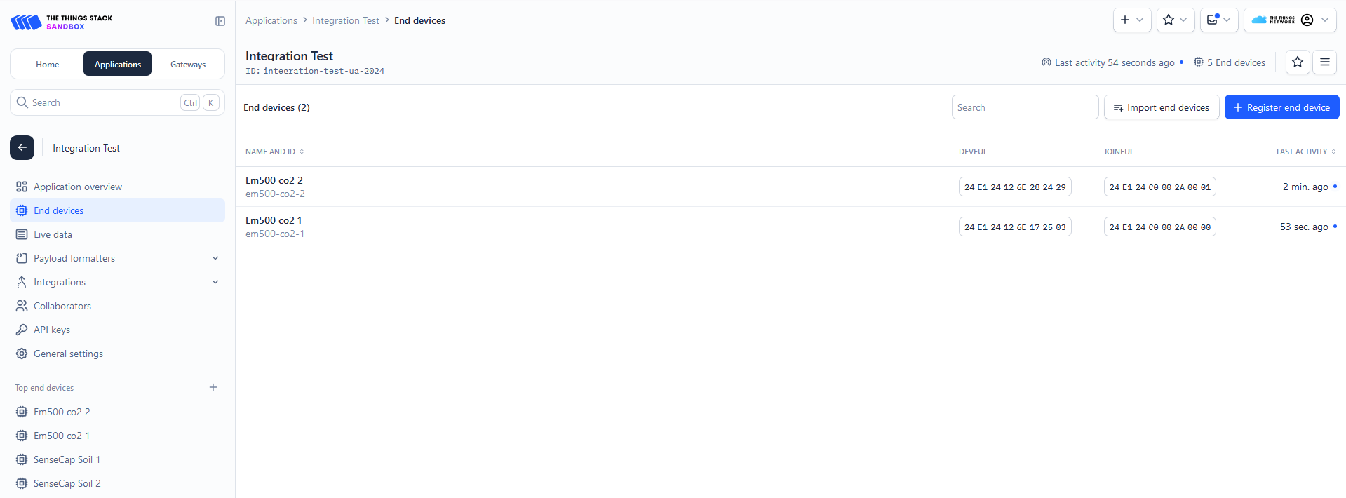
TTN Integration - Step Two: Add Devices
.csv file for each device model
.csv import

Slide 5
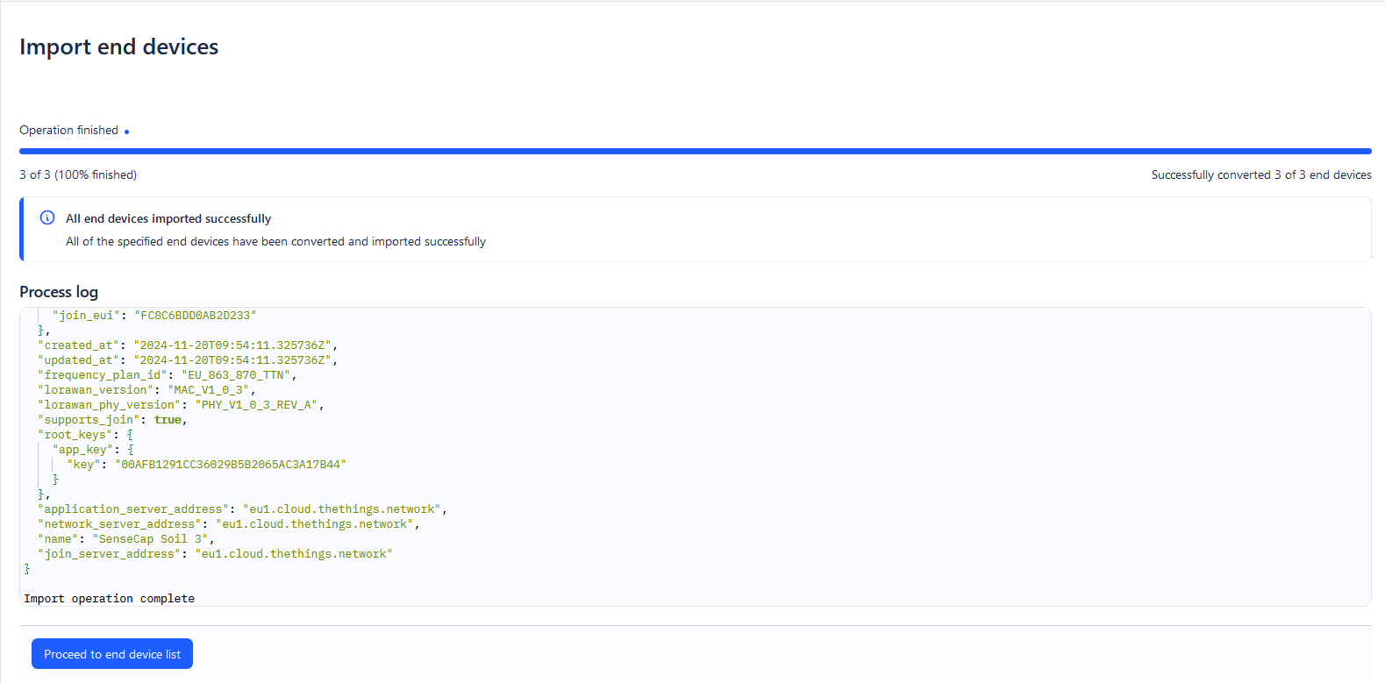
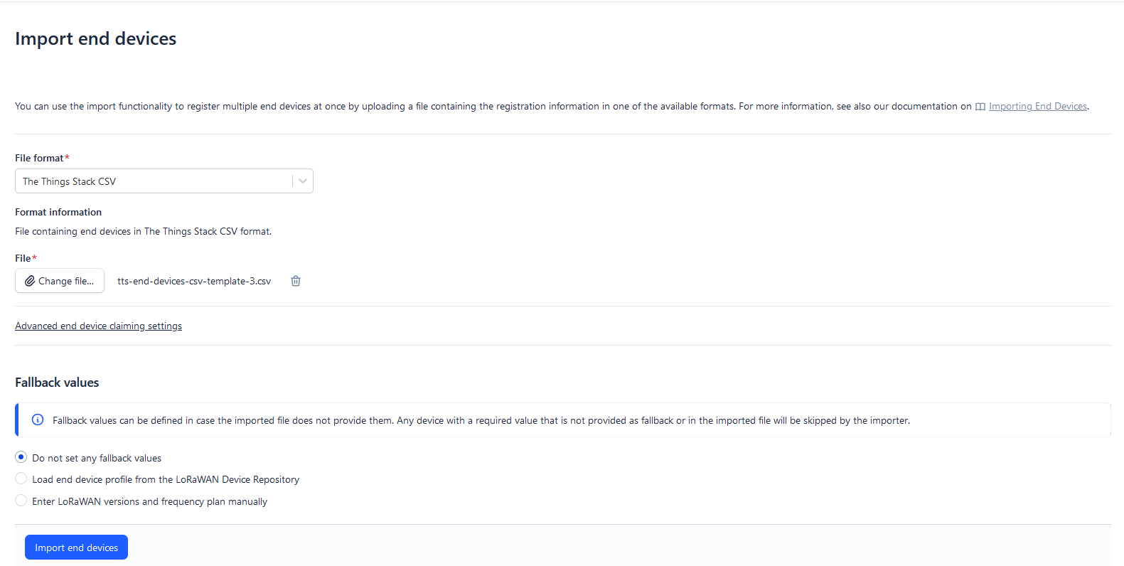
TTN Integration - Step Two: Add Devices

Slide 6
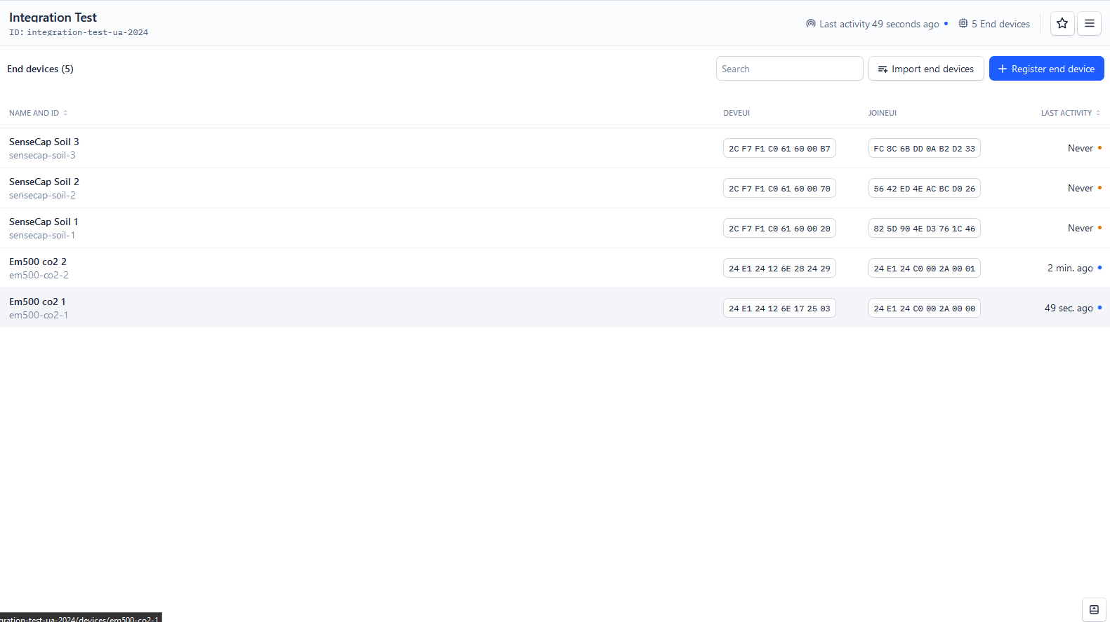
TTN Integration - Step Two: Add Devices

Slide 7
TTN Integration - Step three: Apply Application Level Decoder
Step 3.1: How to distinguish each device model.
Step 2: Make one payload formatter with all the decoders.

Slide 8
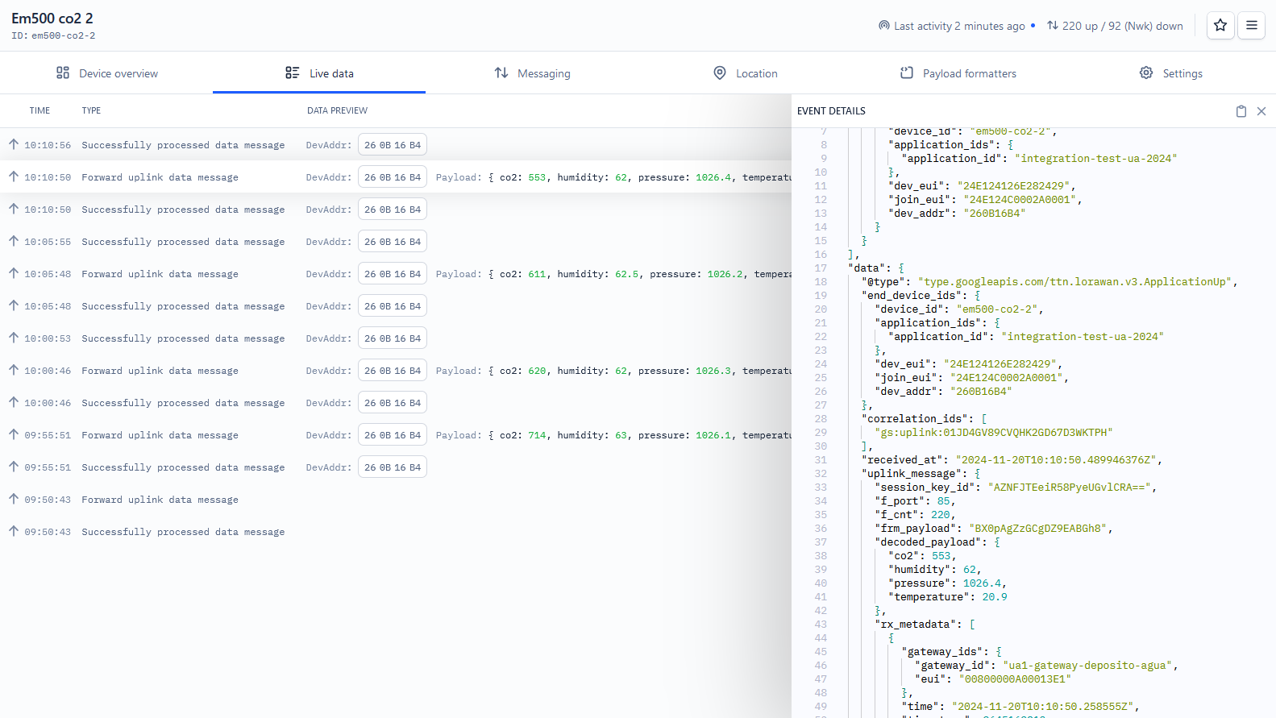
Application Level Decoder : Step 3.1
Step 3.1: How to distinguish each device model

Slide 9
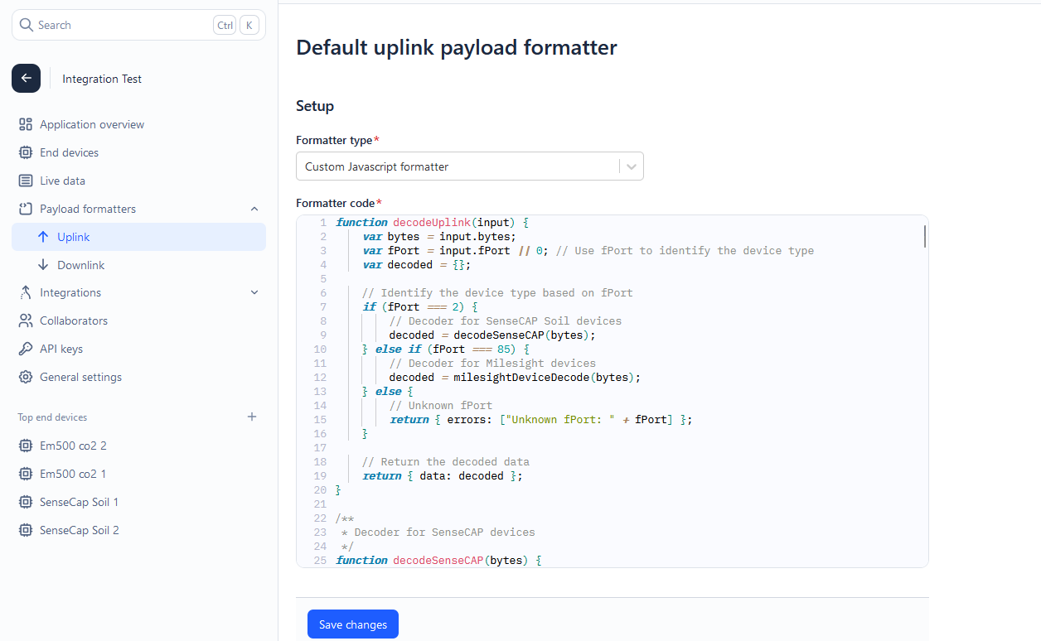
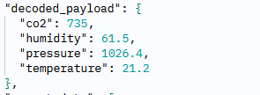
Application Level Decoder : Step 3.2
Step 3.2: Make one payload formatter with all the decoders

Slide 10
Integration Steps
Steps overview using TTN
Sensors are installed and send data to The Things Network (TTN)
Retrieve sensor data using MQTT integration from TTN
Python script retrieves data (using MQTT integration), normalizes it (data model), and sends it to our platform using Kafka.
Notes:
Before starting explaning how the sensor integration will work lets give an overview of the steps and then analyze It in more detail
Put the correct names for the data fields that the sensor captures according our data model

Slide 11
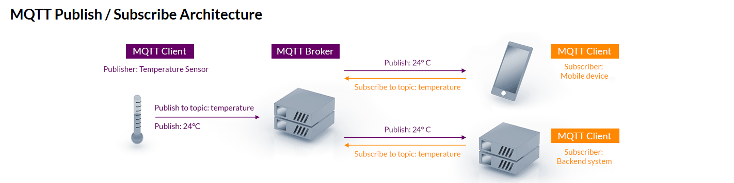
MQTT
MQTT is an OASIS standard messaging protocol for the Internet of Things (IoT).
It allows for messaging between device to cloud and cloud to device.
MQTT integration via TTN Provides a way to stream data from sensors using MQTT.

Slide 12
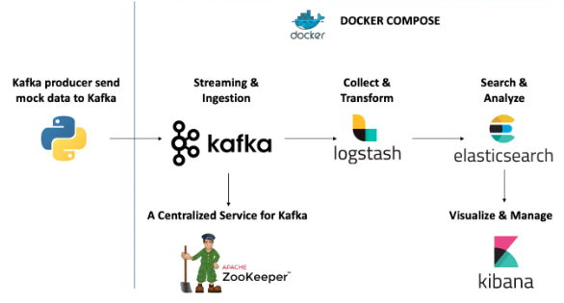
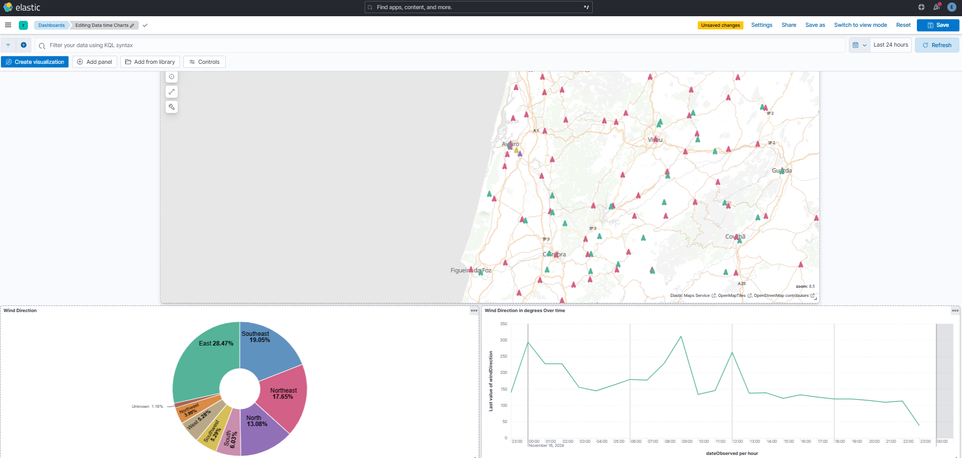
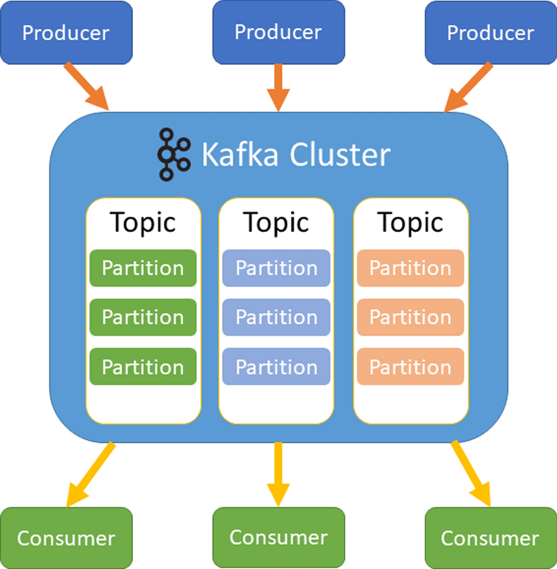
Kafka
Our script
In order to visualize the data in our kibana platform, we need to send the sensor data to our Kafka (automated process).
Kafka is used for building real-time data pipelines streaming analytics, data integration and serves as a storage system.

Slide 13

Resources
At the moment our plataform is receiving data from 5 different sensors. Two of which are from Dragino:
1 dragino soil
1 dragino temperature humidity.
The scripts and tutorial to fetch Sensor Data from those two sensors using MQTT Integration from TTN can be accessed here
https://github.com/rat-eos-pc-ua/tutorial/tree/main/TTN/MQTT_Integration
We are actively working on expanding support for other sensor models. Future updates and scripts for additional models will also be available in this repository.

Slide 14
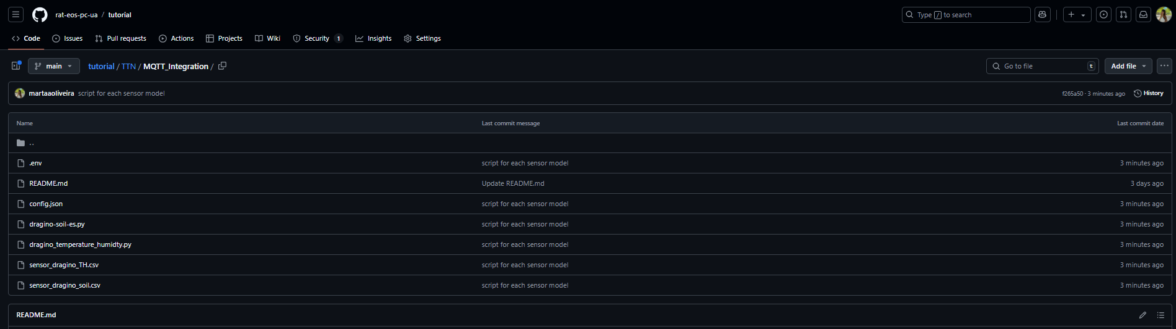
Folder structure Overview
https://github.com/rat-eos-pc-ua/tutorial/tree/main/TTN/MQTT_Integration

Slide 15

Folder structure Overview
Separate Python Scripts for Each Sensor Model:
Each sensor type (e.g., Dragino Soil, Dragino Temperature Humidity, em500) has a unique data structure.
Separate scripts for each specific models* makes updating more straightforward.
Future updates and scripts for additional models will also be available in this repository
Dedicated CSV Files for Each Model:
Stores device-specific information (e.g., ID, location) for each model.
Same CSV file imported to TTN
Facilitates easy management and updates.
This modular approach ensures scalability as the number of sensors and models grows and makes updating more straightforward.
Environment File (.env)
Stores sensitive MQTT credentials and app configurations
Configuration File(config.json)
Kafka connection credentials
Permissions should be configured to restrict access to the .env file
Files are simple text files and can be read and written using any text editor
It is a good security practice to set the .env file as read-only for the application or specific users, preventing accidental modification.
*If we have 20 sensors of dragino_soil will he have only one script to that model.

Slide 16
Script’s Overview
Connects to MQTT Broker: Listens for incoming data from sensors.
Receives Incoming Messages from sensors via MQTT:
Transforming Sensor Data
According our data model
https://www.rateospc.pt/swagger-ui/
Creating Kafka Producer and send data to our platform

Slide 17
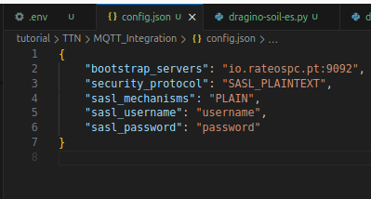
Config.Json
In order to connecto to kafka you will need the following file configuration.
The values username, password, security protocol will be sent via email to ensure security and to not be exposed publicly.
Adjust the values for the ones we will send you.
Ensure that the configuration file is in the same directory as the script

Slide 18
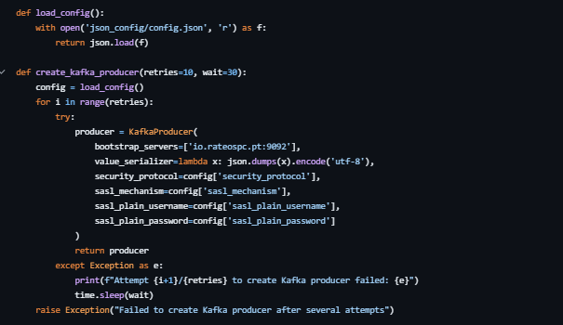
Create Kafka Producer
Creates our Kafka using authentication using the values on a configuration file(config.json)
No adjustments needed.

Slide 19
CSV FILES
The Relevant fields for the script
Same CSV that was uploaded in TTN to import new devices.
One CSV file for each model
1 CSV file for all the dragino temperature humidity sensors
1 CSV file for all the dragino soil sensors
1 CSV file for em-500 sensors
1 CSV file for all the weather-Station sensors
Column | Description
id | The unique identifier for each sensor
Latitude | The latitude coordinate where the sensor is installed.
Longitude | The longitude coordinate where the sensor is installed.
Location | A descriptive name of the location (e.g., city, region, building).

Slide 20
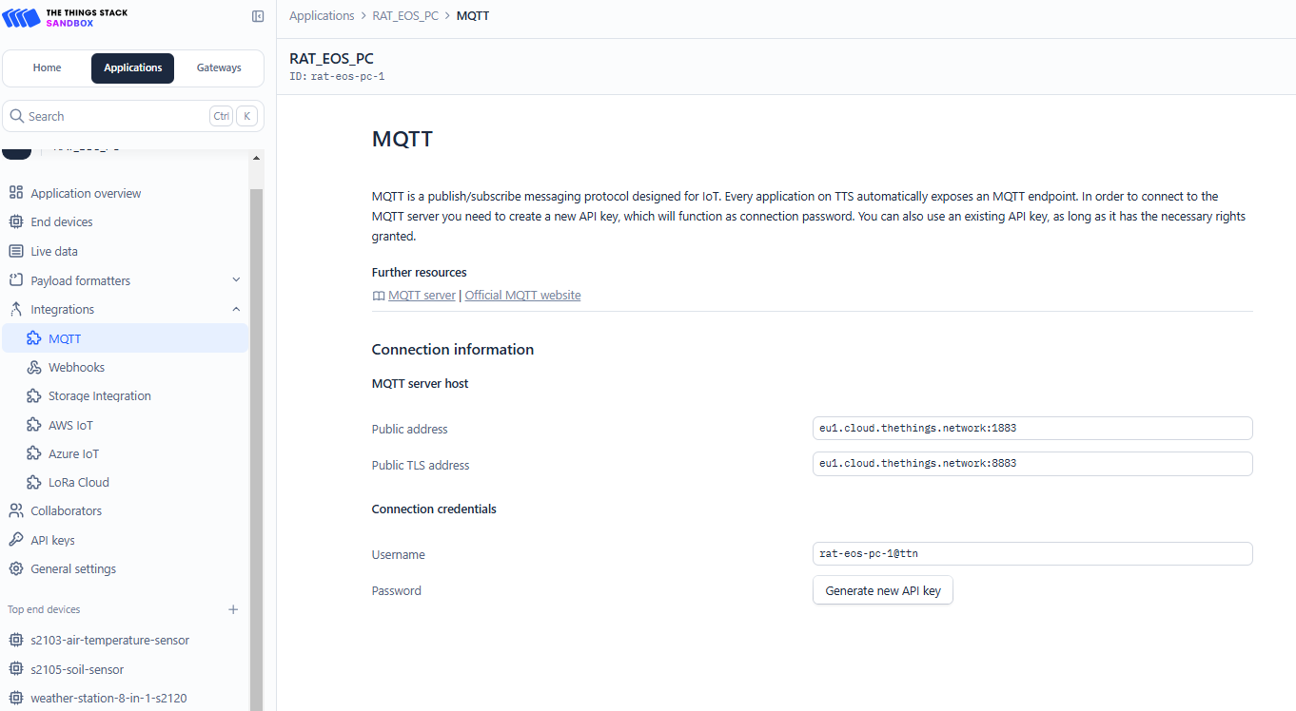
Credentials to connect to MQTT Broker
APP_NAME
USERNAME
Acess_Key

Slide 21
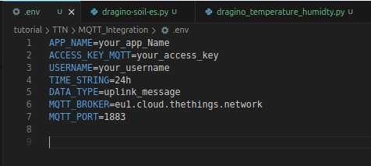
.env file
Adjust only the fields with the values shown previosuly
APP_NAME
ACESS_KEY_MQTT
USERNAME

Slide 22
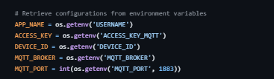
Credentials to connect to MQTT Broker
No adjustments needed.
Ensure that the .env file is in the same directory as the script

Slide 23
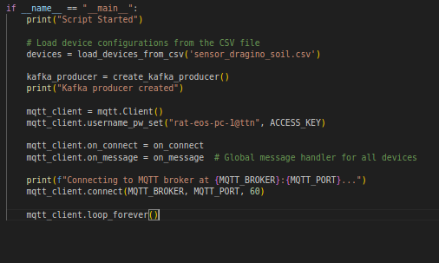
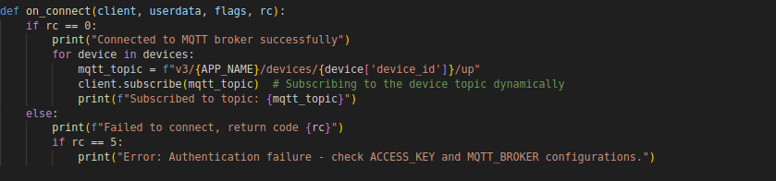
Connecting to MQTT Broker script
Using the values of the fields that were shown on the MQTT integration page (previous slide).
on_connect is a function triggered when the MQTT client connects to the broker.
on_message is gonna be called every time new data is received from the broker.
No adjustments needed.

Slide 24
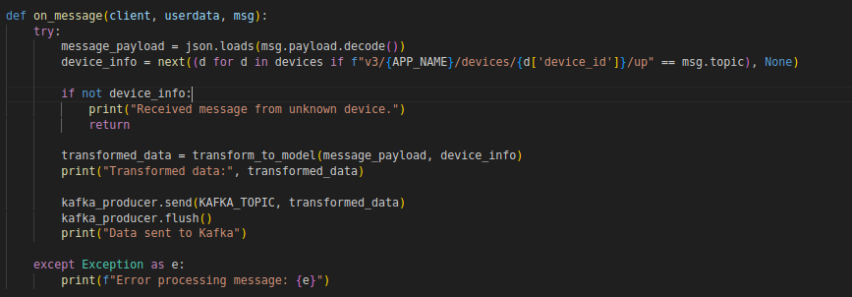
Receiving MQTT Messages script
on_message is triggered when a message is received from the subscribed MQTT topic (new data from the sensor as arrived).
Parses the incoming message and transforms the raw sensor data into a structured format using transform_to_model().
Sends the processed data to the Kafka topic in order to be visualized in our platform.
No adjustments needed.

Slide 25
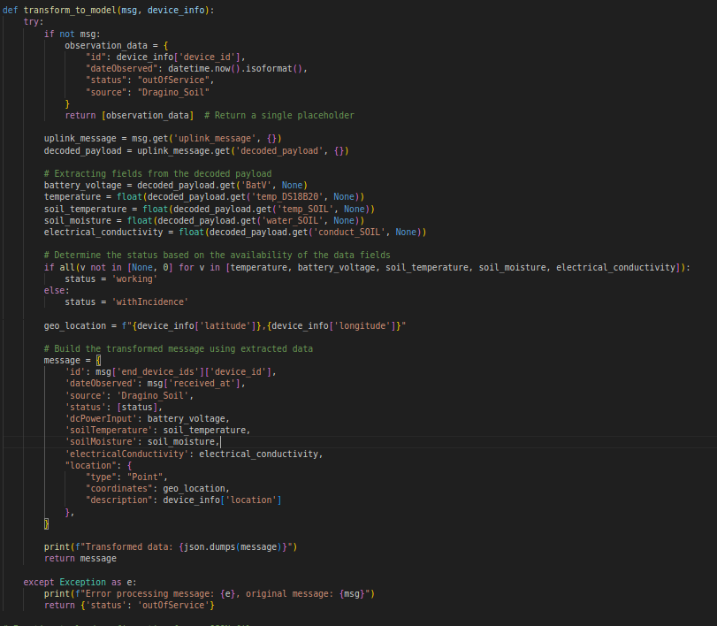
Transforming Sensor Data According our data model
transform_to_model processes the MQTT message to extract sensor data and constructs a structured message with the sensor values with the correct data model structure.
The status field indicates if all sensors are working properly or if there's an issue. If there are empty fields, we add the information that the sensor is ‘withIncidence’.
The fields on “message” needs to be according our data model. If not, the data will not be available in our platform.
No adjustments needed.

Slide 26
Conclusion: Overall adjustments
The only changes needed are
Update the env file with the correct MQTT credentials from your TTN.
Adjust the configuration.json with the given credentials to you
Populate the csv files with the device information for each sensor model. The name of the csv files need to be as our repository:
sensor_dragino_TH.csv
sensor_dragino_soil.csv

Slide 27

Requirements
VM/Server
To run the script continuously and handle real-time data.
Preparing CSV Files for Each Sensor model
Creating Environment Variables (.env file)
Setting Up Kafka Configuration (config.json)
Stay Updated with Script Changes
Check the repository regularly for new changes or releases.
If there are updates: Download the latest script from the GitHub repository given and replace it (to the corresponding script).
Running Scripts on a VM/Server
Ensure Network configurations like firewalls, VPNs, or NATs don't block access to MQTT and KAFKA communications.
Install the required dependencies using pip
pip install paho-mqtt kafka-python python-dateutil
Verify the correct behavior of the scripts

Slide 28

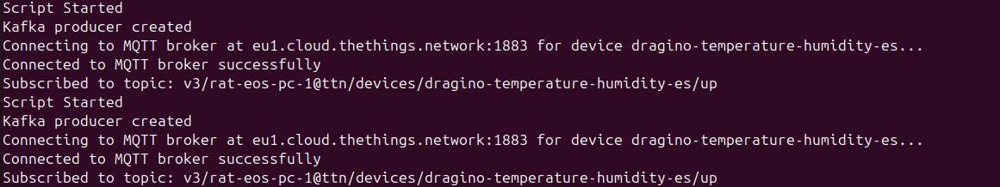
Correct behaviour
Successful case

Slide 29

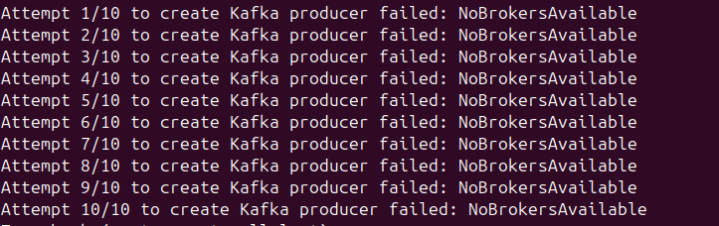
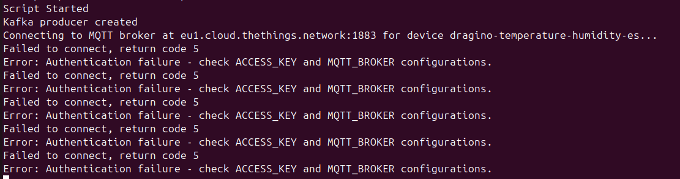
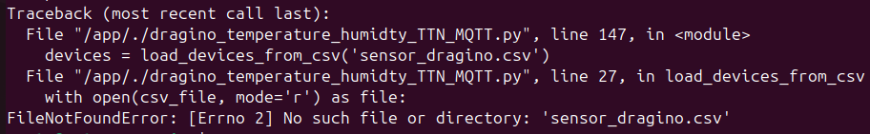
Common Errors and Troubleshooting
Wrong Kafka Credentials
Wrong MQTT Credentials/environments
CSV name files dont match
Unsuccessful cases

Slide 30
Common Errors and Troubleshooting
Connection Issues:
Ensure correct MQTT Broker URL and credentials.
Verify Kafka configurations.
Check if the Kafka was produced and the connection to MQTT was successful.
Availability of the files needed
Check if the values from .env and config.json are being correctly loaded to the scripts (they need to be in the same directory as the scripts).
Check the names of the csv files are according our repository.
This files need to be in the same directory as the script.

Slide 31
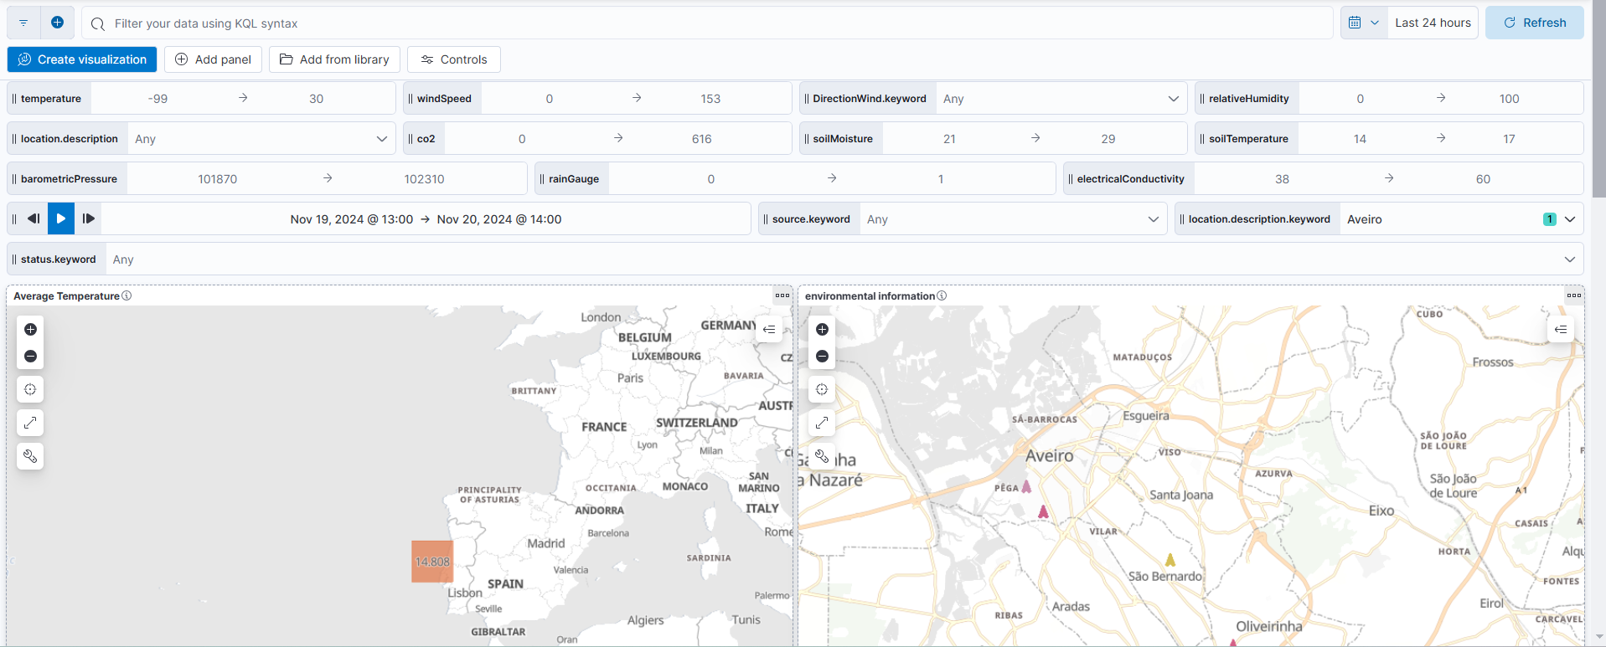
Verification
Check if data is being sent to our platform

Slide 32
How to run a python script?
Suggestions:
Using Docker:
https://www.geeksforgeeks.org/how-to-run-a-python-script-using-docker/
Using tasks
https://medium.com/analytics-vidhya/easiest-way-to-run-a-python-script-in-the-background-4aada206cf29

Slide 33
Thank you

