Slide 1
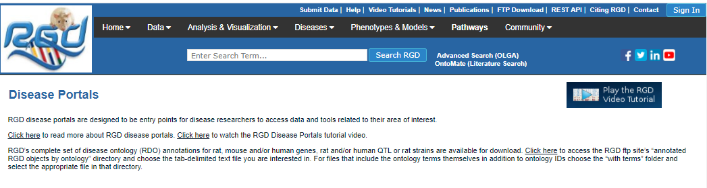
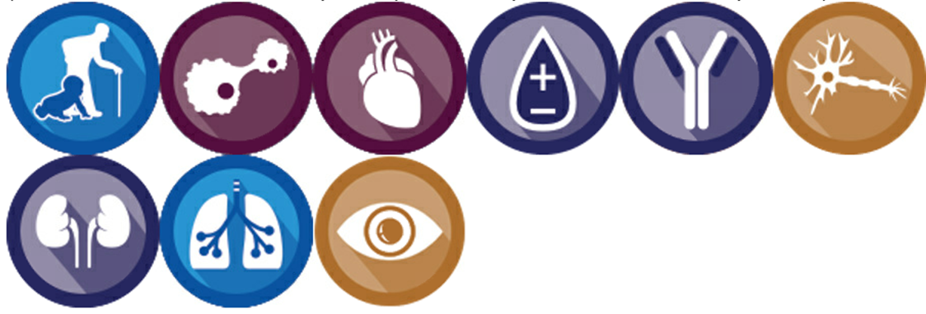



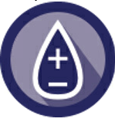
Disease Portals
About RGD’s Disease Portals
RGD has numerous Disease Portals, where relationships between diseases and genes, QTLs and strains can be explored in human, rat, mouse and in the other five species at RGD. The portals contain data sections for eight other ontologies related to the portal disease category, as well as links to visualization/analysis tools and additional information.
About the RGD Disease Portals
Welcome to the RGD Disease Portals. These portals are designed to be entry points for disease researchers to access data and tools related to their area of interest. Click here for help with the RGD Disease Portals.
Aging & Age-Related Disease
Cancer & Neoplastic Disease
Cardiovascular Disease
COVID-19
Developmental Disease
Diabetes
FTP Download
Hematologic Disease
Immune & Inflammatory Disease
Disease Ontology (RDO) Annotations – Ontology Term IDs Only
RDO – Gene (8 Species)/QTL (Rat & Human)/Rat Strain
RDO Annotations – Ontology Terms & IDs
RDO – Gene (8 Species)/QTL (Rat & Human)/Rat Strain
Liver Disease
Neurological Disease
Obesity & Metabolic Syndrome
Renal Disease
Respiratory Disease
Sensory Organ Disease

Slide 2
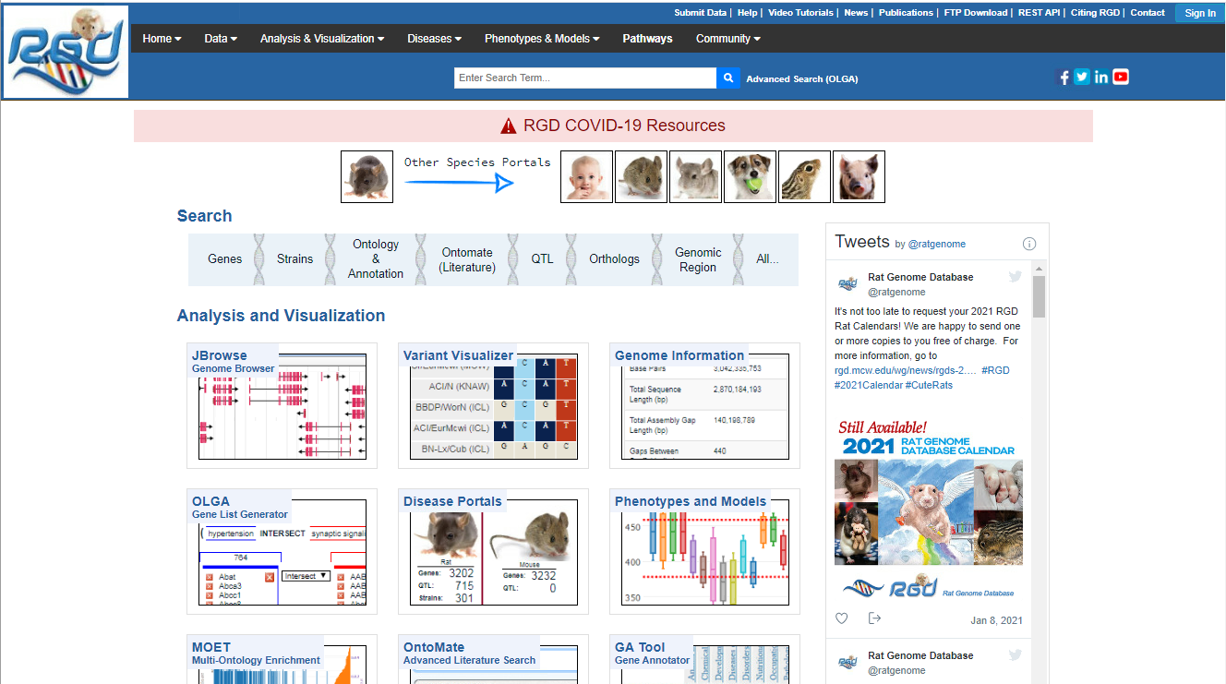
Disease Portals
RGD has numerous disease portals, where relationships between diseases and genes, QTLs and strains can be explored in human, rat, mouse and the other five species at RGD. The Disease Portals landing page can be accessed either by clicking ‘Diseases’ in the top black banner of the home page, or the central panel.

Slide 3
Jump to information about the:
Disease Portal Entry Page (anchor to A)
Ontology, Species and Term Selection (anchor to B)
Gviewer (anchor to C)
Term Enrichment (anchor to D)
Analysis Tools, Model Strains, Information Links (anchor to E)
Click here to view the Disease Portal Video Tutorial out for now
Jump To…
Help Home OK
RGD Rat Community Videos some content outdated
RGD Data Help Topics structure OK, content probably outdated
RGD Tools Help Topics structure needs revision, many tools missing
RGD Search Features outdated?

Slide 4
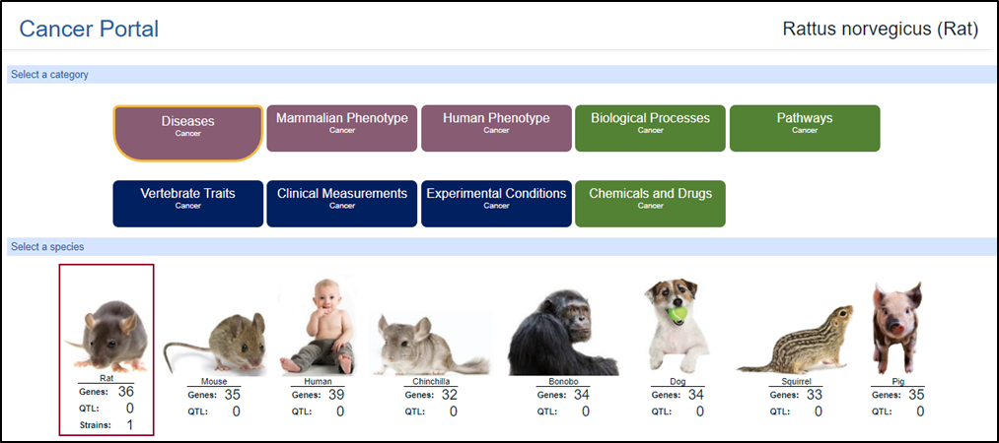
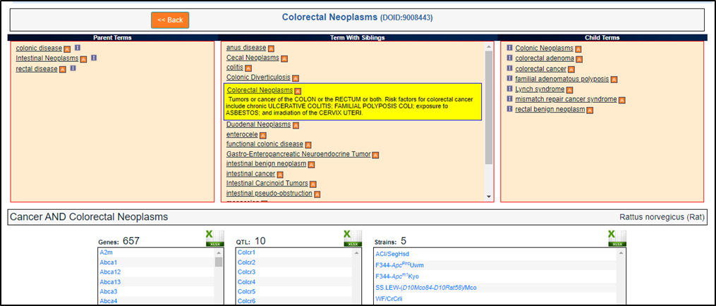
Disease Portal Help
A
Disease Portal Entry Page
B
1. For each portal, the default view is of the disease section of the portal. Any one of nine ontologies can be selected.
2. Any one of eight species can be chosen by clicking on the image. Here rat is selected.
3. For that species, the numbers of genes, QTLs and strains annotated to the designated ontology are displayed.
4. The RGD ontology browser is presented, loaded with the selected ontology, where one can navigate to and pick a desired term.
5. Downloadable gene, QTL and strain lists annotated to the chosen term are displayed.
1
2
3
4
5

Slide 5
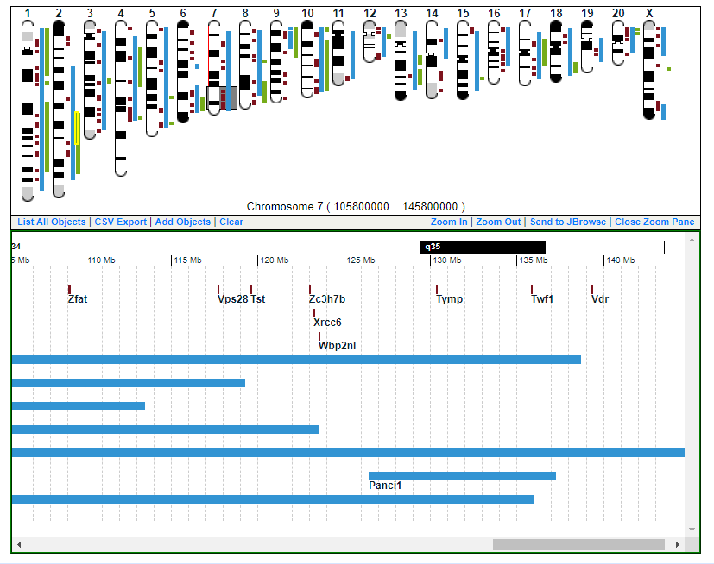
C
6
6. Where available, a GViewer instance of the designated species’ chromosome complement is shown, indicating where on the chromosomes the retrieved genes (brown), QTLs (blue) and strains (green) map.
7. Clicking on a colored object brings up a horizontal close-up display of that object in the context of other genomic features. Clicking on an object in this display links to that object’s report page.
7

Slide 6
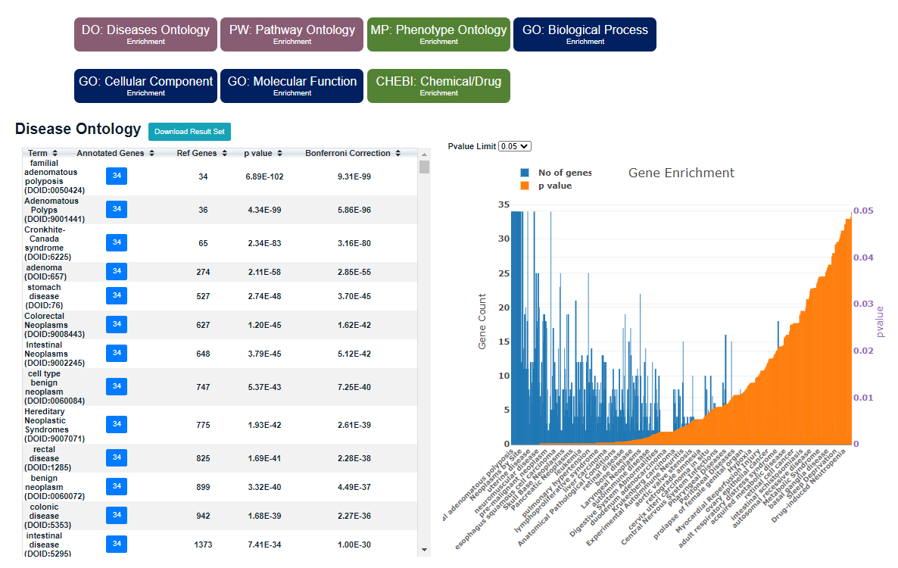
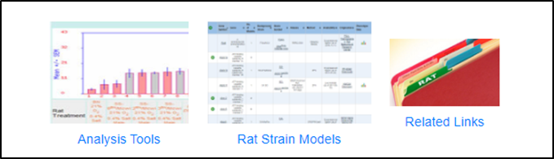
D
8. An instance of MOET (Multiple Ontology Enrichment Tool) is provided to display gene enrichment results for gene annotations to any of the three branches of GO or four other ontologies. Also see the stand-alone MOET.
9. Links to a set of analysis tools from RGD and elsewhere.
10. A tool to find annotated pertinent rat strain models.
11. Links to relevant RGD pathway data, as well as links to pertinent information sources outside RGD.
8
E
9
10
11

Slide 7
