Slide 1




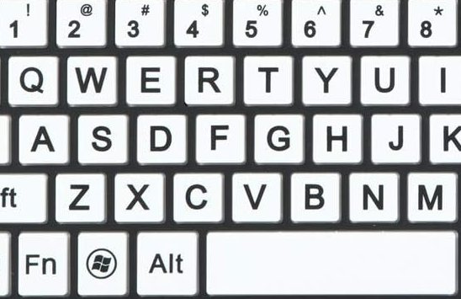
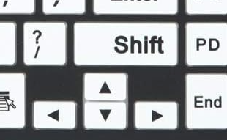




PLAYER MOVEMENT
Player One “Samurai Mack”
Player Two “Kenji”
JUMP
RIGHT
JUMP
LEFT
LEFT
RIGHT
ATTACK
ATTACK

Slide 2
Refreshing the browser at any time will restart the game – each player will restart with full health and timer will be reset to 59 seconds.

