Slide 1
Mental State Examiner
By students of 3rd year CSE-B
Pranjal Singh 2002900100109
Priyanshi 2002900100111
Ratan Deep Singh 2002900100118

Slide 2
Table of contents
01
02
03
04
Introduction
Mental State Examiner
Aspects of MSE
Tech Stack

Slide 3
01
Introduction
In today’s world which is full of rush, everybody is under some sort of mental stress. To measure the one’s mental status, we are designing a platform. Let’s know more…

Slide 4
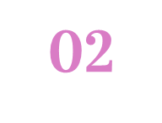
What is MSE
It’s a technique used to determine whether a person is experiencing abnormalities in thinking , reasoning ability, feeling or behavioural. The MSE is used to identify the person's present mental state.

Slide 5
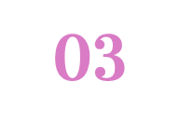
Aspects of MSE
• Behaviour
• Speech
• Thought
• Mood and affect
• Perception
• Cognitive functioning
• Insight

Slide 6
Assessment
The objective is to create a 8-10 minutes self assessment program, in which a person can analyse his mental state on the basis of the given aspects of MSE.
Based on his answers to the assessment we will evaluate the mental state using mathematical algorithms and also provide the person with some suggestions on how to make our mind stress free.

Slide 7
How to maintain a positive mental health?
Try to think positive
Be physically active
Adopting some hobbies
Always get enough sleep

Slide 8
04
Tech Stack
Front-end : ReactJS
Back-end : NodeJS, ExpressJS
Database : MongoDB
Deployment : Netlify

Slide 9
Thanks
Do you have any questions?

