Slide 1
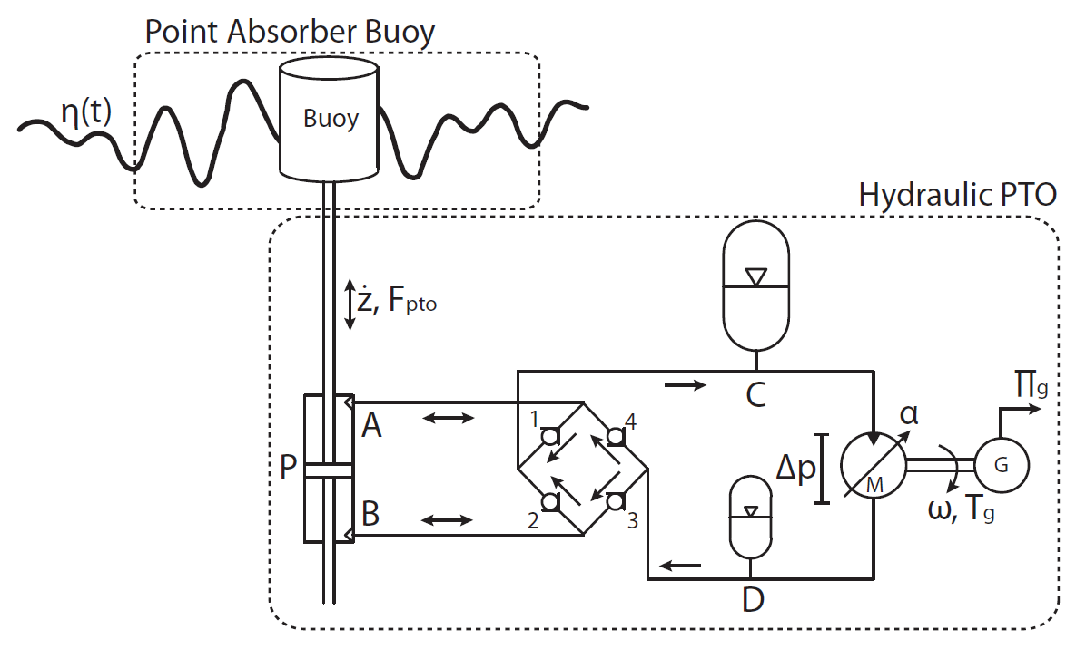
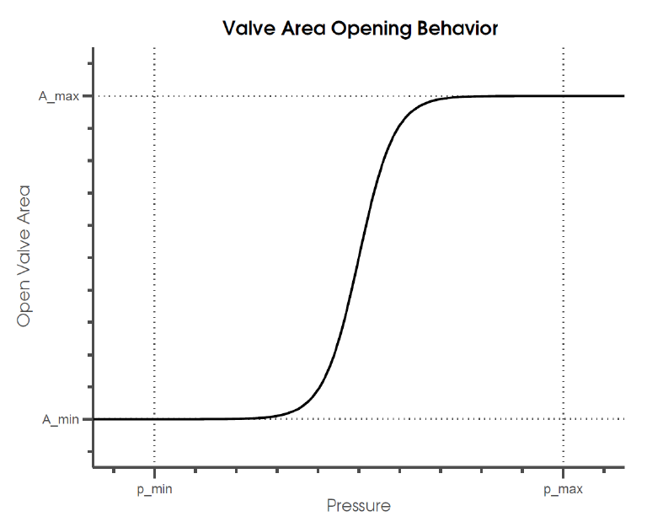
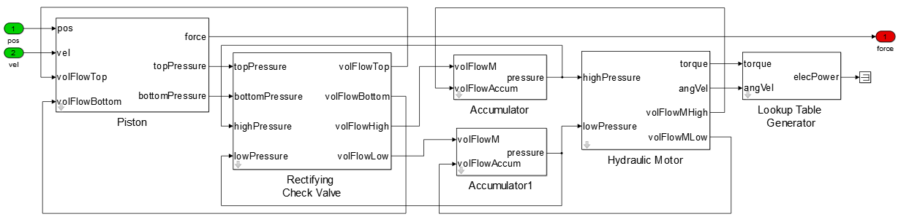
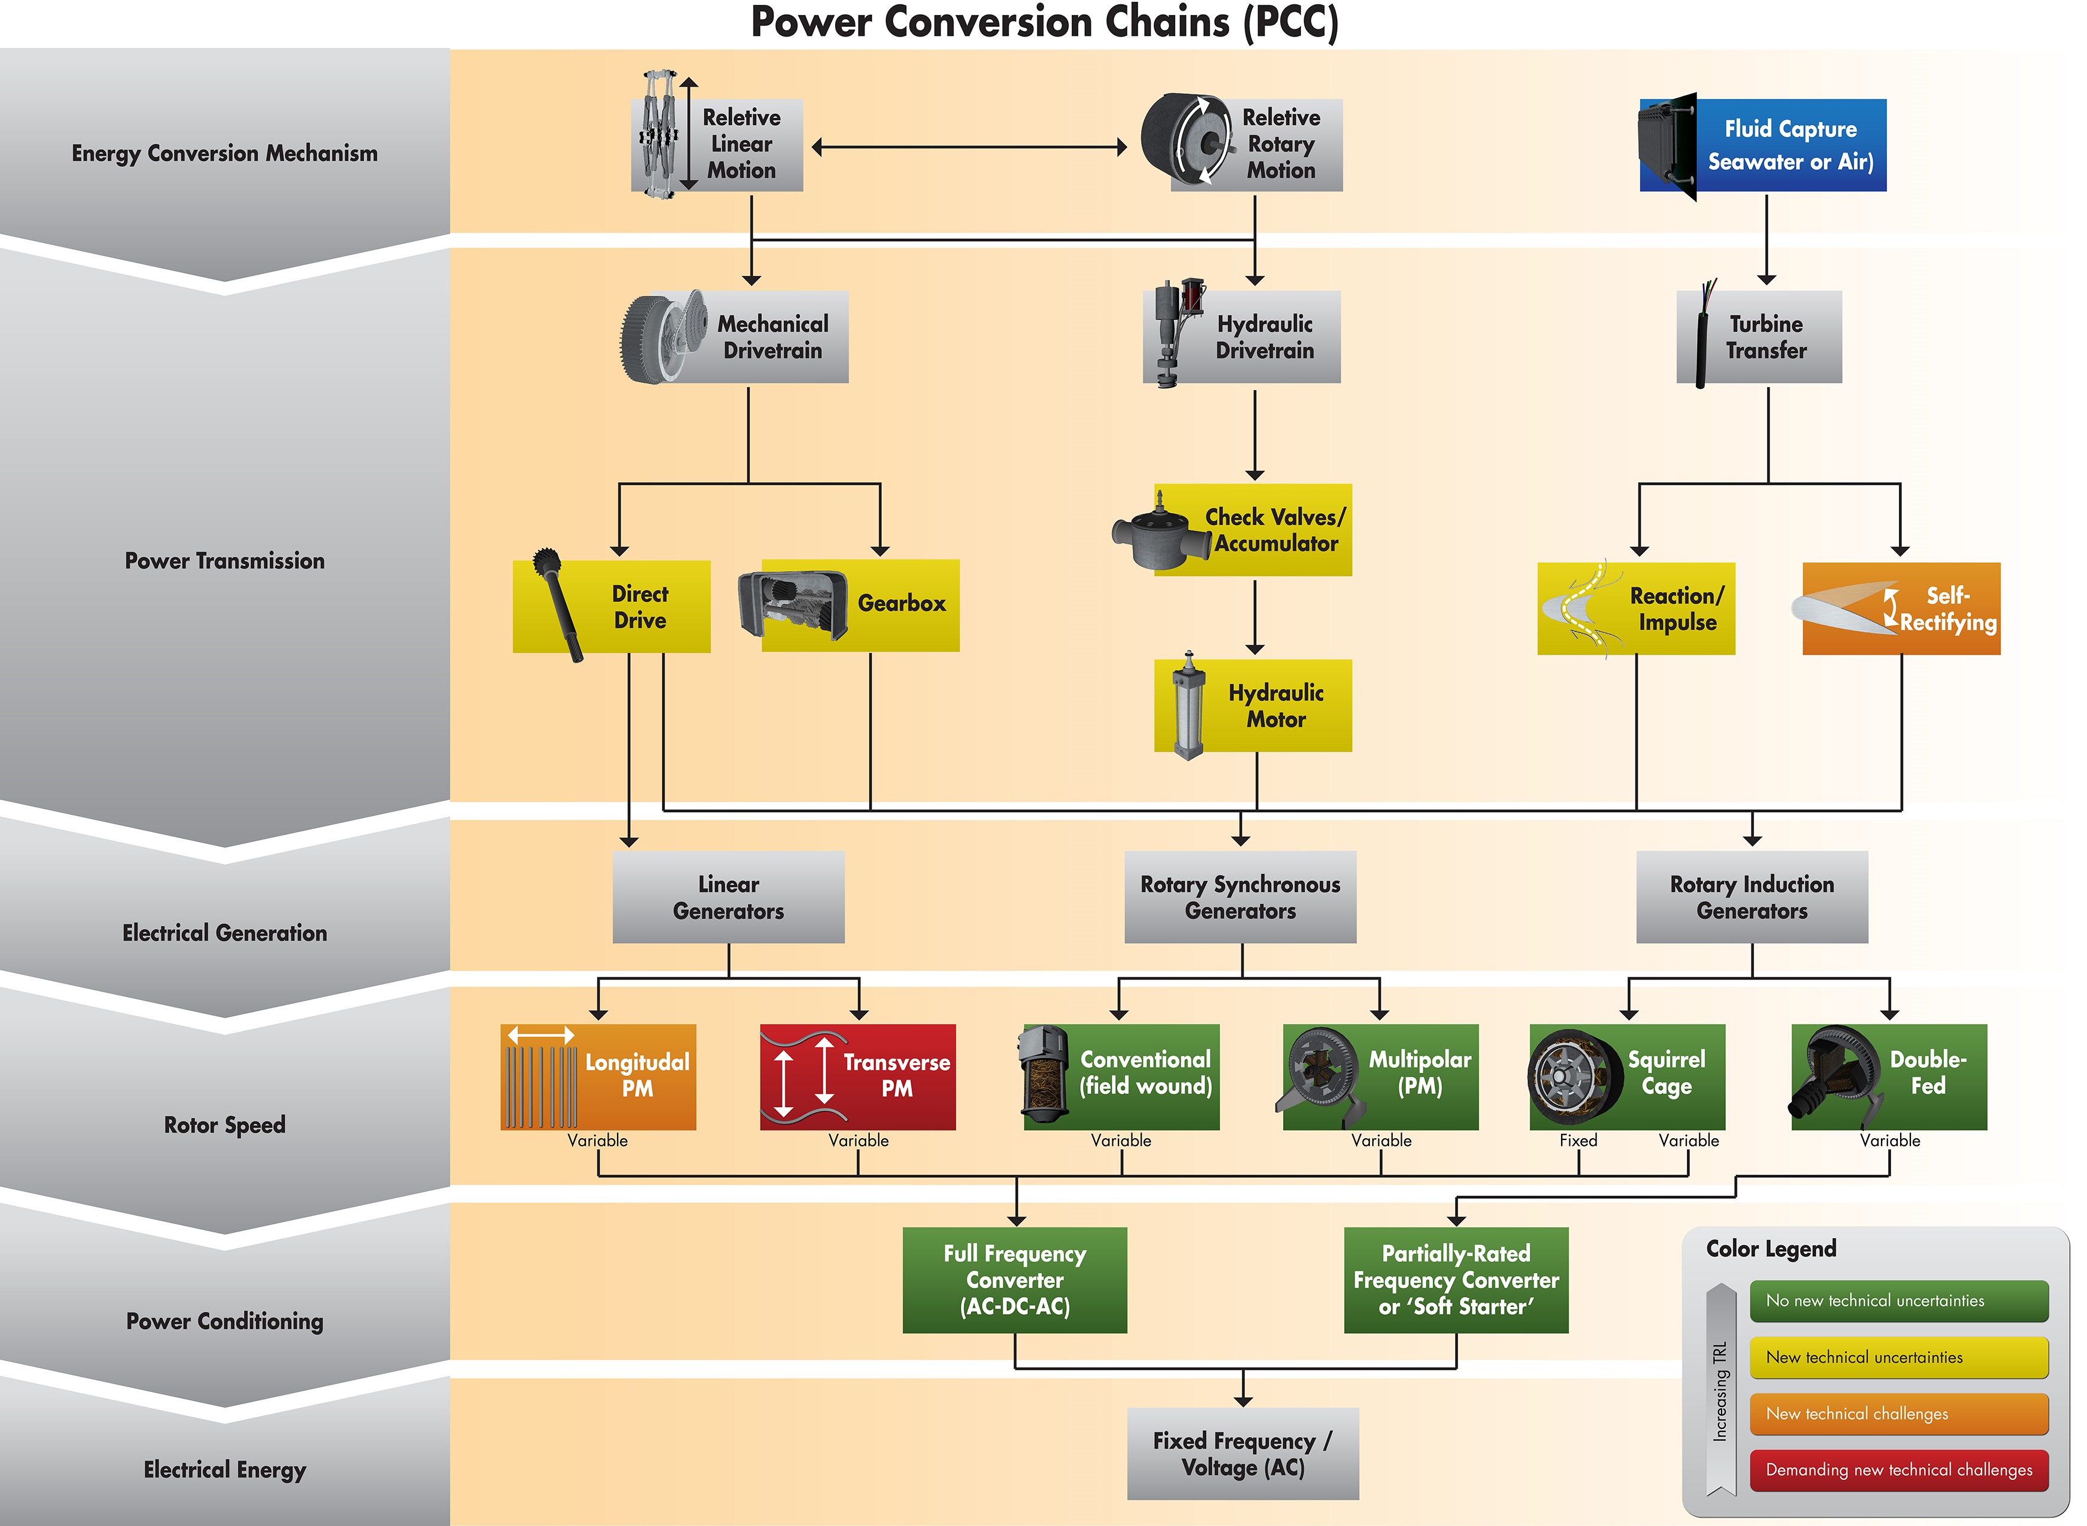
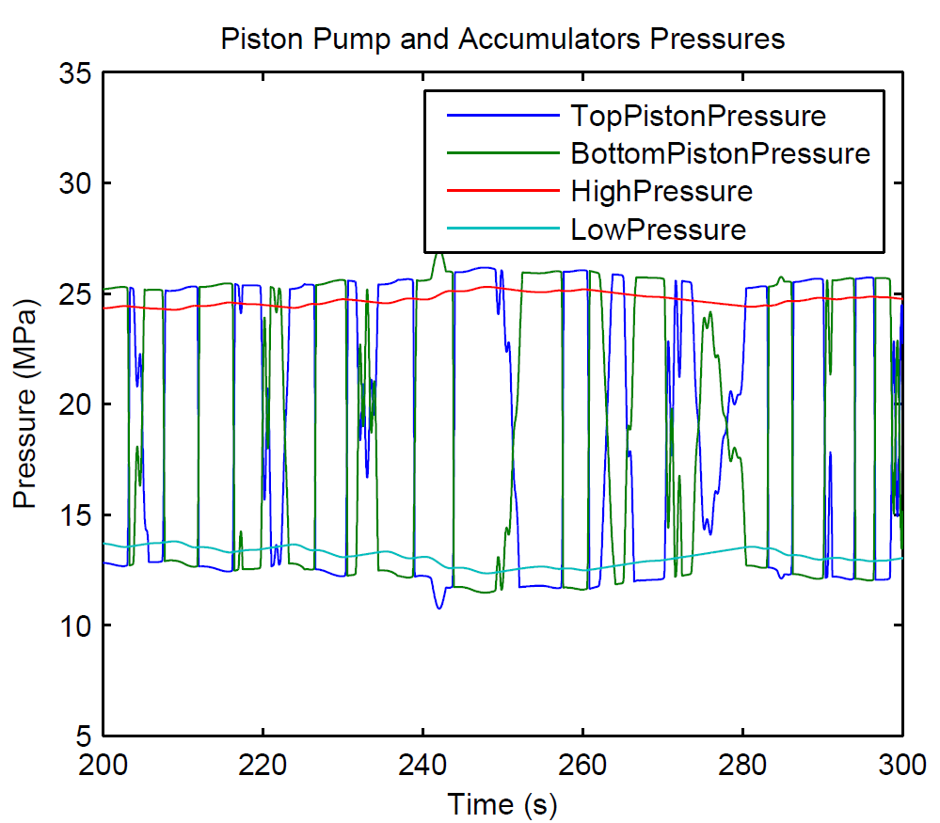
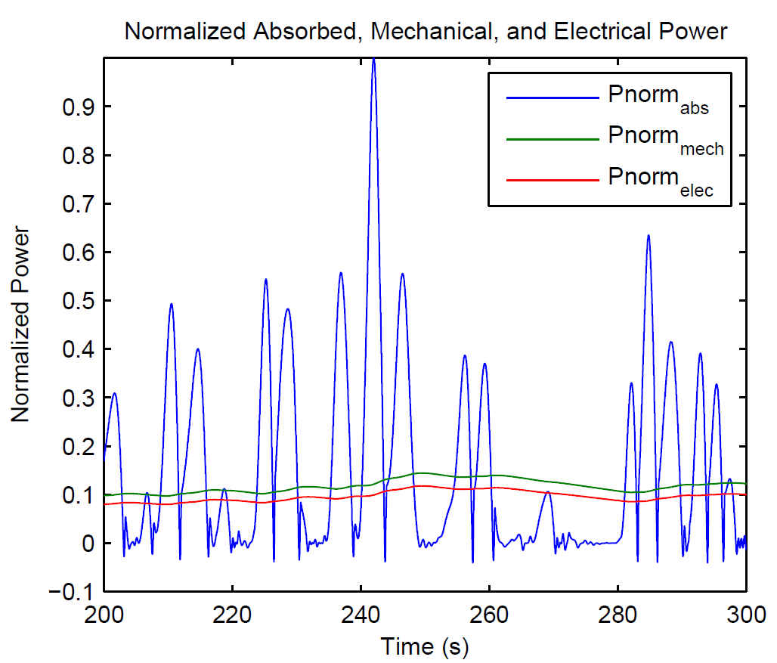
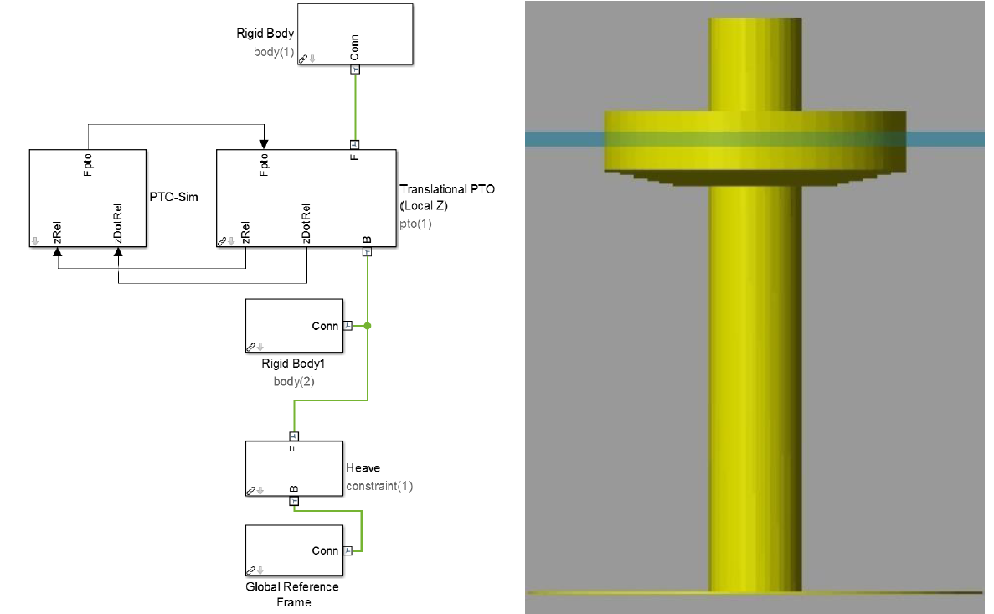
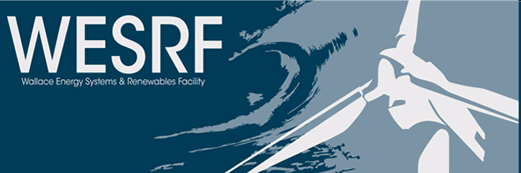
PTO-Sim: Development of a Power Take Off Modeling Tool for Ocean Wave Energy Conversion
Ratanak So, Asher Simmons, Ted Brekken
Oregon State University
Sean Casey
Energy Storage System, Inc
Sam Kanner
University of California Berkeley
Abstract
Sandia National Laboratories (SNL) and National Renewable Energy Laboratory (NREL) have collaborated to develop the open-source Wave Energy Converter (WEC) modeling tool WEC-Sim, capable of running on a standard personal computer. Its main function is to simulate WECs of arbitrary geometry subject to operational waves; both regular and irregular waves. However, WEC-Sim Version 1.0 models a power take-off (PTO) as a simple linear damper. A collaborative effort between SNL and the Energy Systems group at Oregon State University (OSU) has resulted in the development of PTO-Sim, an additional WEC-Sim library for accurately modeling a WEC PTO system such as hydraulic or direct-drive. This development of PTO-Sim makes WEC-Sim a wave-to-wire model by adding functionality that extends WEC-Sim capabilities. The WEC PTO system is easily created with drag and drop PTO-Sim library blocks to build a model that can estimate absorbed and electrical power.
Figure 3. Schematic of the PTO-Sim hydraulic model (left) and valve opening behavior as a function of pressure difference.
Figure 4. Simulink model of the hydraulic system.
Simulation Results
Figure 5 shows the relationship between the piston pressures and accumulators pressures. Top and bottom piston pressures are alternated as the buoy moves up and down. High and low accumulator pressures follow the top and bottom piston pressures, respectively.
Figure 6 shows the power produced by the PTO. The blue line represents the power absorbed at the piston. The green line represents the power at the axle connecting the motor and generator. Finally, the red line represents the electrical power at the output of the generator.
Figure 1. Power conversion chain from mechanical energy to electrical connection to grid. Lower TRLs are novel concepts and higher TRLs are more proven technology.
Figure 5. Piston pump and accumulator pressures. A check valve is open when the differential pressure is greater than minimum pressure. The valve is fully opened when the differential pressure reaches maximum.
Figure 5. Absorbed, mechanical, and electrical power.
Conclusion
The development and application of PTO-Sim, the WEC-Sim module responsible for accurately modeling WEC conversion of mechanical power to electrical power through its PTO system.
The demonstration results illustrate the power smoothing (i.e., energy storage) inherent to hydraulic systems.
Acknowledgements
This research was made possible by support from the Wind and Water Power Technologies Office within the DOE Office of Energy Efficiency and Renewable Energy. The work was supported by Sandia National Laboratories, a multi-program laboratory managed and operated by Sandia Corporation, a wholly owned subsidiary of Lockheed Martin Corporation, for the U.S. Department of Energy's National Nuclear Security Administration under contract DE-AC04-94AL85000. Special thanks to Kelley Ruehl and Carlos Michelen for their support on the development of PTO-Sim.
CONTACT INFORMATION:
Wallace Energy Systems and Renewables Facility School of Electrical Engineering and Computer Science
1148 Kelley Engineering Center Oregon State University, Corvallis, OR 97331-5501
Web Page: http://eecs.oregonstate.edu/wesrf/
Figure 2. An example of a fully integrated PTO-Sim coupled with WEC-Sim simulations. RM3 model in WEC-Sim (left), and with the animation (right).

