Slide 1

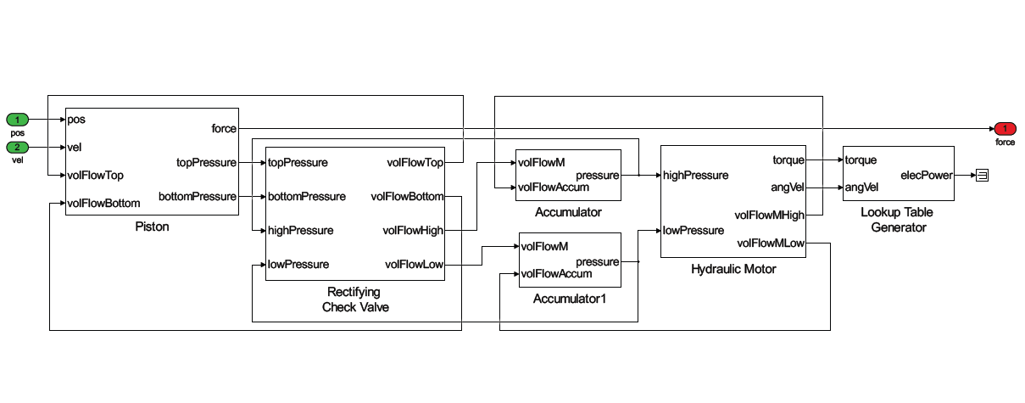
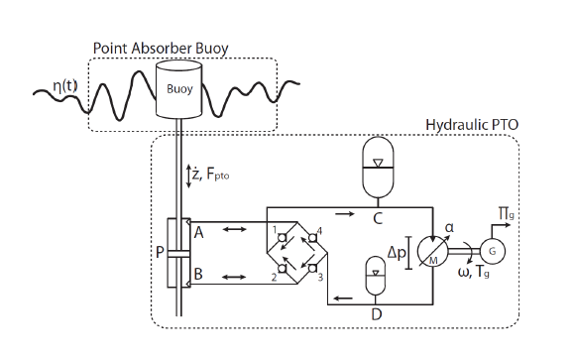
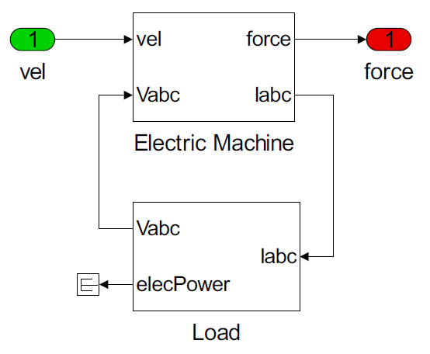
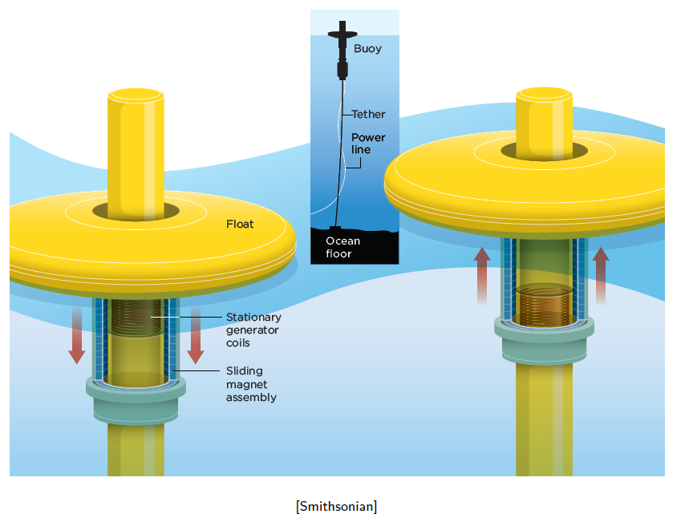
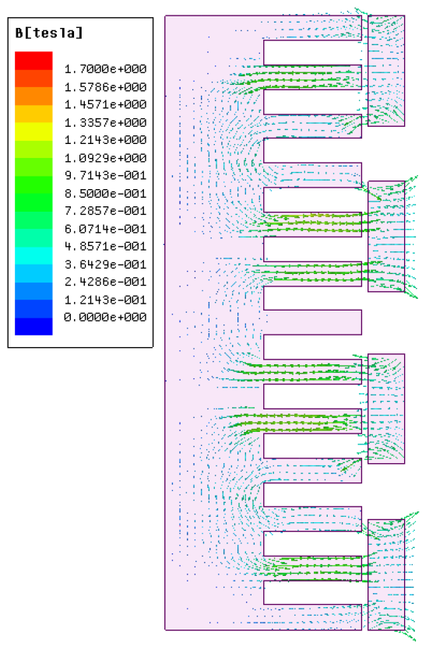
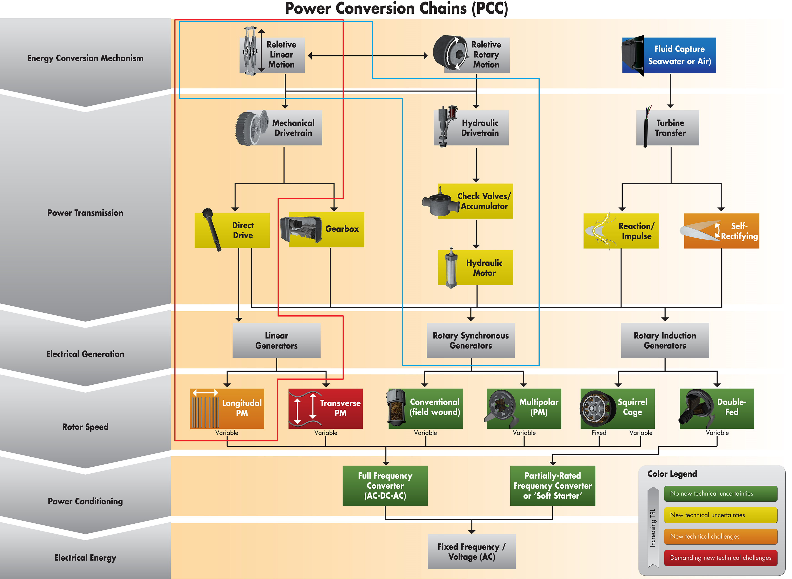
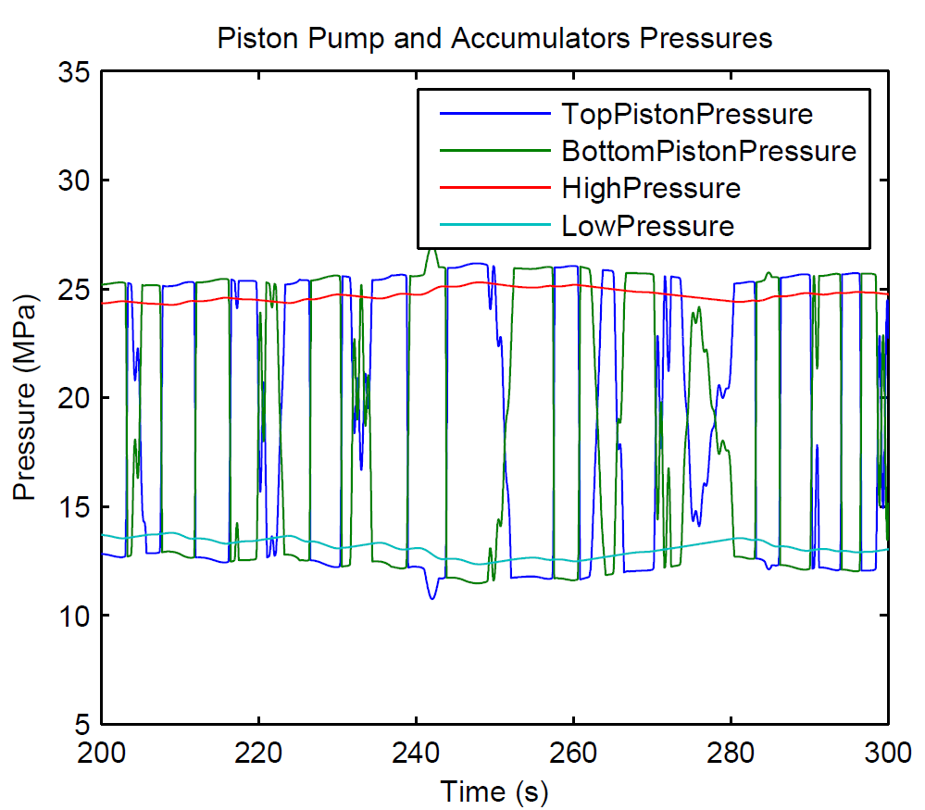
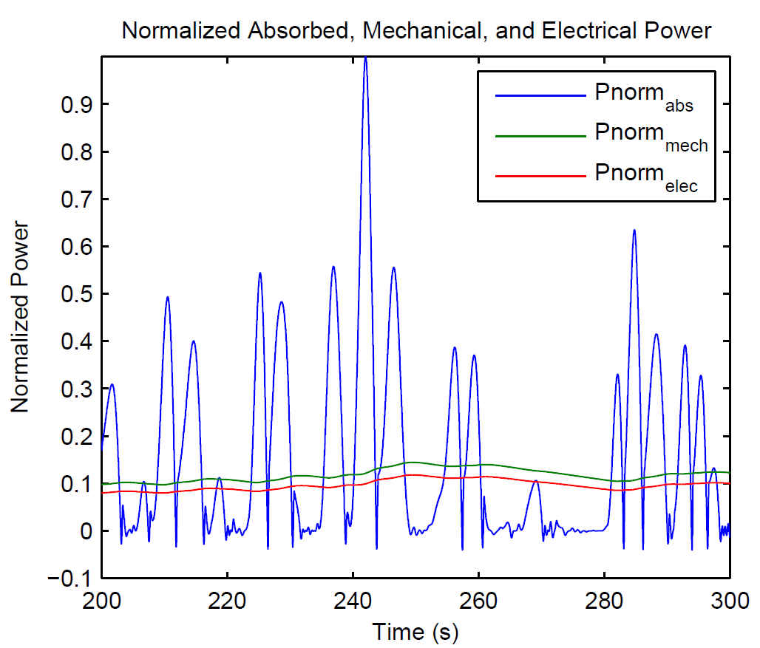
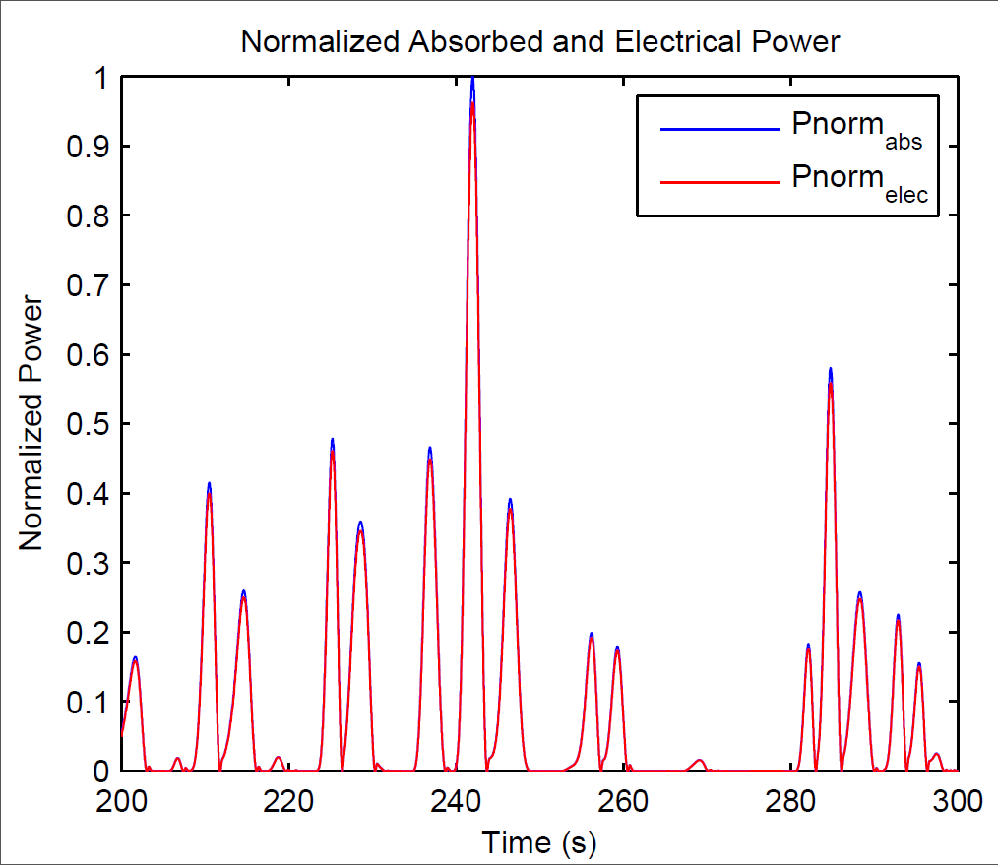
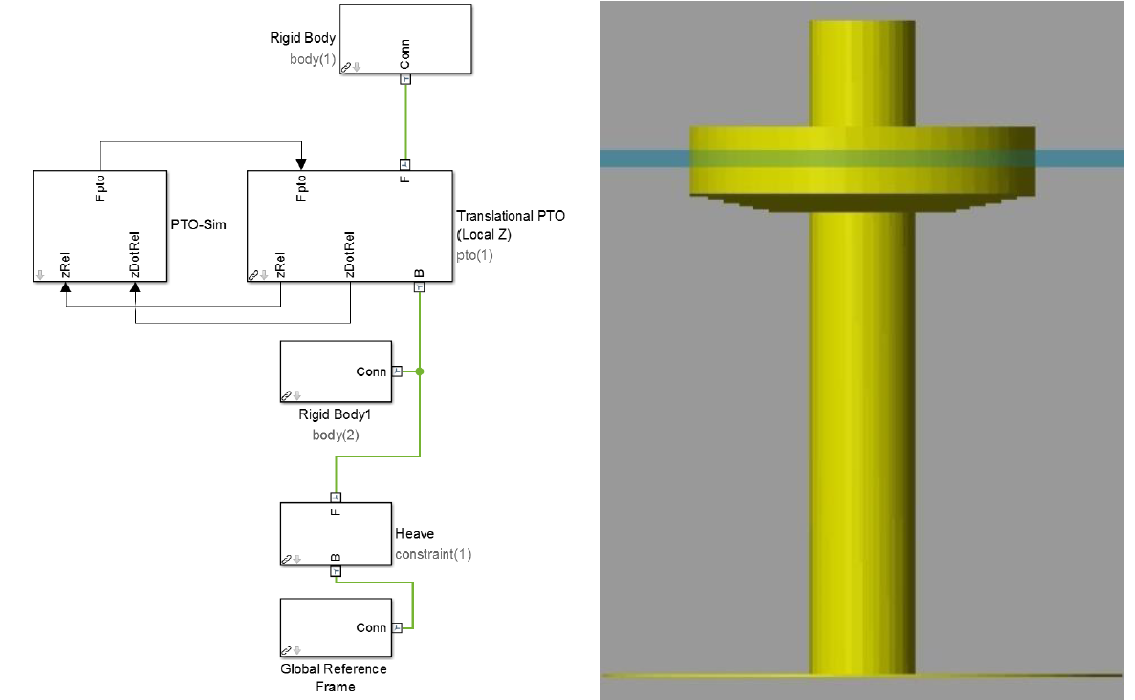

PTO-Sim: Development of a Power Take Off Modeling Tool for Ocean Wave Energy Conversion
Ratanak So, Asher Simmons, Ted Brekken
Oregon State University
Sean Casey
Energy Storage System, Inc
Sam Kanner
University of California Berkeley
Abstract
A collaborative effort between the Energy Systems group at Oregon State University (OSU) and Sandia National Laboratories (Sandia) has resulted in the development of PTO-Sim, an additional WEC-Sim library used to accurately model a device’s PTO system (hydraulic or direct-drive). Sandia and the National Renewable Energy Laboratory (NREL) jointly developed the open-source Wave Energy Converter (WEC) modeling tool WEC-Sim, capable of running on a standard personal computer. Its main objective is to simulate WECs of arbitrary geometry subject to regular and irregular operational waves. However, WEC-Sim Version 1.0 models a power take-off (PTO) as a simple linear damper. Development of PTO-Sim makes WEC-Sim a wave-to-wire model by adding functionality that extends WEC-Sim capabilities. In PTO-Sim, a PTO model is easily created with drag and drop PTO-Sim library blocks used to simulate absorbed and electrical power.
Figure 3. Simulink model of the hydraulic system.
Figure 4. Schematic of the PTO-Sim hydraulic model.
Figure 5. Simulink model of the direct drive system.
Figure 6. Direct Drive: OSU L10.
Figure 7. Cross section view of slots and magnets.
Figure 8. Piston pump and accumulator pressures. A check valve is open when the differential pressure is greater than minimum pressure. The valve is fully opened when the differential pressure reaches maximum.
Figure 9. Absorbed, mechanical, and electrical power. Blue line is the power produced by the PTO. The green line is the power at the axle connecting the motor and generator. Red line is the electrical power at the output of the generator.
Figure 10. Absorbed and Electrical Power of the direct drive PTO. Blue line is the power produced by the PTO and the red line is the electrical power.
Conclusions
The development and application of PTO-Sim:
The WEC-Sim module responsible for accurately modeling WEC conversion of:
Mechanical power to electrical power through its PTO systems.
The usefulness of the PTO-Sim tool:
Comparing the results from two different architectures:
Hydraulic PTO
The native storage capability
Direct Drive PTO
A direct reflection of the incident sea state
The goal of designing PTO-Sim:
To abstract the end-user from the details but to make the WEC more accessible
Figure 1. Power conversion chain from mechanical energy to electrical connection to grid. Lower TRLs are novel concepts and higher TRLs are more proven technology.
Acknowledgements
This research was made possible by support from the Wind and Water Power Technologies Office within the DOE Office of Energy Efficiency and Renewable Energy. The work was supported by Sandia National Laboratories, a multi-program laboratory managed and operated by Sandia Corporation, a wholly owned subsidiary of Lockheed Martin Corporation, for the U.S. Department of Energy's National Nuclear Security Administration under contract DE-AC04-94AL85000. Special thanks to Kelley Ruehl and Carlos Michelen for their support on the development of PTO-Sim.
CONTACT INFORMATION:
Wallace Energy Systems and Renewables Facility School of Electrical Engineering and Computer Science
1148 Kelley Engineering Center Oregon State University, Corvallis, OR 97331-5501
Web Page: http://eecs.oregonstate.edu/wesrf/
Figure 2. An example of a fully integrated PTO-Sim coupled with WEC-Sim simulations. RM3 model in WEC-Sim (left), and with the animation (right).
Notes:
-Add SNL logo, that’s where funding came from
-text contrast difficult to read
I reordered text to talk about OSU first, otherwise you start off talking about the labs (which shouldn’t be the focus)
Use simple phrases, people wont read this line by line, maybe even change to bullets
Why is only the hydraulic system included? For PES I would think the DD system is also interesting

