Slide 1
Central tendency and dispersion measures
Dr. Tirthajyoti Sarkar
August 31st, 2019

Slide 2
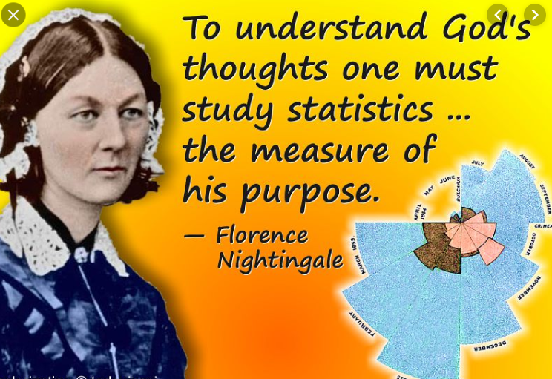
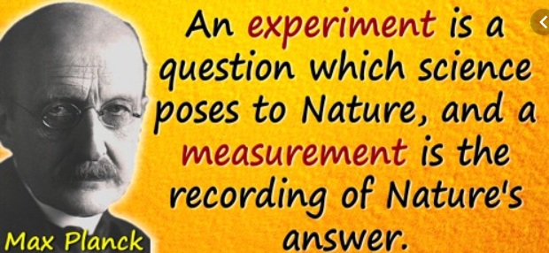
Measure and describe...
Deep scientific thoughts have always been inspired by measuring and analyzing raw data for patterns
Statistics has been serving society centuries before data science took off :-)

Slide 3
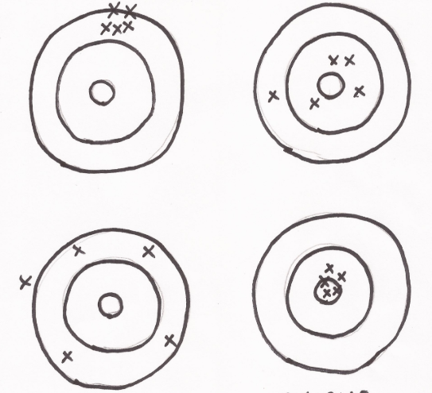
Central tendency and dispersion
There are ups and downs in life. Same for data. There are peaks and troughs but also a baseline.
What is that one number toward which all the measurements tend to gravitate?
But there are enormous variety among datasets. Some look like a close-knit family, others behave like highly dispersed organization.
Need to measure dispersion or spread

Slide 4
Mean(s), median, mode
(Arithmetic) mean: Colloquially called the all too familiar ‘Average’.
Median: The central quantity in a dataset, when it is sorted by (increasing or decreasing) values. Robust to outliers.
Mode: The most frequently occurring data. Mainly useful for categorical datasets.
Geometric mean: Used in special circumstances (datasets where multiplicative growth is observed)
Harmonic mean: Used in special circumstances.

Slide 5
Variance and standard deviation
Variance: A measure of the average (squared) distance of data from their mean value. Squaring is done to turn distance measures positive.
Standard deviation: Just the (positive) square-root of variance to make the quantity comparable to the actual data points in terms of physical units.
These concepts are general. Do not equate them with the ‘Bell curve’. Your dataset may not follow a Bell curve, and you may not be able to apply six sigma techniques but you can always compute mean and variance.

Slide 6
Other descriptive statistics measures
Min and Max: Simple as they sound. Minimum and maximum of a dataset, respectively.
Range: The numerical difference between the Min and Max.
Percentile: It is a measure used indicating the value below which a given percentage of observations in a group of observations falls. For example, the 20th percentile is the value below which 20% of the observations may be found.
Quantile: If a dataset is divided in q equal groups, then it is said to have q quantiles. Median is a 2-quantile. Quartiles are 4-quantiles, etc.

Slide 7
Python coding (head over to the Notebook)
First, we will use rather inefficient but extremely simple code to compute these quantities from a sample dataset.
Why this approach? To be comfortable with mathematical/statistical programming and build a ‘hacker’ mindset.
What if you don’t have access to sophisticated libraries and ready-made routines? Can you still code up a computation from ground up?
Thereafter, we will introduce numerical computing libraries and use out-of-the-box functions/methods.

