Slide 1
Bivariate statistics, correlation, plotting
Dr. Tirthajyoti Sarkar
August 31st, 2019

Slide 2
What is bivariate analysis?
As the name suggests, it involves ‘bi’ or two variables.
It has a special place in analytics.
We humans are most comfortable with a X-Y plot. We cannot perceive more than 3-D, and 3-D plots are hard to interpret in most cases. So, a simple 2-D visualization works best for data modeling and analysis.
However, the bivariate analysis goes far beyond just the visualization. It also involves - correlation, simple linear regression, etc.

Slide 3
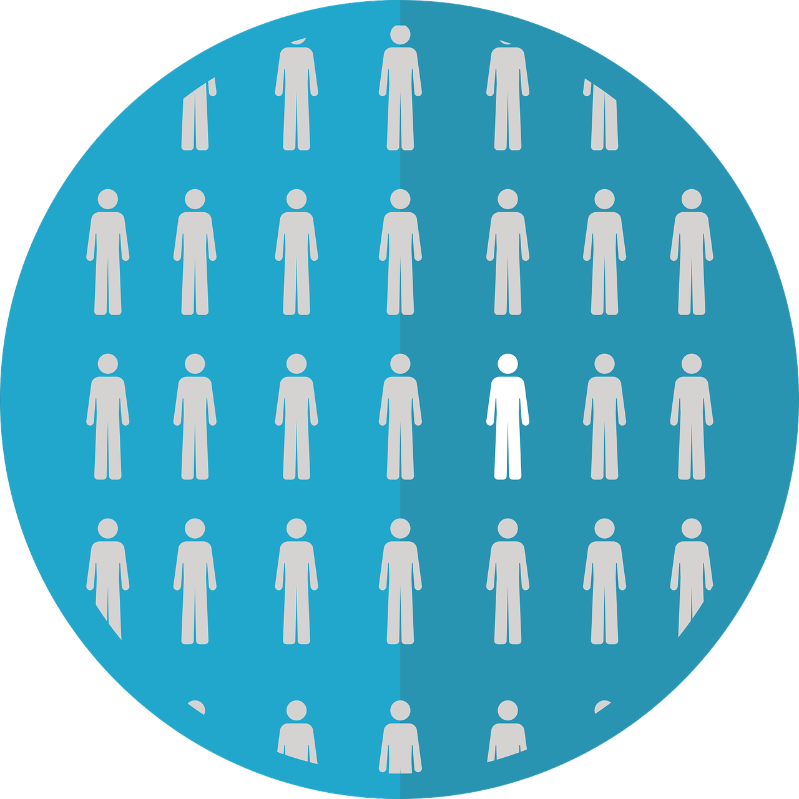


Keywords: “Population”, “Sample”, “Estimation”
Population represents the entire mass of objects about which some measurement can be made for statistical purpose. Almost impossible to obtain data about.
Sample is a tiny, but fairly representative, fraction of a population, used for actual statistical modeling.
The central goal of statistics is to ‘estimate’ properties of the population by examining the sample - estimation.
Note the parallel to ML - generalization.

Slide 4

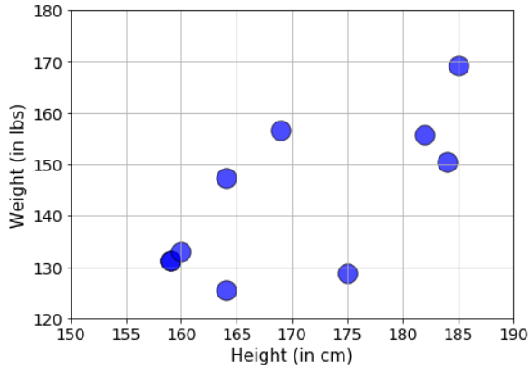
Scatterplot: Bread and butter of bivariate analysis
Is there a ‘relationship’?
Is the relationship linear?
Is there a cause-effect?
Suppose, we want to want estimate the correlation between height and weights of high-school students.
We cannot obtain data for all U.S. high-school students easily/cheaply.
So, we sample from our local school.
Then, we visualize the data in a 2-D plot (shown on the right).

Slide 5
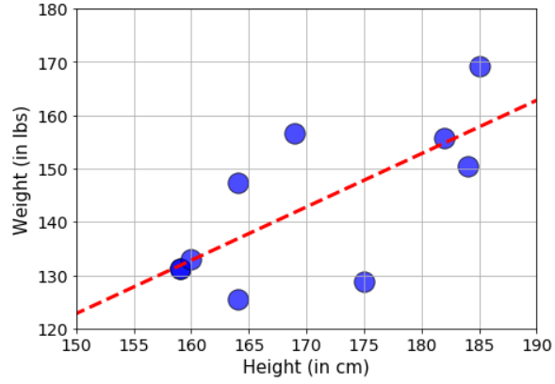
“Fitting the data”: Just a quick view
If we fit a linear model with this sample data, we see the red dashed line shown in the right hand side figure.
Is this line the best we could do?
What does it mean? Can I predict weight given any height data from this line?
Will a jiggly nonlinear fit be better than a simple straight line?
These questions will be re-visited multiple times later and discussed at depth.

Slide 6
Correlation and its measure
At the minimum, even before we do any kind of fitting, we want to do the extent of correlation between the two sets of data points - weight and height.
Being correlated means - moving in the same general direction as the other variable moves. Note it involves direction, so it is like a vector. Its sign matters.
If we see a general increase in weight as the height increases, then we say they are ‘positively correlated’, and the correlation coefficient is a positive number. And vice versa for the negative case.
It is measured by so-called correlation coefficient (ranges from -1 to 1).
Note that, correlation is a strictly linear concept. If y = x², then the correlation coefficient is zero even though y values are completely determined by x.

Slide 7
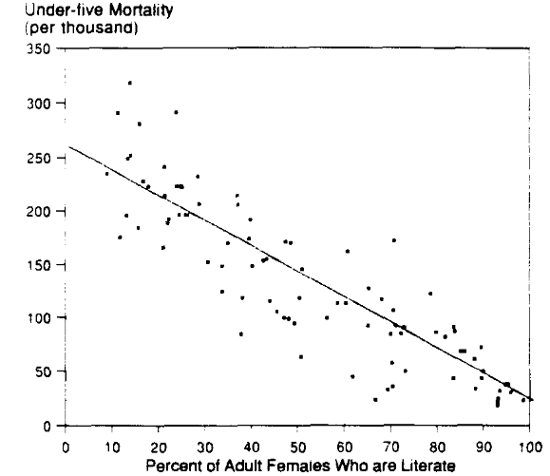
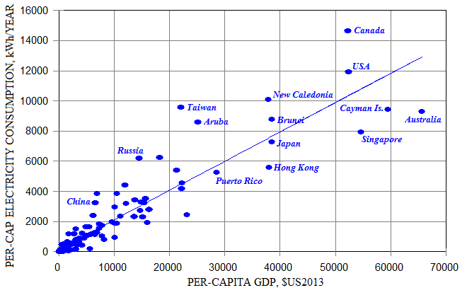
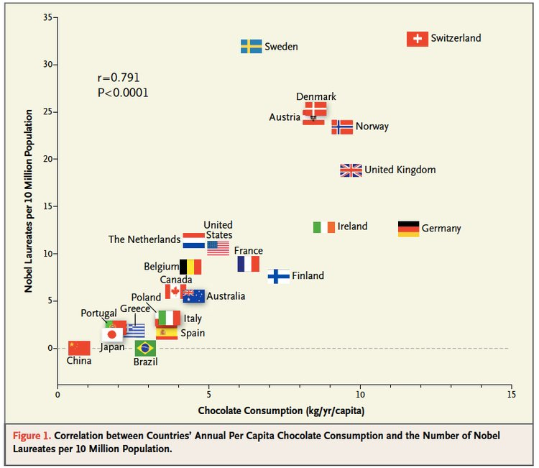
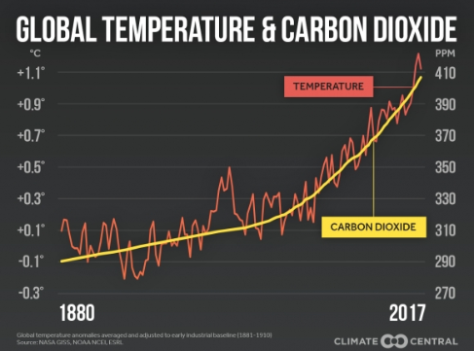
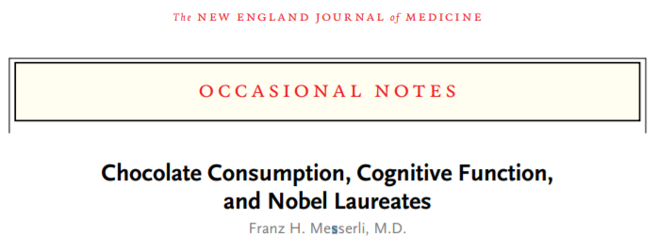
Some simple examples from the real world

Slide 8
Let’s do hands-on coding...
We will go through basics of Numpy library in somewhat more detail.
We will learn how to handle Pandas DataFrame object. This is the most important data analysis library in the Python ecosystem.
We will take a simple dataset and create some scatterplot visualizations using the Matplotlib library.
We will also compute correlation coefficient between pairs of variables. We will use the basic formula and Numpy function.
We will also show how to show the whole correlation matrix when the dataset consists of more than two variables. Will also do a heatmap (using Seaborn library).

