Slide 1
Concept of probability
Dr. Tirthajyoti Sarkar
August 31st, 2019

Slide 2

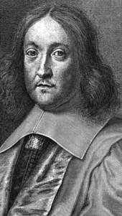
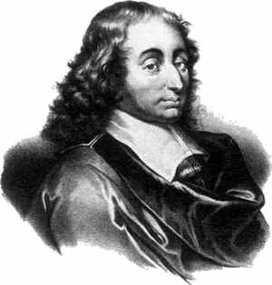
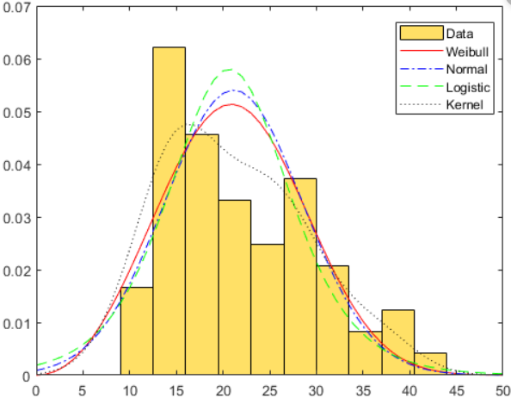

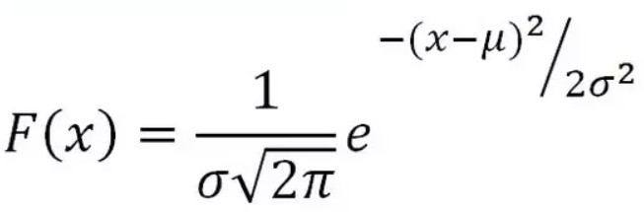
“Greed is Good”
A gambler's dispute in 1654 led to the creation of a mathematical theory of probability by two famous French mathematicians, Blaise Pascal and Pierre de Fermat.

Slide 3
Two camps - frequentists and Bayesians
“Two dice are rolled together. What is the probability of getting a total which is a multiple of 3?”
This problem is solved by Counting. You count and enumerate all the possible outcomes such as {1,1}, {1,2}, {2,1}... {6,6}, then count the number of outcomes where the total is a multiple of 3, such as {1,2}, {2,1}, {2,4}, {4,2}, etc. Then you just take the ratio.
You count and enumerate all the possible outcomes such as {1,1}, {1,2}, {2,1}... {6,6},
Count the number of outcomes where the total is a multiple of 3, such as {1,2}, {2,1}, {2,4}, {4,2}, etc.
Take the ratio
Would Sir Isaac Newton approve this method?

Slide 4
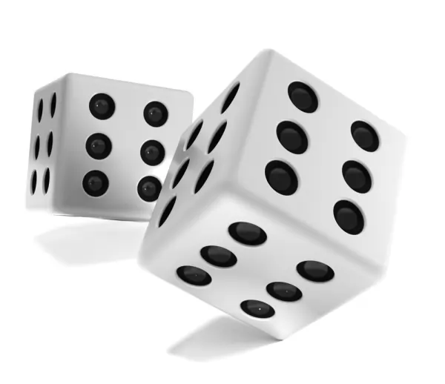
Roll of dice is governed by strict laws of physics
Therefore, in theory, you can precisely calculate the outcome of a dice roll (even if it is loaded or unfair), given its initial position, mass, surface area etc. and the applied force, torque, air friction, etc.
But physics becomes intractable very quickly and first principle calculations are impossible for all but simplest of systems. Therefore, for all practical natural processes, we need a theoretical framework which can work with the inherent uncertainty that characterizes such systems.

Slide 5
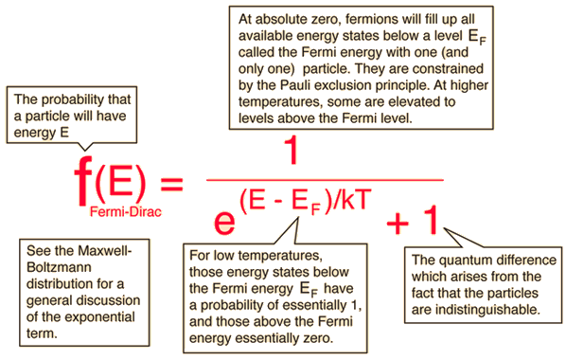
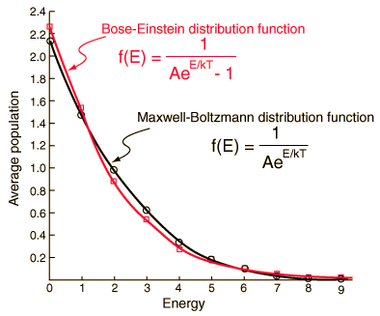
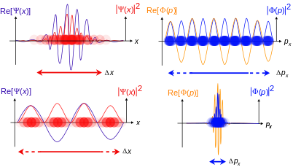
How pervasive is the concept of probability?
Light, heat, energy
Solids, electrons, protons
Wave, particle, all of reality!

Slide 6
Where in data science/machine learning?
Data is inherently noisy and uncertain. But customers want a “confident” answer from you, the data scientist.
Therefore, you must pass the data through the sieve of probability to be able to give some guarantee to your customer.
Probability theory is applied in virtually all machine learning and statistical modeling techniques -
Linear Regression, Logistic regression, Poisson regression
Naive Bayes classification, O/P layer of most deep learning models
Clustering such as k-means
Ensemble techniques such as Random forests, Bagging, Boosting
Language models (NLP), text mining
Advanced AI algorithms - Markov processes, Bayesian networks, Reinforcement learning

Slide 7

Fundamental definitions and rules
Sample space: Set of all possible events for an experiment/phenomenon.
Event: Favorable outcome that is under investigation. Probability of the event is given by,
Range: Probability ranges between 0 and 1 (inclusive). 0 ≤ Pr(event) ≤ 1
Total: Total probability of all events must sum up to 1.
Joint probability: If A and B are two events, then the joint probability is the probability of them happening together. It is denoted by Pr(A,B).
Independence: If A and B are mutually independent events (one does not affect other in any way), then the joint probability is the product of individual probabilities: Pr(A,B) = Pr(A) x Pr(B)

Slide 8
What will we learn in the bootcamp?
Set theory basics, permutation/combination, and simple probabilities using Python
Random variables, trials, expectation, law of large number
Probability distributions - discrete and continuous, CLT
How probability distributions are used in statistical modeling and inference - F-test, chi-square test, ANOVA
Hypothesis testing, p-values
Conditional probability, Bayes’ rule and its application examples
Circle back to the concept in the context of machine learning algorithms such as linear and logistic regression, k-means clustering, spam filtering, etc.

