Slide 1
Random variables, probability distributions
Dr. Tirthajyoti Sarkar
August 31st, 2019

Slide 2
Definitions
Random variable: A variable whose possible values are numerical/categorical outcomes of a random/natural/statistical phenomenon or experiment. There are two types of random variables - discrete and continuous.
Trial/experiment: Scientifically designed test/experiments to measure statistical properties of a population or a natural phenomenon. Often randomized to reduce selection bias and derive causation. Example - clinical drug trial, political polling.
Control group: The control group is defined as the group in an experiment or study that does not receive treatment by the researchers and is then used as a benchmark to measure how the other tested subjects do.
Expectation/Expected value: The expected value of a random variable, intuitively, is the long-run average value of repetitions of the same experiment.

Slide 3

“Law of large numbers”
The law of large numbers (LLN) is a theorem that describes the result of performing the same experiment a large number of times.
According to the law, the average of the results obtained from a large number of trials should be close to the expected value, and will tend to become closer as more trials are performed.
Average (Arithmetic mean)
Expected value
Mathematical definition next page
If we throw dice large number of times, the expected value approaches to the average: 3.5. Note that 3.5 is not the face value of a dice. So, expected value is not the ‘most likely’ or ‘mostly occurring’ values in trials.

Slide 4
Probability distribution
“A probability distribution is a statistical function that describes all the possible values and likelihoods that a random variable can take within a given range.”
Used for statistical inference
Outputs discrete and continuous values
Quantifies uncertainty
Random variable
Maps I/P to O/P
Has a domain of validity

Slide 5
Discrete probability distributions
A discrete probability distribution (applicable to the scenarios where the set of possible outcomes is discrete, such as a coin toss, or a roll of dice, or a quality failure event in manufacturing) can be encoded by a discrete list of the probabilities of the outcomes, known as a probability mass function.
Bernoulli distribution
Binomial distribution
Poisson distribution
Geometric distribution

Slide 6

Continuous probability distributions
A continuous probability distribution (applicable to the scenarios where the set of possible outcomes can take on values in a continuous range (e.g. real numbers), such as the temperature on a given day) is typically described by probability density functions (with the probability of any individual outcome actually being 0).
Formally, if X is a continuous random variable, then it has a probability density function ƒ(x), and therefore its probability of falling into a given interval, say [a, b], is given by the integral
Normal distribution
Chi-square distribution
Weibull distribution
Student’s t-distribution
F- distribution
Uniform distribution

Slide 7
Probability mass function
A probability mass function (PMF) is a function that gives the probability that a discrete random variable is exactly equal to some value. The probability mass function is often the primary means of defining a discrete probability distribution.
Example - A fair dice has all 6 faces turning up equal probability of ⅙. On the other hand, a loaded dice may have higher probability of 3 and 6 turning up than the others.
Fair dice
Loaded dice
1
2
3
4
5
6
1
2
3
4
5
6

Slide 8
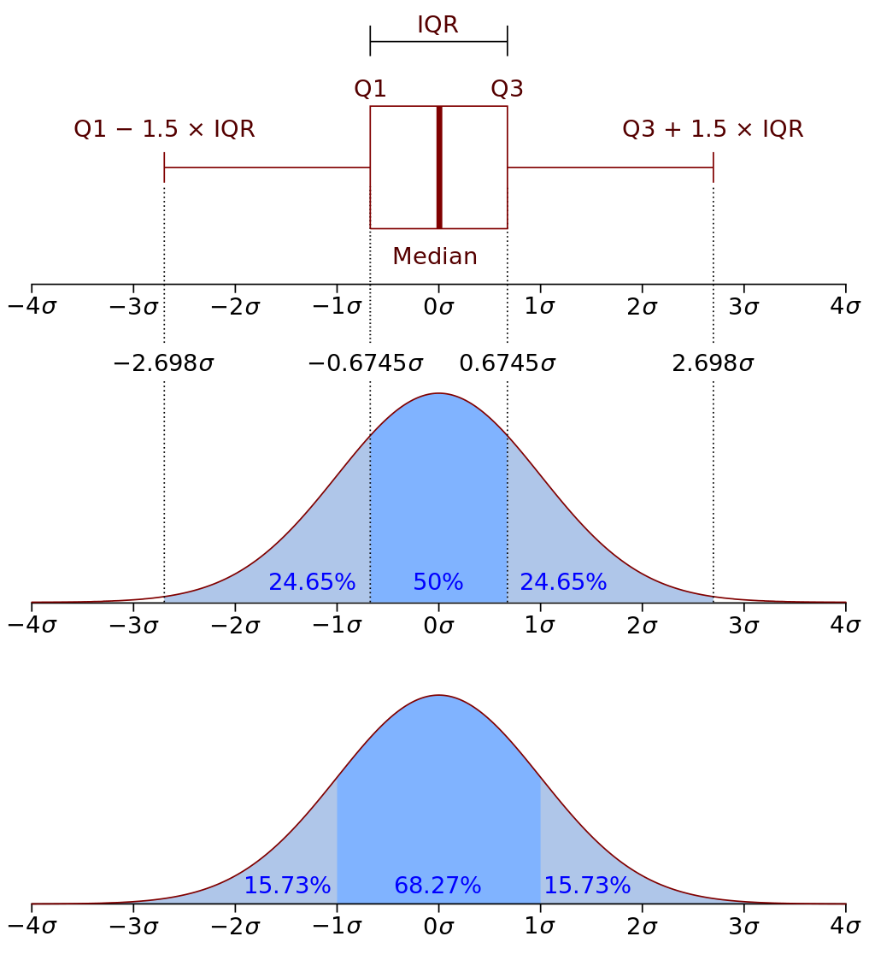
Probability density function
A probability density function (PDF), or density of a continuous random variable, is a function whose value at any given sample (or point) in the sample space (the set of possible values taken by the random variable) can be interpreted as providing a relative likelihood that the value of the random variable would equal that sample.
In a more precise sense, the PDF is used to specify the probability of the random variable falling within a particular range of values, as opposed to taking on any one value.

Slide 9



Expectation, CDF, variance, moments
CDF: Cumulative distribution function (CDF) of a real-valued random variable X, evaluated at x, is the probability that X will take a value less than or equal to x.
Variance: The expectation of the squared deviation of a random variable from its mean. Informally, it measures how far a set of (random) numbers are spread out from their average value.
Moments: A moment is a specific quantitative measure of the shape of a function. For probability distributions, they, collectively, determine all the properties. First raw moment is mean, second central moment is variance, 3rd and 4th standardized moments are skewness and kurtosis, respectively.
Expectation: The expected value of a random variable is the long-run average value of repetitions of the same experiment.

Slide 10
Let’s see some examples using Python
We will see how using Scipy/Numpy, we can generate random variables from the following distributions, and what happens when we manipulate them,
Bernoulli
Binomial
Poisson/Exponential
Uniform
Normal
Chi-square
F- and t-distributions

