Slide 1
Exploratory data analysis (EDA) for Data Science
Dr. Tirthajyoti Sarkar
August 31st, 2019

Slide 2
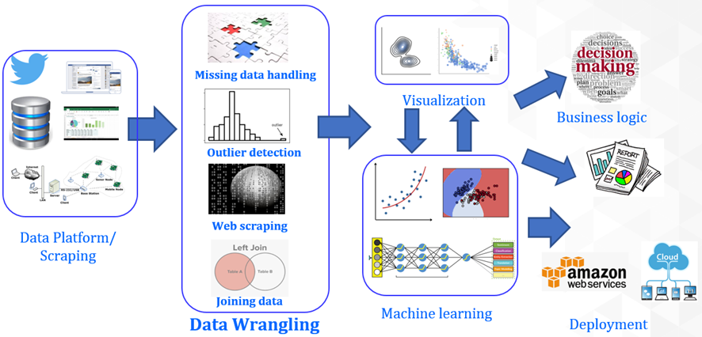
Data wrangling at the forefront
Exploration

Slide 3
EDA: Visualize, probe, detect, summarize
While creating visualizations - think what will bring out the unique characteristics of the data and the business problem.
Do not go fancier than what is needed. Avoid 3-D plots if possible.
Are interactive plots helpful? If yes, add them with minimalistic user controls. But do not create interactive plots with more than one/two controlling variables.
Use plots and charts for probing anomalies and easy-to-find patterns in the data. If something looks odd, probe into the source and cause. Add note, record assumptions, pass on any recommendation up the model chain.
Always try to perform basic descriptive statistics (if the scale allows) to gather numerical scores.
Summarize key insights of EDA, so that machine learning or business intelligence team can have a baseline to start with.

Slide 4
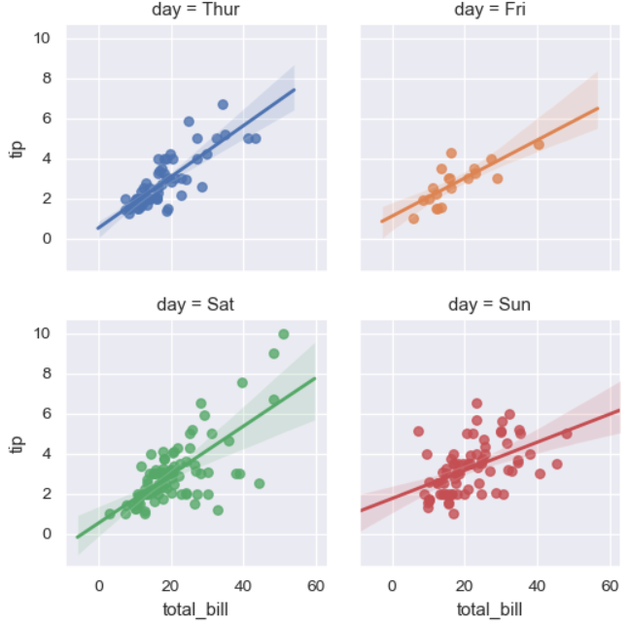
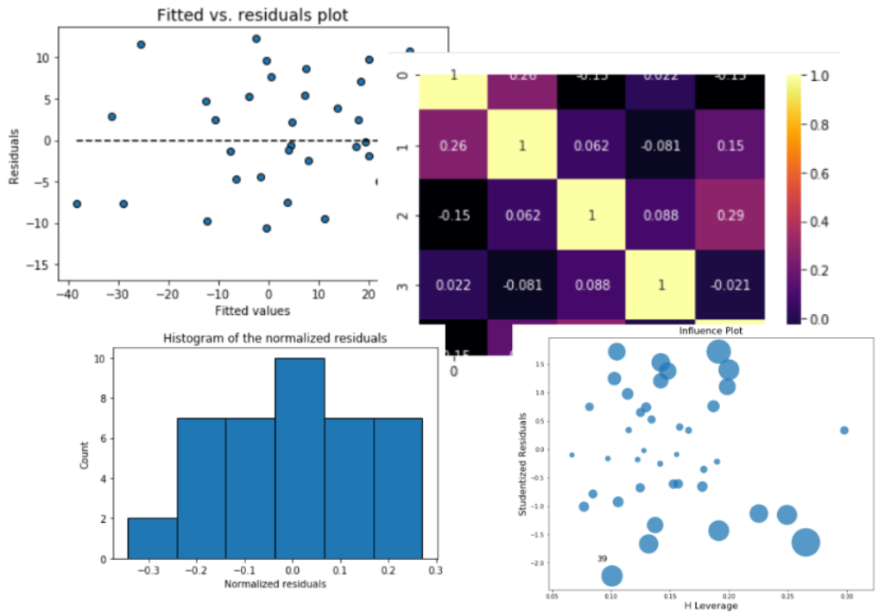
Purposeful plots and charts
Box plots with outliers, aided by color to include multiple categorical variables
Residual plots, histogram, leverage plots with dynamic marker size to show outliers, correlation matrix etc., for a regression problem.
Clean scatter plots in a grid, showing the linear fit and confidence interval

Slide 5
EDA does not have to be a single layer of visualizations
First layer of visualizations, interactive charts
Summary statistics table, basic linear fits, normality checks
Basic outlier detection
Missing value detection and appropriate handling
Standardized feature transformations and 2nd layer of visualizations
Basic tests for compatibility, scaling, ML flow
Summary report/documentation with a statistician’s eye and business analysts’ goal

